Slide 1
Identification of Design Principles for Platform Engineering in Public Sector
Bachelor’s Thesis Kick-Off Presentation
Vasilisa Poliarus, 23.05.2022

Slide 2
Agenda
Motivation
Research Goals and Research Methodology
Current Progress
Timeline

Slide 3

1. Motivation
Situation: Concept of Government as a Platform (GaaP) is becoming increasingly popular
Government as a Platform: An open platform that allows people inside and outside government to innovate and evolve the outcomes through interactions between government and its citizens (O’reilly, 2011).
Benefits:
Costs reduction
Enablement of efficient and user-friendly services
→ public value enhancement

Slide 4
Motivation
IT silo systems
Platfrom-oriented infrastructure
Component
1
Component
1
Component
1
User services
Component
2
Component
2
Component
2
Platformization
Boundary resources
Component
3
Component
3
Component
3
Core component C
Core component A
Core component B
Core component
A
Core component
B
Core component
C
How to design?
(Bygstad & Hanseth, 2018)
Barriers:
Application of GaaP in practice can be challenging (Kuhn et al., 2022)
Not enough information about how to successfully design platform in the public sector

Slide 5
Solution Approach
Estonia
UK
Italy
X-Road
eID
eesti.ee
GOV.UK Pay
GOV.UK Verify
GOV.UK Notify
SPID
PagoPA
IO app
Lead by example (O‘Reilly, 2011) -> Learn from successful countries
(Cordella & Paletti, 2019; Vaher, 2020; Margetts & Naumann, 2017)

Slide 6
2. Research Goal and Research Methodology
Goal of the thesis:
Identify design decisions of successful GaaP countries and develop design principles.
Research Approach:
Successful cases:
Estonia, UK, Italy
Coding Concept
Data Analysis
Design principles for platform engineering in the public sector
21 existing interviews

Slide 7


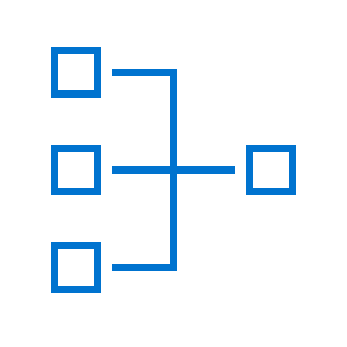


Research Questions
1
What are the dimensions of design decisions in applying GaaP in practice?
Literature
review
Interviews
analysis
Coding concept
2
What are design decisions of countries that successfully apply GaaP?
Apply coding schema on interviews
Design decisions
3
Which design principles can be derived from these decisions?
Analyze and structure design decisions
Design principles

Slide 8
3. Current progress
Design decision structure
Issue 1
…
Existing artifacts give rise to issues about the evolving design
Alternative is one of several positions that respond to the issue
Justification is a statement giving the reasons for and against selecting the related alternative
Alternative
1
Alternative
n
…
Justification
1
Justification
n
Justification
1
Justification
n
…
…
(Potts & Bruns, 1988)
Design principle
1.1.1
Design principle
1.n.n
…

Slide 9
Coding Concept Based on Design Decision
Citation from estonian interview:
Design decision structure
”If you have an eID as a citizen it is going to be utterly useless unless someone starts to accept it. On the other hand, for service providers it must be easy for them. There are no users because there are no services and there are no services because there are no users, and you have to get rid of this somehow. In Estonia we had very precise and very narrow requirements that solved the problem from the consumer side. Every citizen must have an eID card by law. <…> All the banks and telcos understood that their customers had the cards so they started to integrate it in their services because it was safe and risk-reducing for them.”
(Kutt, 2021)
Issue | How to integrate eID in digital public services?
Alternative | Make eID compulsory for everyone.
Justification | All citizens obtain eID, hence service providers start integrating eID in their services and make them more user-friendly and safe.

Slide 10
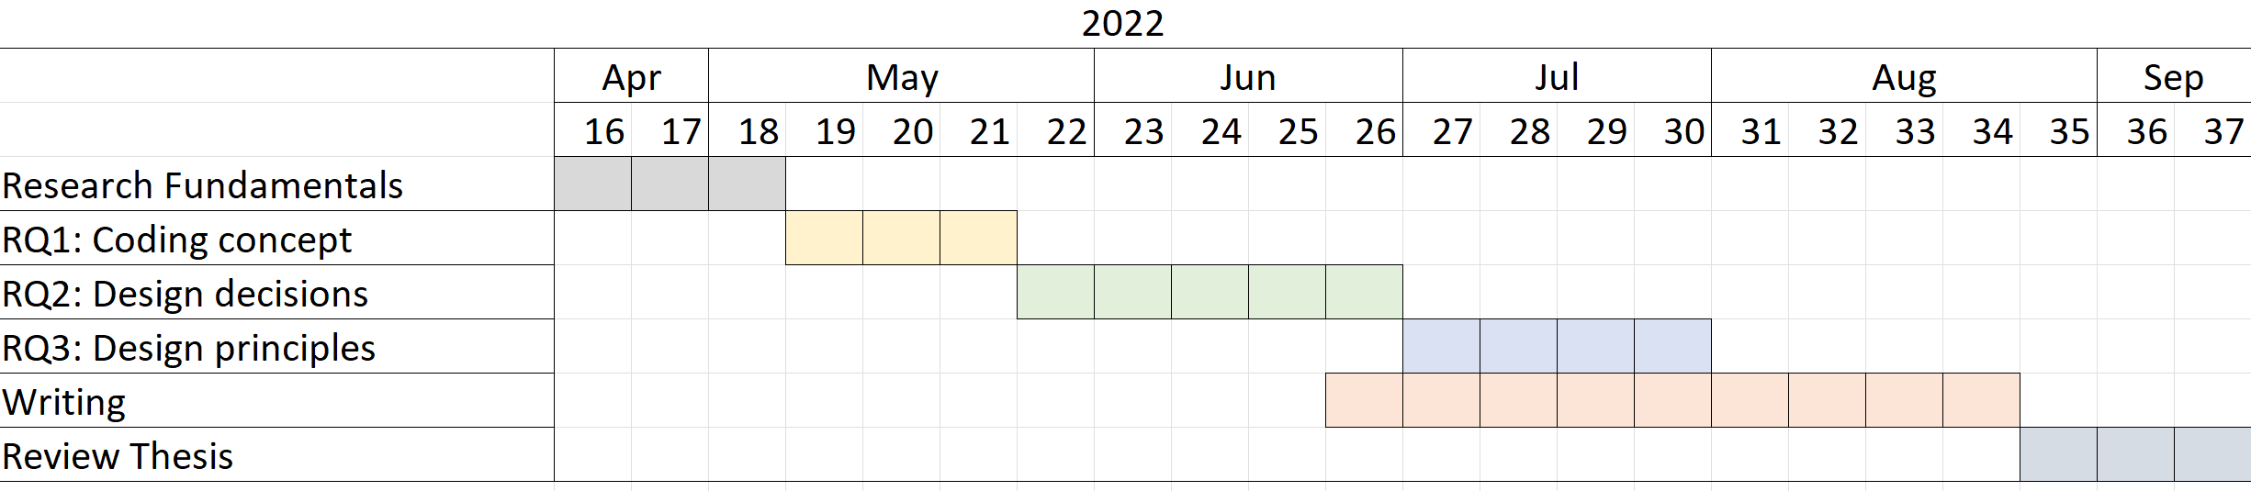
4. Timeline
Registration
15.04.22
Kick-Off
Presentation
23.05.22
Submission
15.09.22

Slide 11
Vasilisa Poliarus
Bachelor’s Student Information Systems
17132
vasilisa.poliarus@tum.de

Slide 12
References
Bygstad, Bendik & Hanseth, Ole (2018). Transforming Digital Infrastructures through Platformization.
O’Reilly, Tim (2011). Government as a Platform.
Kuhn, Peter & Buchinger, Matthias & Balta, Dian & Matthes, Florian (2022). Barriers of applying Government as a Platform in Practice: Evidence from Germany.
Cordella, Antonio & Paletti, Andrea (2019). Government as a platform, orchestration, and public value creation: The Italian case.
Vaher, Kristo (2020). Next generation digital government architecture.
Margetts, Helen & Naumann, Andre (2017). Government as a platform: what can estonia show the world?
Potts, Colin & Bruns, Glenn (1988). Recording the Reasons for Design Decisions.
Kuhn, Peter (2022). Towards Government as a Platform: An Analysis Method for Public Sector Infrastructure.

Slide 13
Backup

Slide 14
Dimensions
Dimension | Characteristics | Purpose
Platform elements | platform core, boundary resources, ecosystem | identify the software components of the infrastructure and map them into a platform structure
Platform roles | platform owner, complementor, user | identify the stakeholders of the infrastructure and map them to platform roles
Platform openness | openness, participation, co-creation | identify the infrastructure use cases and their implementation in order to map them to the levels of openness, participation, co-creation
Platform management | facilitation and orchestration, provision of tools, management of assets | identify the management activities of the infrastructure owner and map them to platform management categories
(Kuhn, 2022)

Slide 15
Solution Approach
Lead by example (O‘Reilly, 2011) -> Learn from successful countries:
X-Road (interoperability platform)
eID (digital and mobile identification)
eesti.ee (public services platform)
Estonia
GOV.UK Pay (payment platfrom)
GOV.UK Verify (digital identity project)
GOV.UK Notify (notification platform)
Government Digital (procurement platfrom for Marketplace digital services in public sector)
UK
CIE (electronic ID card)
SPID (digital identity)
PagoPA (service payment platform)
ANPR (interoperability platfrom)
IO app (public services platfrom)
Italy
(Cordella & Paletti, 2019; Vaher, 2020; Margetts & Naumann, 2017)

