Slide 1
Assessing the Resilience of Word-Level Differential Privacy Mechanisms: An Adversarial Approach
05/2/2024, Master’s Thesis Kick-off Presentation
Furkan Yilmaz

Slide 2
Outline
Motivation
Research Questions
Methodology
Progress
Timeline

Slide 3





Motivation
Introduction:
Current Natural Language Processing (NLP) techniques are firmly ingrained in Big Data
Privacy Concerns:
However, using these methods may require handling private or sensitive data
As a result, privacy in NLP has come under more attention
Privacy Example:
Health Information: Medical records, Prescription details…
Financial Information: Bank account numbers, Social Security numbers
Differential Privacy (DP):
A prominent and extensively studied strategy is Differential Privacy (DP), drawing the focus of many researchers on how to integrate this privacy enhancement tool into NLP models
Notes:
Introduction:
Current NLP techniques are pivotal in managing text-based tasks within the realm of Big Data.
Privacy Concerns:
The integration of NLP methods often involves dealing with private or sensitive data.
The increased attention to privacy in NLP has become imperative.
Differential Privacy (DP):
DP emerges as a prominent and extensively studied strategy.
Many researchers focus on incorporating DP into NLP models to enhance privacy.

Slide 4


Motivation
Word-Level DP Mechanism Illustration
Random Noise
Each fireteam member also had a special attribute
DP Mechanism
Together fireteam formed however did one special element

Slide 5




Motivation
Research Gap:
Thesis Objective:
Assessment of word-level DP mechanisms against adversary NLP models.
Formerly people were assessing the privacy level via theoretical guarantees using epsilon values
Investigation of the adversarial attacks on privacy with the aim of revealing the original text inputs from the privatized, obfuscated text outputs
Each fireteam member also had a special attribute
Together fireteam formed however did one special element .
Notes:
Research Gap:
Despite advancements, assessing word-level DP mechanisms against adversarial NLP models remains an open research area.
Be more specific
Mentıon the before, Task specific mazbe and not like lıterallz mımıckıng
Thesis Objective:
The thesis aims to investigate unveil privacy, specifically targeting the revelation of original text inputs from privatized, obfuscated text outputs generated by word-level DP mechanisms.

Slide 6
Outline
Motivation
Research Questions
Methodology
Progress
Timeline

Slide 7
Research Questions
What prerequisites must be satisfied in order for an attacker to infer original plaintext from privatized, obfuscated text outputs?
What specific training methodologies and architectural features are essential for a model to possess the capability to be able to retrieve the original plaintext?
  What are the suitable metrics to assess how well these models work in terms of recovering the original plaintext?
How can a benchmark be devised to evaluate and compare the resilience of alternative models trained with word-level differential privacy for privatizing textual inputs against an attacker's attempts to infer the original inputs?

Slide 8
Outline
Motivation
Research Questions
Methodology
Progress
Timeline

Slide 9





Methodology – Model Train Phase
Obfuscated Public Text
Private Text
A specific word–level mechanism will be chosen and dataset with this mechanism will be created.
Dataset consists of original text and the obfuscated text.
The metrics to be used for training the adversary NLP model will be determined.
Different adversary NLP models with hyperparameters will be tested with cross-validation.
Hyperparameter selections and finetuning will be done.
The best model will be chosen.
Generated Text
Obfuscated Text
Train Adversary Model
Inference Attack

Slide 10



Methodology – Model Train Phase
Shadow
Corpus
A specific word–level mechanism is chosen and a dataset with this mechanism is created.
Input
Output
Wikipedia
DP Mechanism
Obfuscated
Wikipedia
Shadow Corpus: A dataset that mirrors the characteristics of the main corpus
Dataset consists of original text and the obfuscated text.
Data(csv):
Original S.
Obfuscated S. 1
Obfuscated S. 2
Obfuscated S. 3
Original S.
Obfuscated S. 1
Obfuscated S. 2
Obfuscated S. 3
Original S.
Obfuscated S. 1
Obfuscated S. 2
Obfuscated S. 3
Original S.
Obfuscated S. 1
Obfuscated S. 2
Obfuscated S. 3
Differentially Private = Obfuscated
Wikipedia (Label)
Model
Obfuscated
Wikipedia
Different adversary NLP models will be trained
Loss()
Predict
Feed
Prediction
Update
weights

Slide 11





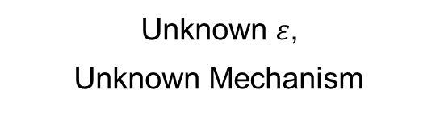




Methodology – Testing Phase with 3 Attacker Model
$$ε=1$$
$$ε=2$$
$ε=$?
$$ε=0.5$$
$ε=$?
$ε=$?
Known $ε$,
Known Mechanism
Unknown $ε$,
Known Mechanism
Unknown $ε$,
Unknown Mechanism
The amount of known information will affect how a training dataset is created !

Slide 12
Outline
Motivation
Research Questions
Methodology
Progress
Timeline

Slide 13


Current Progress
Dataset Creation Efforts:
Architecture Evaluation Efforts:
Training Efforts:
Diverse datasets created with varying mechanisms and epsilon values.
Considering multiple levels of obfuscation for sentences; testing various numbers for dataset evaluation.
Initial use of Transformer encoder (e.g. BERT) and LSTMs observed to be ineffective.
Adoption of sequence-to-sequence architecture (e.g. T5).
Ongoing training of T-5 with different datasets.
Cross-entropy used for training. Rouge score employed for validation set evaluation.

Slide 14
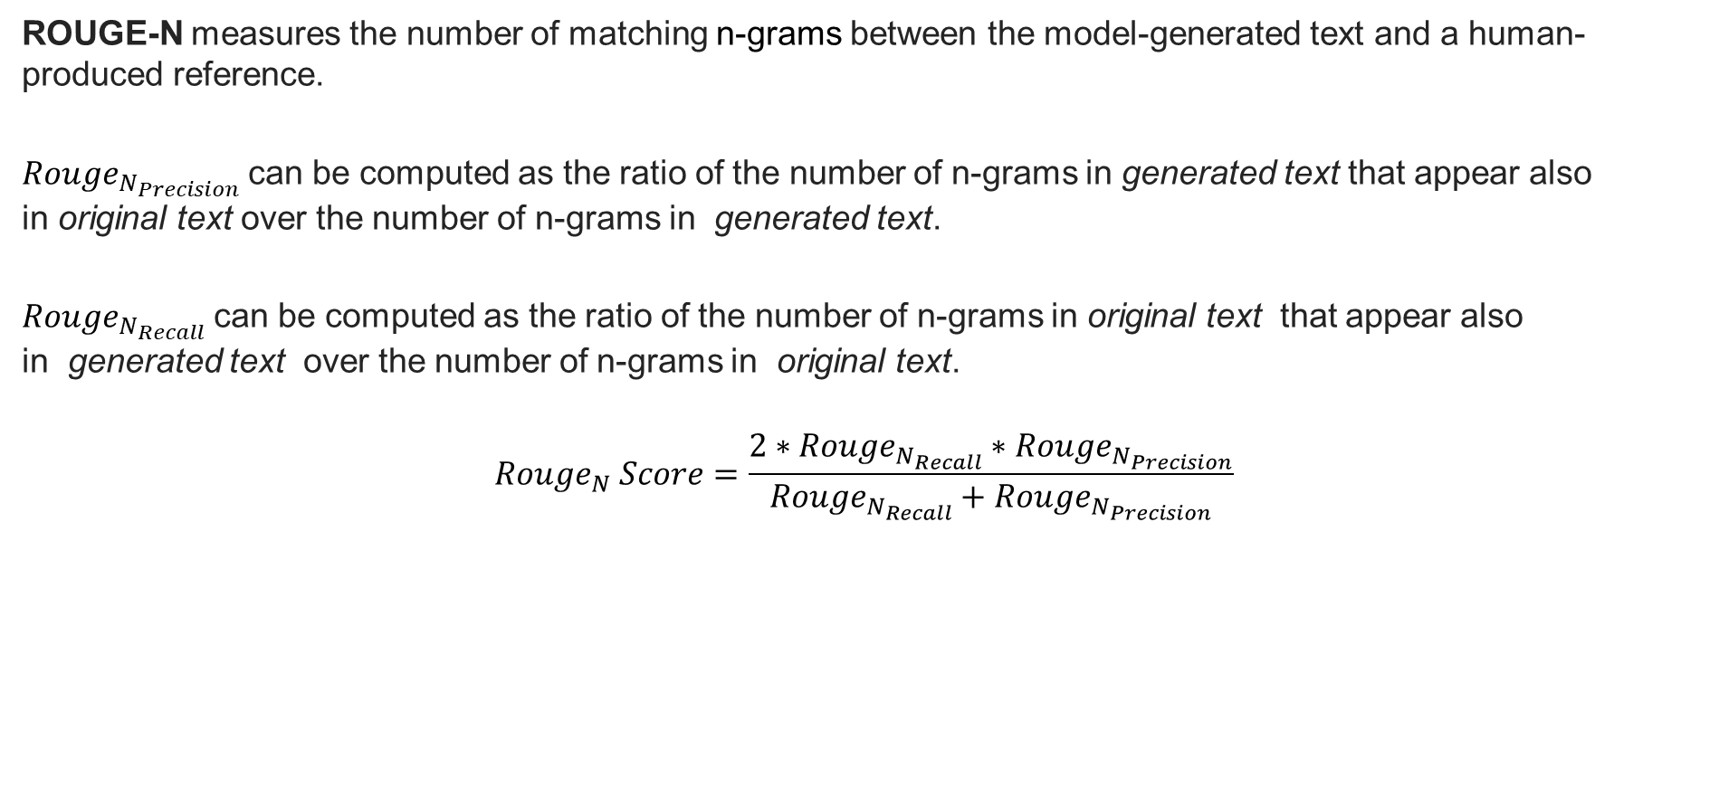
Rouge-N
ROUGE-N measures the number of matching n-grams between the model-generated text and a human-produced reference.
$Rouge_{N_{Precision}}$can be computed as the ratio of the number of n-grams in generated text that appear also in original text over the number of n-grams in generated text.
$Rouge_{N_{Recall}}$can be computed as the ratio of the number of n-grams in original text that appear also in generated text over the number of n-grams in original text.
$$Rouge_{N} Score=\frac{2∗Rouge_{N_{Recall}}∗Rouge_{N_{Precision}}}{Rouge_{N_{Recall}}+Rouge_{N_{Precision}}}$$

Slide 15

Initial Findings
Training with T5-small on small dataset
  Excellent performance when the original sentence is in the dataset but not the obfuscated sentence.
  Prone to overfitting due to dataset characteristics.
Training with T5-small on bigger dataset
  Current Rouge score indicates promising performance, averaging around 72% for total unseen data.
Original Sentence
it is now used as a museum by the forest council
Obfuscated Sentence
it has again used that the exhibitions brought one forest council
Recovered Sentence
it is now used as a museum by the forest council
In dataset
Original Sentence
each fireteam member also had a special attribute
Obfuscated Sentence
together fireteam formed however did one special element
Recovered Sentence
together squadrons formed as needed for special forces.
Not in dataset
Original Sentence
each fireteam member also had a special attribute
Obfuscated Sentence
together fireteam formed however did one special element
Recovered Sentence
each fireteam member also had a special element.
Original Sentence
in english at yale university in 1987 .
Obfuscated Sentence
as arabic up yale academic into 1987 .
Recovered Sentence
the english left yale university in 1987.

Slide 16


Expected Outcome
Inferring the original dataset with a higher rouge score
New benchmark, a new way to assess word-level DP mechanisms

Slide 17
Outline
Motivation
Research Questions
Methodology
Progress
Timeline

Slide 18
Timeline
Currently
Here
Task | Months
 | 0.5 | 1 | 1.5 | 2 | 2.5 | 3 | 3.5 | 4 | 4.5 | 5 | 5.5 | 6
Literature Review
Dataset Preparation
Model Development
Finding Suitable Metrics for Training
Fine Tuning
Dataset Creation for Attacker Models
Testing for 3 attacker Models
Benchmark Creation
Thesis Writing

Slide 19
Furkan Yılmaz
furkan.yilmaz@tum.de

Slide 20
Attackers
Known epsilon known mechanism
unKnown epsilon known mechanism
unKnown epsilon unknown mechanism
Maybe → white and block box with ındomaın out domain data knowledge

Slide 21
Stick to the good sebis traditions
  Provide action links at the bottom of the slide to guide the audience to our web pages or publications (see below). (Select the text, press CTRL-K)
  Use a file name according to our sebis conventions which helps us and our audience to find the file of your presentation on our web site with Google search:
    YYMMDD Author Short Title
    Include this string in the footer (Einfügen -> Kopf- und Fusszeile -> Fusszeile)
    The unusual date format simplifies the search for the latest version of a slide in an alphabetical directory listing (Dropbox, Explorer, Tricia, Sky-Drive)
[Ha13g] Hauder, M., Roth, S., Matthes, F.: Current Tool support for Metrics in Enterprise Architecture Management
For more information visit BEAMS , EAM Pattern Catalog and EAM KPI Catalog (http://wwwmatthes.in.tum.de)

Slide 22
Use the sebis visual language
(shapes, fonts, colors, sizes)
Default
Line Style
Default Rectangle
Default
Rounded R.
Text
Default
Text
User
Store
Information
Arrow
Cloud
Process
Box
Explanation
Fast
Form 1
Fast
Form 2
Fast
Form 3
Fast
Form 4
Fast
Form 5
Fast
Form 6
Fast
Form 6
Fast
Form 1
Fast
Form 2
Fast
Form 3
Fast
Form 4
Fast
Form 5
Fast
Form 6
Fast
Form 6

