Slide 1
A Study on Computer Aided Design Tools for Business Model Generation.
Eine Studie zur Softwareunterstützung von Geschäftsmodellentwicklung auf Grundlage des Business Model Canvas.
Verena Költgen, 03.11.2014, Garching
Notes:
Welcome to my final presentation of my bachelorthesis.
My name is
I study Wirtschaftsinformatik (Business Information Systems) at the tum in the 7. Semester
My Topic is a study on…
To give you a better insight to my topic I have the following research questions

Slide 2
Research Question
Which software can…
…support business model generation…
… with the use of Business Model Canvas…
… by implementing creative and social psychological approaches?
Notes:
But why i asked this question?

Slide 3
Research Question
Which software can…
…support business model generation…
… with the use of Business Model Canvas…
… by implementing creative and social psychological approaches?

Slide 4
Motivation
Information Systems
Increasing development and use of Information Systems (IS)
Computer Supported Cooperative Work (CSCW)
IS for CSCW: Group Creativity Supporting Systems (GCSS)
Notes:
Why I focus my research Question on software?
cause men are more and more supported by machines
Beyound the production of goods, the work is supported with Information Systems
Over the last decades a increasing development and use of information systems is noticeable.
these systems are althought be used to support creative group work ( example: Business Model generation )
The research to the field of CSCW (Computer - Supported Cooperative Work ) shape the term (group) creativity support systems .

Slide 5
Research Question
Which software can…
…support business model generation…
… with the use of Business Model Canvas…
… by implementing creative and social psychological approaches?

Slide 6


Motivation
Business Model
Notes:
Since the 90s, the use of the word "business model “ increases
the successes , the company already had with a new or revised business model ( eg Google and Apple ) are noticable

Slide 7
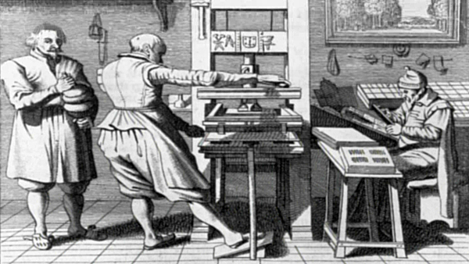
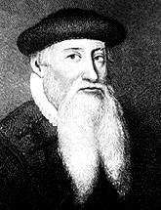
Motivation
Business Model
What can I do with my innovation to be profitable?
Notes:
Johannes Gutenberg mechanical printing press

Slide 8
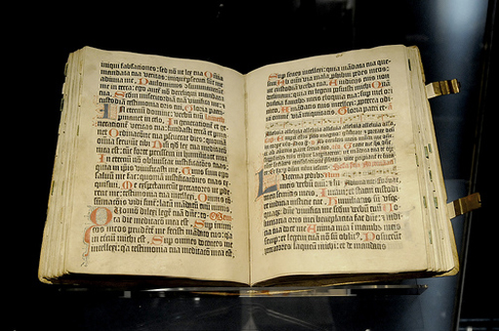
Motivation
Business Model
I can produce the bibel and sell it!
Notes:
His business model was to print the Bible
Steve Jobs said once: be always prepared for the downfall of the Business
Therefore keep your business model as dynamic as possible
In a saturated market a good business model can help your innovation to be successfull and provitable

Slide 9
Research Question
Which software can…
…support business model generation…
… with the use of Business Model Canvas…
… by implementing creative and social psychological approaches?
Notes:
You find many models for a Business Model generation
But the one with many Referances of big Companies
And most quoated is the Business Model Canvas

Slide 10
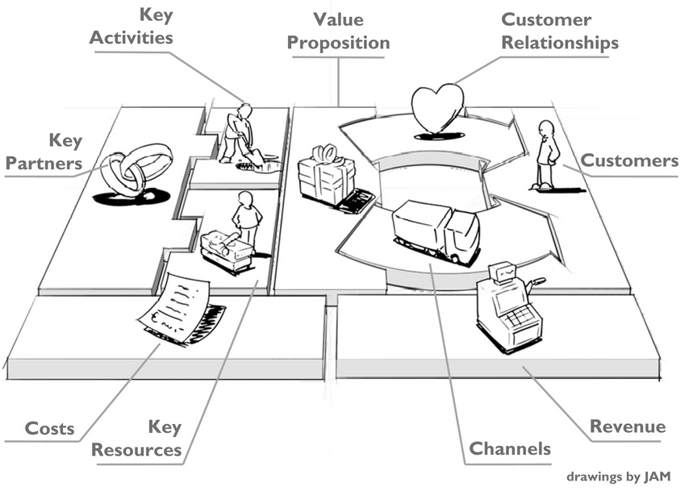
Motivation
Business Model Canvas (BMC)
Notes:
Alexander Osterwalder and Yves Pignuer developed this canvas
Later in this presentation i will shortly excplane it‘s use.

Slide 11
Research Question
Which software can…
…support business model generation…
… with the use of Business Model Canvas…
… by implementing creative and social psychological approaches?

Slide 12
Motivation
Creative and social psychological approaches
IS for CSCW: Group Creativity Supporting Systems (GCSS)
group social psychology
creativity
approaches used for GCSS- functionalities
Notes:
I introduced a few slides before, the term of group creativity supporting Systems
It exiest a big research field for these Systems
The one field refer to the group → group social psychology
The other field refers to creativity
The approaches of these research field are used for the functionalities of Group Creativity Supported Systems

Slide 13
Research Question
Business Modle Generation
computer-aided
creative group work
Notes:
For my thisis I looked at the Process of Business Model Generation
as an computer-aided creative group work

Slide 14
Overview
Method
Basic Knowledge
Evaluation
Conclusion and Key Findings
Outlook
Notes:
Now I will show you how i answerd my research question:

Slide 15
Method
capture basics
find existing software which map the BMC
identify theoretical basics for this kind of software
define Business Model Generation with the use of BMC
draw conclusions
collect the results
rate the tools for each criteria
evaluate the tools
choose one tool of each category
group the tools into categories
make a list of all found tools
choose software
set the characteristics of each criteria (five-level scale)
weighting the criteria
establish criteria (BMC, creativity, social psychology)
establish objective criteria with the captured basics

Slide 16
Capture Basics
Business Model Generation

Slide 17
Capture Basics
Business Model Generation
Business Model Canvas

Slide 18
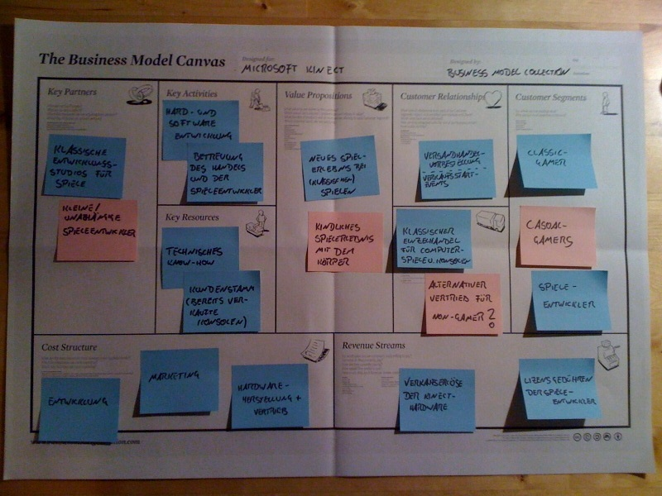
Capture Basics
Business Model Canvas
Source: http://www.businessmodelcollection.de/wp-content/uploads/2010/11/Microsoft-Kinect-Business-Model-101129.jpg
Notes:
I don‘t wanne go into detail, just to give you an hint what you need when you use the BMC:
Nine building blocks, so you can’t forget a important part of an Business Model
The description of each Block with helpful questions
Colered sticky notes
You can switch them easily cause of the specific glue

Slide 19
Capture Basics
creativity
Business Model Generation
Business Model Canvas
Notes:
Next you need a bit of creativity to find the best Business Model for your Product

Slide 20
Capture Basics
creative process
creativity
Business Model Generation
Business Model Canvas
Notes:
This creativity take place in an creative prozess

Slide 21
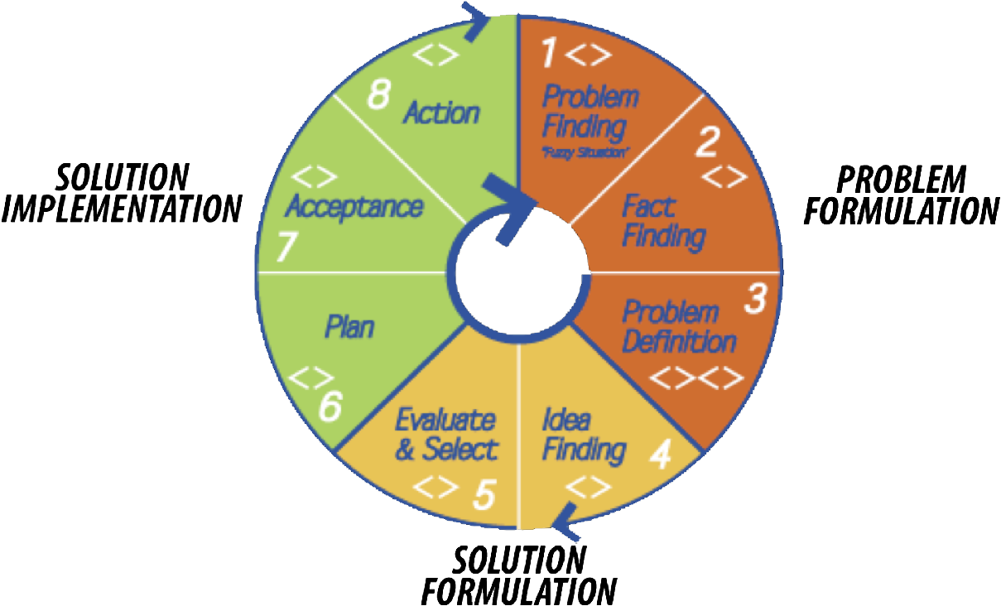
Capture Basics
Creative Process
Source: http://www.basadur.com/Portals/0/Images/SimplexWheel.png
Notes:
For the Business Model Generation just the first 6 phases are relevant
Cause only the plan is part of an business model

Slide 22
Capture Basics
creative process
creativity
Business Model Generation
creativity techniques
Business Model Canvas
Notes:
For each phase of the creativity process the person can use creativity techniques
One, each of you mite know, is the Brainstorm…
another one is the buzzword-method. For example you are a company which rents Hi-Fi equipmets.
The buzzword “pocket knife” could lead to an Bus with all equipment needed for one Party.
It could be used at street festivals or something else.

Slide 23
Capture Basics
creative process
creativity
Business Model Generation
creativity techniques
Business Model Canvas
social psychology
Notes:
The process of a Business Model Generation could take place in a group work.
There for the software which will be tested later must support such group work.

Slide 24
Capture Basics
Social Psychology
social pressure
loss of motivation
social competition
Notes:
Social pressure exist mostly in company structures.
For example, when the superior of any group member is part of the group,
the employee could be unsure about his ideas and don’t announce them.
The result is a sinking Group performance.
Loss of Motivation could be the result of two reasons.
First: Many Group Members are very productive, so another one don’t feels himself responsible for more ideas.
Second: One very Productive Member could be feel used and reduces his motivation
To support the group performance the social competition could be useful.
Persons need competitions to rise their motivation. The social competition could be arise with the other members or with another comparable group

Slide 25
Capture Basics
creative process
Computer Supported Cooperative Work
creativity
Business Model Generation
creativity techniques
Business Model Canvas
social psychology
Notes:
Now all Basics we found in the other topics could lead to functions for group creativity supported system.

Slide 26
Capture Basics
Computer Supported Cooperative Work
map the Business Model Canvas
creative process
creativity techniques
group social psychology
    anonymity/ pseudonyms
    Simultaneous editing
Notes:
One is to map the Business model canvas
creative process as a structure for the software and creativity techniques, like brain writing, support the creative part
and to support the group work the editing people should be anonymized to avoid social pressure
But have pseudonyms to support the social comaption
Simultaneous editing should avoid production blockades, which arise when a Member listen to another idea and can’t think for a new one in the same time.
Now we have all Basics we need.

Slide 27
Method
choose software
make a list of all found tools
group the tools into categories
choose one tool of each category
evaluate the tools
rate the tools for each criteria
collect the results
capture basics
find existing software which map the BMC
identify theoretical basics for this kind of software
define Business Model Generation with the use of BMC
establish objective criteria with the captured basics
establish criteria (BMC, creativity, social psychology)
weighting the criteria
set the characteristics of each criteria (five-level scale)
draw conclusions

Slide 28
establish objective criteria with the captured basics
Implementation of BMC compared to pen and paper
  Implementation
  Description of the blocks
  several BMC per project
  notes Move
  Coloring the notes
Additional opportunities for BMC
  Descriptions per note
  Comments by group members
  Protocol of the BMC
  Read-only function
  Export
  Import
  Examples
  copy function
  financial planning
Notes:
The first block of criteria should cover all functions you would also have by perform the BMC with pen and paper, like colored sticky notes or the description of each nine building blocks
The additional opportunities are functions I would expect from an BMC supported software.
Beispiele

Slide 29
establish objective criteria with the captured basics
creativity process
creativity techniques
group performance
  Simultaneous editing
  Several group members
  Anonymously?
  Social competition?
Notes:
If a software supports the creative process it uses it as an structure to lead the user through the phases.
Minimum one creative technique should be implemented
And to support and rise the group performance the functions shown here should be implemented.
The criteria I chosen just refer to functionalities of software, other like ergonomic aspects are not rated in this thesis.

Slide 30
weight and set the characteristics of each criteria
weighted with 1 : function is desirable
weighted with 2 : function is helpful
weighted with 3 : function is necessary
Notes:
Not each criteria is necessary to generate a business model:
I weighted each criteria with a three level scale:

Slide 31
weight and set the characteristics of each criteria
rated with 1 : function does not exist
rated with 2 : function does not support sufficiently
rated with 3 : function supports adequately
rated with 4 : function supports well
rated with 5 : function supports especially
Notes:
Afterwards I set the set the characteristics of each criteria with a five-level scale

Slide 32
weight and set the characteristics of each criteria
rated with 1 : function does not exist
rated with 2 : function does not support sufficiently
rated with 3 : function supports adequately
rated with 4 : function supports well
rated with 5 : function supports especially
100 % function cover
Notes:
Afterwards I set the set the characteristics of each criteria with a five-level scale

Slide 33
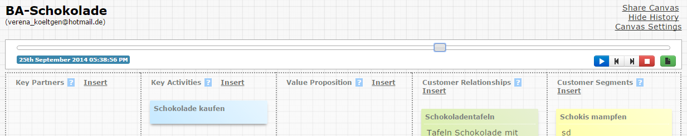
weight and set the characteristics of each criteria
criteria |  | weight | rated
Additional opportunities for BMC | Protocol of the BMC | 1 | 5
Source: canvanizer.com
Notes:
One example

Slide 34
Method
choose software
make a list of all found tools
group the tools into categories
choose one tool of each category
evaluate the tools
rate the tools for each criteria
collect the results
capture basics
find existing software which map the BMC
identify theoretical basics for this kind of software
define Business Model Generation with the use of BMC
establish objective criteria with the captured basics
establish criteria (BMC, creativity, social psychology)
weighting the criteria
set the characteristics of each criteria (five-level scale)
draw conclusions

Slide 35
make a list of all found tools
Software | Apps
LeanLaunchLab | Canvas Model Design
RunPad | ideaBoost
LeanMonitor | Business Model Canvas Startup
Canvanizer | Canvas Business Model
BMFiddle | BizCanvasApp
LeanStack
BM-Designer
Lienzo
Mural.ly
CanvasBM
BMCanvas
not evaluated
Notes:
This tools support all the Business Model Canvas.

Slide 36
group the tools into categories
Premium | Standard | Basic
LeanLaunchLab | Canvanizer | Mural.ly
RunPad | BMFiddle | CanvasBM
LeanMonitor | LeanStack | BMCanvas
 | BM-Designer
 | Lienzo
Notes:
I assign the tools into three categories. This assignment depends on the existence of functions of the first two categories:
“Implementation of BMC compared to pen and paper” and “Additional opportunities for BMC“

Slide 37
choose one tool of each category
Premium | Standard | Basic
LeanLaunchLab | Canvanizer | Mural.ly
RunPad | BMFiddle | CanvasBM
LeanMonitor | LeanStack | BMCanvas
 | BM-Designer
 | Lienzo
benchmark: Strategyzer developed from A. Osterwalder

Slide 38
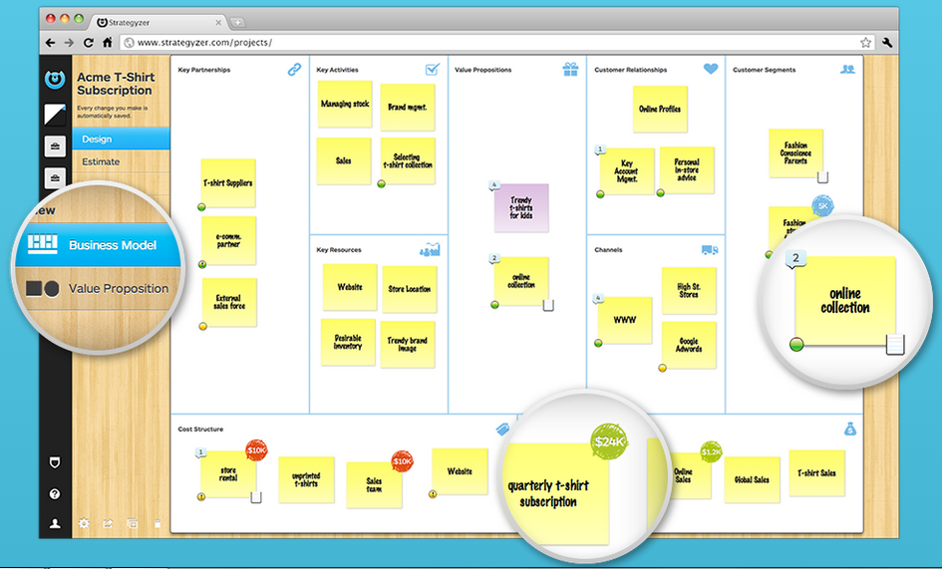
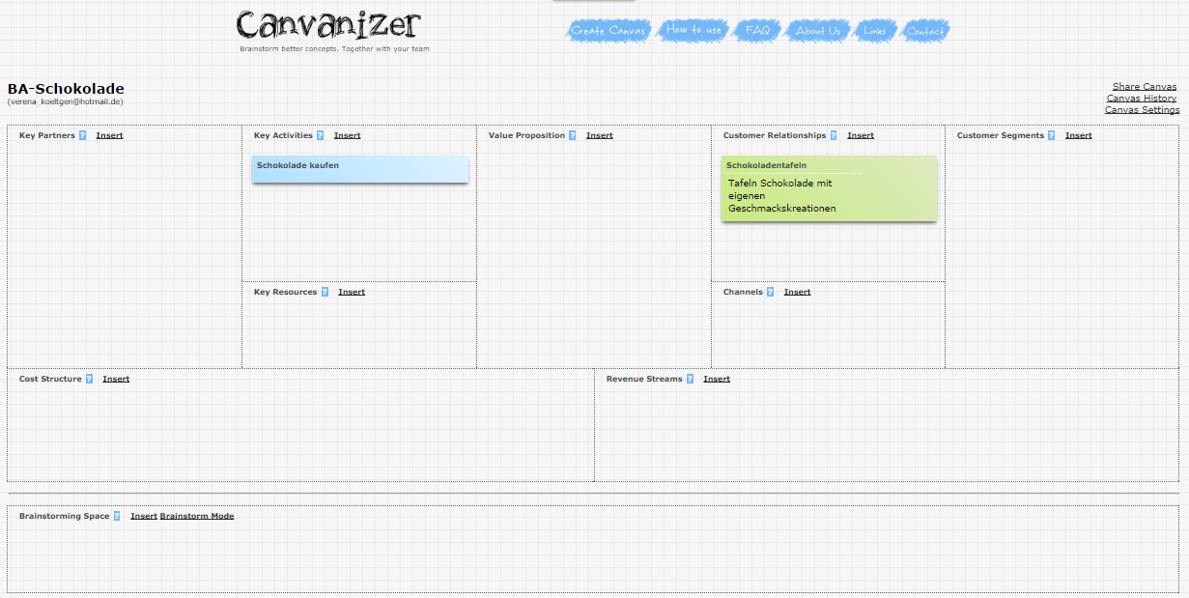
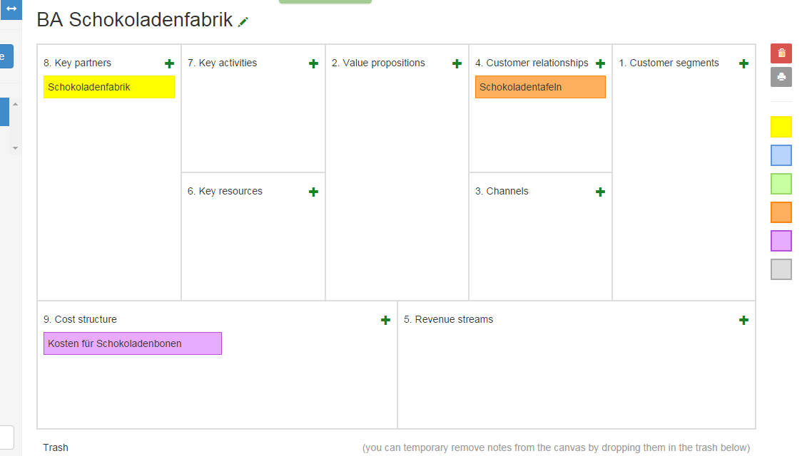
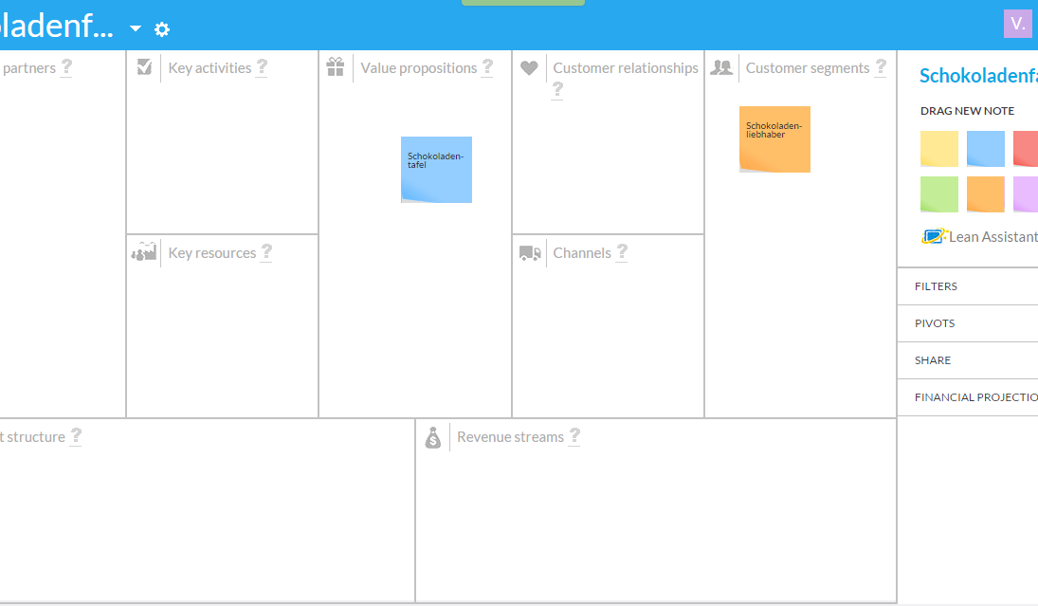
Choosen Software

Slide 39
Method
choose software
make a list of all found tools
group the tools into categories
choose one tool of each category
evaluate the tools
rate the tools for each criteria
collect the results
capture basics
find existing software which map the BMC
identify theoretical basics for this kind of software
define Business Model Generation with the use of BMC
establish objective criteria with the captured basics
establish criteria (BMC, creativity, social psychology)
weighting the criteria
set the characteristics of each criteria (five-level scale)
draw conclusions

Slide 40
Evaluation
 |  | Gewichtung | Strategyzer | Canvanizer | BMCanvas | LeanMonitor | Durchschnitt Insgesammt
Implementation of BMC compared to pen and paper | implementation | 3 | 3 | 3 | 3 | 3 | 3
 | description of the blocks | 3 | 5 | 3 | 2 | 3 | 3,25
 | several BMC per project | 2 | 4 | 2 | 3 | 4 | 3,25
 | notes Move | 3 | 4 | 3 | 3 | 4 | 3,5
 | coloring the notes | 3 | 3 | 3 | 3 | 3 | 3
weight average |  |  | 3,786 | 2,857 | 2,786 | 3,357 | 3,196
Additional opportunities for BMC | descriptions per note | 2 | 4 | 2 | 3 | 4 | 3,25
 | comments by group members | 1 | 4 | 2 | 2 | 4 | 3
 | protocol of the BMC | 1 | 3 | 5 | 1 | 1 | 2,5
 | read-only function | 1 | 1 | 3 | 1 | 3 | 2
 | export | 2 | 5 | 4 | 3 | 3 | 3,75
 | import | 1 | 1 | 3 | 1 | 1 | 1,5
 | examples | 3 | 4 | 3 | 1 | 1 | 2,25
 | copy function | 2 | 1 | 4 | 1 | 1 | 1,75
 | financial planning | 1 | 5 | 1 | 1 | 4 | 2,75
weight average |  |  | 3,286 | 3,071 | 1,643 | 2,286 | 2,571
creativity process | problem finding | 3 | 1 | 1 | 1 | 1 | 1
 | fact finding | 3 | 2 | 1 | 1 | 2 | 1,5
 | problem definition | 3 | 2 | 1 | 1 | 1 | 1,25
 | idea finding | 3 | 2 | 2 | 2 | 2 | 2
 | evaluate & select | 3 | 3 | 3 | 2 | 4 | 3
 | plan | 3 | 1 | 1 | 1 | 1 | 1
weight average |  |  | 1,833 | 1,500 | 1,333 | 1,833 | 1,625
creativity techniques | Are some implemented? | 3 | 2 | 3 | 2 | 3 | 2,5
weight average |  |  | 2 | 3 | 2 | 3 | 2,5
group performance | Simultaneous editing | 3 | 4 | 4 | 3 | 3 | 3,5
 | Several group members | 3 | 4 | 3 | 3 | 4 | 3,5
 | Anonymously? | 3 | 5 | 3 | 3 | 4 | 3,75
 | Social competition? | 3 | 4 | 1 | 1 | 4 | 2,5
weight average |  |  | 4,250 | 2,750 | 2,500 | 3,750 | 3,313
weight average |  |  | 3,031 | 2,636 | 2,052 | 2,845 | 2,641
Notes:
At the Bottom you can see, that the first assignment into the categories Basic, standard, and premium was right.

Slide 41
Conclusion
Notes:
Values

Slide 42
Key findings
each tool supports the Business Model Generation with group work
no functions of a creative supported systems
A not licensed tool can support the BMC nearly as good as a licensed one
Notes:
each tool supports the Business Model Generation with group work – Basic tools nearly the same then premium tools
The criteria „creative process“ and „creative techniques“ are not well supported
-
A big company can use a premium licensed tool. For little companies a standard tool is enough

Slide 43
Outlook
With this thesis you can implement a better tool especially in terms of creativity
Further questions could be:
find new functions for creative processes to provide a structure for creativity support systems

Slide 44
Verena Költgen
0
verena.koeltgen@tum.de

