Slide 1
Master’s Thesis – Kick-off presentation
Assessing the cost and benefit of a microservice landscape discovery method in the automotive industry
Advisor: Martin Kleehaus
Student: Nektarios Machner 27.05.2019

Slide 2
Agenda
1. Motivation
2. Research problem
4. Solution proposal
5. Evaluation
6. Timeline
3. Research questions
7. Discussion

Slide 3
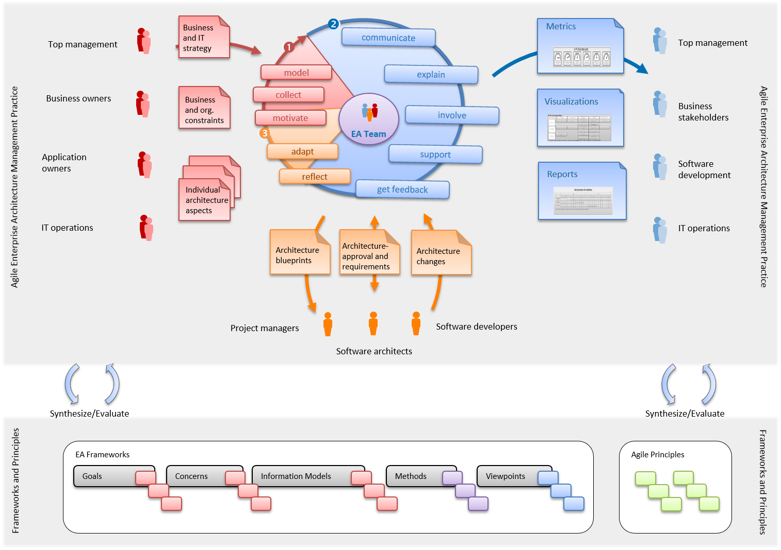
1. Motivation (1)
EAM aims to document and manage the complexity of the business IT landscape in relation to business requirements
conveys holistic view of entire organization
define current state in an EA model and derive future planned states heading towards an optimized EA
improve business and IT alignment
realize cost saving potentials
source:
wwwmatthes.in.tum.de

Slide 4
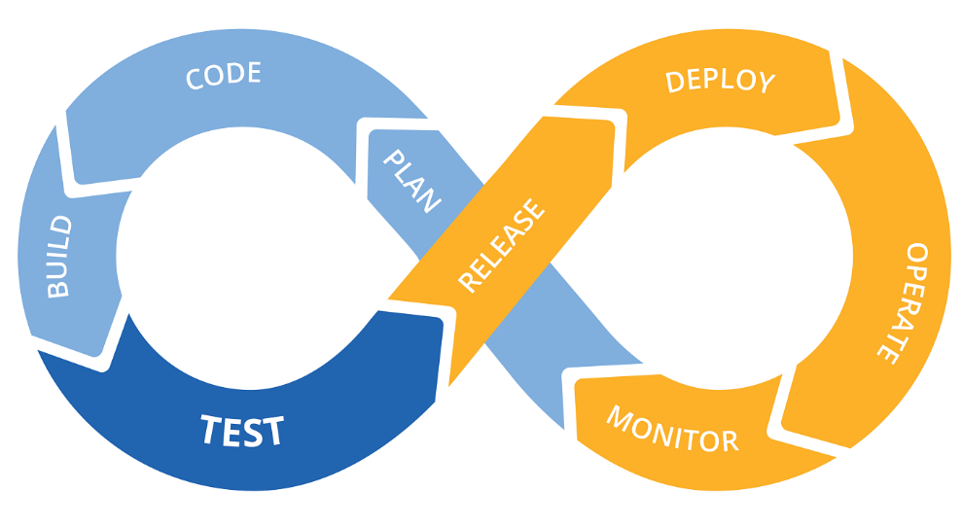
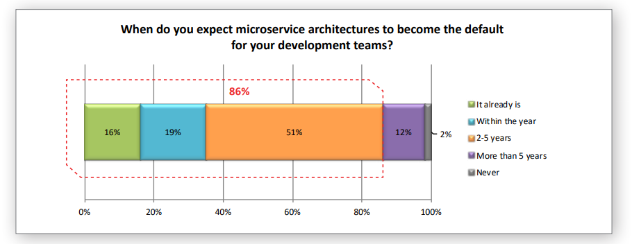
1. Motivation (2)
Microservice architecture
highly maintainable and testable
independently deployable
organized around business capabilities
loosely coupled
rising adoption of agile methodologies and microservice-based architectures
rising number of code deployments
decrease in time-to-market
EA landscape is in constant change
EAM Tools provide support, but require manual input
high degree of manual work with very little automation
widely distributed responsibilities
EA documentation often incomplete or outdated and mostly very costly to maintain
research on holistic models/tools to facilitate EAD scarce
DevOps Lifecycle
source:
www.microservices.io
https://openwt.com
Dimensional Research: Global Microservices Trends: A survey of development professionals (April 2018)

Slide 5
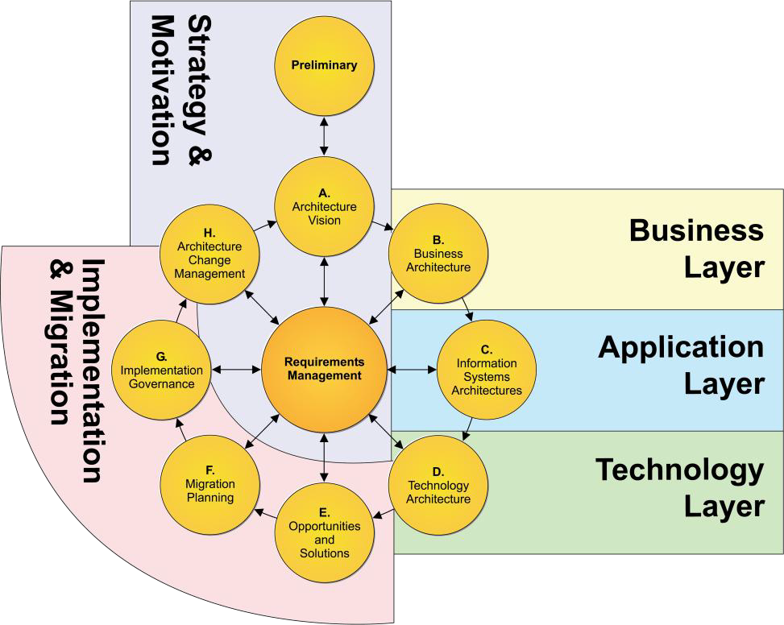
1. Motivation (3)
in previous work source entities of the ArchiMate meta-model could be covered with
20% on the business layer,
75% on the application layer and up to
50% on the technology layer
automation of EAD faces various challenges:
overload of productive systems due to large volume of transactions for automated data collection
selection of the right productive systems as information sources for EAD
detection of changes and propagation
insufficient data quality at source
transformational challenges due to missing standards
abstraction gap
Mapping between TOGAF ADM and ArchiMate language
source:
https://www.opengroup.org/togaf
M. Buschle, M. Ekstedt, S. Grunow, M. Hauder, F. Matthes, and S. Roth. Automated Enterprise Architecture Documentation using an Enterprise Service Bus. 2012.
Hauder, M., Matthes, F., Roth, S.: Challenges for Automated Enterprise Architecture Documentation - In the 7th Workshop on Trends in Enterprise Architecture Research (TEAR 2012), Barcelona, Spain, 2012.

Slide 6
2. Research problem (1)
Fig.: Usage and relevance as EA information sources (n=123).
majority of organizations have no dedicated process for EA documentation defined
only 23 participants (18.7%) stated that they have implemented some form of automated EA documentation mechanisms for their EA tool
(mostly limited to simple file import mechanisms that are manually triggered)
direct data integration between other information systems and the EA tool only considered by few organizations
62%
59%
55%
51%
47%
48%
44%
45%
41%
32%
27%
27%
20%
12%
10%
9%
6%
6%
source:
Farwick, M., Hauder, M., Roth, S., Matthes, F., Breu, R.: Enterprise Architecture Documentation: Empirical Analysis of Information Sources for Automation - In the Hawaii International Conference on System Sciences (HICSS 46), Maui, Hawaii, 2013

Slide 7
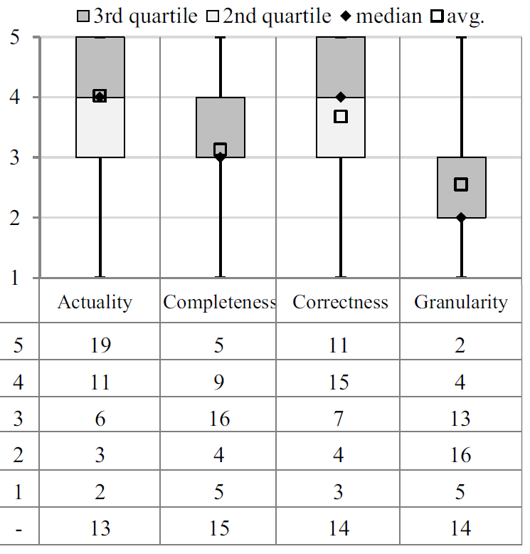
2. Research problem (2)
used to monitor infrastructure and its performance (APM)
high actuality and correctness
scope of monitoring tools is too granular
main problem:
bridging the abstraction gap between existing information silos and EA tools
Fig.: Information source quality attributes of Network Scanners (n=54)
source:
Farwick, M., Hauder, M., Roth, S., Matthes, F., Breu, R.: Enterprise Architecture Documentation: Empirical Analysis of Information Sources for Automation - In the Hawaii International Conference on System Sciences (HICSS 46), Maui, Hawaii, 2013

Slide 8
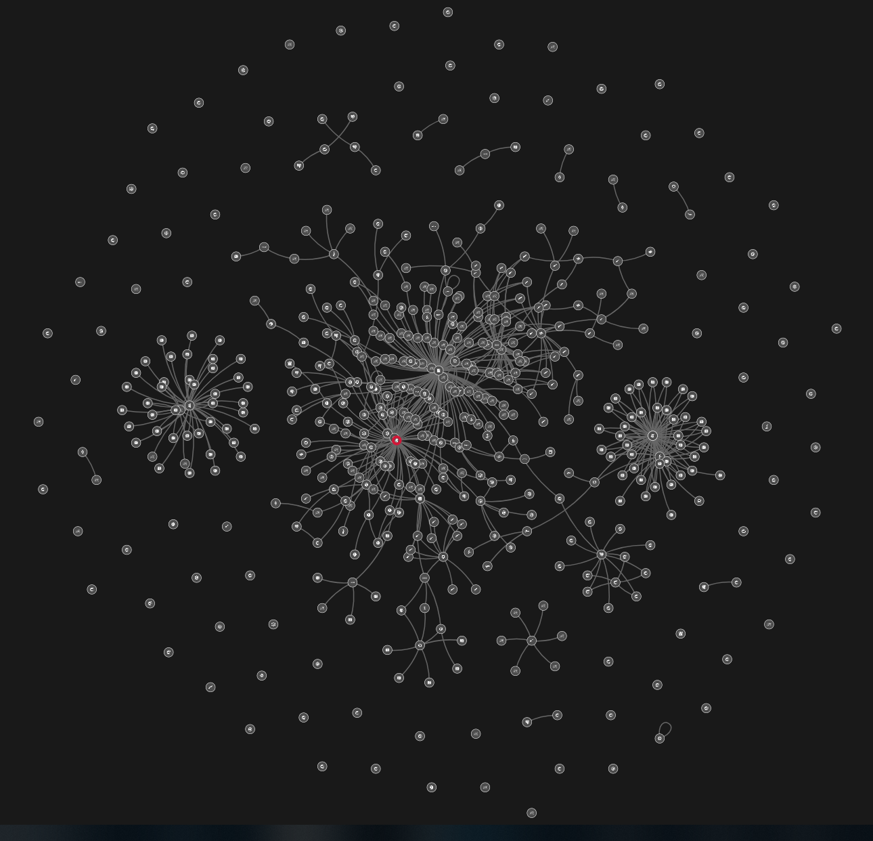
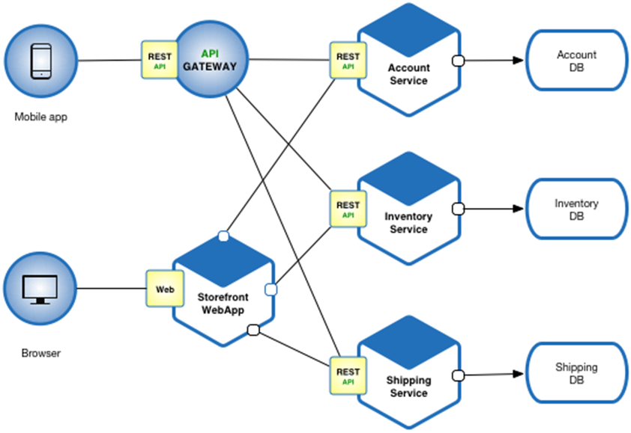
2. Research problem (3)
Microservice architecture example
Smartscape topology
source:
www.microservices.io
MediaMarktSaturn dynatrace Smartscape topology

Slide 9
3. Research Questions
Which IT artifacts and their communication relationships can be discovered through runtime data?
What prerequisites need to be fulfilled?
What are benefits and limitations of this solution?
How can IT artifact relationships be visualized properly?
RQ1
RQ2
RQ3
RQ4

Slide 10
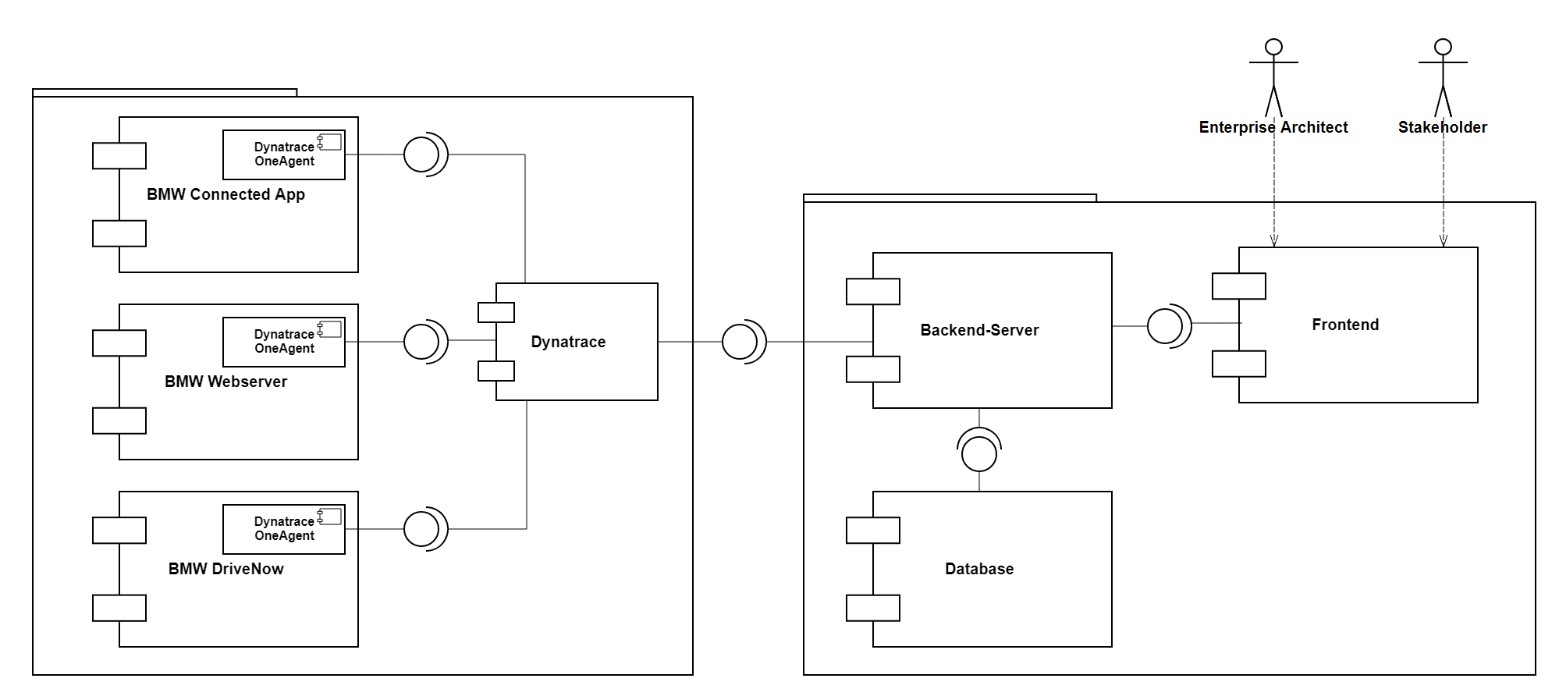







4. Solution proposal
BMW Group IT
proposed solution
source (logos):
www.bmwgroup.com, www.dynatrace.com, www.nodejs.org, www.graphql.org, www.mongodb.com, www.reactjs.org, www.cytoscape.org

Slide 11
5. Evaluation
relevant requirements
desired outcome
case study design
as-is meta-model
updated meta-model
relevant research data
final prototype version
answers to research questions
thesis write-up
Requirements analysis
Literature research
Interviews with stakeholders
As-Is-Evaluation
Analysis of as-is situation
Data collection from relevant sources
On-Site experience
Case Study
Evaluation design
Final Assessment
Implementation of prototype
Feedback from stakeholders
Refinement of prototype
Semi-structured interviews with stakeholders
Gap analysis
Critical assessment of benefits and limitations
Final evaluation of research questions
Definition of relevant case study parameters
(assessment criteria, stakeholders, methods of information gathering)
source (logo): www.bmwgroup.com

Slide 12
6. Timeline
April
May
June
July
August
September
October
Literature research
Prototype development
Prototype evaluation
Writing
Registration Date
Submission Date
Notes:
continue development of prototype
do further requirements analysis to tailor prototype to BMW’s needs
explore options of how to best visualize certain architecture artifacts (e.g. API-level)

Slide 13
Thank you for your attention!
Discussion
Advisor: Martin Kleehaus
Student: Nektarios Machner 27.05.2019

Slide 14
Nektarios Machner
nektarios.machner@in.tum.de

