Slide 1
Modeling
Application Landscapes as
Dynamic Systems
Master’s Thesis | SS2013
  Supervisor: Prof. Dr. Florian Matthes
  Advisor: Alexander W. Schneider, M.Sc.
  Author: Maximilian Burger, B.Sc.

Slide 2
1. Motivation: A system theoretic perspective
  Increased competitive environment
    External sources for change: business, law, and technology evolution
    Constant change is needed to adapt to the complexity of the environment
  Increased importance of IT and business IT alignment
    Internal sources for change: BPR, M&A, IT and company transformation
    Constant change is necessary to adapt to the needs of the business
  Problem:
  Uncertainty of change processes:
  outcome often unexpected
  through omitting important
  influence factors like people
  and the behavioral aspect
  and a system’s dynamics.
Environment
Business
Evolution
Business
Law
Application Landscape
Technology
Evolution
Person
Application
Notes:
1. IT-Abteilungen performen nicht wie von Unternehmen gewünscht (System Außenwahrnehmung). kostet viel, ist langsam
2. Business IT Alignment soll dieses Problem lösen
3. EAM hat es sich zum Ziel gemacht, business it alignment herzustellen (Quellen)
4. Aktuelle Architekturbeschreibungen: Statische Sicht somit nur auf Struktur (Zeitpunktbetrachtung), Hoffnung: Rückschlüsse auf Außenwahrnehmung möglich, jedoch keine Literatur vorhanden (muss man zeigen, ist aber dann auch der Gap)
5. Änderungen erfolgen in Form von Projekten -> Strukturänderung mit dem Ziel die Gesamtperformance zu verbessern -> besseres alignment
6. Complexity Theory: Ursache für notwendige Änderung kann auch Zunahme der Environment complexity sein, die betrachtet jedoch das Unternehmen und damit auch die AWL als System
7. System Theory sagt uns structure & behavior
8. Behavior heute nicht in EA Modellen modelliert
9. Zusammenhang zwischen System-Performance und System-Struktur jedoch nicht vollständig erkennbar (ausschmücken) Beispiele: Projektmethode wird nicht betrachtet (agile), da evtl. keine Auswirkung auf Struktur auch bisher nicht modelliert
10. Hypothese: Modellierung des Verhaltens des Systems (mit Beteiligung Menschen) schließt diese Lücke ein wenig
11. Darum allgemeines Modell entwickeln und anhand von Beispielen den Zusammenhang zeigen

Slide 3
2. Definitions
  Enterprise Architecture (EA) is a coherent whole of principles, methods, and models that are used in the design and realization of an enterprise’s organizational structure, business processes, information systems, and infrastructure. (Lankhorst 2005)
  EA management (EAM) is a continuous management function seeking to improve the alignment of business and IT and to guide the managed evolution of an organization. Based on a holistic perspective on the organization the EA management function is concerned with the management, i.e., the documentation, analysis, planning, and enactment, of the EA. (Buckl 2011)
  A system consists of
  a boundary delineating the environment from the system parts,
  an interface defining the interaction and behavior of the system and
  an inside setup with the structure, states and state transitions. (Broy 2012)
Notes:
• a system boundary, defining what is part of the system itself and what is outside of
the system
• an interface (determined by the system boundary), defining
the kinds of interaction between the system and the environment is possible
(static/syntactic interface)
the behavior of the system seen from outside (interface behavior, dynamic interface,
interaction view)
• an inside setup consisting of
the structure and division in subsystems (architecture)
the states and state transitions (state view).
• The interaction and state views are build upon a data model.
• Views can be documented by means of feasible models.

Slide 4

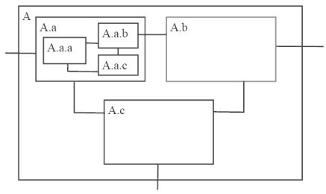








3. Dynamics
Mainland Australia
System
Application Landscape
Poor crop on sugar cane plantation
Problem
High functional redundancy
Distribution of bugs
Cause
Unmanaged application introductions
Introduction of cane toad to kill bugs
Measure
Standardization
Less bugs
Outcome 1
Less functional redundancy
Outcome 2
Less business IT alignment ?
Shadow IT ?
Inconsistent business logic ?
Security issues ?
Inefficiencies ?
…
???
???
???
No consideration of behavioral aspects over time
Reason
No consideration of behavioral aspects over time

Slide 5
4. Layers from EA Structure to IT Success
IT Success
KPIs
Goals
KPIs
Implies
Implies
Alignment
Business Process Support
Business Process Support
Implies
Induce
Implies
System Dynamics
System Dynamics
Behavior
Implies
Implies
Static AL Architecture
Static AL Architecture
Structure
Changes
as-is to-be t

Slide 6
5. Thesis
  Research Question: How can application landscapes be modeled as dynamic systems in order to increase predictability of possible outcomes of structural change?
  Methodology: Design Science
  Evaluation: Qualitative interviews
  Outcomes: Least complicated useful model;
  Examples of use;
  Providing a base and motivations for further research.
  Scope: Environmental change and software / EA evolution have an impact on behavior but are not meant by the term dynamics in this context.
  Dynamics and behavior can be found in the whole EA, but this thesis is about application landscapes only.
Notes:
Related Work:
Dynamics and change management
- Evolving Philosophers (Kramer), Dynamic Systems (Luenberger), Ecosystem states (Holling)
Models of application landscapes and EA evolution
- SE (Breu), EAM (Buckl), Co-evolution (Kandjani)
Complex Adaptive Systems
- Introduction (Holland), Biosphere (Levin), Heroin Market (Hoffer), Supply Chains (Langdon)

Slide 7
6. Possible Components of the Model
Elements
Application
Business Process
Person
Project
User
Owner
Developer
Other Stakeholder
Links
supports
is viable to
uses
communicate
needs coordination with .. about ..
develops
excludes
includes
waits for
authorizes
depends on
States
Application
Project
running, maintenance,
expiring, defect,
deprecated
Business Process
Person
initiated, started,
declined, finished
initiated, supported,
deprecated
owning, developing,
using, rejecting
create (element)
Functions
activate (element)
assign (element, state)
passivate (element)
link (element1, element2, link)
assert (element, state)
delete (element)
unlink (element1, element2, link)
change (element, state)
Notes:
Eine Person kann z.B. durch Vererbung spezifiziert werden oder durch den Status, oder durch entsprechende Beziehungen (Links)

Slide 8
7. References
Buckl, S. (2011). Developing Organization-Specific Enterprise Architecture Management Functions Using a Method Base. PhD Thesis, Technische Universität München.
Broy, M. (2012). Software engineering, Lecture Script, Munich.
GablerVerlag. (2013, May). System (10th ed.). Gabler. Retrieved from http://
wirtschaftslexikon.gabler.de/Archiv/3210/system-v10.html
Hevner, A.R. (2007): A three cycle view of design science research. In: Scandinavian Journal of Information Systems, Vol. 19 (2007) No. 2.
Hevner, A.R.; March, S.T.; Park, J.; Ram, S. (2004): Design science in information systems research. In: Mis Quarterly, Vol. 28 (2004) No. 1, pp. 75-105.
Offermann, P.; Levina, O.; Schönherr, M.; Bub, U. (2009): Outline of a design science research process. In: Proceedings of the 4th International Conference on Design Science Research in Information Systems and Technology (DESRIST '09). ACM, New York, NY, USA, Article 7, pp. 1-11.
Lankhorst, M. (2005). Enterprise architecture at work: Modelling, communication and analysis.
Springer.
Kandjani, H., Bernus, P., & Nielsen, S. (2013). Enterprise architecture cybernetics and
the edge of chaos: Sustaining enterprises as complex systems in complex business
environments. In System sciences (HICSS), 2013 46th hawaii international conference on (p. 3858–3867).

Slide 9
Backup

Slide 10
Agenda
  Motivation
  Scope and Definition
  Dynamics
  Structure to Success
  Thesis overview
  First modeling approach
  References

Slide 11
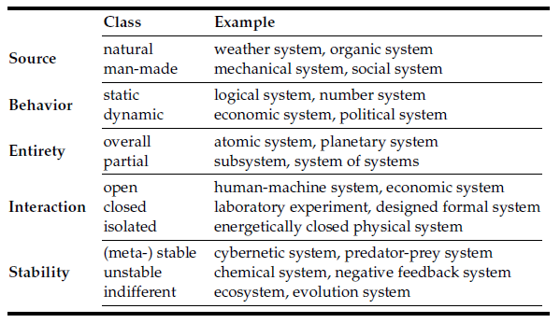
Classification of Systems
Adopted from GablerVerlag (2013)

Slide 12
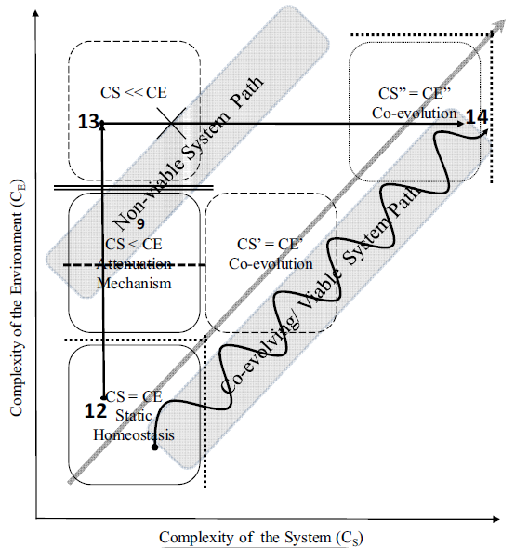
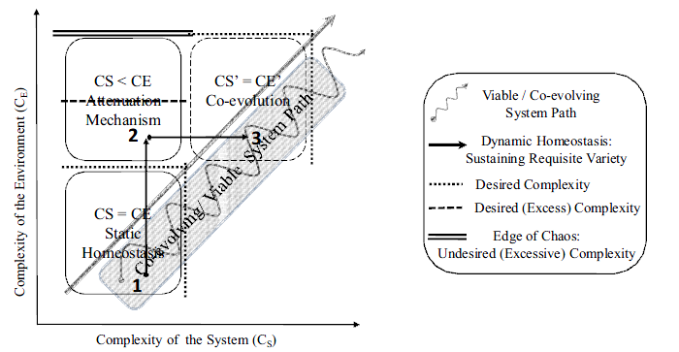
Co-evolving System Path
Kandjani et al. (2013)

Slide 13
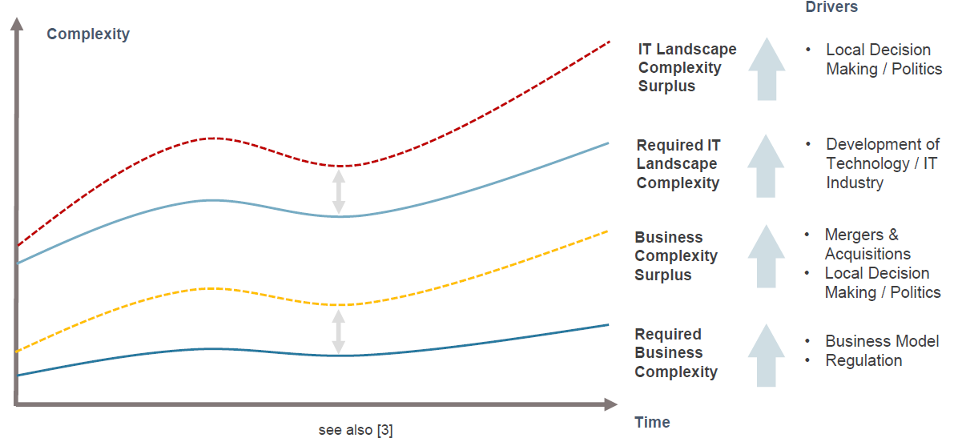
Complexity Surplus

Slide 14
Research Methodology
Environment
(Application Domain)
People
Design Science Research
Knowledge Base
(Foundations)
Scientific Theories & Methods
Organizational Systems
Technical Systems
Problems & Opportunities
Experience & Expertise
Meta-Artifacts (Design Products & Design Processes)
Build Design Artifacts & Processes
Relevance Cycle
Requirements
Field Testing
Rigor
Cycle
Grounding
Additions
to KB
Design
Cycle
Evaluate
Own illustration, based on Hevner (2007)

Slide 15
Research Schedule
Problem identification
Solution design
Evaluation
Thesis & Review
Problem
Model design
Relevance
Model Applic.
Methodology
Grounding Th.
Rigor Cycle
Presentation
Evaluation
Inaugural
presentation
Final
presentation
Introduction
Theory and Concepts
Least c,u Model
Future Work
Related Work
Possible Models
Results & Evaluation
Research Questions
Benefits & Limitations
Methodology
Use Cases
Conclusion
Proceeding
Artifact / Thesis
Presentation
Own illustration, based on Offermann et al. (2009)

Slide 16
Backup References
GablerVerlag. (2013, May). System (10th ed.). Gabler. Retrieved from http://
wirtschaftslexikon.gabler.de/Archiv/3210/system-v10.html
Hevner, A.R. (2007): A three cycle view of design science research. In: Scandinavian Journal of Information Systems, Vol. 19 (2007) No. 2.
Hevner, A.R.; March, S.T.; Park, J.; Ram, S. (2004): Design science in information systems research. In: Mis Quarterly, Vol. 28 (2004) No. 1, pp. 75-105.
Offermann, P.; Levina, O.; Schönherr, M.; Bub, U. (2009): Outline of a design science research process. In: Proceedings of the 4th International Conference on Design Science Research in Information Systems and Technology (DESRIST '09). ACM, New York, NY, USA, Article 7, pp. 1-11.
Kandjani, H., Bernus, P., & Nielsen, S. (2013). Enterprise architecture cybernetics and
the edge of chaos: Sustaining enterprises as complex systems in complex business
environments. In System sciences (HICSS), 2013 46th hawaii international conference on (p. 3858–3867). Retrieved 2013-04-28, from http://ieeexplore.ieee.org/xpls/abs all.jsp?arnumber=6480311

