Slide 1
Developing a Framework for Managing Change Requests through Stand-Alone Workflows
Antrittspräsentation zur Masterarbeit, 13.05.2013
Bearbeiter: Annemarie Heuschild
Aufgabensteller: Prof. Dr. Florian Matthes
Betreuer: M.Sc. Matheus Hauder

Slide 2
Agenda
1
Motivation & Background
2
Related Work
3
Objective &Outcome
4
Next Steps

Slide 3
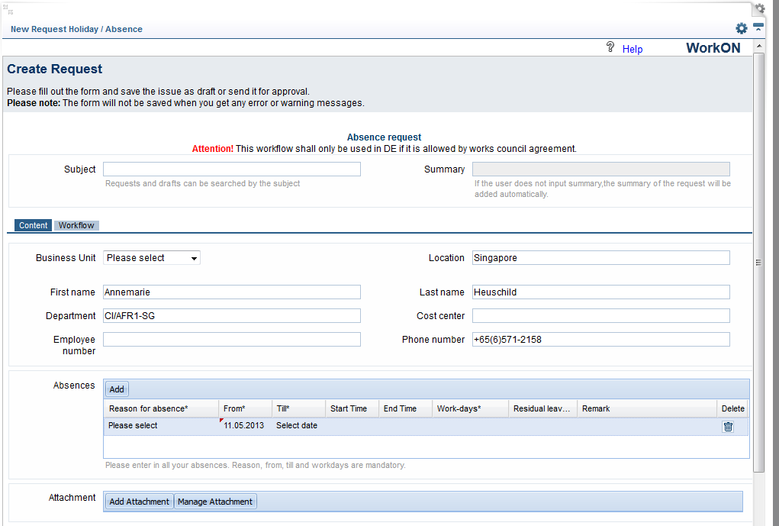
Motivation & Background
WorkON project

Slide 4
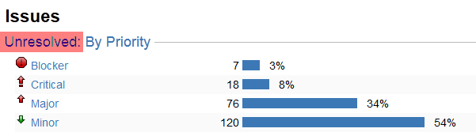
Motivation & Background
WorkON project

Slide 5
Motivation & Background
WorkON project
Resulting in
Unsatisfied customer
Less usage
More support
Additional work
→ Migration just completed, but successor already in pipeline
Questions to ask
What went wrong?
What to do with the backlog?
How to avoid a situation like this in future?
Find the root cause!

Slide 6
Motivation & Background
Reasons for project failure*
Project Impaired Factors % of Responses
1. Incomplete Requirements 13.1%
2. Lack of User Involvement 12.4%
3. Lack of Resources 10.6%
4. Unrealistic Expectations 9.9%
5. Lack of Executive Support 9.3%
6. Changing Requirements & Specifications 8.7%
7. Lack of Planning 8.1%
8. Didn’t Need It Any Longer 7.5%
9. Lack of IT Management 6.2%
10. Technology Illiteracy 4.3%
Other 9.9%
44.1%
* Report by the Standish Group of over 365 Companies and 8000 Projects in the USA [Chaos 1995]

Slide 7
Motivation & Background
Reasons for project failure
Customers are not able to form (technically) well specified requirements
(especially in advance of the project and without consulting/support)
Priorities (and thus requirements) change often
(Internet)Technologies change fast
Solution:
Integrate customer
Make it less technical
Clarify responsibilities
Combine change request management with workflows

Slide 8
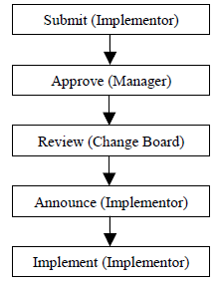
Related work
Models for change request management
Simple models, e.g. Rajlich (1999) and Dietel (2004)
Request: Formulate the change request.
Extraction: Extract the applicable concepts from change request.
Location: Locate the concepts in the code.
Actualization: Implement the concepts explicitly and fully in new code.
Incorporation: Replace the latent concepts in the old code by program dependencies between the old and new code (“plug in” the new code).
Propagation: Propagate change through the old code and fix all inconsistencies introduced by the change

Slide 9
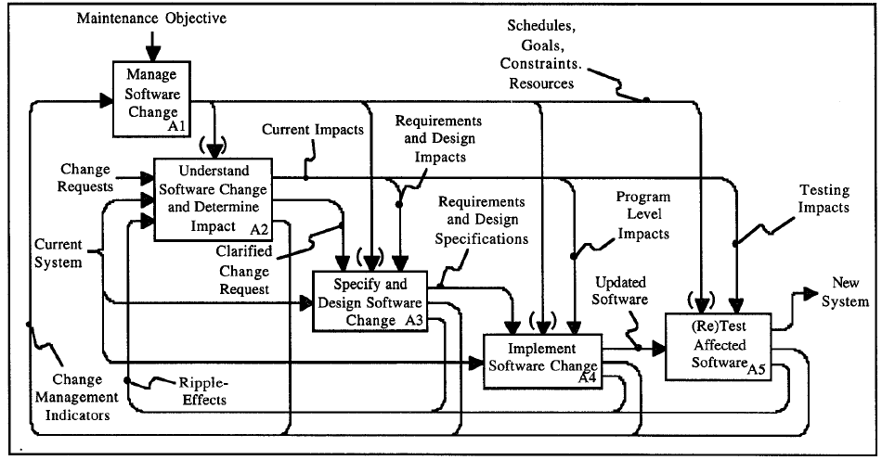
Related work
Models for change request management
Models focusing on a certain aspect, e.g. Bohner (1996), Ahn/Chong(2007), Stojanov (2007)

Slide 10
Related work
Modeling workflows
Petri nets
Modeling languages such as YAWL, UML, BPMN
Encourage reuse through workflow patterns, CBR
More flexible as constraint based
Agile workflows

Slide 11
Objective & Outcome

Slide 12
Next steps
April 15
May 15
June 15
July 15
Aug 15
Sep 15
Oct 15
Nov 15
Framework
Tool search
Implemen-tation
Buffer
Hand over at RB SGP
Writing 1,2
Writing 3-7
Re-view
Buffer
Literature research

Slide 13
Questions and Feedback?

