Slide 1
Identification of Cross-Blockchain Transactions: A Feasibility Study
Patrick Nieves, 07.05.2018, Munich

Slide 2
Outline
Motivation
Research Questions
State of the Art
Analysis
Implementation
Evaluation
Conclusion & Outlook

Slide 3




Motivation
Analysis of Cross-Blockchain transactions
Alice
Bob

Slide 4
Outline
Motivation
Research Questions
State of the Art
Analysis
Implementation
Evaluation
Conclusion & Outlook

Slide 5
Research Questions
3. How accurate is the implemented Solution? What are the Limits?
2. How can Cross-Blockchain Transactions be recognized?
1. What is the current State of the Art regarding Cryptocurrency Exchange?

Slide 6
Outline
Motivation
Research Questions
State of the Art
Analysis
Implementation
Evaluation
Conclusion & Outlook

Slide 7
















State of the Art
Types of Cryptocurrency Exchanges
Trading Platforms
Over-The-Counter Exchanges
Decentralized Platforms
Instant Cryptocurrency Exchanges

Slide 8
Outline
Motivation
Research Questions
State of the Art
Analysis
Implementation
Evaluation
Conclusion & Outlook

Slide 9
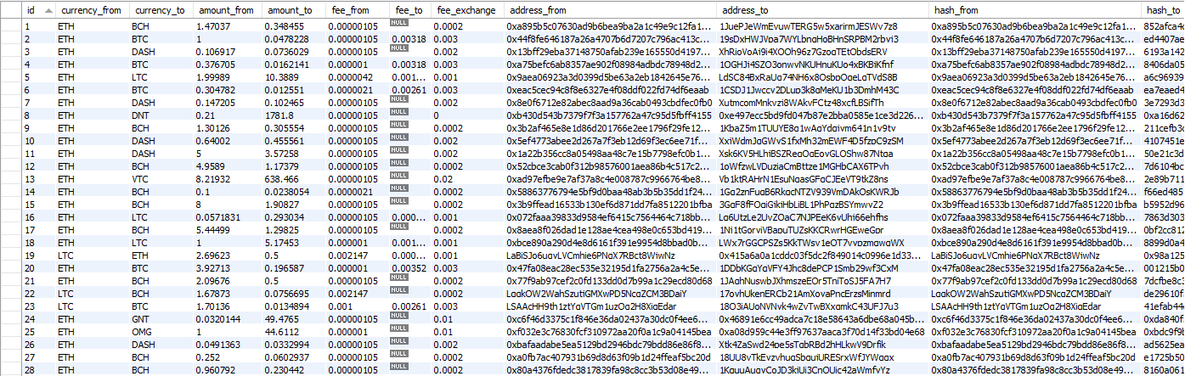
Analysis
Data Retrieval - Scraper Algorithm
Get last 50 Transactions (shapeshift.io/recenttx/50)
Get Transaction by Hash
(shapeshift.io/txStat/0x0056d4165b1ba0b05ec334308db4b78d71299191)
[
{
"curIn": "REP",
"curOut": "BCH",
"timestamp": 1510527713.046,
"amount": 2.79353472,
"txid": 318131
},
{
"curIn": "LTC",
"curOut": "BCH",
"timestamp": 1510527706.291,
"amount": 27.87439585,
"txid": 777727
},
{
"curIn": "ETH",
"curOut": "BCH",
"timestamp": 1510527706.225,
"amount": 0.43348018,
"txid": 580973
},
{
"curIn": "SALT",
"curOut": "BCH",
"timestamp": 1510527705.528,
"amount": 35.52130301,
"txid": 407891
},
{
"curIn": "ETH",
"curOut": "LTC",
"timestamp": 1510527684.702,
"amount": 0.008,
"txid": 998546
}
]
{
"status": "complete",
"address": "0x0056d4165b1ba0b05ec334308db4b78d71299191",
"withdraw": "XotVm3i6mue9uhWxGbtsw7qjmFpdpms5aa",
"incomingCoin": 1,
"incomingType": "ETH",
"outgoingCoin": "1.09433849",
"outgoingType": "DASH",
"transaction": "5a0101618c90dead9b0ab441733db9002ab4d4ade65427ab1f9ac77013990f38"
}

Slide 10


Analysis
Time Differences
Deposit
Withdrawal
Transaction Time
Block Confirmation Time
Processing Duration
0 – 15 minutes
Transaction Time
Block Confirmation Time
Exchange Duration

Slide 11
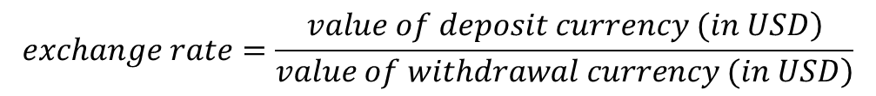
Analysis
Exchange Rate
1.
$$exchange rate=\frac{\left.value of deposit currency (in USD\right)}{\left.value of withdrawal currency (in USD\right)}$$
2.
$$expected amount{=(deposit amount∗exchange rate)−exchange fee}$$
3.
$$expected amount∗0.9 <withdrawal amount{<expected amount∗1.1}$$

Slide 12


Analysis
Process Flow - Ethereum
Withdrawal
Deposit
Withdrawal Address
Customer
Deposit Address
Main Address
Sending Addresses

Slide 13


Analysis
Process Flow - Bitcoin
Withdrawal
Deposit
+
…
Customer
Deposit Address
Ext. Deposit/
Storage
Withdrawal Address

Slide 14
Outline
Motivation
Research Questions
State of the Art
Analysis
Implementation
Evaluation
Conclusion & Outlook

Slide 15







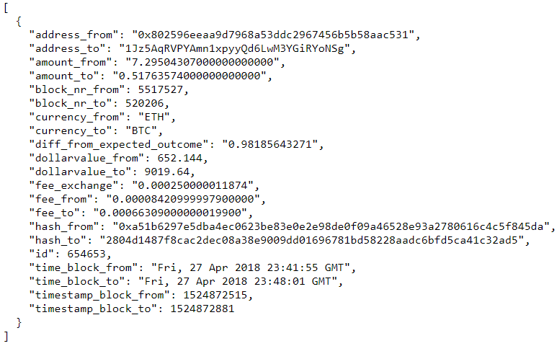


Implementation
Architecture
Recognition Tool
+
Scraper
Blockchain API Service
Storage
REST API
Exchange API Service
External Services
Market Data API Service

Slide 16

Implementation
Address Recognition - Ethereum
Deposit Address
Main Address
Sending Addresses
Deposit Recognition:
Withdrawal Recognition:
Succeeding transaction exists
  Input address equals output address of deposit transaction
  Output address is Shapeshifts main address
Input Address is one of the four Shapeshift sending addresses

Slide 17
Implementation
Address Recognition - Bitcoin
Transaction Flow
…
Customer
Deposit Address
Ext. Deposit
Output is known Shapeshift address & not P2SH
Classify as withdrawal & add all Inputs to known Shapeshift addresses
Output is known Shapeshift address & is P2SH
Classify as deposit

Slide 18

Implementation
Transaction Matching
Deposits
Withdrawals
tx
tx
tx
tx
Block
tx
tx
.
.
.
tx
15 min.
Time
tx
Block
tx
Block
tx
tx
tx
.
.
.
.
.
.

Slide 19
Outline
Motivation
Research Questions
State of the Art
Analysis
Implementation
Evaluation
Conclusion & Outlook

Slide 20
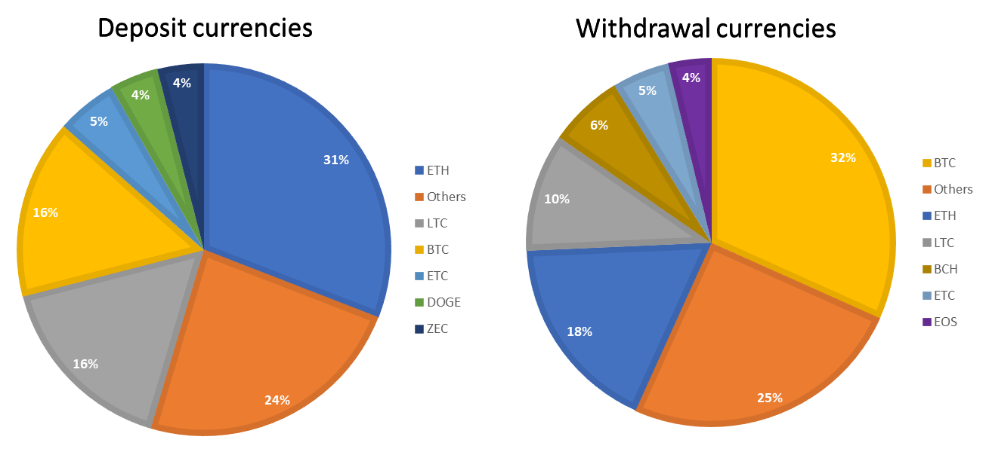
Evaluation
Scraped Data
Time Range | 23. February – 1 March 2018
Total Exchanges | 64,688 Exchanges
Value Received | 48,039,179.40 $
Total Fees Received | 70,346.89 $
Average Fee Paid Per Exchange | 1.09 $

Slide 21
Evaluation
Tool Data
Comparison with Scraped Data
Assessment of Matches found

Slide 22
Evaluation
Explanation of Outcome
Exchanges not found
  Small values
  Not found by address recognition
Wrong matches
  High number of transactions with the same value in the same period
  Other currency involved (39%)
New correct matches
  Long duration for deposit confirmation

Slide 23
Outline
Motivation
Research Questions
State of the Art
Analysis
Implementation
Evaluation
Conclusion & Outlook

Slide 24
Conclusion & Outlook
Outcome & Improvements
Outcome
Improvements
Identification of cross-blockchain transactions feasible with certain limits
More currencies
Insights into the processes of an exchange service
Improvement of address recognition
Creation of an exchange dataset (Further analysis, e.g. address clustering)

Slide 25
B.Sc. Information Systems
Patrick Nieves
patrick.nieves@tum.de

Slide 26
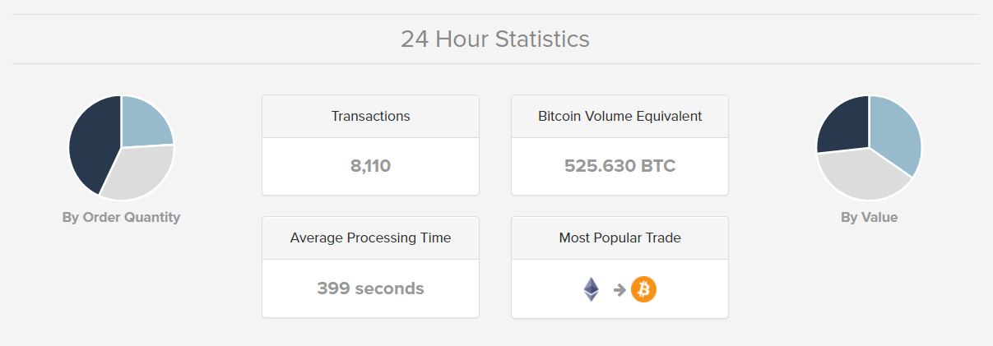
Backup
Shapeshift Transactions Overview
Retrieved from: https://shapeshift.io

Slide 27
Backup
Shapeshift API Response - Comparison

Slide 28
Backup
Scraped Data – Currency Pairs

Slide 29
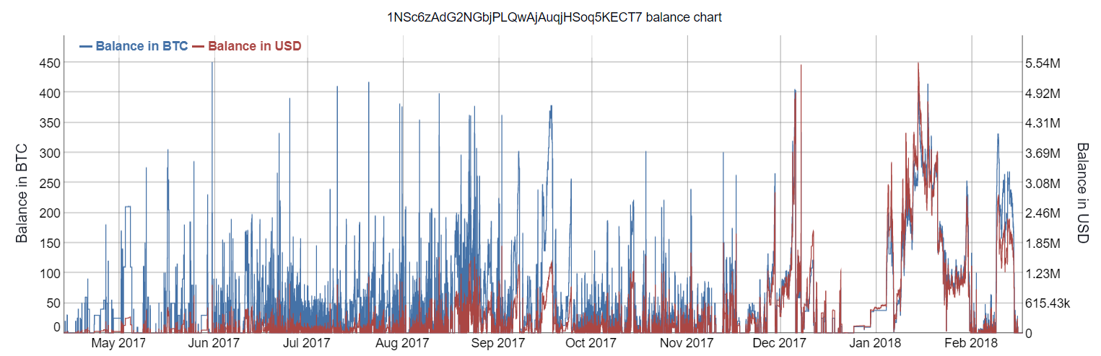
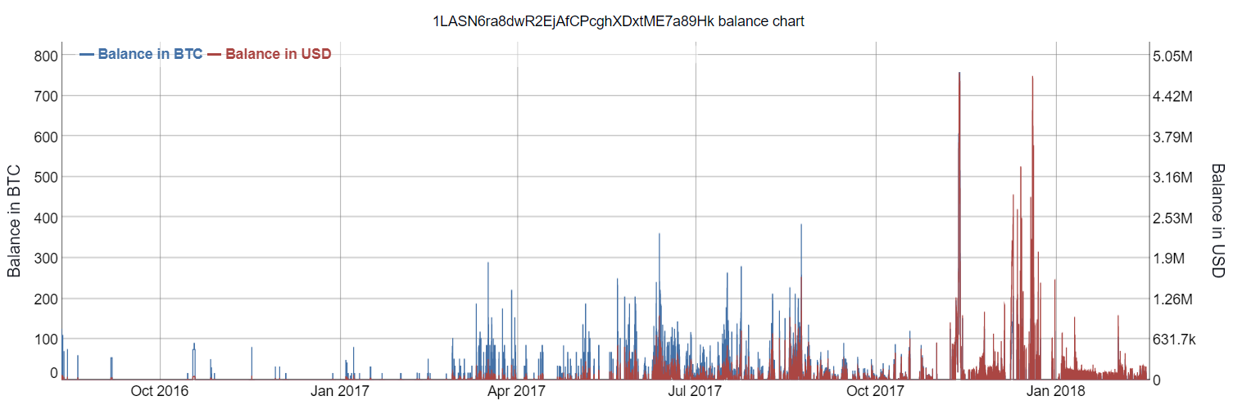
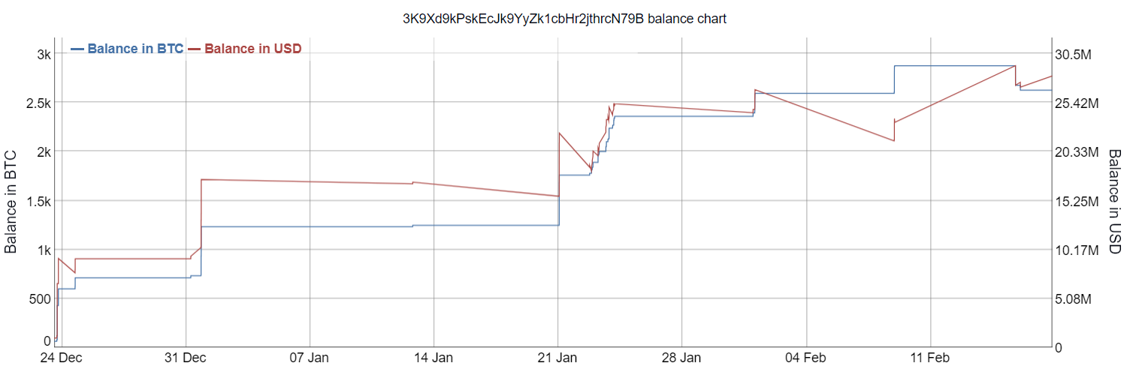
Backup
Balance Overview
Shapeshifts main deposit address
Bifinex deposit address
Storage address
Retrieved from: https://bitinfocharts.com

Slide 30
Backup
Identified Ethereum Addresses for Shapeshift
Name | Addresse
Main address | 0x70faa28a6b8d6829a4b1e649d26ec9a2a39ba413
Sending address 1 | 0xd3273eba07248020bf98a8b560ec1576a612102f
Sending address 2 | 0x3b0bc51ab9de1e5b7b6e34e5b960285805c41736
Sending address 3 | 0xeed16856d551569d134530ee3967ec79995e2051
Sending address 4 | 0x563b377a956c80d77a7c613a9343699ad6123911
Bitfinex deposit address | 0xDa1E5D4Cc9873963f788562354b55A772253b92f
Poloniex deposit address | 0xe8ed915E208B28c617d20F3F8Ca8e11455933aDf
Bittrex deposit address | 0xE9319eBA87Af7C2fc1F55ccDe9d10eA8efbd592d
Binance deposit address | 0xb36eFd48c9912Bd9fd58b67b65f7438F6364a256

Slide 31
Backup
Identified Bitcoin Addresses for Shapeshift
Name | Addresse
Main deposit address | 1NSc6zAdG2NGbjPLQwAjAuqjHSoq5KECT7
Bitfinex deposit address | 1LASN6ra8dwR2EjAfCPcghXDxtME7a89Hk
Poloniex deposit address | 1BvTQTP5PJVCEz7dCU2YxgMskMxxikSruM
Bittrex deposit address | 1NoHmhqw9oTh7nNKsa5Dprjt3dva3kF1ZG
Binance deposit address | 17NqGW6HY3f2LY7wFkEDn9yXpq8LWMRMEQ
Storage address | 3K9Xd9kPskEcJk9YyZk1cbHr2jthrcN79B

