Slide 1
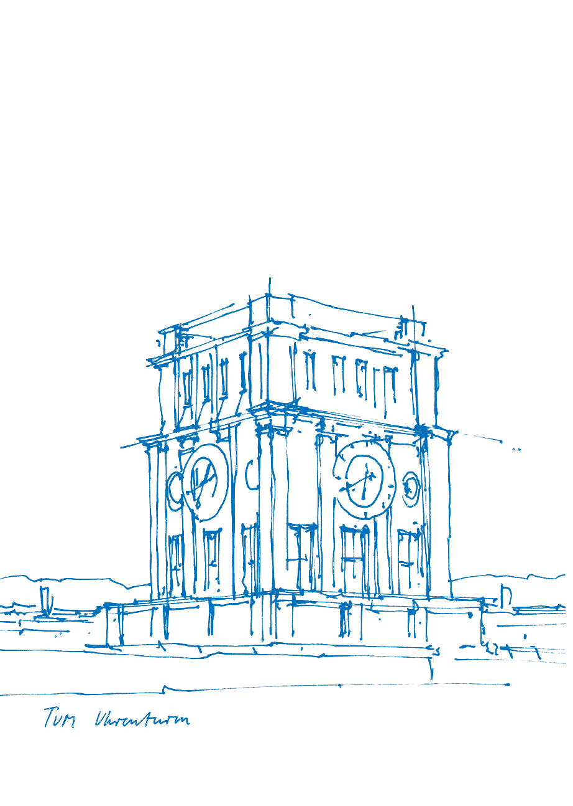
Collecting Feedback on Design Patterns for
Platform Engineering in the Public Sector
Bachelor’s Thesis Final Presentation
Student: Dmytro Voitsekhivskyi
Advisor: Peter Kuhn
Suprervisor: Prof. Dr. Florian Matthes
Technical University of Munich
School of Computation, Information and Technology
Chair of Software Engineering for Business Information Systems
Munich, 27th of March 2023
Notes:
Hello everyone.
I'm delighted to be here today to hold a final presentation of my bachelor's thesis on Collecting Feedback on Design Patterns for Platform Engineering in the Public Sector
Advised by Peter.

Slide 2
Contents
Motivation
Resolution
Theoretical Background
Methodology
Results
Discussion
Conclusion
Notes:
The agenda for today’s presentation is following:
First I’ll highlight the motivation of the topic and what resolution we have found for the existing complication.
Then, I'll be taking you through the carried out research process, from the theoretical background to the methodology and ultimately the results. I'll then move on to discuss the implications of my findings and how they can be applied to the field and further works, as well as
So, without further ado, let's dive into my presentation.
2

Slide 3
Motivation - Definition of GaaP
    Government as a Platform (GaaP) is a promising approach to the digital transformation of the public sector due to its efficiency through the reuse of common components [1].
    GaaP is enabled by platform-oriented infrastructure. [2]
    Significant cost reduction [2].
    TODO create a catchy slide (image)
    Mention Germany
Notes:
So . any type of visual representation harnesses visual perception.
In our brain visual processing takes up to 50% of the total activity and
the visual setting is generally comprehended in 1/10th of a second.
In fact, visualising time series turns data into a form mild for understanding and analysing, by
by bringing the trends to the foreground.
Moreover, visualising time dependent data is substantially used everywhere.
1

Slide 4
Motivation - Definition of GaaP
    Government as a Platform (GaaP) is a promising approach to the digital transformation of the public sector due to its efficiency through the reuse of common components [1].
    Germany could take good advantage of GaaP.
[2]
[2]
Notes:
First off, let’s start with the context and the main concept, namely Government as a Platform.
Government as a Platform is a promising concept to approach digital transformation in the public sector due to its efficiency and reusable components.
GaaP aims to simplify citizen intreaction with the public services and Germany could potentially take advantage of implementing, known for having peculiarities with the public services, for example, related to KVR.
3

Slide 5
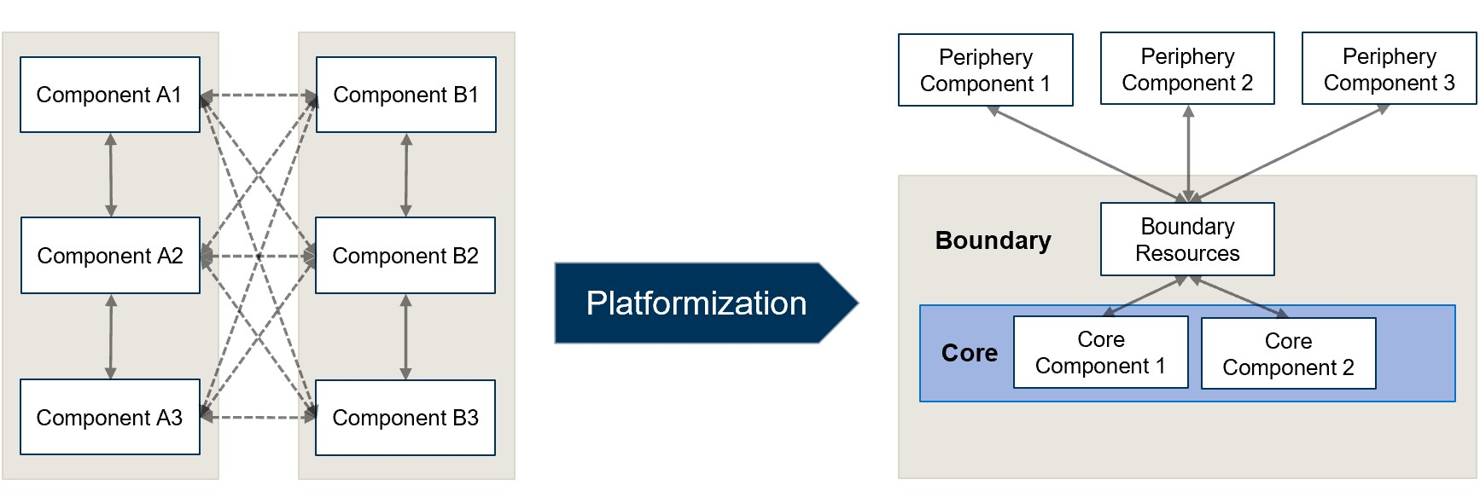
Motivation - Complication
    No clear guidelines or methods for the transformation process towards platform-oriented infrastructure—platformization [1].
    How to design a good platform-oriented infrastructure in a public sector?
Platformization process [3]
Notes:
The main complication with this approach, however, is that there are still no clear guidelines on how to implement GaaP.
Particularly, the so called transformation process is yet not defined, even though the starting point, namely the silo based infrastructure and the end goal—platform-oriented infrastructure are clear.
So, the question remains: how to design a good platform-oriented infrastructure in a public sector?
4

Slide 6
Resolution: Learning from Successful Countries
    Italy, Estonia, UK are (relatively) successful in the application of GaaP.
    Interviewing experts to collect and refine feedback on existing design patterns for platform engineering.
[4]
[5]
Notes:
And the resolution of the emerged complication that we pursued be learning from already successful countries.
For example, Italy, Estonia and the UK and relatively successful in the application of GaaP in practice, making public services convenient and accessible for their citizens.
A round of interviews was conducted to discuss existing design patterns and extend a set with new ones, but more on that later on.
5

Slide 7
Resolution: Learning from Successful Countries
    Research questions:
      RQ1: What are the dimensions of design decisions in applying GaaP in practice?
      Expected result: Coding concept
      RQ2: What are design decisions of countries that successfully apply GaaP?
      Expected result: List of design decisions
      RQ3: Which design patterns can be derived from these decisions?
      Expected result: Design patterns
Notes:
Let’s just quickly go over the research questions of this thesis.
First RQ is: SLIDE
Second is concerned with the design decisions made by the successful countries
And the third is directed towards patterns that can be derived from those decisions

Slide 8
Theoretical Background
    Government as a Platform (GaaP) is the implementation of the private sector platform concept in the public sector [6].
    The goal of GaaP is to simplify access to and the use of governmental services [7]
    Shared infrastructure and services can help reduce costs, improve efficiency, and reduce duplication of effort [8].
    It involves an open platform that aims to increase public value through the
    collaboration of citizens and the government [3].
Notes:
Now the foundation of the research—the theoretical background.
The theoretical background section of the thesis aims to provide a comprehensive and informative overview of the research, highlighting its significance, relevance, and contribution to the field.
Let’s quickly go over the main points of the TB.
LAST POINT: but as mentioned ealier the process of tranforming towards platform-oriented structure is still unclear.
7-8

Slide 9
Theoretical Background
    Application of Platform Structures and Principles (Dimensions):
      Platform architecture—identifies the infrastructure [7].
      Platform roles—determines stakeholders of the infrastructure [12, 7].
      Platform openness—readiness for collaboration [13].
      Platform management—orchestration of the platform [14].
Notes:
GaaP delivers better digital public services to citizens, emphasizing citizen engagement and participation in the policy process
GaaP is based on reusing existing digital assets and processes to create shared digital infrastructure and services

Slide 10
Theoretical Background
    Intelligence information technology is influencing various paradigms such as the economy, labour, social culture, politics, and public services
    Countries are investing in intelligence information technology to overcome economic depression caused by issues such as low birth rates, ageing, and deflation
    Application of Platform Structures and Principles (Dimensions):
      Platform architecture—identifies the infrastructure [7].
      Platform roles—determines stakeholders of the infrastructure [12, 7].
      Platform openness—readiness for collaboration [13].
      Platform management—orchestration of the platform [14].
      ADD MORE
Platform-oriented infrastructure [3]
Notes:
So . any type of visual representation harnesses visual perception.
In our brain visual processing takes up to 50% of the total activity and
the visual setting is generally comprehended in 1/10th of a second.
In fact, visualising time series turns data into a form mild for understanding and analysing, by
by bringing the trends to the foreground.
Moreover, visualising time dependent data is substantially used everywhere.
1

Slide 11
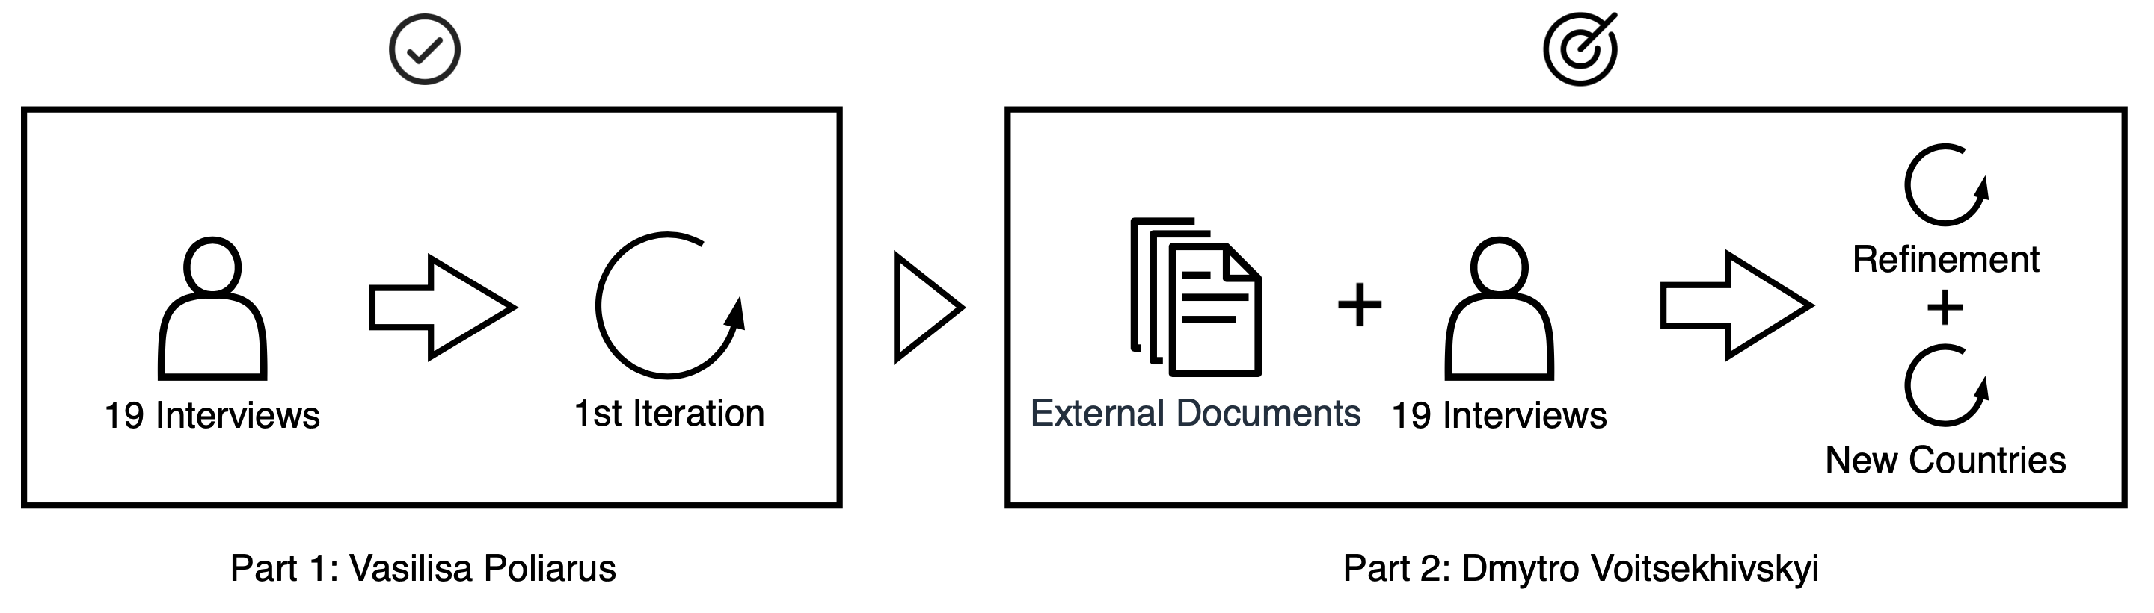
Methodology: Learning from the Best
    First iteration (before this BT) — 19 existing interviews.
      Italy, Estonia, UK
    Second iteration (object of this BT) — conducting 10 interviews.
      Italy, Estonia, UK
Notes:
The methodology comes straight from the resolution approach.
Learning from the best or learning from successful.
In the previous work on design patterns 19 interviwes were conducted and analysed.
During this thesis we have conducted a second round of 10 interviews, which were based on the previous results and available strategic documents for better refinement and expansion of the existing set.

Slide 12
Results - Coding Concept
    Content dimensions:
      Platform architecture—concerned with the infrastructure apects [9].
      Platform governance—concerned with the roles of the stakeholders [9, 10].
      Platform principles—concerned with the openness, participation and co-creation [11].
      Platform management—concenrned with the orchestration of the platform [12].
    Structural dimensions:
      Descriptive—existing state of affairs and experience [13].
      Prescriptive—suggestions and recommendations [14].
Notes:
When analysing interviews a coding concept was used.
The following dimensions have been chosen for coding
*Depending on the time*

Slide 13
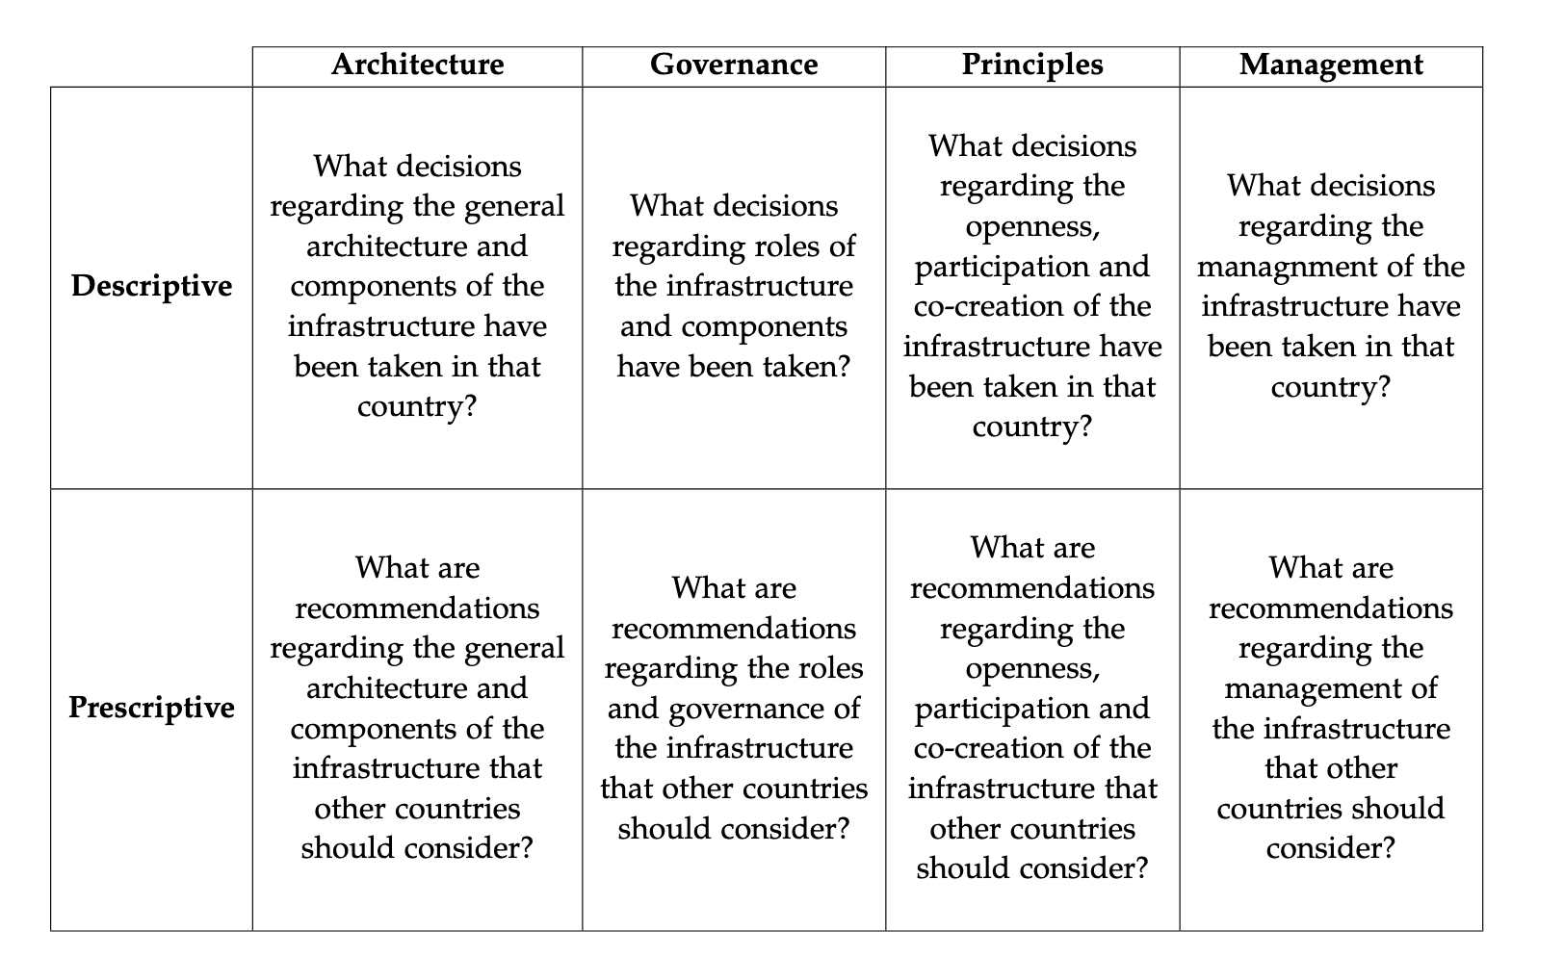
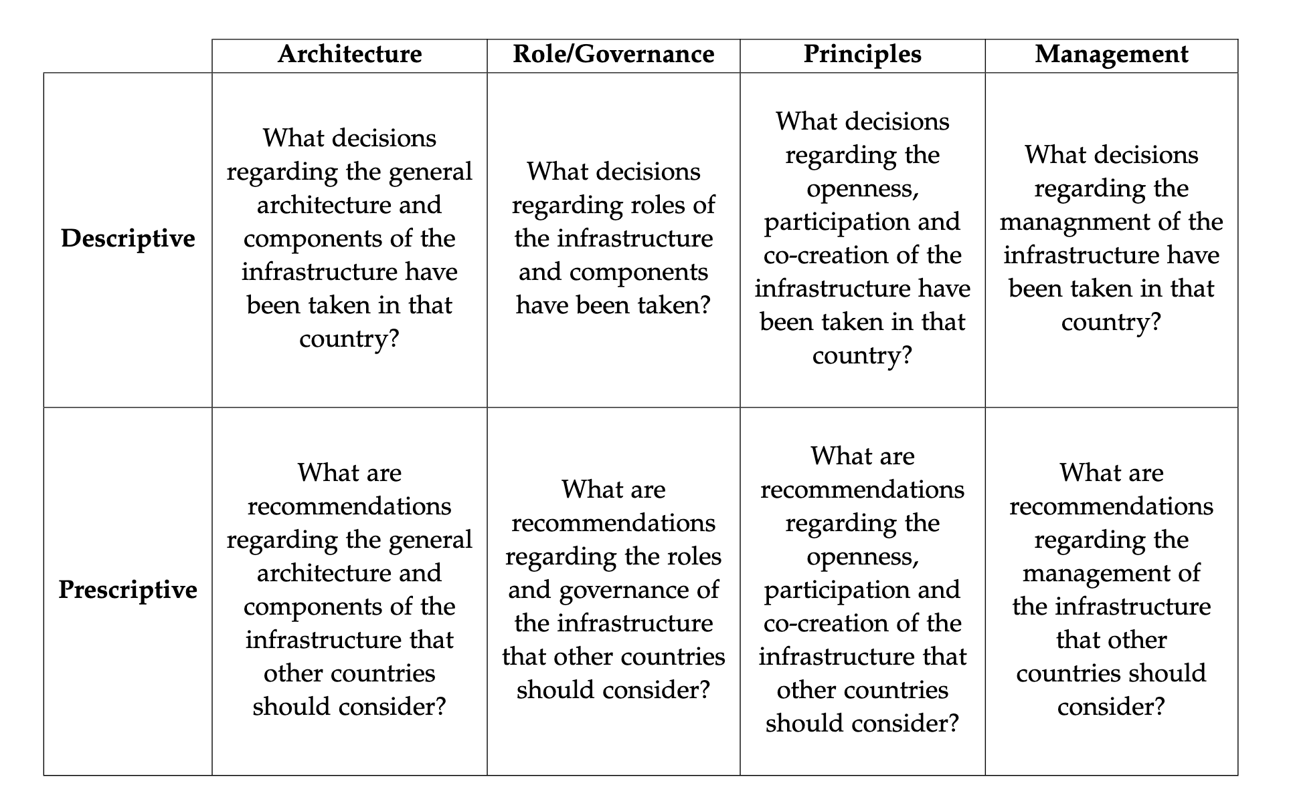
Results - Coding Matrix
Notes:
That’s the complete coding matrix or schema with all previously mentioned dimensions and corresponding questions to be answered.
We have both prescriptive and descriptive character for all content dimensions.

Slide 14
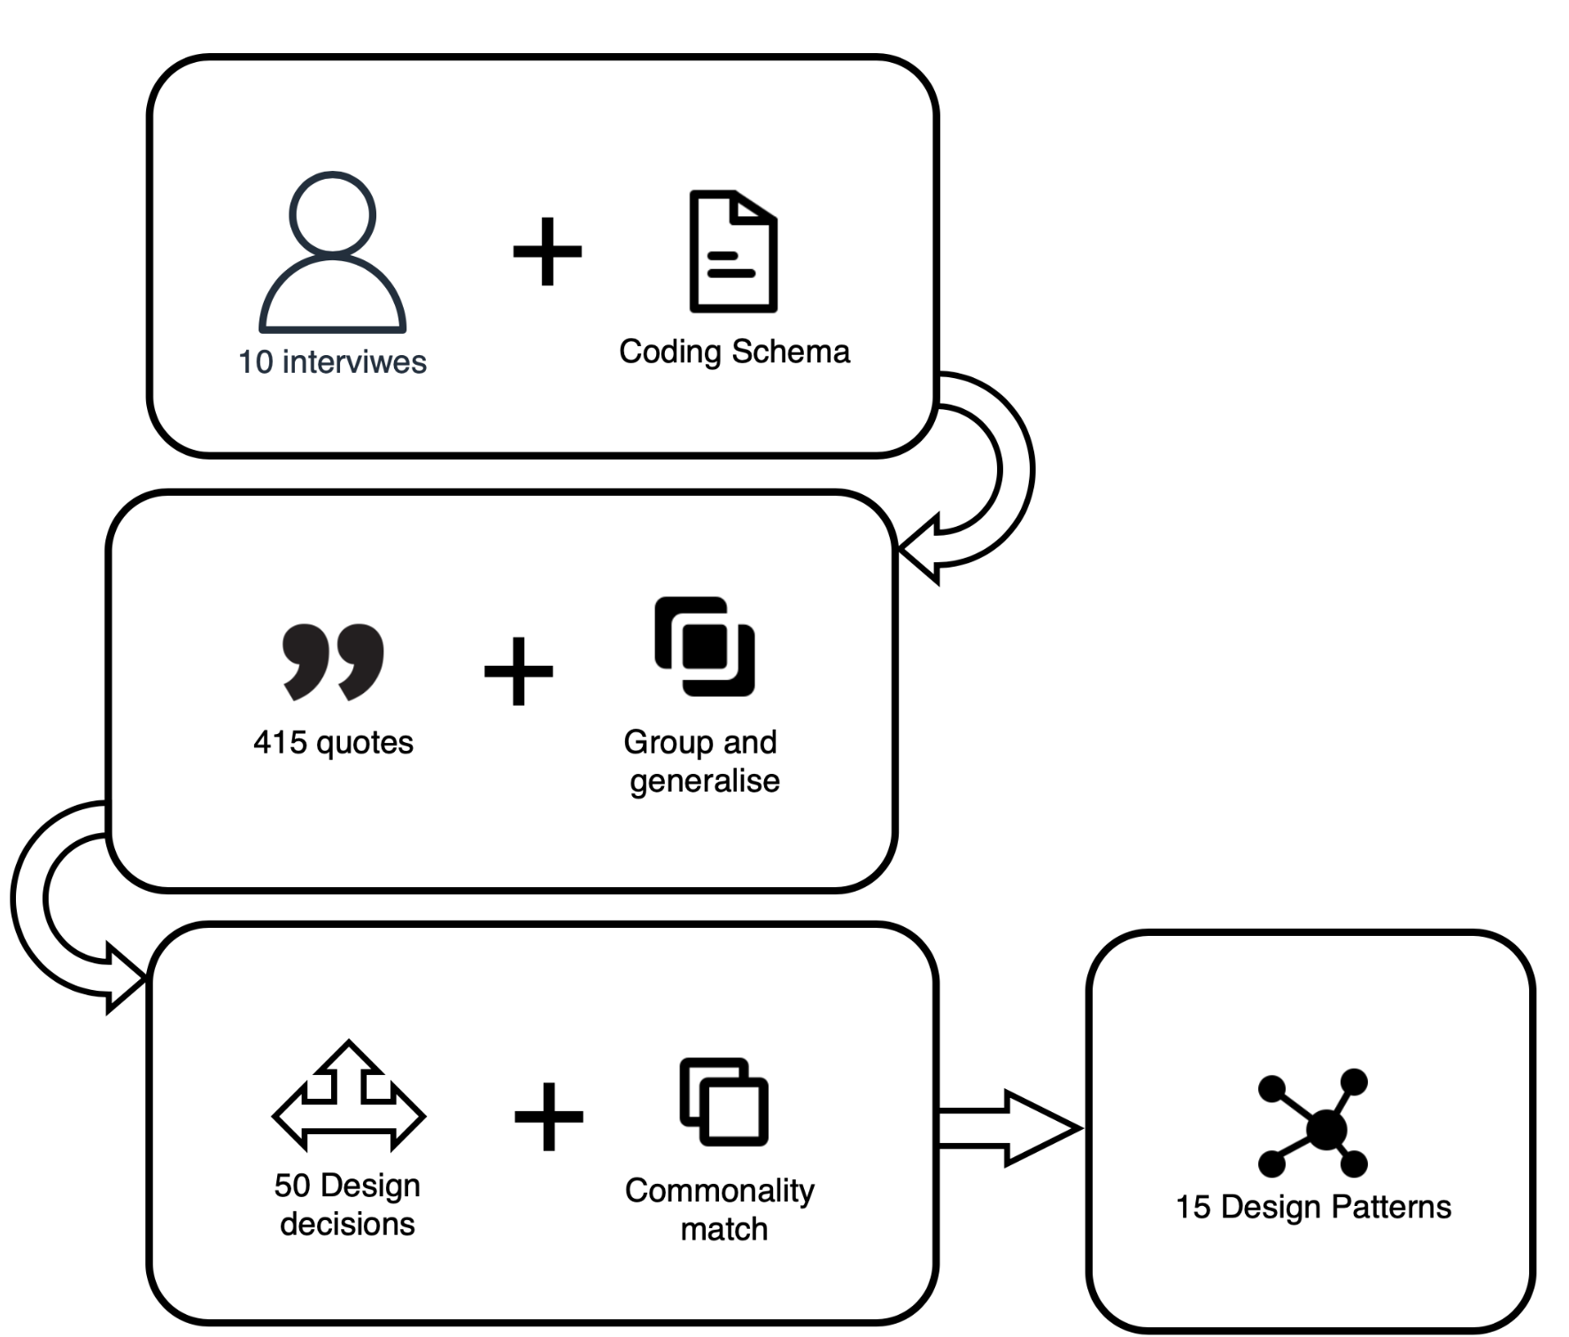
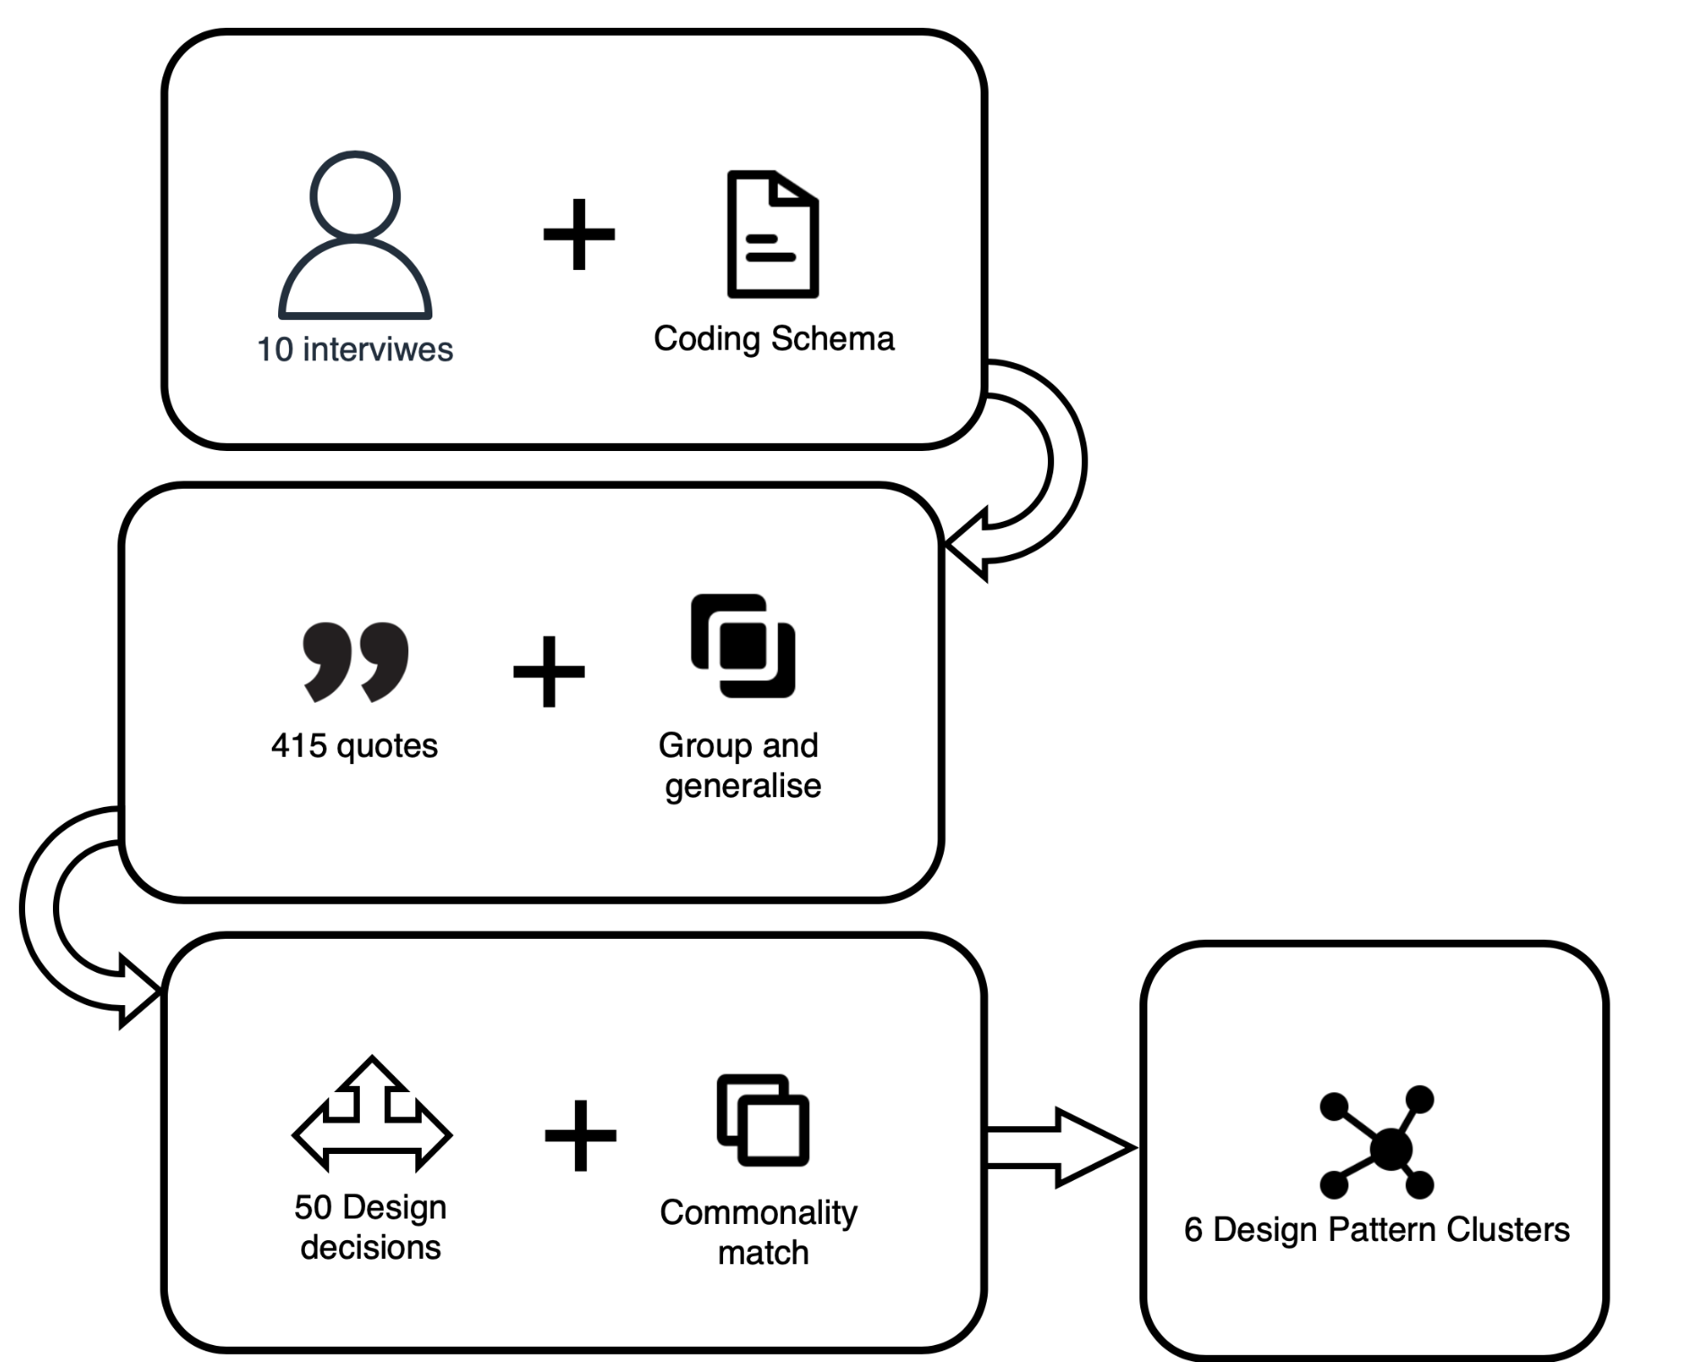
Results - Design Patterns
Notes:
On this slide you can see the overview of the stages and the workflow
The interviews were coded using a developed coding schema becoming 415 quotes which were then grouped and generalised into 50 design decisions and once matched with each other resulted in 15 design patterns.

Slide 15
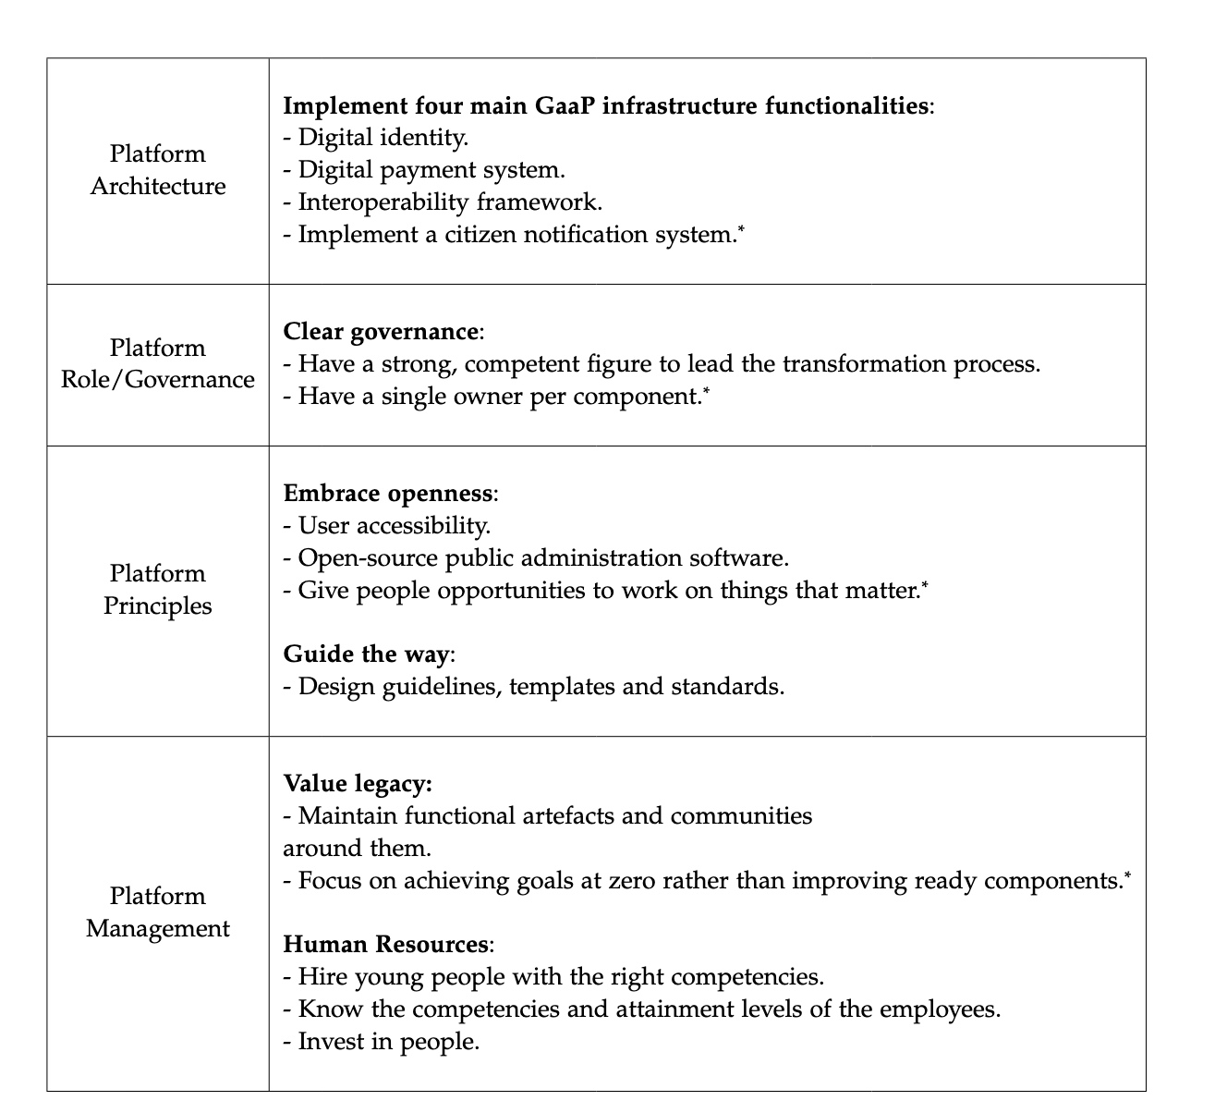
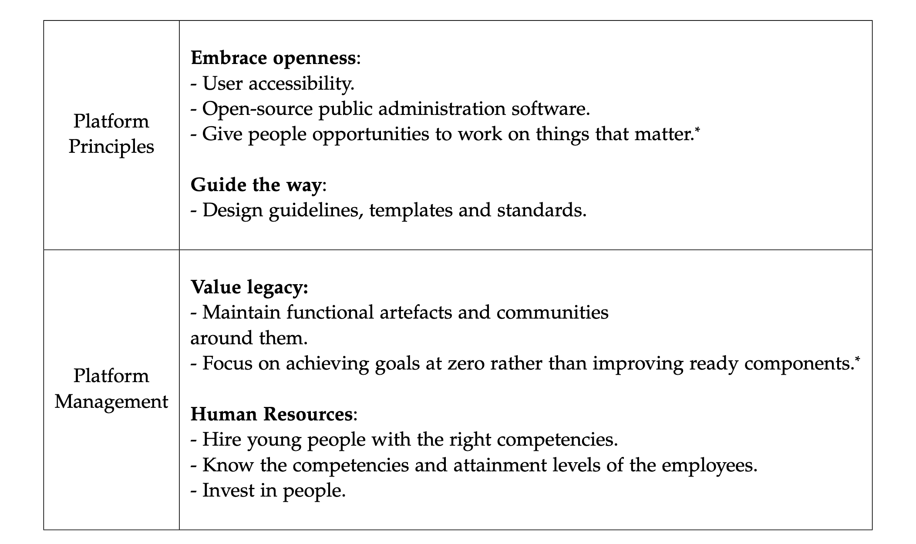
Results - REPLICATE?
Notes:
So . any type of visual representation harnesses visual perception.
In our brain visual processing takes up to 50% of the total activity and
the visual setting is generally comprehended in 1/10th of a second.
In fact, visualising time series turns data into a form mild for understanding and analysing, by
by bringing the trends to the foreground.
Moreover, visualising time dependent data is substantially used everywhere.
1

Slide 16
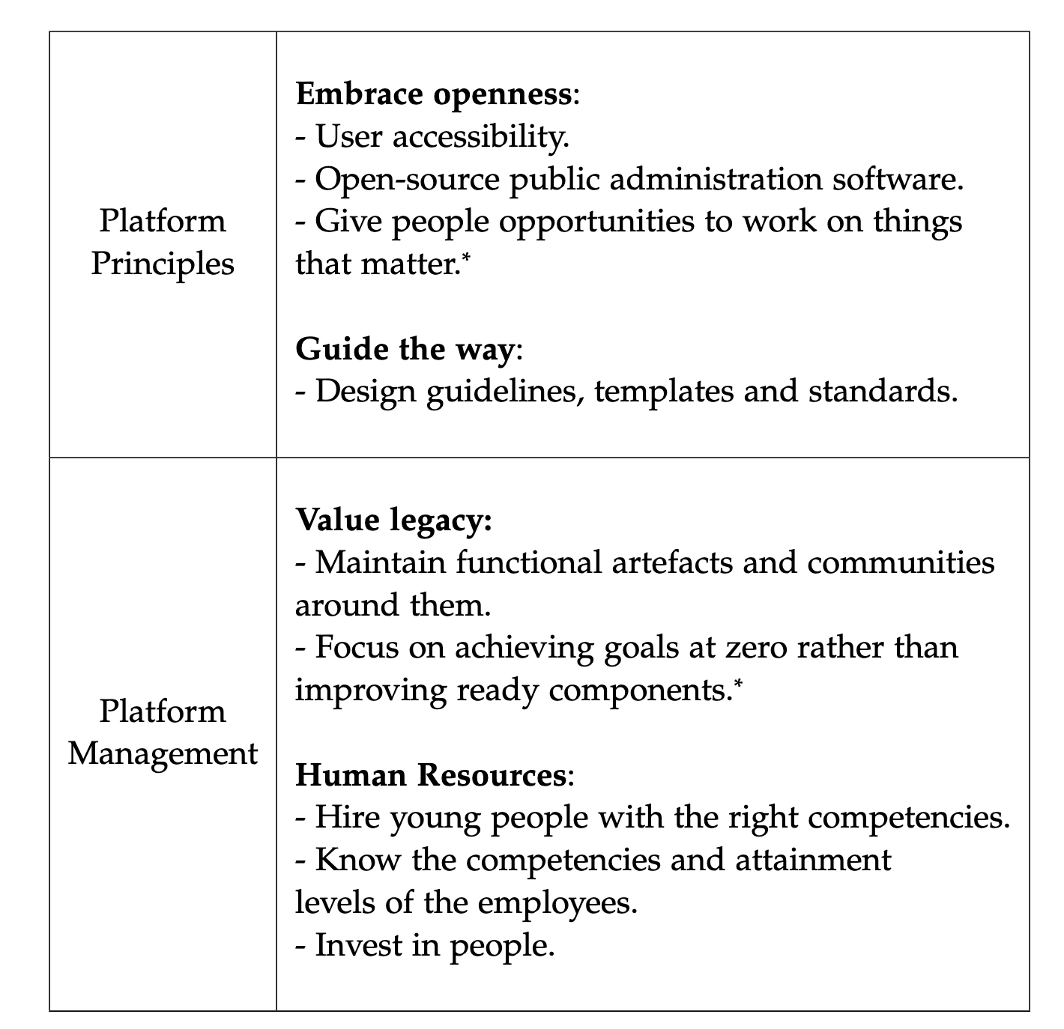
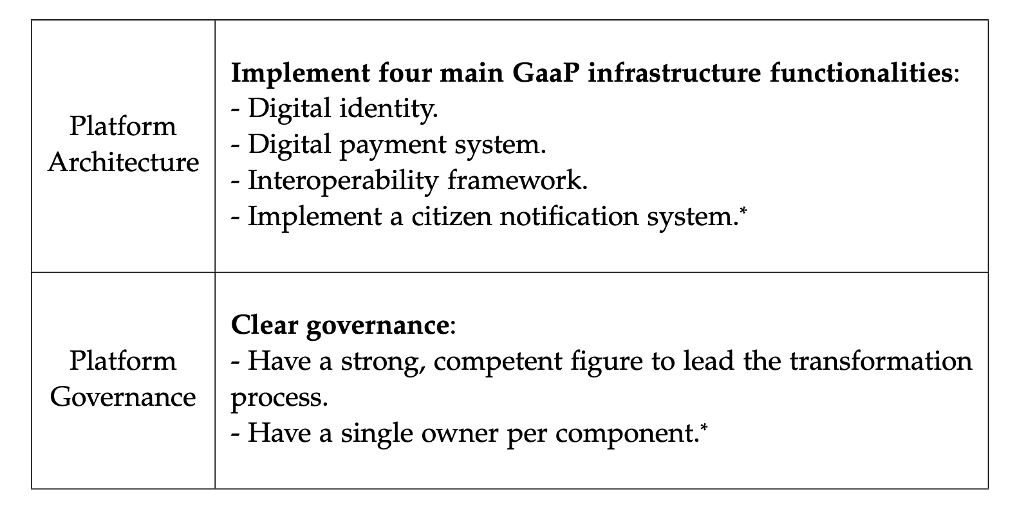
Results - Design Patterns
Notes:
On this slide you can see resulting design patterns against corresponding dimensions groupped into 6 clusters.
According to our findings, one should *Name clusters in a verbal way*
.. and handle human resources, particularly: *patterns*

Slide 17
Results - REPLICATE?
Dive into one of the dimensions
Provide quotes leading to results
TODO — putting a diagram together on Thursday will show then.
Notes:
So . any type of visual representation harnesses visual perception.
In our brain visual processing takes up to 50% of the total activity and
the visual setting is generally comprehended in 1/10th of a second.
In fact, visualising time series turns data into a form mild for understanding and analysing, by
by bringing the trends to the foreground.
Moreover, visualising time dependent data is substantially used everywhere.
1

Slide 18
Results - Example
    Dimension: Platform Governance
      Clear Governance — “Have a strong, competent figure to lead the tranformation process.”
    Quotes:
      “The center has a particular minister who's often third in power in Parliament or in the ruling party behind the Prime Minister in the Deputy Prime Minister. And his job was to make sure everybody complied. He did that through the force of his own personality.” — 01-GB
      “Because everybody puts their own agenda first, and it doesn't mean that central initiatives often aren't successful because they need to be winners and losers in all these transformations and
      it's quite hard to achieve that without the use of the Prime Minister.” — 01-GB
      “Really by muscle rather than rules.” — 01-GB
      “You do need leadership. I think the combination of my leadership and our minister was noted.” — 02-GB
      ”We established a digital commission and we called Diego Piacentini to run it. So he had to overcome resistance by various administrations.” — 04-IT
Notes:
I’ll quickly provide an example of the decision making
Dimension Platform Governance
Design Pattern cluster — Clear Governance
Design Pattern — have a strong, competent figure to lead the transformation process.
Here we see several quotes, all sharing the idea of necessary leadershing.
For example, in the UK it was a minister in a collaboration with the head of GOV UK.
In Italy they called Diego Piacentini who brought his experience from the private sector, namely Amazon, where he held a position of a Senior Vice President of the International Consumer Business to the public sector.
Estonia’s former prime minister was also pushing digitalisaion back in the days.

Slide 19
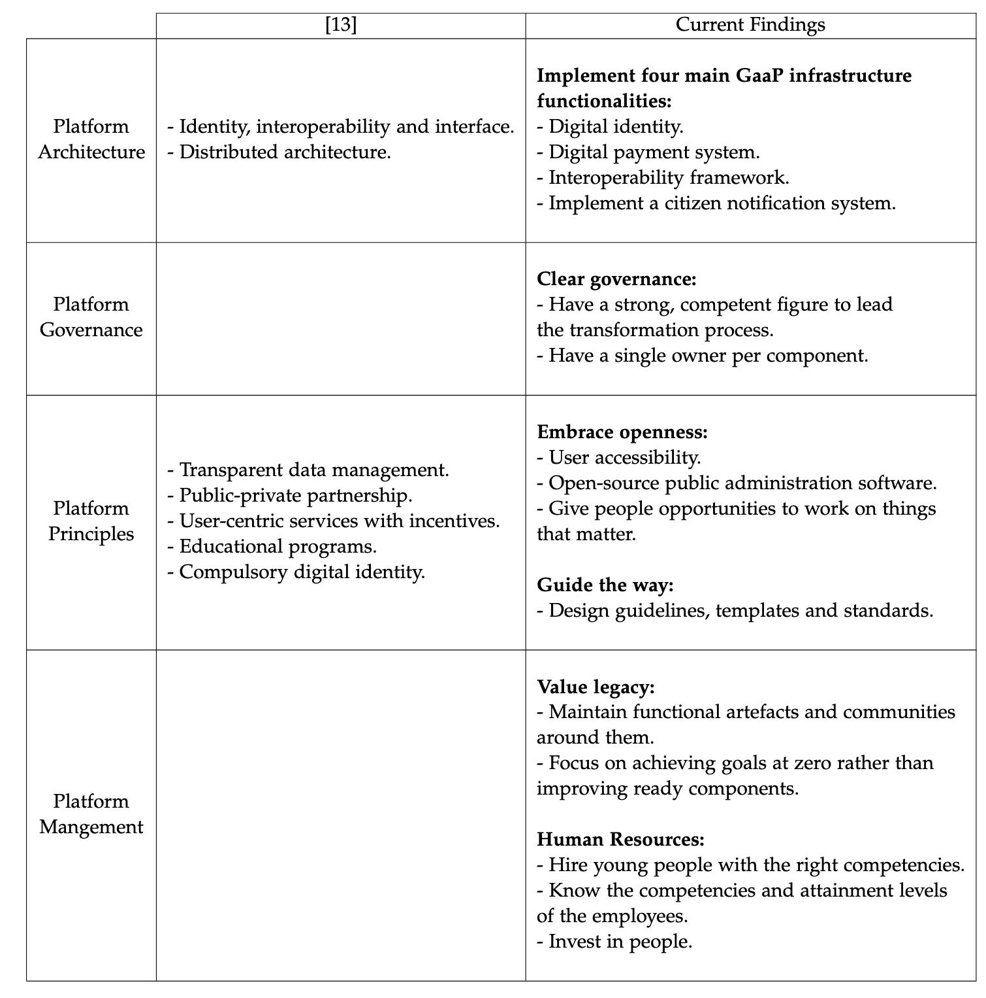
Discussion - Comparison with v1
First iteration (Poliarus) [13]
Second iteration (Voitsekhivskyi)
Notes:
Based on the first round of interviews and findings we managed to reconfirm some patterns and extend an existing set with new patterns and also better structure them.

Slide 20
Discussion - Comparison with v1
First iteration (Poliarus) [13]
Second iteration (Voitsekhivskyi)

Slide 21
Discussion
    Are the findings actual design patterns?
    Observed cases:
      Few cases examined.
      Differences in culture, politics, and societal values.
      Importance of context and peculiarities when solving a problem.
      Difficult to draw universal conclusions.
    Suggestions:
      Unique characteristics and contexts should be considered.
      Consider a more suitable term.
Notes:
- Design theories
- Reference decisions

Slide 22
Conclusion
    Summary:
      6 design pattern clusters.
      More refined, comprehensive patterns.
      Mutual opinions collected.
      More systematic and evidence-based understanding of GaaP.
    Limitations:
      Few cases.
      What is a suitalbe criteria for commonalites.
      Incomplete coverage of aspects.
    Future work:
      More cases.
      Seek more generalised patterns.
      Procedures on applying the patterns.
      Suitability assessment of solutions.

Slide 23
References
Kuhn, Peter, et al. "Barriers of applying Government as a Platform in Practice: Evidence from Germany." Proceedings of the 55th Hawaii International Conference on System Sciences. 2022.
https://happytowander.com/kvr-munich-survival-guide/
Vasilisa Poliarus, “Identification of Design Principles for Platform Engineering in the Public Sector” (2022)
https://www.gov.uk/pay-council-tax
https://developers.italia.it/
T. O’Reilly. “Government as a Platform”. In: Innovations: Technology, Governance, Globalization 6.1 (2011), pp. 13–40.
P. Kuhn, S. Dallner, M. Buchinger, and D. Balta. “Towards “Government as a Platform”: An analysis framework for public sector infrastructure”. In: (2022).
T. Elston and M. MacCarthaigh. “Sharing services, saving money? Five risks to cost-saving when organizations share services”. In: Public Money & Management 36.5 (2016), pp. 349–356.
H. Seo and S. Myeong. “The priority of factors of building government as a platform with analytic hierarchy process analysis”. In: Sustainability 12.14 (2020), p. 5615.
B. Bender and M. Heine. “Government as a Platform? Constitutive Elements of Public Service Platforms”. In: International Conference on Electronic Government and the Information Systems Perspective. Springer. 2021, pp. 3–20.
H. Seo and S. Myeong. “Determinant factors for adoption of government as a platform in South Korea: Mediating effects on the perception of intelligent information technology”. In: Sustainability 13.18 (2021), p. 10464.
G. Jeannot. “Life and death of “government as a platform” in France”. In: Revue francaise dadministration publique 173.1 (2020), pp. 165–179.
J. W. Creswell and J. D. Creswell. Research design: Qualitative, quantitative, and mixed methods approaches. Sage publications, 2017.
S. Buckl, F. Matthes, and C. M. Schweda. “Utilizing patterns in developing design theories”. In: (2010).

Slide 24
References — CLEAN UP ONCE DONE
1. Kuhn, Peter, et al. "Barriers of applying Government as a Platform in Practice: Evidence from Germany." Proceedings of the 55th Hawaii International Conference on System Sciences. 2022.
Kuhn, Peter; Dallner, Simon; Buchinger, Matthias; and Balta, Dian, "Towards “Government as a Platform”: An analysis framework for public sector infrastructure" (2022). Wirtschaftsinformatik 2022 Proceedings. 4.
3. Vasilisa Poliarus, “Identification of Design Principles for Platform Engineering in the Public Sector” (2022)
8. https://happytowander.com/kvr-munich-survival-guide/
9. https://developers.italia.it/
10. https://www.gov.uk/pay-council-tax

Slide 25
References
12. B. Bender and M. Heine. “Government as a Platform? Constitutive Elements of Public Service Platforms”. In: International Conference on Electronic Government and the Information Systems Perspective. Springer. 2021, pp. 3–20.
13. H. Seo and S. Myeong. “Determinant factors for adoption of government as a platform in South Korea: Mediating effects on the perception of intelligent information technology”. In: Sustainability 13.18 (2021), p. 10464.
14. G. Jeannot. “Life and death of “government as a platform” in France”. In: Revue francaise dadministration publique 173.1 (2020), pp. 165–179.

