Slide 1
Identification of a minimal set of interaction patterns to support a service-oriented manufacturing IT landscape
Sandro Stürzenhofecker | October 10th, 2022 | Final Presentation

Slide 2
Outline
Introduction
Objective & Research Questions
Methodology
Interaction Dimensions & Characteristics
Suitable set of interaction patterns
Minimal set of interaction patterns
Exemplary application
Conclusion

Slide 3

Introduction: Arising challenges of the silo-based manufacturing IT
Enterprise IT platform
Enterprise
control level
ERP
Silo manufacturing site A
Silo manufacturing site B
Heterogenous application landscape
  Redundant development and maintenance resources
  Challenging to introduce standards across silos
Interoperability across silo borders
  Increases complexity due to spaghetti connections
Manufacturing IT
Manufacturing IT
Manufacturing
control level
Service
Service
Manufacturing OT
Manufacturing OT
Manufacturing
level
Machine
Machine
Silo-based architecture [1]
Levels are introduced by [2]

Slide 4

Introduction: Platformization and the Integration Framework
Enterprise IT platform
Enterprise IT platform
Enterprise
control level
Enterprise
control level
ERP
ERP
Silo manufacturing site A
Silo manufacturing site B
Global Manufacturing IT platform
Manufacturing IT
Manufacturing IT
Service
Global
Communication Bus
Service
Manufacturing
control level
Manufacturing
control level
How to interact in the new architecture?
Service
Service
Local manufacturing site A
site B
Local Manufacturing IT
Service
Service
Service
Local
Communication Bus
A
Local
Communication Bus
Manufacturing OT
Manufacturing OT
Manufacturing OT
B
Manufacturing
level
Manufacturing
level
Machine
Machine
Machine
Machine
Machine
Platform-oriented architecture [3]
Integration Framework introduced by [4]

Slide 5
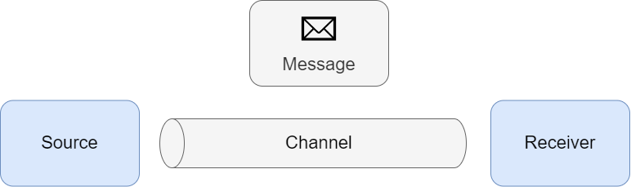
Introduction: Interaction
System interaction between totally automated systems [5]
One-way, bidirectional or multi-directional, direct or indirect, or instantaneous or continuous exchange of messages [5]
Interaction components:
Exchanged information
Information provider
Information receiver
Information flow path
SMCR model of Berlo [6]
Adaption of bigger picture of EIPs [7]

Slide 6
Introduction: Required Interaction Types
Enterprise IT platform
Services requiring interactions
Data management services
Decision-making services
Analytical services
Enterprise
control level
ERP
Global Manufacturing IT platform
Service
Global
Communication Bus
Service
Manufacturing
control level
Local manufacturing site A
Required Interaction Types
Interactions between machines and services
Interactions between services
Interactions between ERP and services
site B
Local Manufacturing IT
Service
Service
Service
Local
Communication Bus
A
Local
Communication Bus
Manufacturing OT
B
Manufacturing
level
Machine
Machine
Machine
Services of the manufacturing control level are introduced by [8]

Slide 7

Objective & Research Questions
Goal: Development of a framework that facilitates the application of standardized interactions within the platform-oriented manufacturing IT, and its periphery
RQ1: What are the types of interactions to fulfill the use cases of a manufacturing IT platform of a high-tech electronics manufacturer?
RQ2: What is a suitable set of interaction patterns for a manufacturing IT platform?
RQ3: What is a minimal set of interaction patterns to satisfy the demand of the given use cases?

Slide 8
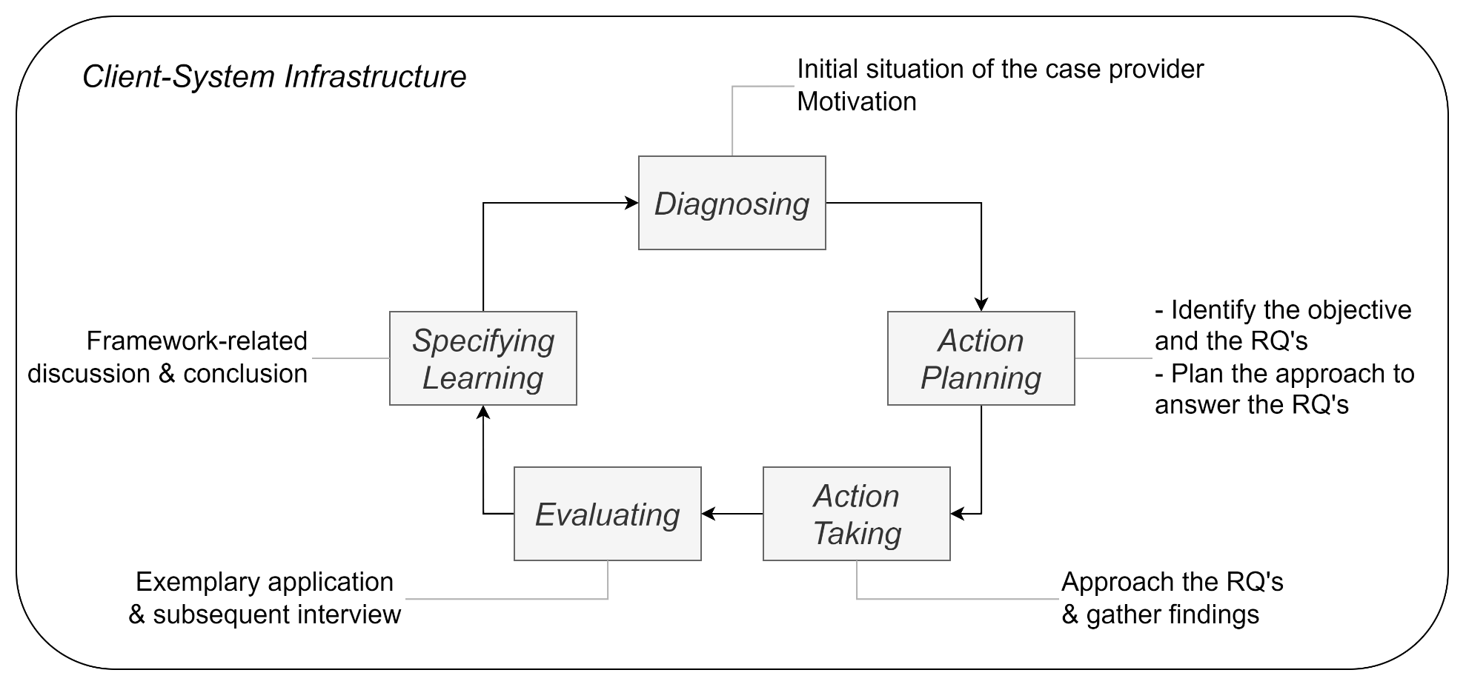
Methodology
Action Plan
Research Question 1
2 Workshops
Focus group discussion
2 Semi-structured interviews
Research Question 2
3 Focus group discussions
Research Question 3
Workshop
2 Semi-structured interviews
Action Research Cycle [9]

Slide 9
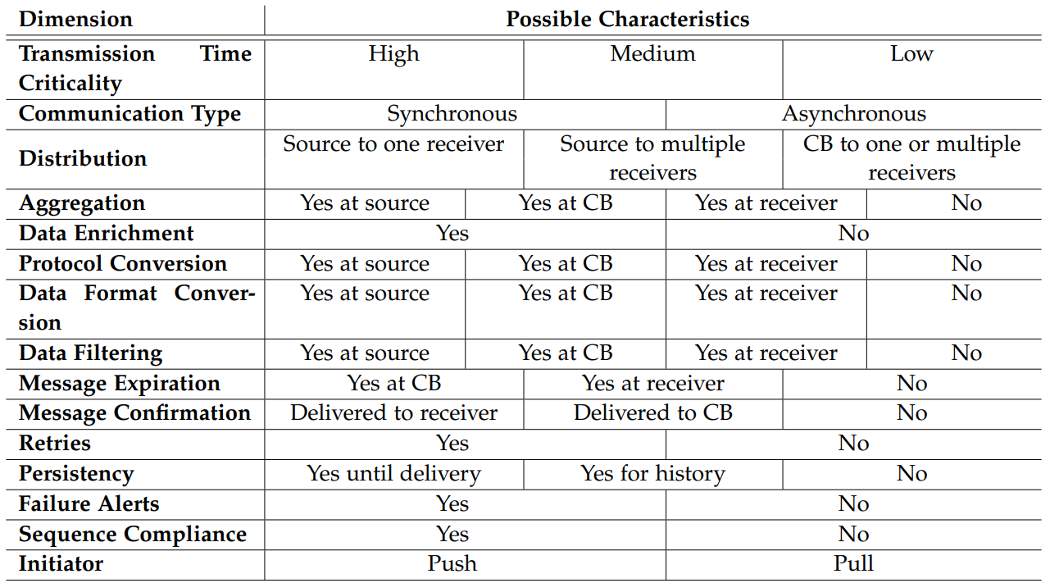
Interaction Dimensions & Characteristics
Metadata Dimensions
Dimensions related to interaction properties
Interaction Type
Source-Receiver-Combination (SRC)
Channel (Path the information
flows through the architecture)
Many dimensions relate to EIPs introduced by [7]

Slide 10
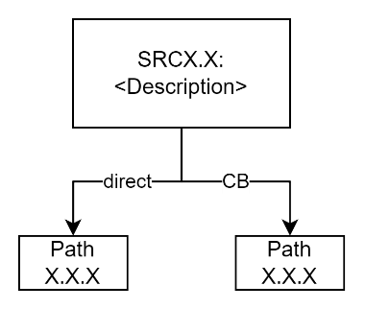
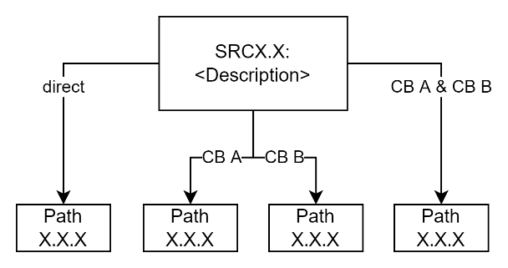
Suitable set of interaction patterns: Logical Possibilities
Interaction within a network zone
Enterprise IT platform
Enterprise
control level
ERP
Global Manufacturing IT platform
Service
Global
Communication Bus
Service
Manufacturing
control level
Local manufacturing site A
site B
Local Manufacturing IT
Interaction across network zones
Service
Service
Service
Local
Communication Bus
A
Local
Communication Bus
Manufacturing OT
B
Manufacturing
level
Machine
Machine
Machine

Slide 11
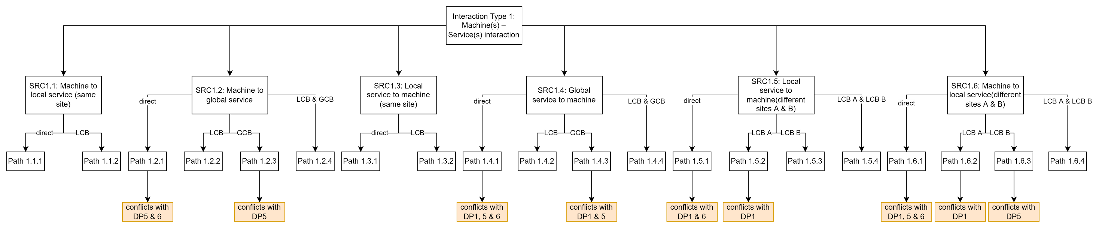
Suitable set of interaction patterns: Determine suitability
6 Design Principles were defined
48 Logical possibilities were checked for compliance → 21 conflicts detected
Exemplary result of Interaction Type 1:

Slide 12
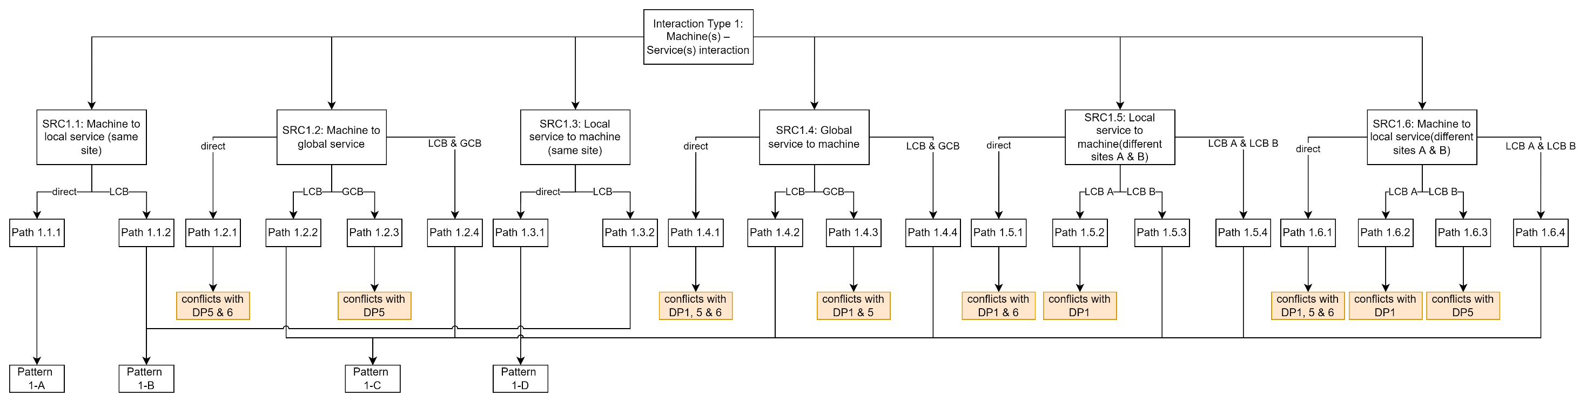
Minimal set of interaction patterns: Minimization
Consolidation was performed based on the characteristic classifications
Suitable set of 27 interaction patterns is minimized to 8
Exemplary result of Interaction Type 1:

Slide 13
Minimal set of interaction patterns: Resulting Set
Pattern Id | Pattern Name
1-A | Direct machine to service interaction
1-B | Indirect interaction between service and machine within a network zone
1-C | Indirect interaction between service and machine across network zones
1-D | Direct service to machine interaction
2-A | Direct interaction between services within a network zone
2-B | Indirect interaction between services within a network zone
2-C | Interaction between services across network zones
3-A | Interaction between service and ERP

Slide 14
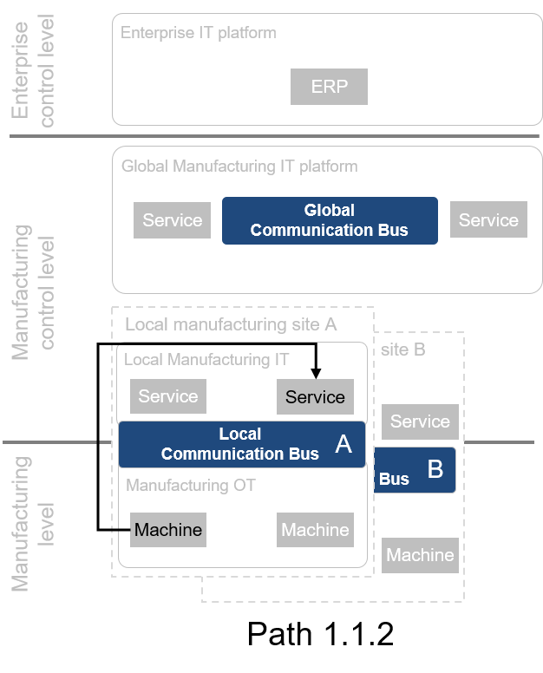
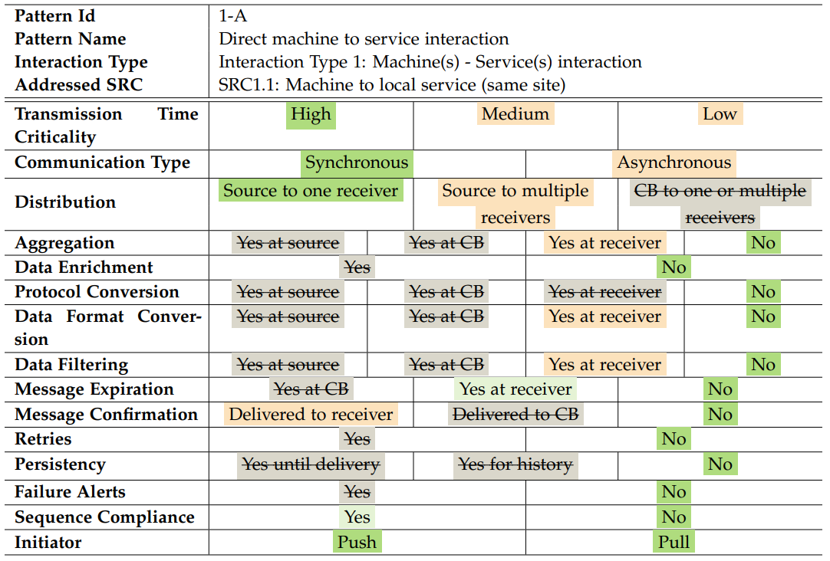
Minimal set of interaction patterns: Exemplary Pattern 1-A
Legend
Standard Case
Deviation with no downsides
Deviation with downsides
Permitted deviation
Path 1.1.1

Slide 15
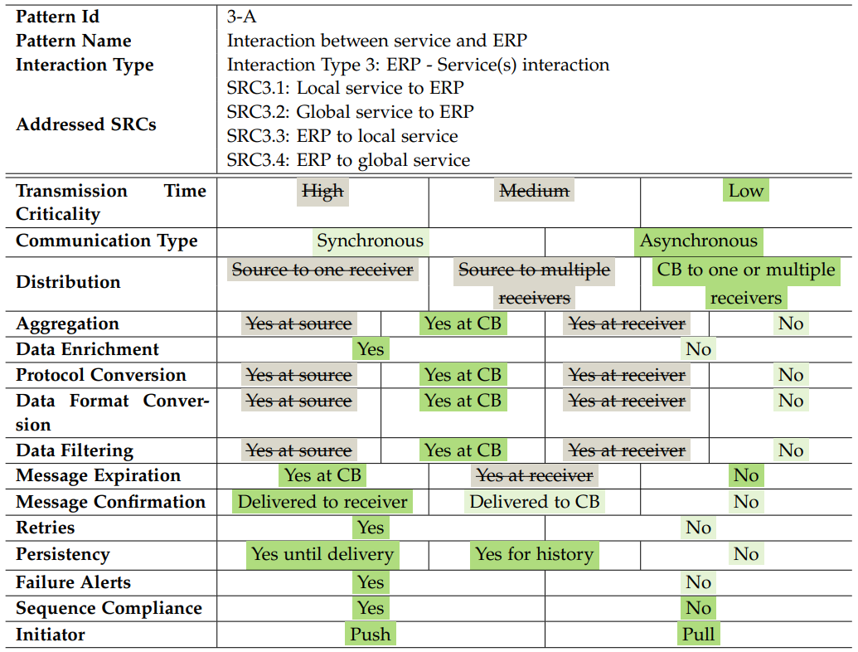
Exemplary Application: First interaction use case
Legend
Standard Case
Deviation with no downsides
Deviation with downsides
Permitted deviation
ERP
Interaction Pattern based on the classification tree:
Enterprise
control level
production
jobs
Master
Computer
Local Service
Manufacturing
control level
status
updates
Punching
Machine
Manufacturing
level
→ Pattern 3-A matches the use case

Slide 16
Exemplary Application: Second interaction use case
Legend
Standard Case
Deviation with no downsides
Deviation with downsides
Permitted deviation
ERP
Interaction Pattern alternative 1 based on the classification tree:
Enterprise
control level
production
jobs
Master
Computer
Local Service
Manufacturing
control level
status
updates
Punching
Machine
Manufacturing
level
→ Pattern 1-A does not match the use case

Slide 17
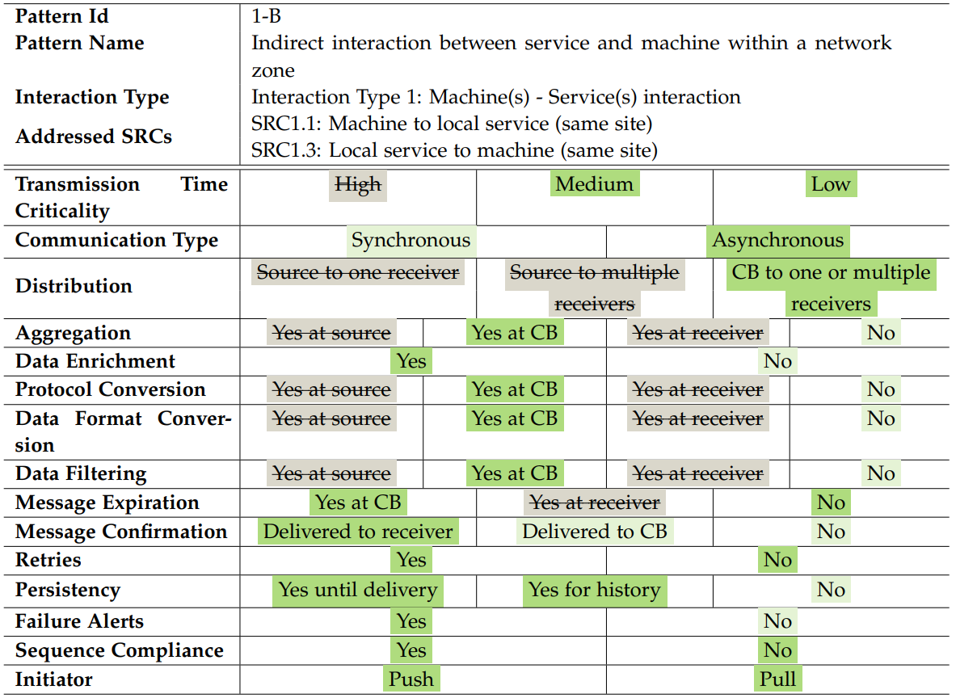
Exemplary Application: Second interaction use case
Legend
Standard Case
Deviation with no downsides
Deviation with downsides
Permitted deviation
ERP
Interaction Pattern alternative 2 based on the classification tree:
Enterprise
control level
production
jobs
Master
Computer
Local Service
Manufacturing
control level
status
updates
Punching
Machine
Manufacturing
level
→ Pattern 1-B matches the use case
Occurred issue:
Expiration based on more recent message is not covered

Slide 18


Exemplary Application: Findings
Characteristic classifications of the interaction patterns match with the use cases
Interaction patterns require familiarization
Classification trees illustrate the bigger picture and are perceived as useful
The dimensions do not cover all interactions in their entirety

Slide 19
Conclusion
Contribution to theory
Introduction of a framework that proposes standardized interactions for a platform-oriented manufacturing IT through interaction patterns
Propose a decentralized approach to interact within the integration framework of a platform-oriented architecture that may increase its stability
Contribution to practice
Provide a framework that facilitates applying standardized interactions in a platform-oriented manufacturing IT

Slide 20



Conclusion
Limitations
Future Work
User-friendliness
Improve through further cycles
Considered dimensions
Generalize findings
Theoretical evaluation
Single case problem
Evaluate the integration framework approach

Slide 21
Sandro Stürzenhofecker
Bachelor’s Student Informatics
17132
s.stuerzenhofecker@tum.de

Slide 22
References
  [1] F. Bannister, “Dismantling the silos: Extracting new value from it investments in public administration,” Information Systems Journal, vol. 11, no. 1, pp. 65–84, 2001. doi: 10.1046/j.1365-2575.2001.00094.x.
  [2] VDI-Fachbereich Informationstechnik, “Manufacturing execution systems (mes),” VDI-Gesellschaft Produkt- und Prozessgestaltung, 2016, VDI 5600 Blatt 1.
  [3] B. Bygstad and O. Hanseth, “Transforming digital infrastructures through platformization,” in ECIS, 2018.
  [4] B. Bygstad and O. Hanseth, “Governing e-health infrastructures: Dealing with tensions,” in ICIS, 2016.
  [5] S. Alter, “System interaction theory: Describing interactions between work systems,” Communications of the Association for Information Systems, vol. 42, no. 1, pp. 233–267, 2018. doi: 10.17705/1CAIS.04209
  [6] D. K. Berlo, The process of communication; an introduction to theory and practice. New York: Holt, Rinehart and Winston, 1960.
  [7] G. Hohpe and B. Woolf, Enterprise integration patterns: Designing, building, and deploying messaging solutions, 1st ed.: Addison-Wesley Professional, 2004.
  [8] H.-H. Wiendahl, A. Kluth, and R. Kipp, “Marktspiegel business software mes – fertigungssteuerung 2021/2022,” Fraunhofer-Institut für Produktionstechnik und Automatisierung, Tech. Rep., 2021.
  [9] G. I. Susman and R. D. Evered, “An assessment of the scientific merits of action research,” Administrative science quarterly, vol. 1, no. 1, pp. 582–603, 1978. doi: 10.2307/2392581.

Slide 23
Backup Slides

Slide 24
Detailed Action Plan
Index | Method | Participants | Duration | Date | Objective
RQ1
M1.1 | Workshop | 4 Solution Architects | 120 min | 30.05.2022 | 1: Brainstorm dimensions of an interaction 2: Separate in scope and out of scope dimensions
M1.2 | Workshop | Head of Solution Architects | 90 min | 01.06.2022 | Identification of dimension characteristics
M1.3 | Focus Group | 2 Solution Architects | 60 min | 24.06.2022 | 1: Validation of SRC’s 2: Validation of dimension characteristics
M1.4 | Interview semi-structured | Head of Solution Architects | 60 min | 27.06.2022 | #1 Identification of technical limitations between dimension characteristics
M1.5 | Interview semi-structured | Head of Solution Architects | 90 min | 01.07.2022 | #2 Identification of technical limitations between dimension characteristics
RQ2
M2.1 | Focus Group | Head of Solution Architects ESB expert | 60 min | 06.07.2022 | Identification of undesired information flow paths
M2.2 | Focus Group | 2 Solution Architects | 120 min | 15.07.2022 | Validation of DPs & information flow paths
M2.3 | Focus Group | 2 Solution Architects | 60 min | 03.08.2022 | Validation of DPs & information flow paths
RQ3
M3.1 | Workshop | 2 Solution Architects | 90 min | 27.07.2022 | Identification of generic classifications
M3.2 | Interview semi-structured | 1 Solution Architect | 60 min | 09.08.2022 | Validation of classifications
M3.3 | Interview semi-structured | Head of Solution Architects | 90 min | 10.08.2022 | Validation of classifications

Slide 25
Design Principles Overview
DP1 | LCB A serves as single point of entry to interact with a machine or service that is located in local manufacturing site A from outside of site A
DP2 | GCB serves as interface between the Enterprise IT level and the Manufacturing IT level
DP3 | Communication via CB is preferred over direct communication to isolate the communication logic from the business logic
DP4 | 1 CB is preferred over 2 CBs to minimize the amount of intermediates
DP5 | LCB A serves as interface between a service that is located outside of A and a machine that is located inside A
DP6 | No direct interaction across network borders

Slide 26
Design Principle 1
Enterprise IT platform
Enterprise
control level
ERP
LCB A serves as single point of entry to interact with a machine or service that is located in local manufacturing site A from outside of site A
Global Manufacturing IT platform
Service
Global
Communication Bus
Service
Manufacturing
control level
Local manufacturing site A
site B
Local Manufacturing IT
Service
Service
Service
Local
Communication Bus
A
Local
Communication Bus
Manufacturing OT
B
Manufacturing
level
Machine
Machine
Machine
Note: This principle only affects interactions across zones

Slide 27
Design Principle 2
Enterprise IT platform
Enterprise
control level
ERP
GCB serves as interface between the Enterprise IT level and the Manufacturing IT level
Global Manufacturing IT platform
Service
Global
Communication Bus
Service
Manufacturing
control level
Local manufacturing site A
site B
Local Manufacturing IT
Service
Service
Service
Local
Communication Bus
A
Local
Communication Bus
Manufacturing OT
B
Manufacturing
level
Machine
Machine
Machine

Slide 28
Design Principle 3
Enterprise IT platform
Enterprise
control level
ERP
Communication via CB is preferred over direct communication to isolate the communication logic from the business logic
Global Manufacturing IT platform
Service
Global
Communication Bus
Service
Manufacturing
control level
Local manufacturing site A
site B
Local Manufacturing IT
Service
Service
Service
Local
Communication Bus
A
Local
Communication Bus
Manufacturing OT
B
Manufacturing
level
Machine
Machine
Machine

Slide 29
Design Principle 4
Enterprise IT platform
Enterprise
control level
ERP
1 CB is preferred over 2 CBs to minimize the amount of intermediates
Global Manufacturing IT platform
Service
Global
Communication Bus
Service
Manufacturing
control level
Local manufacturing site A
site B
Local Manufacturing IT
Service
Service
Service
Local
Communication Bus
A
Local
Communication Bus
Manufacturing OT
B
Manufacturing
level
Machine
Machine
Machine

Slide 30
Design Principle 5
Enterprise IT platform
Enterprise
control level
ERP
LCB A serves as interface between a service that is located outside of A and a machine that is located inside A
Global Manufacturing IT platform
Service
Global
Communication Bus
Service
Manufacturing
control level
Local manufacturing site A
site B
Local Manufacturing IT
Service
Service
Service
Local
Communication Bus
A
Local
Communication Bus
Manufacturing OT
B
Manufacturing
level
Machine
Machine
Machine

Slide 31
Design Principle 6
Enterprise IT platform
Enterprise
control level
ERP
No direct interaction across network borders
Global Manufacturing IT platform
Service
Global
Communication Bus
Service
Manufacturing
control level
Local manufacturing site A
site B
Local Manufacturing IT
Service
Service
Service
Local
Communication Bus
A
Local
Communication Bus
Manufacturing OT
B
Manufacturing
level
Machine
Machine
Machine

Slide 32
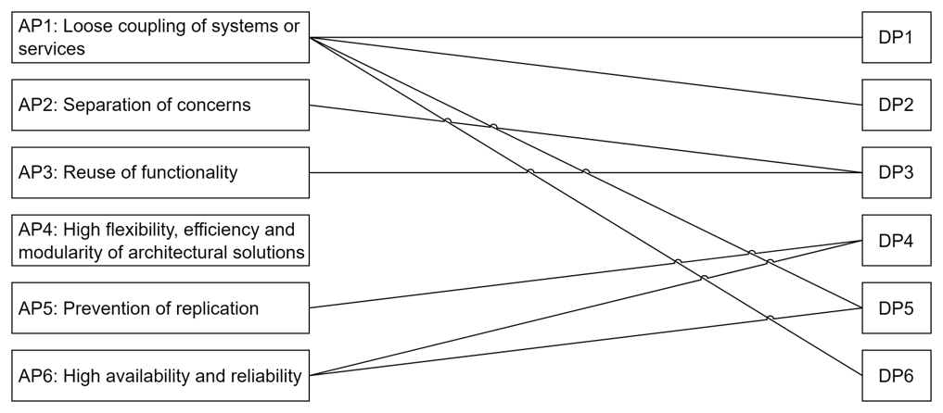
Mapping of Architecture Principles and Design Principles
LCB A serves as single point of entry to interact with a machine or service that is located in local manufacturing site A from outside of site A
GCB serves as interface between the Enterprise IT level and the Manufacturing IT level
Communication via CB is preferred over direct communication to isolate the communication logic from the business logic
1 CB is preferred over 2 CBs to minimize the amount of intermediates
LCB A serves as interface between a service that is located outside of A and a machine that is located inside A
No direct interaction across network borders

