Slide 1
A Study on Computer Aided Design Tools for Business Model Generation.
Eine Studie zur Softwareunterstützung von Geschäftsmodellentwicklung auf Grundlage des Business Model Canvas.

Slide 2
Research Questions
Which Software supports a Business Model generation using Business Model Canvas?
Does the BMC-Software offer creativity techniques? If so which?
How can the moderation and facilitation be expanded to ensure adequate assistance?
Notes:
Was sind probleme und was würden sie sich wünschen beim bmc (generell und software)

Slide 3
contents
Business Model Definition
Business Model Generation
Creative problem-solving technique
Software
further procedure

Slide 4
Business Model Definition
Timmers (1998)
>>an architecture for the product, service and information flows, including a description of the various business actors and their roles;
and a description of the potential benefits for the various business actors;
and a description of the sources of revenues.<<
Notes:
The first Definition of Business Model
Most cited

Slide 5
Business Model Definition
Osterwalder; Pigneur (2010)
>>A business model describes the rationale of how an organization creates, delivers,
and captures value. […]
The nine blocks cover the four main areas of a business:
customers, offer, infrastructure, and financial viability.<<
Notes:
shorter

Slide 6
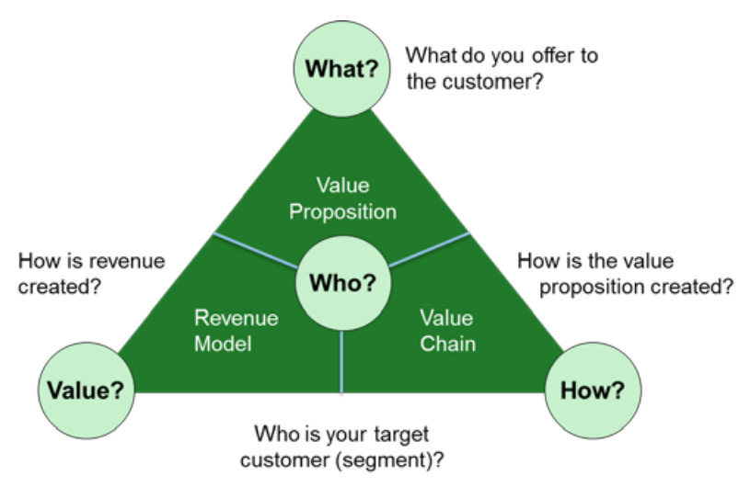
Business Model Generation
St. Galler Business Model Navigator

Slide 7



Business Model Generation
Who? customers
Customer Segments
Channels
Customer Relationships

Slide 8

Business Model Generation
What? offer
Value Proposition

Slide 9



Business Model Generation
How? infrastructure
Key Resources
Key Activities
Key Partnerships

Slide 10


Business Model Generation
Value? financial viability
Revenue Streams
Cost Structure

Slide 11
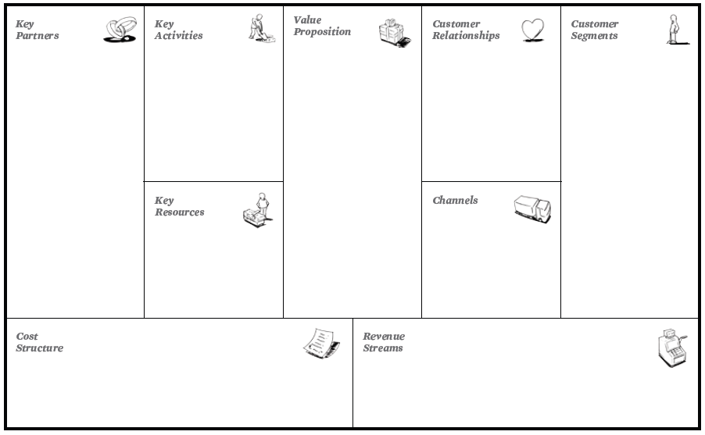
Business Model Generation
Business Model Canvas

Slide 12
Creative problem-solving technique
Overview
intuitive methods
discursive methods
combined
Notes:
Intuitive methods:
short time many Ideas
Quantative
Discursive methodes:
Prozess solving
Qualitative
Besser devergent und konvergent UND einzeln und Gruppe

Slide 13
Creative problem-solving technique examples
intuitive methods
Brainstorming
Brainwriting
Bionik
„Galleriemethode“
discursive methods
„Morphologischen Kasten“
„Relevanzbaumanalyse“
Combined
Denkhüte von De Bono
„Wertanalyse“
Notes:
Kreativitätsprozess nach basadur 1994
Heinz schuler yvonne görlich kreativität
2.5 kreativität als prozess

Slide 14



Software search
Google Suche
AppStore
PlayStore
15
4
2
→ Selection of the most different tools

Slide 15
further procedure testing
Within the lecture: Gründung und Führung kleiner softwareorientierter Unternehmen (IN9006)
3 tools will be tested by other studentgroups
Evaluation by a questionnaire

Slide 16
further procedure timeline
May – software search
June – select and cluster the software
July – testing the software
August – evaluate the software
September + October – write the thesis

Slide 17
Notes:
Fragebogen: was war die größte herrausforderung? Probleme stärken tool/methode

