Slide 1
Identification of Design Principles for Platform Engineering in the Public Sector
Bachelor’s Thesis Final Presentation
Vasilisa Poliarus, 13.09.2022

Slide 2
Agenda
Motivation
Resolution
Methodology
Results
Discussion
Conclusion

Slide 3




Motivation – GaaP as Promising Concept
Government as a Platform (GaaP): an open platform aiming to increase public value through collaboration of citizens and government [1].
Public value
User-friendly services
Efficient service delivery
Cost reduction

Slide 4
Motivation – Towards Platform-oriented Infrastrucutre
IT silo systems
Platfrom-oriented infrastructure
Component A1
Component B1
Periphery Component 1
Periphery Component 2
Periphery Component 3
Component A2
Component B2
Platformization
Boundary
Boundary Resources
Core
Core Component 1
Core Component 2
Component A3
Component B3
How to design?
(based on [2])
Barriers:
Application of GaaP in practice can be challenging [3]
Not enough information about how to successfully design platform in the public sector

Slide 5
Resolution – Learn from Successful Countries
Estonia
The UK
Italy
X-Road
eID
eesti.ee
GOV.UK
GOV.UK Pay
GOV.UK Verify
GOV.UK Notify
SPID
PagoPA
ANRP
IO app
→ Top 5 in EGDI [4]
→ Leading example
→ Top 10 in EGDI [4]
→ Early start
→ Significant progress
→ Three-Year Plan for DT in PA [5]
Lead by example [1] -> Learn from successful countries
Goal of the thesis: Develop design patterns for platform engineering in the public sector based on practical experience of successful GaaP countries.

Slide 6



Resolution - Research Questions
1
What are the dimensions of design decisions in applying GaaP in practice?
Coding concept
2
What are design decisions of countries that successfully apply GaaP?
Design decisions
3
Which design patterns can be derived from these decisions?
Design patterns

Slide 7


Methodology – Data Analysis
RQ1
RQ2
RQ3
Interviews
analysis
219 quotes
Rule of two
1
Coding concept
44
Design decisions
7
Design patterns
Apply coding schema on interviews
Analyze and structure design decisions
Literature
research
Rule of two:
Design decisions made by at least two of three analyzed countries are considered as valid design patterns

Slide 8
Methodology – Multiple Case Study
Interview participants:
Interview focus topics:
Country | Organization
Italy (8) | Digital Transformation Team
 | Department of Public Administration
 | Digital Transformation Ministry
 | AgID
 | Private
 | Council of Minister
 | Advisory Group on Advanced Technology
Estonia (6) | E-Governance Academy
 | Cybernetica
 | Cyber4Dev
 | E-Estonia
 | Government
UK (5) | Cabinet Office
 | Government Digital Service
 | Public Digital
GaaP definition and main constitutive elements
GaaP strategy and governance
GaaP public values and possible negative aspects [6]
19
semi-sctructured interviews

Slide 9
Results – Coding Concept
Different perspectives of GaaP → Content dimensions [3]
Different perspectives of design decision → Structural dimensions [7]
Content Dimension | Characteristics
Platform architecture | Platform core, boundary resources, ecosystem, components' connection and interaction
Platform roles | Platform owner, complementor, user
Platform openness | Openness, participation, co-creation
Platform management | Facilitation and orchestration, provision of tools, management of assets, ensuring public value
Structural Dimension | Description
Issue | Problem to be solved
Alternative | One of several options to address the issue
Justification | Reason for the choice or rejection of the corresponding alternative
Two-facets coding matrix

Slide 10
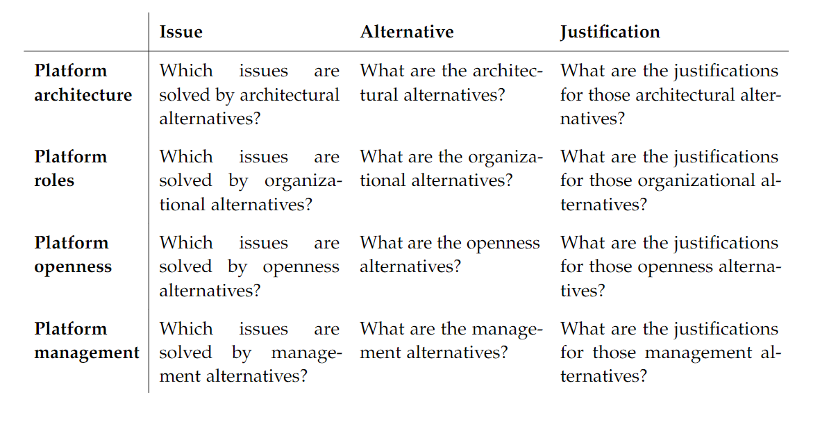
Results – Coding Concept
Structural dimensions
Content dimensions

Slide 11
Results – Coding Concept - Example
Citations from interviews:
Design decision structure
"There is a problem on how to engage members of the different sites like in this case of public services.“ (15-UK)
Low usage of public services
Issue | How to engage members of different sides to use digital public services?
Alternative | Collaborate with private sector and use it as a foundation to promote digital public services.
Justification | The services in the private sector are used on a daily basis and are more useful for ciitizens. It is easier then to integrate these services in public sector.
13-EE - "You have to find services useful for people. Our digital identity was created in collaboration with banks and telcos. So it was useful for them to invest in identity or identification to add trust." (13-EE)
Public-private partnership for promotion of public services
"Whereas the banks interact every week. For a government to roll out electronic ID is very difficult. Even if the overall impact is great, much greater than an individual bank, the government services are not used as much as the banking ones." (11-EE)
Content dimension: platform openness
Usefulness for citizens

Slide 12
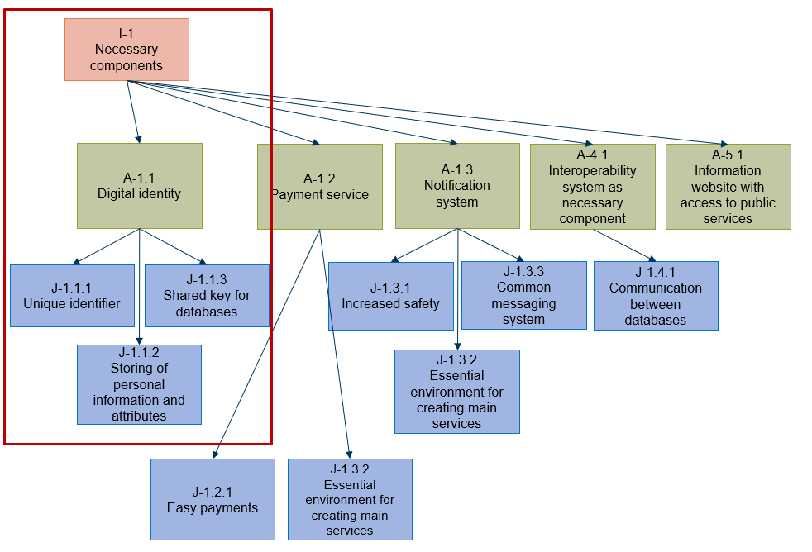
Results – Design Decisions
“What are the main platforms, understood also as core services of the your digital government, the basic fundamental ones?” (8-IT)
I-1
Necessary components
"We are enabled because we show up at an office with an ID, without that we can't do anything.“ (1-IT)
A-1.1
Digital identity
"The first is because it enables the creation of digital services.<…>when you identify yourself to the municipality, the database has as a key the identity card<…>” (8-IT)
J-1.1.1
Unique identifier
J-1.1.3
Shared key for databases
J-1.1.2
Storing of personal information and attributes

Slide 13
Results – Design Decisions
Content dimension | Design decisions
Platform architecture | Digital identity Payment service Interoperability system as necessary component | Notification system Common APIs and standards Distributed architecture for data management etc.
Platform roles | Special responsible person | Politicians‘ publicity in use of public services
Platform openness | Public-private partnership for the promotion of public services | Lower barriers for small and medium companies
Platform management | Project for digital inclusion Compulsory digital identity Options switch-off | Incentives User research and product tests Data privacy laws etc.
Miscellaneous | Easy services Mobile app Once-only principle | Free Internet access Useful services Trainings on data security etc.
Total:
44
Focus
dimensions:
Platform architecture,
Platform management

Slide 14
Results – Towards Design Patterns
Design decisions
Applied in
Incentives
Find incentives, soft ways to push people to using public services
Estonia, Italy
Generalization +
The rule of two
Design pattern
Easy services
Make services simple to use
Estonia, Italy
User-centric services with incentives
Make public services useful and simple for citizens, engage users in the designing process, and provide them incentives
Useful services
Make services useful for citizens
Estonia
User research and product tests
Develop public services using agile methodology for software development with tests and user researches
UK

Slide 15
Results – Design Patterns
Design pattern
Identity, interoperability and interface
Distributed architecture
Transparent data management
Public-private partnership
User-centric services with incentives
Educational programs
Compulsory digital identity
Platform architecture
3
Platform roles
0
44
7
Platform openness
1
Design decisions
Design patterns
Platform management
3
Miscellaneous
2

Slide 16
Results – Design Patterns - Example
Transparent data management
Context | Ensuring citizens’ data privacy and avoidance of full government control
Problem | Sensitive personal data of citizens is under the threat of unauthorized access and should be efficiently protected to avoid information leak or full government control.
Solution | Make operations with users' data transparent and guarantee citizens freedom of information
Dimensions | Platform management, platform architecture
Related design decisions | Transparency (Estonia) Data privacy laws (UK, Italy) Data tracker (Estonia)

Slide 17


Discussion – Towards Design Principles
Can the revealed design patterns be considered as valid design principles?
Supported by literature
Small number of examined cases
Worked in countries with different
geopolitical, economic, and population
characteristics
Limited evaluation criterion
On the global scale, Estonia, the UK,
and Italy are similar countries

Slide 18



Conclusion
Key Findings
Implementation of GaaP is multi-faceted
Focus areas: platform architecture, platform management
7 design patterns as starting point for platform engineering in the public sector
Limitations
Future Work
Small number of case studies
Not optimal evaluation criterion
On the global scale, surveyed countries are similar
Extend a variety of examined countries
Increase the number of case studies
Apply Coplien’s [8] rule of three for pattern validation

Slide 19
Vasilisa Poliarus
Bachelor’s Student Information Systems
17132
vasilisa.poliarus@tum.de

Slide 20
References
[1] T. O’Reilly. “Government as a Platform”. In: Innovations: Technology, Governance, Globalization 6.1 (2011), pp. 13–40.
[2] P. Kuhn, S. Dallner, M. Buchinger, and D. Balta. “Towards “Government as a Platform”: An analysis framework for public sector infrastructure”. (2022).
[3] P. Kuhn, M. Buchinger, D. Balta, and F. Matthes. “Barriers of applying Government as a Platform in Practice: Evidence from Germany”. In: Proceedings of the 55th Hawaii International Conference on System Sciences. (2022).
[4] U. N. D. F. Economic and S. A. DESA. “United Nations E-Government Survey 2020: Digital Government in the Decade of Action For Sustainable Development”. (2020).
[5] Battisti, Daniela. "The Digital Transformation of Italy’s Public Sector: Government Cannot Be Left Behind!." In: JeDEM-eJournal of eDemocracy and Open Government 12.1 (2020), pp. 25-39.
[6] L. Albanese and G. Bettoni. “An integrative framework to successfully implement the government as a platform model. A multiple case analysis”. (2021).
[7] C. Potts and G. Bruns. “Recording the reasons for design decisions”. In: ICSE. Vol. 88. (1988), pp. 418–427.
[8] J. Coplien. “Software Patterns: Management Briefs”. In: SIGS Pubns (1996).

Slide 21
Backup

Slide 22
Interview Data
Country | Interview ID | Organization | Role | Duration (min.)
Italy | 01-IT | Digital Transformation Team | Technical Project Manager | 63
 | 02-IT | Department of Public Administration | Director General | 101
 | 03-IT | Digital Transformation Ministry | Former Minister | 71
 | 04-IT | AgID | Project manager, Officer | 57
 | 05-IT | Digital Transformation Team | CTO | 43
 | 06-IT | Private | Expert in support of PA digitalization projects | 56
 | 07-IT | Digital Transformation Team, Council of Minister | Government Commissioner, Head of Digital Transition | 103
 | 08-IT | Advisory Group on Advanced Technology | Chairman | 120
Estonia | 09-EE | E-Governance Academy | Expert for legal aspects | 60
 | 10-EE | Cybernetica | Development Manager, Legal | 55
 | 11-EE | Cyber4Dev | Expert | 43
 | 12-EE | E-Estonia | Digital Adviser | 48
 | 13-EE | E-Governance Academy | Senior Consultant | 70
 | 14-EE | Government | Former Prime Minister | 24
UK | 15-UK | Cabinet Office | General Director, International Government Service and Digital Envoy | 26
 | 16-UK | Government Digital Service | Product Manager | 51
 | 17-UK | Government Digital Service | Executive Director | 27
 | 18-UK | Government Digital Service | Director at Cabinet Office | 48
 | 19-UK | Public Digital | Partner | 44

Slide 23
Content Dimensions
Dimension | Characteristics | Purpose
Platform elements | platform core, boundary resources, ecosystem | identify the software components of the infrastructure and map them into a platform structure
Platform roles | platform owner, complementor, user | identify the stakeholders of the infrastructure and map them to platform roles
Platform openness | openness, participation, co-creation | identify the infrastructure use cases and their implementation in order to map them to the levels of openness, participation, co-creation
Platform management | facilitation and orchestration, provision of tools, management of assets | identify the management activities of the infrastructure owner and map them to platform management categories
(Kuhn, 2022)

Slide 24
Structural Dimensions
Structural Dimension | Description | Purpose
Issue | Problem to be solved | Provides context of design options; enables better understanding of strategy
Alternative | One of several options to address the issue | Directly relates to the process of stakeholders' needs fulfillment
Justification | Reason for the choice or rejection of the corresponding alternative | Helps to track the explored issues and alternatives as well as their evaluations

Slide 25
Results – Design Decisions
19
44
53
Issues
Alternatives
Justifications

Slide 26
Identified Issues
ID | Issue Name | Country | # Alt.
1 | Necessary components | Estonia, UK, Italy | 5
2 | Connectivity among countries | Italy | 1
3 | Lack of digital transformation culture | Estonia, Italy | 1
4 | Fragmentary government | UK, Italy | 0
5 | Lack of competent employees in the public sector | UK, Italy | 1
6 | Interoperability of systems | Italy | 2
7 | Management of data | Estonia, Italy | 3
8 | Low usage of public services | Estonia, UK, Italy | 11
9 | Lack of communication of services to citizens | Italy | 1
10 | Resistance in using digital identity | Estonia, UK | 6
11 | Lack of skills among citizens | Estonia, Italy | 1
12 | Data privacy | Estonia, Italy | 5
13 | Data security | Estonia, Italy | 4
14 | Secure collaboration with the private sector | Estonia | 0
15 | Inefficient procurement mechanism | UK, Italy | 2
16 | Lack of proper governance of digital transformation | Italy | 0
17 | Lack of clear responsibility | Estonia, Italy | 1
18 | Hierarchy in internal organization | Italy | 0
19 | Inconsistent political leadership | UK | 0

Slide 27
Identified Design Decisions
Content dimension | Design decisions
Platform architecture | Digital identity Payment service Notification system Interoperability system as necessary component "Verify" system | Single national registry platform Common APIs and standards Interoperability system for data management Two digital identities Information website with access to public services | Digital marketplace Distributed architecture for data management Distributed architecture for data security Blockchain for data encryption Decentralized solutions
Platform roles | Special responsible person | Politicians‘ publicity in use of public services
Platform openness | Public-private partnership for the promotion of public services | Public-private partnership for the promotion of digital identity | Lower barriers for small and medium companies
Platform management | Project for digital inclusion Certification system with once-only principle Options switch-off | Incentives No value in paper User research and product tests | Compulsory digital identity Automatic provision of digital identity Cheap digital identity
Miscellanous | Development of a clear understanding of the need in digital transformation Adjustment of regulations within PA and attraction of young employees Guidelines for regulation of relationships between data providers Easy services | Mobile app Trainings on the use of public services Free Internet access Useful services Educational programs on digital literacy Data privacy laws | Transparency Once-only principle Data tracker Trainings on data security Building security in design

Slide 28
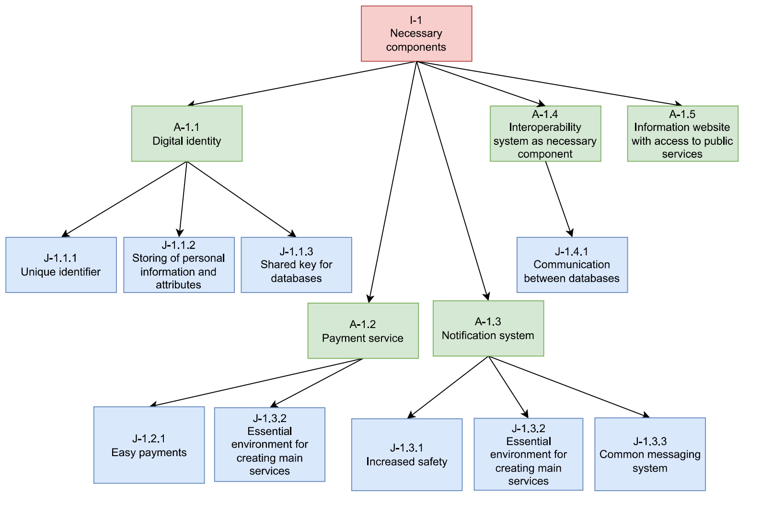
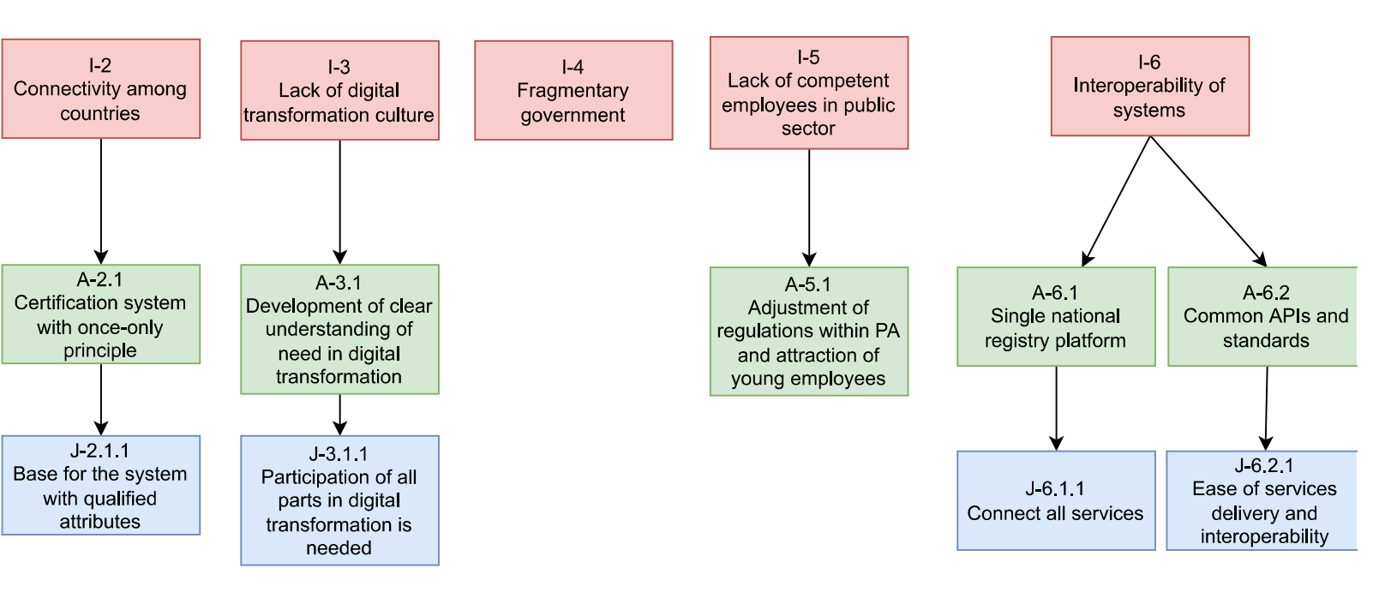
Design Decision Trees

Slide 29
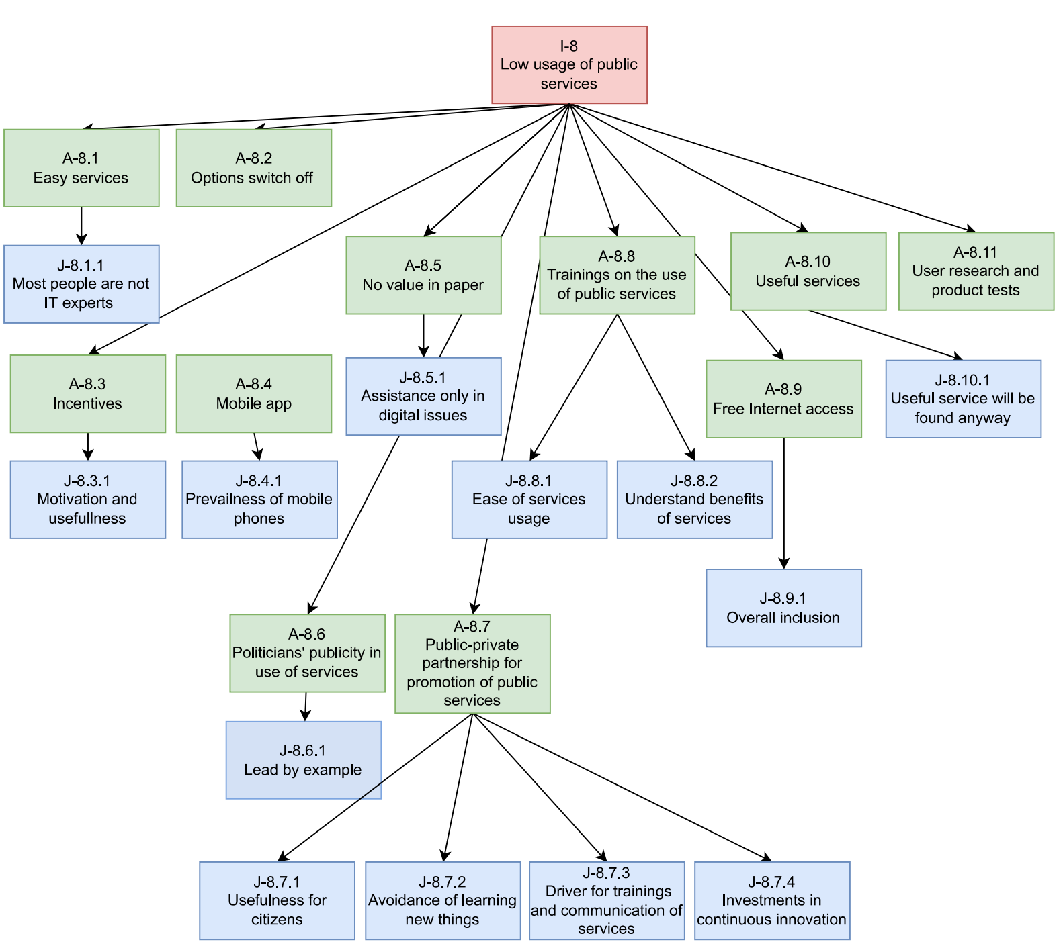
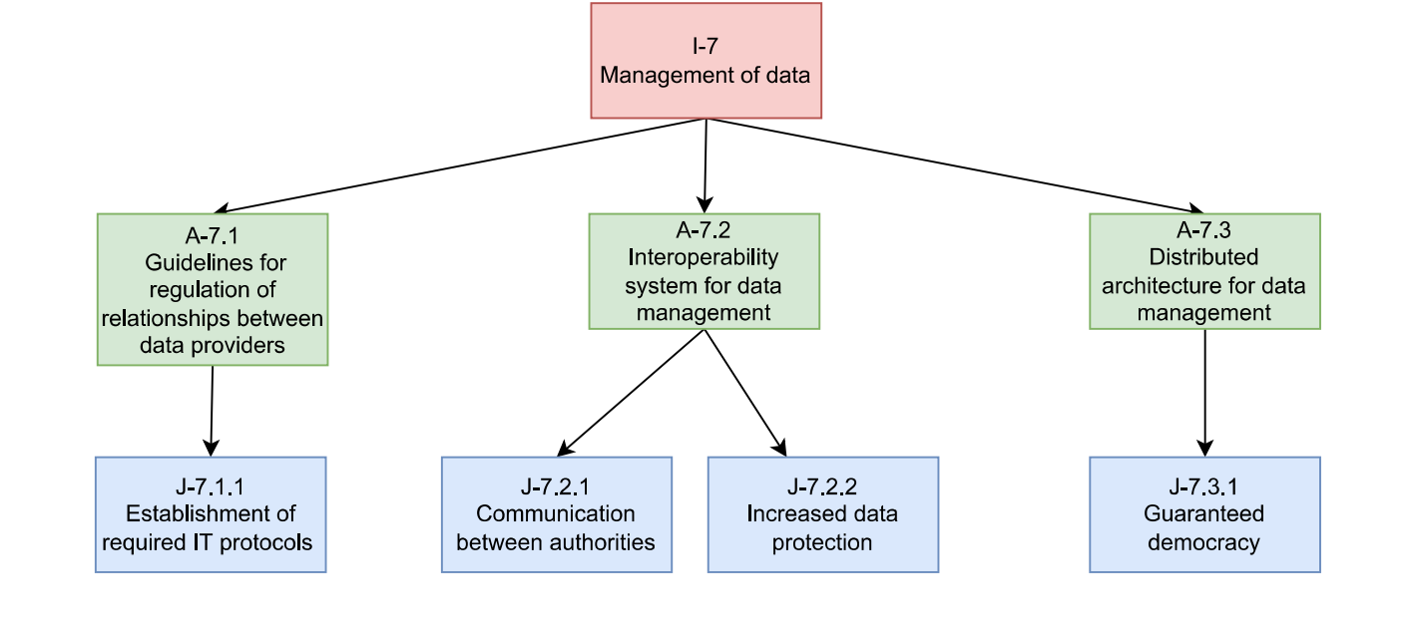
Design Decision Trees

Slide 30
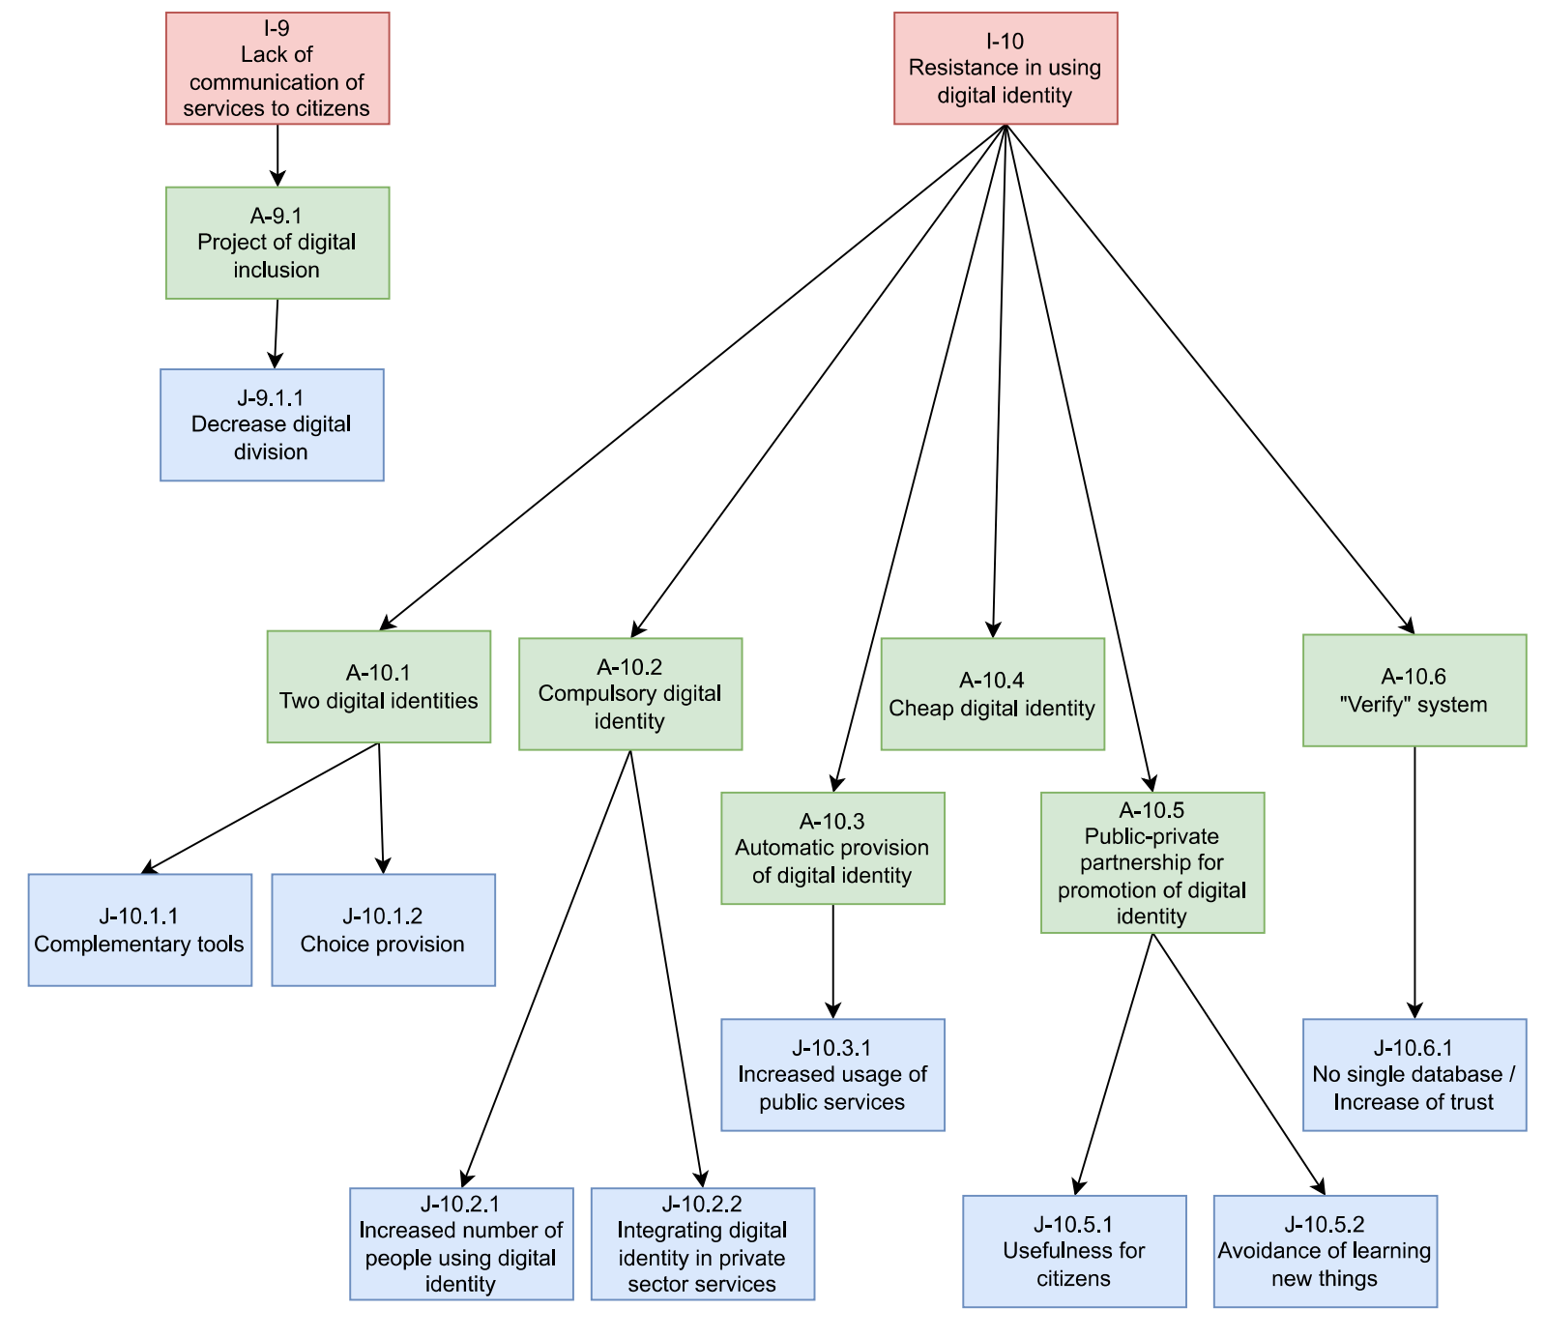
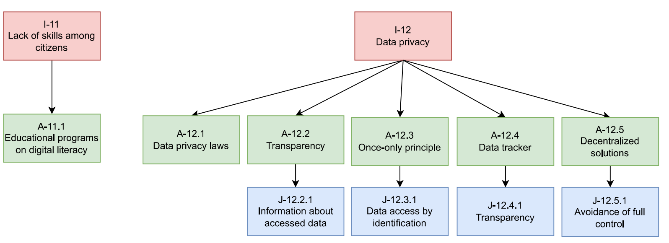
Design Decision Trees

Slide 31
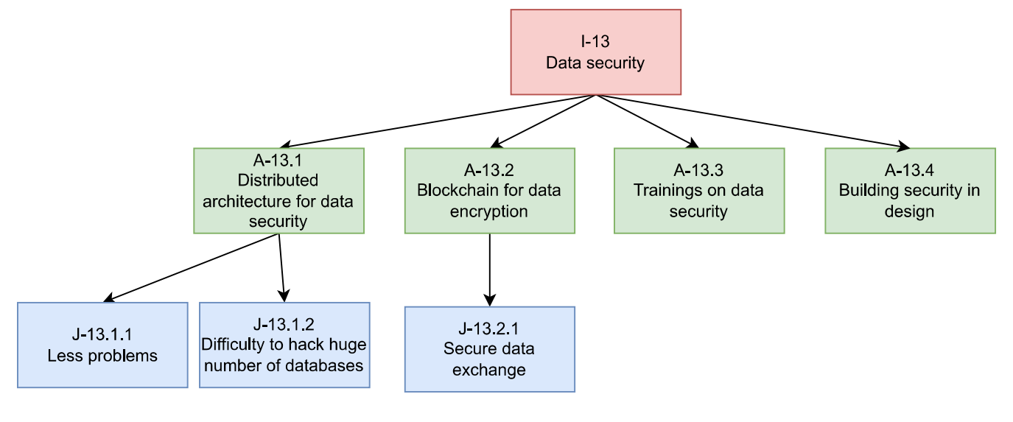
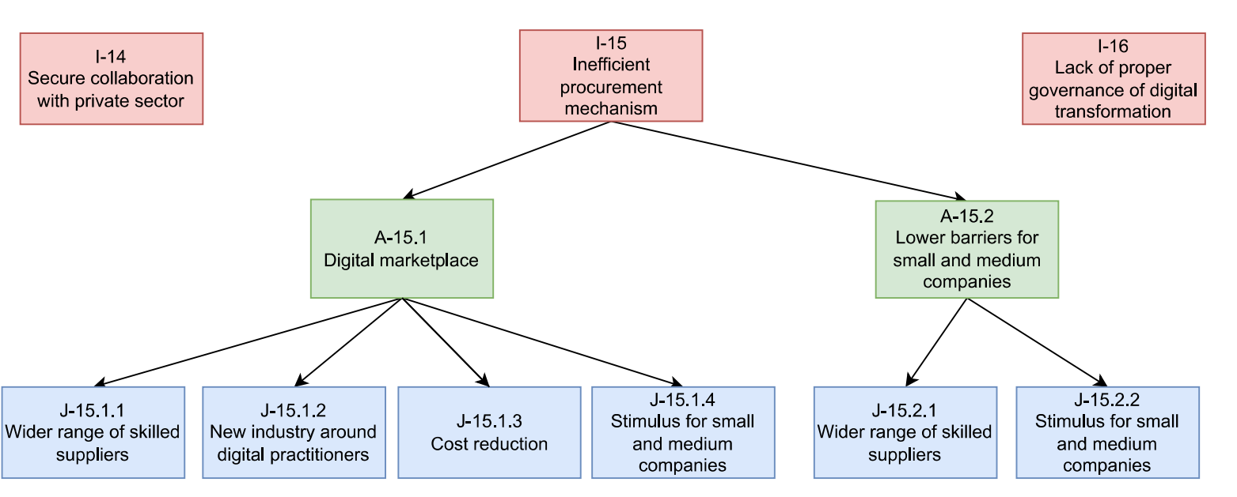
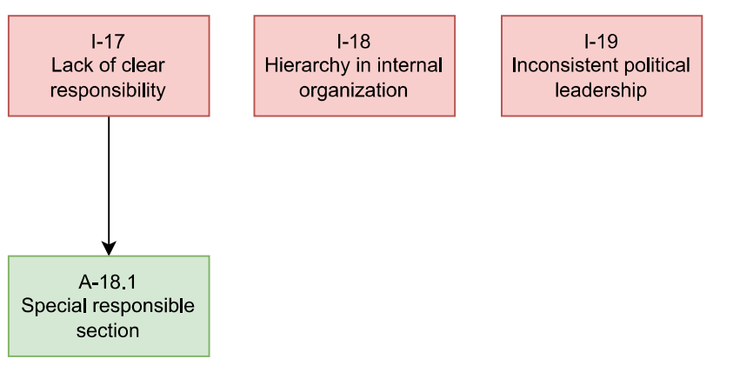
Design Decision Trees

Slide 32
Results – Design Patterns
1
Identity, interoperability, and interface
3
Transparent data management
Implement three essential components that form a good basis for GaaP
Make operations with users' data transparent and guarantee citizens freedom of information
2
Distributed architecture
4
Public-private partnership
Implement decentralized system with data distributed across different databases
Collaborate with private sector and use it as a foundation to promote digital public services

Slide 33
Results – Design Patterns
5
User-centric services with incentives
7
Compulsory digital identity
Make public services useful and simple for citizens, engage users in the designing process, and provide them incentives
Make digital identity compulsory for everyone
6
Educational programs
Organize free educational programs on the use of digital public services and general digital topics

