Slide 1
Investigating the Implementation of Metrics in Large-Scale Agile Development
Evgeni Kiradzhiyski, 12.04.2021, Guided Research - Final Presentation

Slide 2
Outline
Kick-off recap (Background and Motivation)
Research Methodology
Results
  Reasons for Using Metrics in Large-Scale Agile Development
  Challenges of Metrics Large-Scale Agile Development
  Advantages and Disadvantages of Metrics in Large-Scale Agile Development
Conclusion and Future Work

Slide 3
Background - Large-Scale Agile Software Development
Agile Software Development
Large-Scale Agile Software Development
Received great acceptance over the past decades [1, 2]
Encourages team collaboration and active customer involvement [1, 3]
Originally designed for small, co-located teams [1, 3]
The success of the agile methods has inspired organizations to apply these at large-scale projects [3, 4]
Notes:
Since the introduction of the agile manifesto, agile principle gained a lot of popularity with frameworks such as Scrum for example
Over the last two decades, agile methods have transformed and brought unique changes to software development
inspired by the success of those methods, they are applied to a large-scale projects as well;
he success
of the agile methods in software development field has inspired or-
ganizations and practitioners to apply these at large-scale projects

Slide 4
Motivation - Metrics
Metrics are used every day to understand, control and improve what and how we do something [5, 6]
Support management to act based on facts, not on feeling [7]
Used as a backing for managerial decisions during software development and testing [8]
Software Metrics
Agile Metrics
Research field ever since 1970 [9]
Multiple studies investigating the
use of software metrics exist [10, 11]
Metrics, their use, benefits and implications have to be studied in context [10]
Metrics in an agile environment should not harm the agility of the development process [12]
Agile creates conflicts to Traditional measurement approaches [13]
Notes:
Since the introduction of the agile manifesto, agile principle gained a lot of popularity with frameworks such as Scrum for example
Over the last two decades, agile methods have transformed and brought unique changes to software development
inspired by the success of those methods, they are applied to a large-scale projects as well;
he success
of the agile methods in software development field has inspired or-
ganizations and practitioners to apply these at large-scale projects

Slide 5

Research Questions
What reasons have been reported for using metrics in large-scale agile development?
RQ1
What challenges have been reported for using metrics in large-scale agile development?
RQ2
What advantages and disadvantages have been reported for using metrics in large-scale agile development?
RQ3

Slide 6
Research Methodology
Literature Review [14]
  Definition of review scope
  Conceptualisation of topic
  Literature search
Case Study [15, 16]
  Case study design
  Case study preparation
  Data collection
  Data analysis

Slide 7
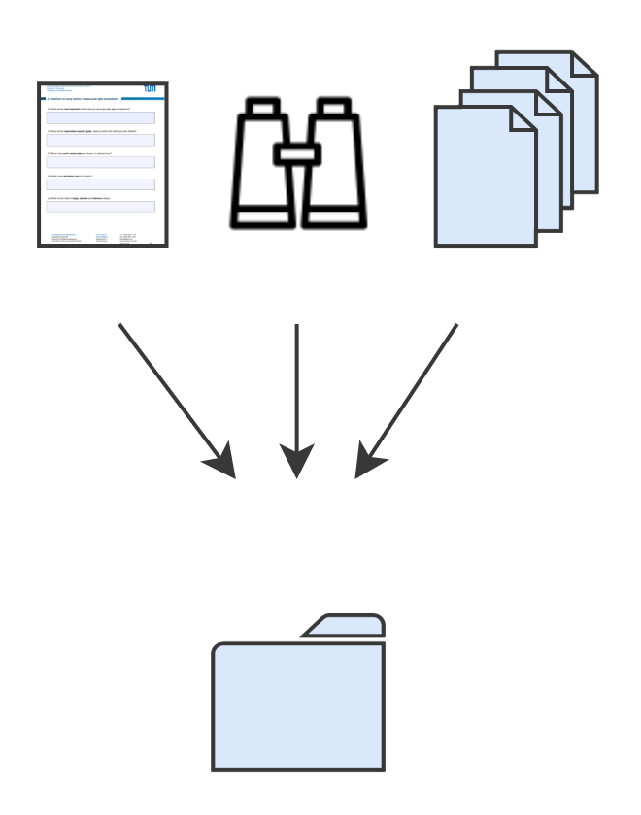
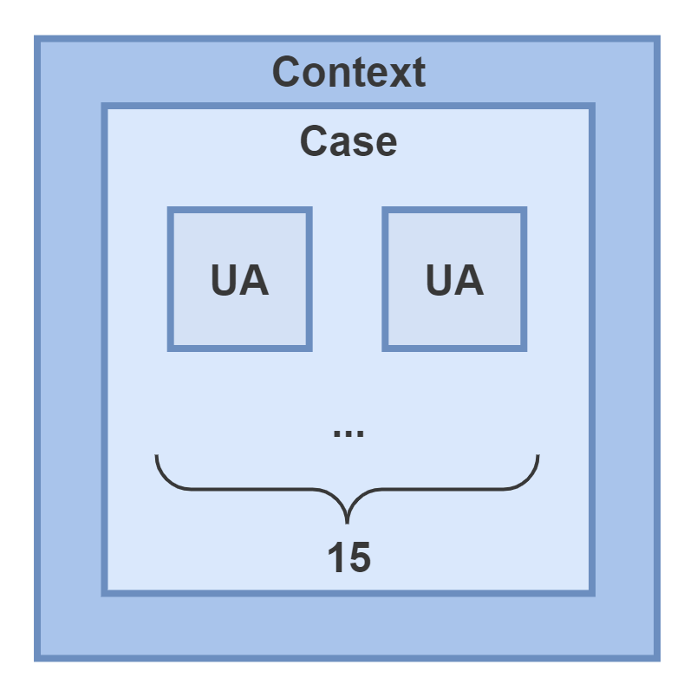
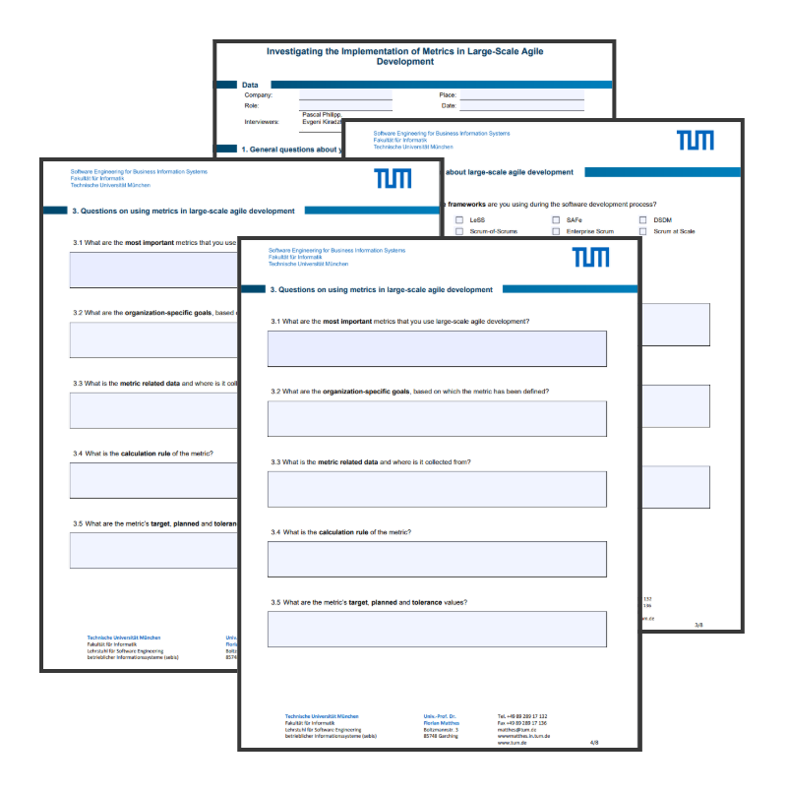

Research Methodology - Case Study (1)
UA = Unit of Analysis
1. Case study design
2.Case study preparation
3. Data collection
4. Data analysis
Deliverable: Embedded case study on the implementation of metrics in LSAD
Deliverable: Interview guidelines to investigate the implementation of metrics in LSAD
Deliverable: Data collected from 24 semi-structured interviews
Deliverable: Findings on reasons, challenges, advantages and disadvantages for using metrics in LSAD
Source: Per Runeson and Martin Höst. 2009. Guidelines for conducting and reporting case study research in software engineering;
Robert K. Yin and Martin Höst. 2009. Case Study Research: Design and Methods (Applied Social Research Methods)

Slide 8
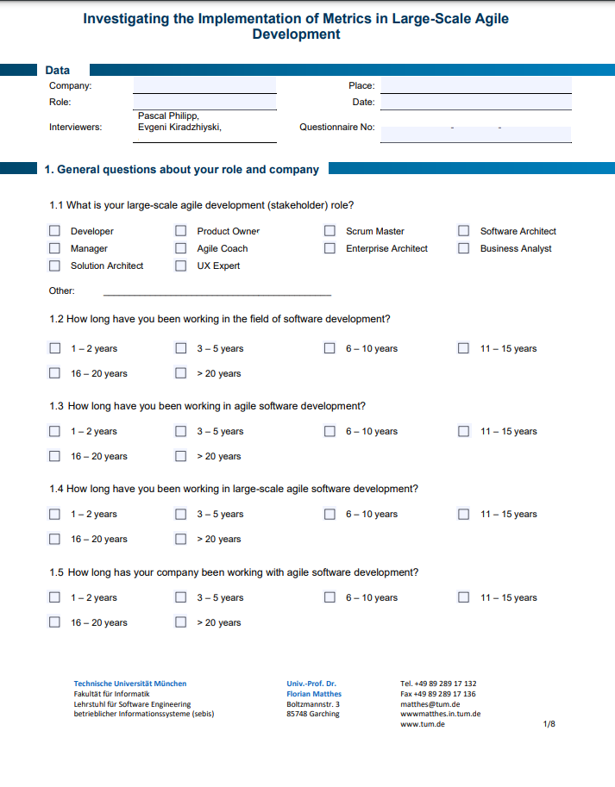
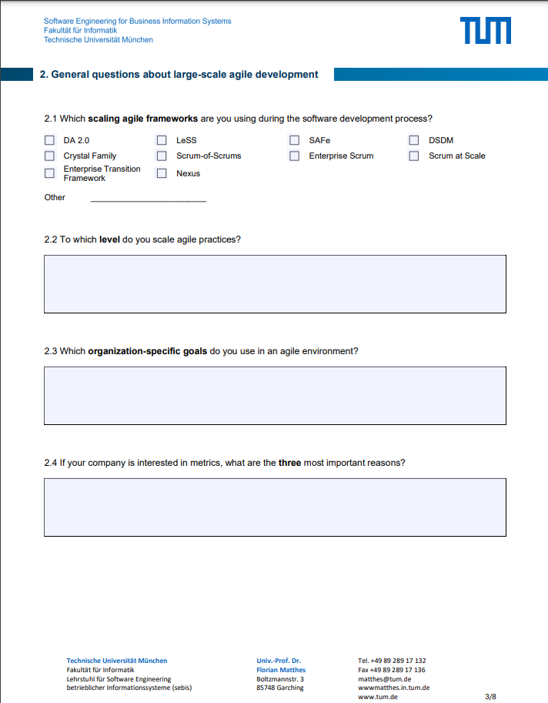
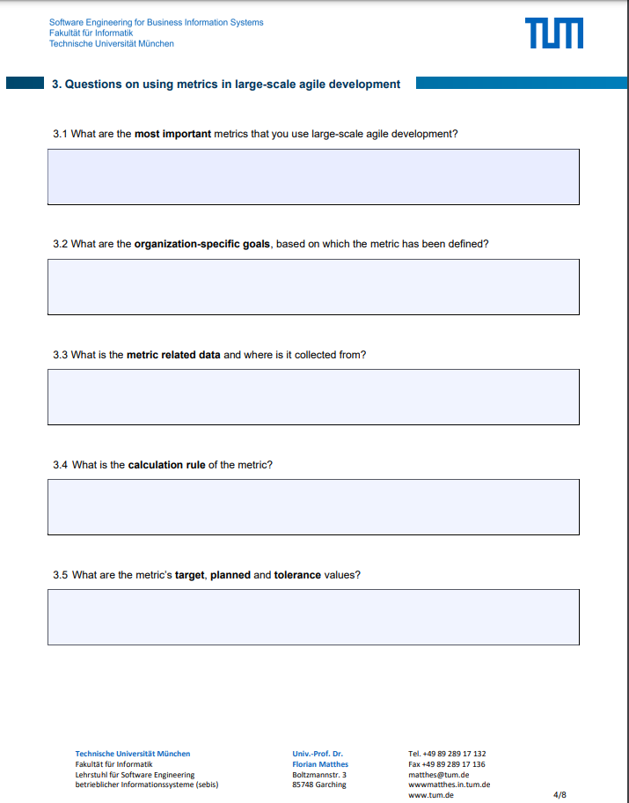
Research Methodology - Case Study (2)
24 Semi-structured interviews between January and March 2021
22 Practitioners with different agile roles and experience
e.g. Agile Coach, Scrum Master, Manager, etc. (see next slide)
Interview duration: 90 Minutes
42 questions (open/closed) in total divided into 5 phases/parts
Transcribing
Coding [17]
Analysis
Interview phases
Introduction
Describe I
Identify I
Describe II
Describe III
10 minutes
10 minutes
10 minutes
50 minutes
10 minutes
Notes:
Semi structured interviews
open and closed questions
glass open at the beginning, specific in the middle and open in the end

Slide 9
Research Methodology - Case Study (3)
ID | Organization | Role | Duration (h:m)
1 | CarCo 1 | Agile Coach | 2:01
2 | BankCo | Manager | 1:52
3 | HealthCareCo | Manager | 1:12
4 | ConsultingCo 1 | Scrum Master, Agile Coach | 0:44
5 | HealthCareCo | Manager, Agile Coach | 1:11
6 | ConsultingCo 1 | Scrum Master, Developer | 1:25
7 | ConsultingCo 1 | Product Owner, Business Analyst | 1:17
8 | ConsultingCo 1 | Solution Architect, Software Architect | 1:21
9 | Telecommunications Co | Agile Coach, Developer, Scrum Master | 1:19
10 | HealthCareCo | Software Architect | 1:37
11 | ConsultingCo 1 | Manager | 1:29
ID | Organization | Role | Duration (h:m)
12 | ConsultingCo 2 | Product owner, Manager, Scrum Master | 1:28
13 | ConsultingCo 2 | Product Owner, Solution & Software Architect, Scrum Master | 1:22
14 | CarCo 2 | Scrum Master | 0:56
15 | RetailCo 1 | Agile Coach | 1:19
16 | InsuranceCo | Agile Coach, Scrum Master | 1:52
17 | InsuranceCo | Release Train Engineer | 1:21
18 | InsuranceCo | Agile Coach, Scrum Master | 2:21
19 | InsuranceCo | Enterprise Architect, Manager, Agile Coach | 1:27
20 | BankCo | Agile Coach | 0:45
21 | RetailCo 2 | Agile Coach, Scrum Master | 1:18
22 | TransportCo | Release Train Engineer, Scrum Master | 1:35

Slide 10
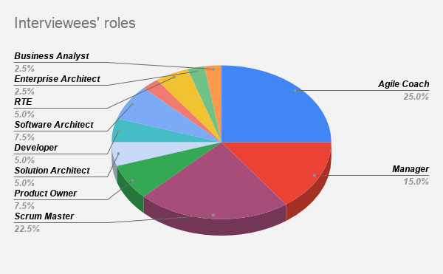
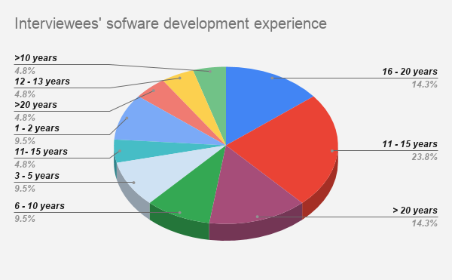
Results - Overview
Around 50% apply agile practices to a program level
Around 50% apply agile practices to a portfolio level
Most influential scaling agile frameworks are SAFe and LeSS
Most of the interview partners were quite experienced in Software Engineering
The majority of the participants have 6 to 10 years experience with agile practices

Slide 11
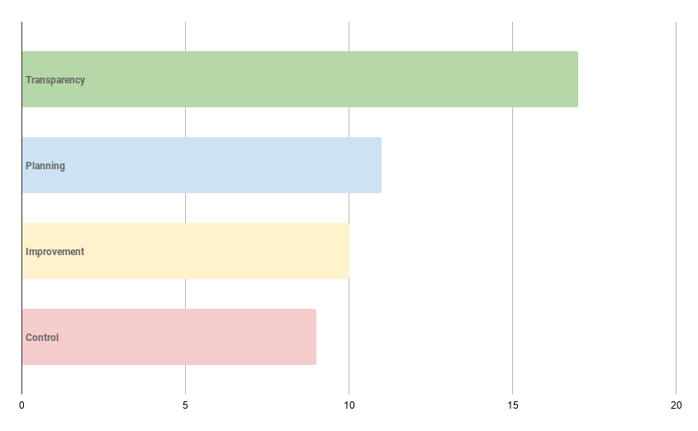
Results - Reasons for Using Metrics (1)
Most important reasons
Transparency
Planning
Improvement
Control
17
11
10
9
No. of occurrences

Slide 12

Results - Reasons for Using Metrics (2)
Transparency
Identified as the most important reason for using metrics mentioned 17 out of 22 times
Visibility and understanding of the status of the project at any stage of development
Transparency about the health of the teams is also important
Planning
Identified as the second most important reason for using metrics, mentioned 11 out of 22 times
Capacity planning and predictability
Plays an important role to customer relationship as it helps with forecasting delivery dates
Improvement
Software quality improvement
Development flow improvement
Finding software problems
Control
Controlling the development process → achievement or maintenance of a certain software quality level
Financial controlling
Control people, get them do the right things

Slide 13
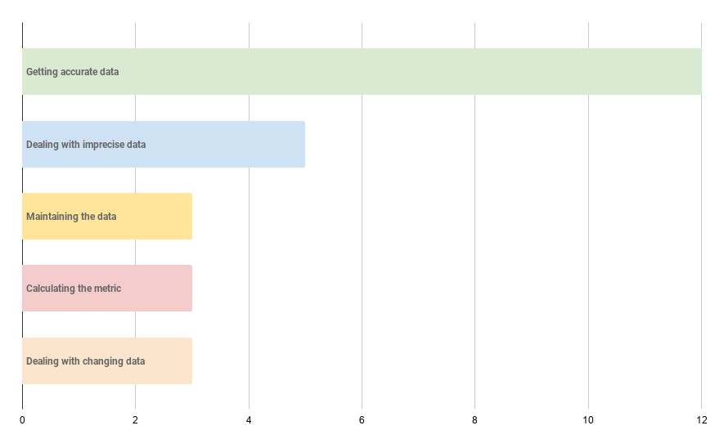
Results - Challenges of Metrics (1)
Identified Challenges
Getting accurate data
Dealing with imprecise data
Maintaining the data
Calculating the metric
Dealing with changing data
12
5
3
3
3
No. of occurrences

Slide 14
Results - Challenges of Metrics (2)
Getting accurate metric-related data
Taking all the variables into account is challenging
Deal with fluctuations
Dealing with imprecise metric-related data
Tracking on wrong tasks
Missing requirements
Maintaining metric-related data
Keeping the data up-to date
Keeping the data well phrased
Deal with changing metric-related data
Adaptation of a metric value throughout the sprints
Definition of a story point changes over time
Calculating the metric value
Different ways of calculation on a lower (team) level
Challenging to calculate the metric on a higher level

Slide 15
Results - Advantages and Disadvantages of Metrics
Easy to use
Easy to use and understand from everyone
Provide good visualization and lead to transparency
Provide visibility and understanding of the status of the project at any stage of development
It is just a number
The metric value does not tell you what to do
It just indicates if you are slower/faster than planned
Lack of information about the cause of the problem → further investigation required
Motivate people
Metrics motivate people if they see they are “on track”
Might lead to a good team health
Focus too much on the number
Try to look good, rather than be good → sacrifice quality
Might demotivate people if they are being compared
Мight cause pressure
Notes:
Advantages: Motivate people (burn-down charts)
Disadvantages, It’s just a number: You don’t see the severity of the bugs

Slide 16
Conclusion and Future work
Findings
  Organizations do make use metrics in their LSAD environment
  However, finding the “right” way and what to measure is hard
  There is no exact combination of metrics that should be used
  Metrics do no have only positive aspects, there are downsides as well (Metrics are like a coin, there two sides)
Personal key learnings
  Experience conducting case study interviews
  Gain knowledge in the area from experienced practitioners
  Time management → key learning for further research work
Future work - How can research support the usage of metrics in the industry?
  Identification of additional challenges by studying other organizations within LSAD context
  Validation of the identified challenges

Slide 17
Literature (1)
[1] T. Dingsøy, S. Nerur, V. Balijepally, and N.B. Moe. 2012. "A Decade of Agile Methodologies: Towards Explaining Agile Software Development". Journal of Systems and Software 85 (2012)
[2] N. Maiden and S. Jones. 2010. Agile Requirements Can We Have Our Cake and Eat It Too? IEEE Software 27, 3 (2010), 87–88
[3] Torgeir Dingsøy and Nils Moe. 2014. Towards Principles of Large-Scale Agile Development. Springer, Berlin(2014), 1–8
[4] Mashal Alqudah and Rozilawati Razali. 2016. A Review of Scaling Agile Methods inLarge Software Development.International Journal on Advanced Science, Engineering and Information Technology 6 (12 2016), 828
[5] N. Fenton and J. Bieman. 2014.Software Metrics: A Rigorous and Practical Approach,Third Edition. CRC Press.
[6] H. Probst. 2012.Kennzahlen: Richtig anwenden und interpretieren. Alles, was Sie wissen müssen.Redline Wirtschaft.
[7] Carol Dekkers and Patricia Mcquaid. 2002. The dangers of using software metrics to(Mis)manage. IT Professional l4 (04 2002), 24 – 30
[8] Norman E Fenton and Martin Neil. 1999. Software metrics: successes, failures and new directions. Journal of Systems and Software 47, 2 (1999), 149–157
[9] T. Gilb. 1976.Software Metrics. Chartwell-Bra
[10] Barbara Kitchenham. 2010. What’s up with software metrics? – A preliminary mapping study.Journal of Systems and Software 83, 1 (2010), 37–51
[11] Carlo Bellini, Rita Pereira, and João Becker. 2008. Measurement in software engineering: From the roadmap to the crossroads. International Journal of Software Engineering and Knowledge Engineering 18 (02 2008), 37–64
[12] D. Hartmann and R. Dymond. 2006. Appropriate agile measurement: using metric sand diagnostics to deliver business value. In AGILE 2006 (AGILE’06). 6 pp.–134.
[13] Eetu Kupiainen, Mika V. Mäntylä, and Juha Itkonen. 2015. Using metrics in Agile and Lean Software Development – A systematic literature review of industrial studies. Information and Software Technology 62 (2015), 143–16
[14] Brocke, Jan vom; Simons, Alexander; Niehaves, Bjoern; Niehaves, Bjorn; Reimer, Kai; Plattfaut, Ralf; and Cleven, Anne, "RECONSTRUCTING THE GIANT: ON THE IMPORTANCE OF RIGOUR IN DOCUMENTING THE LITERATURE SEARCH PROCESS" (2009). ECIS 2009 Proceedings. 161.
Notes:
[3] Kim Dikert, Maria Paasivaara, Casper Lassenius, Challenges and success factors for large-scale agile transformations: A systematic literature review, Journal of Systems and Software, Volume 119, 2016, Pages 87-108, ISSN 0164-1212

Slide 18
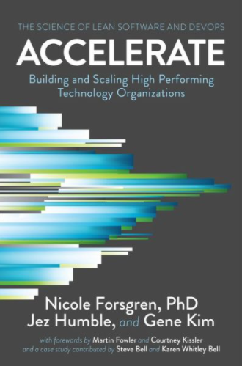

Literature (2)
[15] Per Runeson and Martin Höst. 2009. Guidelines for conducting and reporting case study research in software engineering. Empirical software engineering (2009)
[16] Robert K. Yin and Martin Höst. 2009. Case Study Research: Design and Methods(Applied Social Research Methods). Empirical software engineering (2009).
[17] D. S. Cruzes and T. Dyba. 2011. Recommended Steps for Thematic Synthesis in Software Engineering. In 2011 International Symposium on Empirical Software Engineering and Measurement. 275–284
Forsgren, Nicole and Humble, Jez and Kim, Gene. Accelerate: The Science of Lean Software and DevOps Building and Scaling High Performing Technology Organizations
Reinertsen, D.G. The Principles of Product Development Flow: Second Generation Lean Product Development
Notes:
[3] Kim Dikert, Maria Paasivaara, Casper Lassenius, Challenges and success factors for large-scale agile transformations: A systematic literature review, Journal of Systems and Software, Volume 119, 2016, Pages 87-108, ISSN 0164-1212

Slide 19
Sources
Flaticon (https://www.flaticon.com/)

Slide 20
Thank you for your attention!

Slide 21

Evgeni Kiradzhiyski
evgeni.kiradzhiyski@tum.de
17132
matthes@in.tum.de

