Slide 1
A prototypical tool to discover architecture changes based on multiple monitoring data sources for a distributed system
Patrick Schäfer, 22.05.2017, Munich
Advisor: Martin Kleehaus

Slide 2
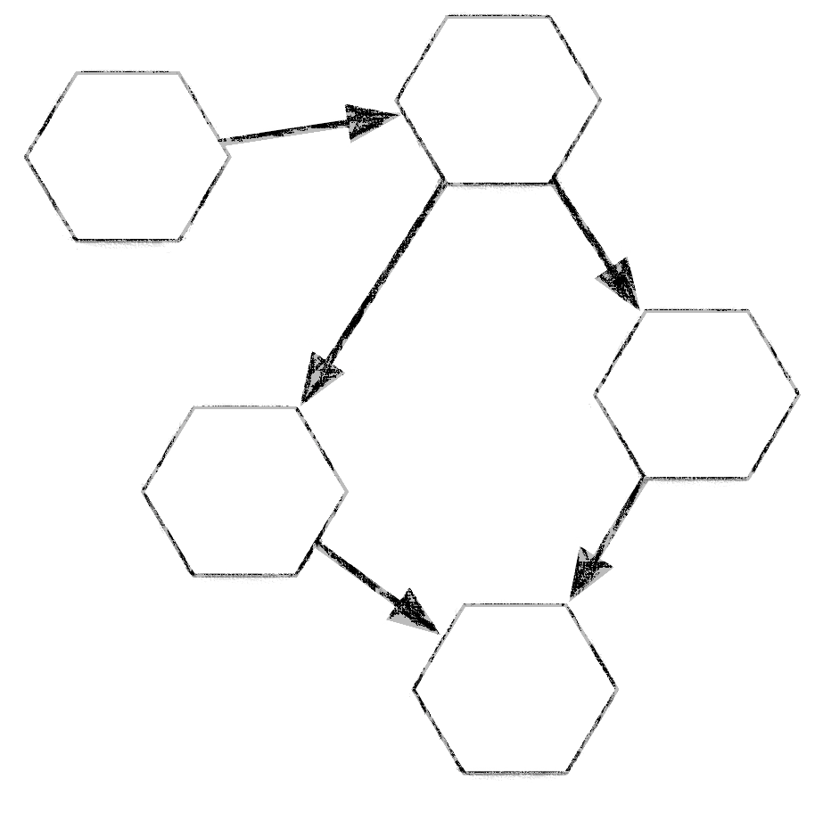
Outline
Motivation
Modeled & Runtime Architecture
Problem Statement
Research Questions
Approach
Architecture Discovery Idea
Discovery System Environment
User Interface Mockups
Limitations
Timeline

Slide 3

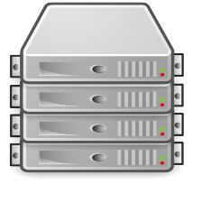

Motivation
Modeled Enterprise Architecture
A3
A1
A2
V
A4
A5
Business Process Model
S 4
S 8
S 1
S 3
S 6
S 9
S 2
S 5
S 7
Component Model
VM
VM
VM
VM
Infrastructure Model

Slide 4


Motivation
Runtime architecture
Necessity of knowledge about runtime architecture
Detecting deviations from modeled architecture
Compliance violations / SLA violations
Semi-automated root cause analysis
Semi-automated Impact analysis
State of the art solution
Application Runtime Architecture Discovery
A1
A2
A3
V
A4
A5
Business Process Model
S 1
S 4
S 3
S 8
Architecture discovery by distributed tracing
S 1
S 4
S 3
S 8
S 2
S 6
S 7
S 9
S 2
S 6
S 7
S 9
S 5
S 5
Component Model
Discovered Components
VM
VM
VM
VM
Infrastructure Model
Discovered Infrastructure

Slide 5

Motivation
Problem statement
Problem: Current discovery solutions don‘t own knowledge about the entire architecture including dependencies between and within the architectual layers
Interlayer dependencies between components
and business activities unknown
Intralayer dependencies on infrastructure layer unknown
Consequences
comparison of modeled and runtime architecture
not possible across all layers
root cause analysis is challenging and time consuming
Incomplete impact analysis
Objective
a system, that owns knowledge about all
realtime architecture components as well as
their inter- and intralayer dependencies
A3
A1
A2
V
A4
A5
Business Process Model
?
S 4
S 8
S 1
S 3
S 6
S 9
S 2
S 5
S 7
Discovered Components
Discovered Infrastructure

Slide 6
Research questions
1
How to discover the Microservice Architecture by applying distributed tracing?
What are component relationship types and how to discover them automatically?
How to discover concurrency and synchronization?
How to recognize changes in the Microservice Architecture?
How to categorize services regarding their target purpose?
How to provide a smart user interface for adding business semantic on top of business services?
2
3
4
5
6

Slide 7
Approach
Architecture Discovery Idea
  Continuous architecture discovery
  by utilizing multiple data sources
System Monitoring
Registry Service data
Architecture Discovery System
Distributed Tracing data
Server logs / configurations
A1
A2
V
A3
A4
A5
Business Process Model
?
S 1
S 4
S 3
S 8
S 2
S 5
S 6
S 7
S 9
Discovered Components
VM
VM
VM
VM
Discovered Infrastructure

Slide 8
Approach
Architecture Discovery Idea
  Continuous architecture discovery
  by utilizing multiple data sources
  Business semantic
  by semi-automated way
  +
System Monitoring
Registry Service data
User Interface
Architecture Discovery System
Business Process Model
Distributed Tracing data
Assign requests to activities
Server logs / configurations
A1
A2
V
A3
A4
A5
Business Process Model
S 1
S 4
S 3
S 8
S 2
S 5
S 6
S 7
S 9
Discovered Components
VM
VM
VM
VM
Discovered Infrastructure

Slide 9

Approach
Discovery System Environment
Gateway Service
Zuul
Registry Service
Eureka
Architecture Discovery Frontend
REST API
REST API
Registry
Client
REST API
Registry
Client
Microservice
Spring Boot
Microservice
Spring Boot
REST API
Architecture Discovery System
Storage
DT Client
Zipkin
DT Client
Zipkin
Message Stream Kafka
Distributed Tracing Server
Zipkin
Architecture Change Notifier
Storage
9

Slide 10
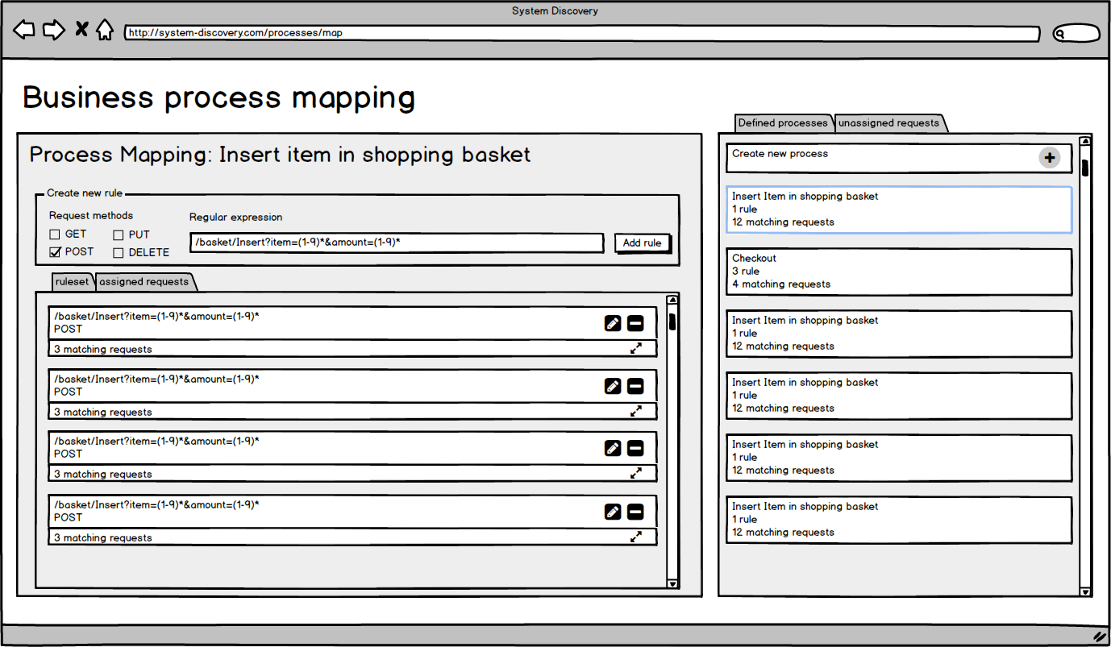
Approach
User Interface Mockup

Slide 11
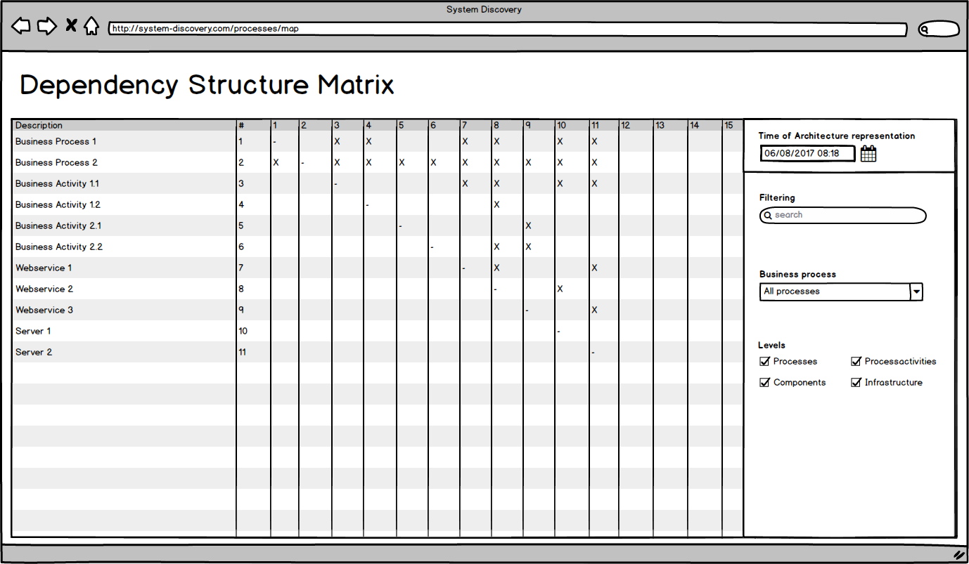
Approach
User Interface Mockup

Slide 12
Timeline
May
June
July
August
September
October
Approach
Literature / Research
Prototype Concept
Prototype Implementation
Thesis
Writing
Review / Print
Infrastructure
Architecture
discovery system
Thesis
Submission
Today
Semantic Input
Architecture
discovery frontend

Slide 13
B.Sc.
Patrick Schäfer
patrick.schaefer@tum.de

Slide 14
Backup

Slide 15
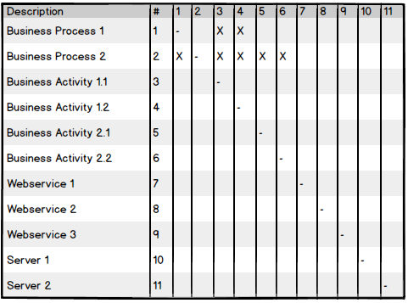
Approach
Resulting datastructure
Dependency Structure Matrix (t)
Dependency Structure Matrix (t+1)
Foundation for automated
detection of architecture changes
comparison of modeled
and runtime architecture
root cause analysis
impact analysis
Dependency Structure Matrix (t+2)

Slide 16
Approach
Discovery data source: Server logs / configurations
Load balancer
Eureka
Service Registry
Architecture Discovery FE
REST API
Registry
Client
REST API
Registry
Client
REST API
Microservice
Microservice
Architecture Discovery System
Storage
Logstash
Server
Logstash server
ElasticSearch
REST API

Slide 17
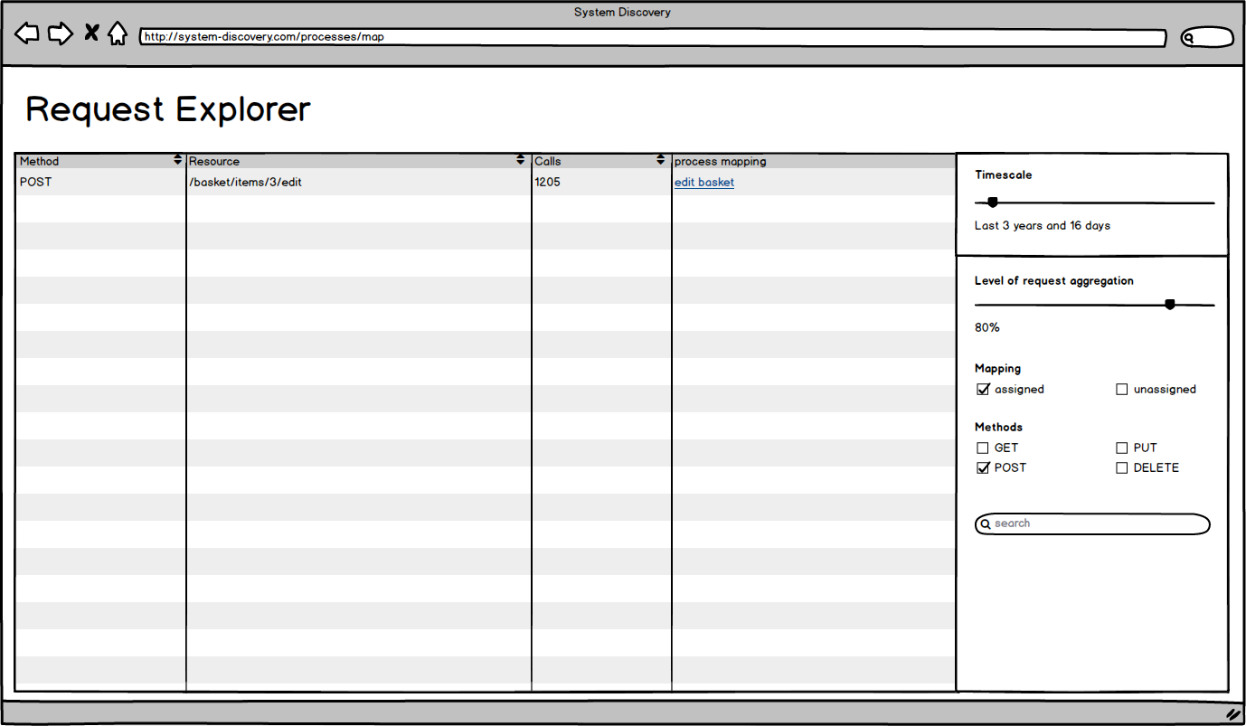
Approach
User interface mockup

