Slide 1
Identification of Cross-Blockchain Transactions: A Feasibility Study
Patrick Nieves, 13.11.2017, Munich

Slide 2
Outline
Motivation
Approach
Research Questions
Timeline

Slide 3













Motivation
Cryptocurrency Exchange
Rising Amount of Cryptocurrencies leads to rising Demand for Cryptocurrency Exchange
Trading Platforms
Instant Cryptocurrency Exchange

Slide 4





Motivation
Instant Cryptocurrency Exchange - Overview
Small fee
Simple process
Fast
Anonymous

Slide 5
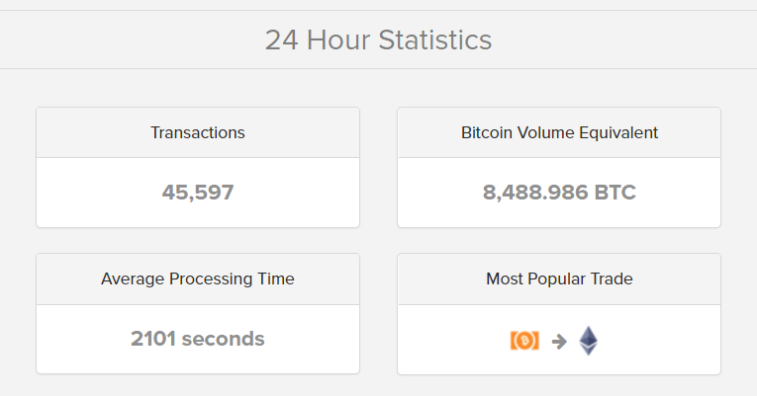
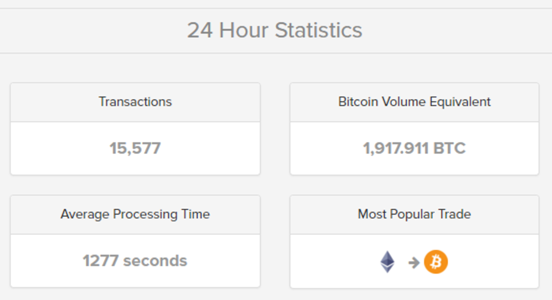
Motivation
Instant Cryptocurrency Exchange - Overview

Slide 6




Motivation
Instant Cryptocurrency Exchange Example - Changelly
1 BTC
+ Network Fee
14.6 ETH
+ Network Fee
Instant Cryptocurrency Exchange
BTC Crypto Wallet
BTC Crypto Wallet
ETH Crypto Wallet
ETH Crypto Wallet
Best Exchange Rate
-
Exchange Fee
Search on Trading Platforms
(e.g. Poloniex, Bittrex)
Total Fee = Exchange Fee + Network Fee
Processing Time and volatile Currencies lead to different final Rates

Slide 7

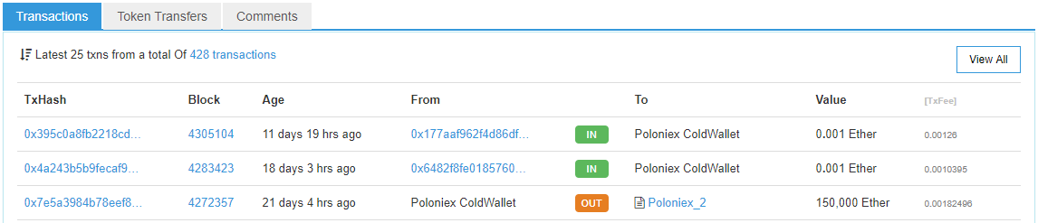


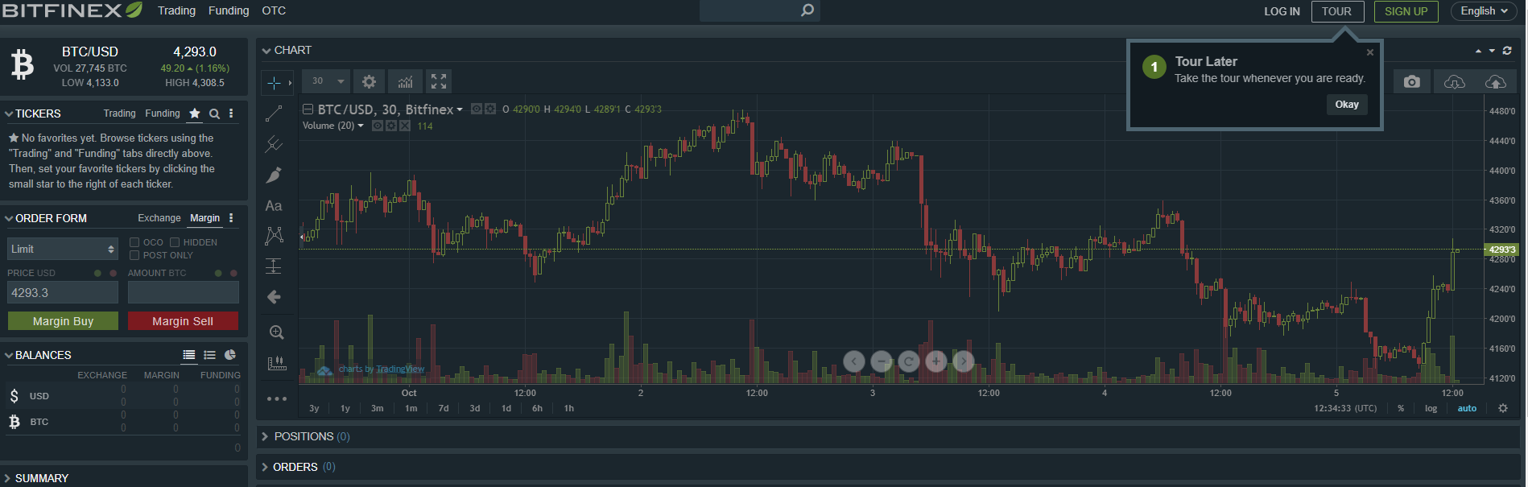

Motivation
Blockchain Data Analysis
Explorer for individual Blockchains
Trading Platforms
Instant Cryptocurrency Exchange

Slide 8
Outline
Motivation
Approach
Research Questions
Timeline

Slide 9








Approach
Solution & Realization
Design of an Algorithm for Recognition of Instant Cryptocurrency Exchange Transactions and Implementation as an Explorer Platform
Analysis of Cryptocurrency Exchange Processes and available APIs/Tools/Technologies
Implementation of the designed Algorithm on an extendable Platform (e.g. possibility of adding more Currencies)
Testing with real data
Design of a Recognition Algorithm (starting with two currencies)

Slide 10
Approach
Architecture
System Frontend
External Services
Blockchain 1
Blockchain 2
Identification Algorithm using Parameters:
Exchange Rate based on extern Rate, Exchange Fee & Transaction Fee
Exchange Duration based on Timestamps
Known Exchange Addresses
REST API
Cross-Blockchain Transactions Identificator
Blockchain API Service
Exchange API Service
Storage
Trading Data API Service
Age | From | To | Input | Outcome | Tx Fee | Tx Hash From | Tx Hash To
1 min | BTC | ETH | 1 BTC | 14.6 ETH | 0.07 ETH | BwUj6Ex3ndo56lsi43N… | 10x9029b388e83e2363f04…
2 min | LTC | BTC | … |  | … | … | …

Slide 11
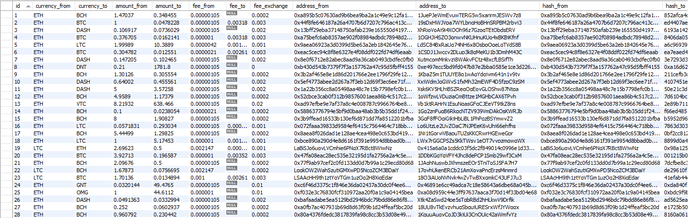
Approach
Data retrieval
Get last 50 Transactions (shapeshift.io/recenttx/50)
Get Transaction by Hash
(shapeshift.io/txStat/0x0056d4165b1ba0b05ec334308db4b78d71299191)
[
{
"curIn": "REP",
"curOut": "BCH",
"timestamp": 1510527713.046,
"amount": 2.79353472,
"txid": 318131
},
{
"curIn": "LTC",
"curOut": "BCH",
"timestamp": 1510527706.291,
"amount": 27.87439585,
"txid": 777727
},
{
"curIn": "ETH",
"curOut": "BCH",
"timestamp": 1510527706.225,
"amount": 0.43348018,
"txid": 580973
},
{
"curIn": "SALT",
"curOut": "BCH",
"timestamp": 1510527705.528,
"amount": 35.52130301,
"txid": 407891
},
{
"curIn": "ETH",
"curOut": "LTC",
"timestamp": 1510527684.702,
"amount": 0.008,
"txid": 998546
}
]
{
"status": "complete",
"address": "0x0056d4165b1ba0b05ec334308db4b78d71299191",
"withdraw": "XotVm3i6mue9uhWxGbtsw7qjmFpdpms5aa",
"incomingCoin": 1,
"incomingType": "ETH",
"outgoingCoin": "1.09433849",
"outgoingType": "DASH",
"transaction": "5a0101618c90dead9b0ab441733db9002ab4d4ade65427ab1f9ac77013990f38"
}

Slide 12


Approach
Gains & Problems
Transparency over Trading Behavior
Difficult Identification of Users
Tracking of Cross-Currency Transactions
Every Broker has different Fees & Rates
Potential Usage for other Projects
Limited API‘s of Brokers

Slide 13
Outline
Motivation
Approach
Research Questions
Timeline

Slide 14
Research Questions
1. What is the current state of art regarding Cryptocurrency Exchange?
Rise of Exchange Service Usage
Exchange Services with different processes and different basic conditions (Fees, Time, Rates, Currencies…)
Atomic Swaps (COMIT, Lightning)

Slide 15
Research Questions
3. How accurate is the implemented Solution? What are the limits?
2. How can Cross-chain Cryptocurrency Exchange Transactions be recognized?
Available Analysis Tools and APIs
Suggestion for future work
Design of suitable Algorithms taking into account different Parameters
Testing with real data (using Data retrieved from Shapeshift)

Slide 16
Outline
Motivation
Approach
Research Questions
Timeline

Slide 17

Timeline
October
November
December
January
February
March
April
Literature/ Research
Data retrievement & Concept
Implementation
Testing
Writing
Today
Official Start Date: 15.10.2017 Official End Date: 15.04.2018 Supervisors: Patrick Holl,
Ulrich Gallersdörfer

Slide 18
B.Sc. Information Systems
Patrick Nieves
patrick.nieves@tum.de

