Slide 1
Leveraging Bayesian Optimization for Accelerating RAG Pipeline Optimization
12 May 2025, Master Thesis Kick-off
Xueru Zheng

Slide 2
Outline
Introduction & Motivation
Research Questions & Methodologies
PoC
Timeline

Slide 3
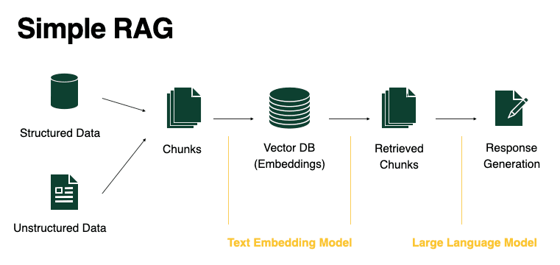
Introduction: RAG (Retrieval-Augmented Generation)
RAG:
RAG = Retrieval + Generation
Used when domain-specific or proprietary Knowledge is required
When use case requires up-to-date information

Slide 4
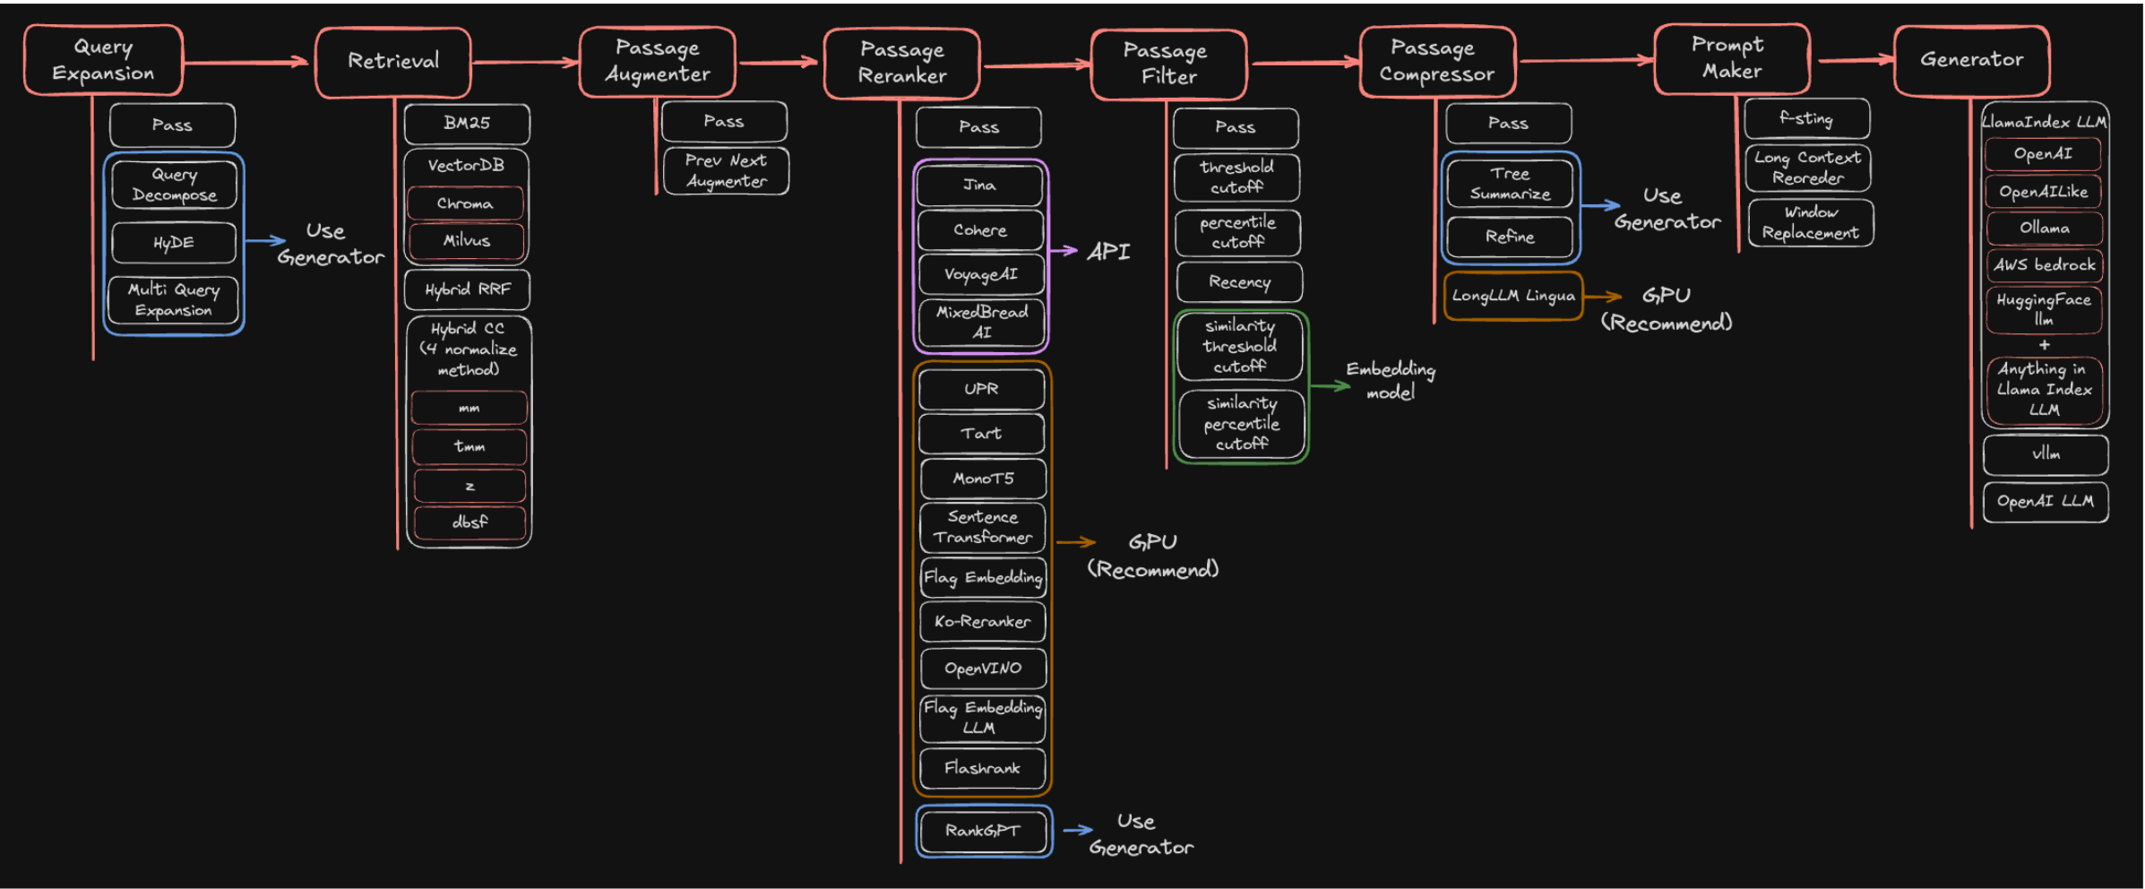
Introduction: Existing pipeline framework
AutoRAG: Automated Search for Optimal Pipeline

Slide 5
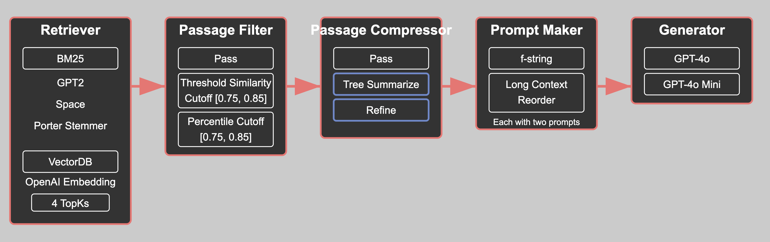
Motivation
RAG involves many configurable components
In total 1920 different combinations
Evaluating RAG configurations is Expensive
Manual Tuning is non-reproducible and non-scalable
Need to balance multiple objectives: resources, time, budgets used

Slide 6
Introduction: Bayesian Optimization
Bayesian Optimization:
Bayesian Optimization consistently outperforms traditional methods in hyperparameter tuning:
  NeurIPS benchmarks (2020) : BO achieved over 100 times better sample efficiency than random search
  Keylabs.ai Benchmark (2024): BO required approximately 12× fewer evaluations than grid search
  A probabilistic method commonly used for tuning hyperparameters when each evaluation is expensive.
  Builds a surrogate model (like a Gaussian Process or Random Forest) to approximate the objective.
  Uses an acquisition function (e.g., Expected Improvement, Upper Confidence Bound) to choose the next most promising configuration.

Slide 7
Baseline and Evaluation
Compare
Compare global optimization against Grid Search
& local optimization against AutoRAG
Optimize
Optimize the metrics scores of a RAG pipeline
Minimize
Minimize total runtime and number of evaluations
Evaluation Metrics
  Metrics for Retriever(precision, recall, ..Etc.)
  Generator(BLEU, METEOR, ..Etc.)
  Metrics from Ragas: Context Precision, Answer Accuracy..Etc.
  Time to Best

Slide 8
Outline
Introduction & Motivation
Research Questions & Methodologies
PoC
Timeline
Notes:
Baseline(one grid search) and Evaluation(optimizing the score and minimize the time needed)

Slide 9
Research Questions
Research Question 1
Where in a RAG pipeline should Bayesian optimization be applied – globally across the full pipeline or locally at individual modules – to most effectively improve end to end generation quality?
What to optimize
Research Question 2
How do different resource constraints (e.g., evaluation budgets, time, compute resources) affect the performance and stability of BO in RAG tuning?
Trade-off
Research Question 3
How sensitive is Bayesian Optimization to the size and quality of the evaluation dataset during RAG pipeline tuning?
Data Impact on BO
Research Question 4
How does the domain of dataset influence the effectiveness and stability of Bayesian Optimization in tuning RAG pipeline configurations?
Outcome Robustness

Slide 10
RQ1: Scope of BO in RAG (method selection + tuning)
RQ1: Where in a RAG pipeline should Bayesian Optimization be applied—globally across the full pipeline
or locally at individual modules—to most effectively improve end-to-end generation quality?
Ablation Study
Global Optimization
Local Optimization
To demonstrate the effectiveness of Bayesian Optimization in jointly handling discrete module selection and continuous hyperparameter tuning within RAG pipelines to improve end to end generation performance​

Slide 11
RQ2: Trade Off
RQ2: How do different resource constraints (e.g., evaluation budges, time, compute resources)
affect the performance and stability of BO in RAG tuning?
Independent Variables
Budget Constraints:
Dependent Variables
Final metrics scores
Convergence Time
number of configurations to explore,
Computational resources used: parallelism
Time

Slide 12
RQ3: Data Impact on BO
RQ3: How sensitive is Bayesian Optimization to the size and quality of the evaluation dataset during
RAG pipeline tuning?
Small vs. Large
Clean vs. noisy
Run BO under each setting, using same search space
Observes changes in search efficiency, stability, and final outcomes

Slide 13
RQ4: Outcome Robustness
How does the domain of dataset influence the effectiveness and stability of Bayesian Optimization
in tuning RAG pipeline configurations?
Configuration Sensitivity and Search Instability
In certain domains, effective RAG performance may rely on tight interactions between components
Tight Coupling of RAG Modules in Domain-Sensitive settings
Does it make BO’s surrogate model less reliable in predicting nearby configurations
Leads to performance cliffs and unreliable BO predictions
Does BO still behave reliably and efficiently in domain-specific data, or does the domain make BO search harder or less stable?

Slide 14
Datasets
Dataset | Description
nfcorpus | Focusing on the medical domain
scifact | Scientific fact-checking
GoldenDataSet_RAG | Collection of QA coming from the help.sap.com page
GoldenDataSet_NewVersion | Collection of QA coming from the he lp.sap.com page
FiQA-2018 | Contains news articles, reports, and social media posts in financial domain
SAP Benefits | Benefits from SAP
Concur | Focused on internal policies
WikiQA | Evaluating open-domain question answering systems
..etc.

Slide 15
Outline
Introduction & Motivation
Research Questions & Methodologies
PoC
Timeline

Slide 16
PoC: Initial Findings
Components included: retriever, passage filter, prompt maker, generator
In total 480 different combinations
Search Methods | BLEU | METEOR | Rouge | SEM | Average Generation Score | Time | Rank in Grid Search
Grid Search | 0.641912 | 0.793373 | 0.705434 | 0.982098 | 0.7807 | 14.81 hours | 1
BO used in RAG pipeline | 0.619955 | 0.784191 | 0.699833 | 0.981352 | 0.7713 | 31m 42s | 20
Average generation score = (BLEU + Meteor + Rouge + SEM) / 4
Worst combination: average generation mean: 0.46

Slide 17
Outline
Introduction & Motivation
Research Questions & Methodologies
PoC
Timeline

Slide 18
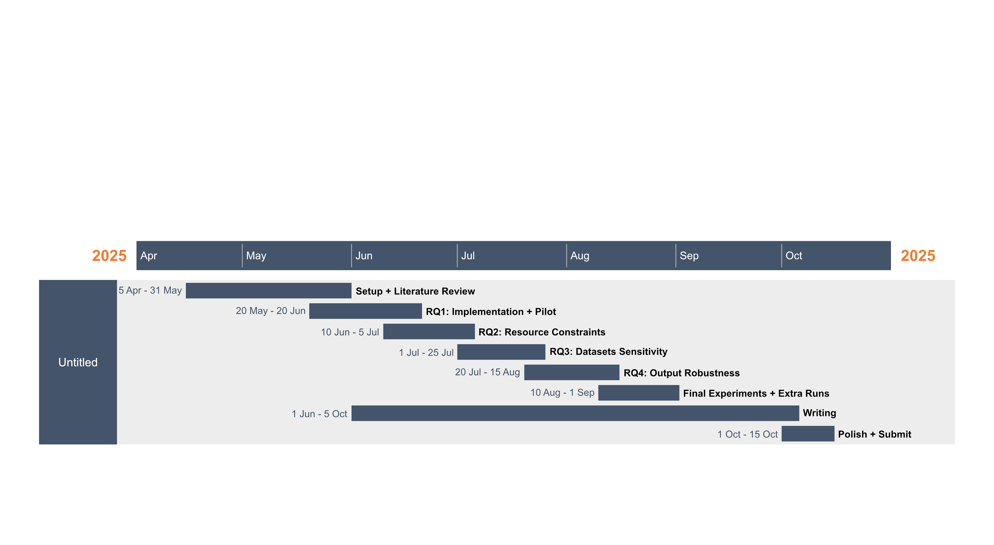
Timeline
Notes:
Setup + Literature:
Literature review on BO, RAG, tuning
- Finalize methodology per RQ
- Design search space & config schema
- Set up AutoRAG + BO framework (RayTune or SMAC3)
RQ1 Implementation + Pilot Experiments:
- Implement module + hyperparameter optimization
- Run BO + baseline (e.g., random/grid)
- Log performance & convergence
RQ2 (Resource Constraints)
- Add trial budgets, fidelity settings, compute caps
- Run constrained vs unconstrained setups
- Visualize search efficiency
RQ3 (Dataset Quality Sensitivity)
- Design noisy/small/balanced evaluation datasets
- Run BO on each and track differences
- Analyze signal sensitivity
RQ4 (Config Consistency Across Domains)
- Tune BO separately on datasets from different domains
- Compare selected configs
- Analyze variance/stability
Final Experiments + Extra Runs
- Rerun any unstable/failed experiments
- Complete missing visualizations
- Export clean config/performance logs
Polish + Submit
- Revise formatting
- Add references
- Final proofread
- Submit PDF + materials

Slide 19
Xueru Zheng
17132
matthes@in.tum.de

Slide 20
Sources
AutoRAG:
https://arxiv.org/abs/2410.20878
https://github.com/Marker-Inc-Korea/AutoRAG
SMAC3:
https://doi.org/10.1007/978-3-642-25566-3_40
https://github.com/automl/SMAC3
RayTune:
https://arxiv.org/abs/1807.05118
https://docs.ray.io/en/latest/tune/index.html
NeurIPS 2020:
https://arxiv.org/pdf/2104.10201
Turner, R., Eriksson, D., McCourt, M., Kiili, J., Laaksonen, E., Xu, Z., & Guyon, I. (2021, April 20). Bayesian Optimization is Superior to Random Search for Machine Learning Hyperparameter Tuning: Analysis of the Black-Box Optimization Challenge 2020. arXiv.org. https://arxiv.org/abs/2104.10201
Keylabs.ai Benchmark (2024):
https://keylabs.ai/blog/hyperparameter-tuning-grid-search-random-search-and-bayesian-optimization

Slide 21
Introduction: Libraries for Bayesian Optimization
RayTune
SMAC3 (Sequential Model-based Algorithm Configuration)
Integrates with a wide range of BO Algorithms
Multi-Objective
Better Scalability
Cost-Aware Optimization
Deploying in Cloud Possible
Optimize multiple instances
Notes:
SMAC3
Core idea: Algorithm configuration with more control,
Strengths: Cost-aware tuning(SMAC3 can model runtime or resource usage as a secondary objective,
Instances:“Often you want to optimize across different datasets, subsets, or even different transformations (e.g. augmentation). In general, each of these is called an instance. Configurations are evaluated on multiple instances so that a configuration is found which performs superior on all instances instead of only a few.“
RayTune
BO tools: BAyesOpt, BOHB, Optuna..

Slide 22
Metrics from Ragas
Retrieval Augmented Generation:
Context Precision: measures the proportion of relevant chunks in the retrieved contexts.
Context Recall: how many of the relevant documents (or pieces of information) were successfully retrieved
Context Entities Recall: what fraction of entities are recalled from reference
Noise Sensitivity: how often a system makes errors by providing incorrect responses when utilizing either relevant or irrelevant retrieved documents.
Response Relevance: measures how relevant a response is to the user input
Faithfulness: how factually consistent a response is with the retrieved context
Nvidia Metrics:
Answer Accuracy: measures the agreement between a model’s response and a reference ground truth for a given question.
Context Relevance: whether the retrieved contexts (chunks or passages) are pertinent to the user input.
Response Groundedness: measures how well a response is supported or "grounded" by the retrieved contexts. It assesses whether each claim in the response can be found, either wholly or partially, in the provided contexts.

Slide 23
User Query
Retriever
Relevant Documents
Generator
Answer

