Slide 1
Investigating the Adoption and Management of Metrics in Large-Scale Agile Software Development at a German IT-Provider
Leon Marius Menzel, 26.04.2021, Kick-Off Presentation Master‘s Thesis

Slide 2
Outline
Motivation
Research questions
Research methodology
Current state
Research timeline

Slide 3





Motivation – What are metrics?
Metric

Slide 4








Motivation – The evolution toward the use of metrics as part of frameworks in large-scale agile software development (LSAD)
Team level agile
Large-scale agile
LSAD Frameworks
Agile methodologies have become the dominant software development mode
Adoption of agile practices in a larger company-wide and cross-team context
Solution: Frameworks help to coordinate multiple teams and create transparency via metrics
Small single teams with fewer than 50 people
Multiple, globally distributed teams
Structure and align cross-team collaboration and communication
Side effects:
Teams are co-located
Control over larger structures of teams and processes
1
Decline in speed, quantity, and quality of working products per team
Application of team-level methods like Scrum or Kanban
End-to-end life-cycle integration incl. project and portfolio level
2
Inability of existing management structures to effectively achieve business agility
Hoda, R., Salleh, N., & Grundy, J. (2018)
Williams, L., & Cockburn, A. (2003)
Alqudah, M., & Razali, R. (2016)
Sutherland, J. and Scrum Inc. (2021)
Alqudah, M., & Razali, R. (2016)
Edison, H., Wang, X., & Conboy, K. (2021).

Slide 5
Motivation – Advantages and disadvantages of metrics in the large-scale agile environment
Why should metrics be used?
What are challenges and drawbacks of using metrics?
Support iteration planning in task prioritization and scoping
Tracking and monitoring of the iteration and project progress to predict end results
Motivate people and support improvement of working practices and performance
Identify or avoid problems in software processes and workflows
Pre- and post-release quality assessment
Feeling of detachment from team level work and cross-team goals
Limited availability of data, time, skill, and guidance prevent profiting from metrics
Pressure and demotivation due to cross-team comparability or incentive setting
False sense of security in the absence of data quality
Misunderstandings through lack of standardization of definition and description
“Working software is the primary measure of progress.” – Agile Manifesto
Kupiainen, E., Mäntylä, M. V., & Itkonen, J. (2015)
Korpivaara, I., Tuunanen, T., & Seppänen, V. (2021)
Ram, P., Rodriguez, P., & Oivo, M. (2018)

Slide 6



Motivation – Related work and research gap
Adoption and management of metrics and strategic goals in large-scale agile software development
Research gap
Dingsøyr, T., & Moe, N. B. (2014)
Korpivaara, I., Tuunanen, T., & Seppänen, V. (2021)
Adoption of metrics and strategic goals at team-level agile software development
Adoption of frameworks in large-scale agile software development
Boerman, M. P., Lubsen, Z., Tamburri, D. A., & Visser, J. (2015)
Cheng, T. H., Jansen, S., & Remmers, M. (2009)
Oza, N., & Korkala, M. (2012)
Ram, P., Rodriguez, P., Oivo, M., & Martínez-Fernández, S. (2019)
Kalenda, M., Hyna, P., & Rossi, B. (2018).
Putta, A., Paasivaara, M., & Lassenius, C. (2018)
Uludağ, Ö., Kleehaus, M., Dreymann, N., Kabelin, C., & Matthes, F. (2019)

Slide 7
Outline
Motivation
Research questions
Research methodology
Current state
Research timeline

Slide 8
Research questions
1
How are metrics in relation to strategic goals currently being used in large-scale agile software development?
2
How can different stakeholders establish and manage metrics and strategic goals to improve the current situation in large-scale agile software development?
3
How should metrics in the context of LSAD be presented to decision makers considering informal control mechanisms, so that their decisions serve company-wide goals?

Slide 9
Outline
Motivation
Research questions
Research methodology
Current state
Research timeline

Slide 10
Research Methodology – Action Design Research (ADR)
The Case Organization
Action Design Research
German medium-sized IT-provider for financial software
Investigation of two organizational units that apply different frameworks at different large-scale agile maturity levels:
  Scrum-at-scale with low-maturity level
  Scaled Agile Framework with higher-maturity level
Plan to scale agile teams and introduce cross-team metrics
Scope: Accompany the goal-oriented introduction and management of metrics in the large-scale agile context
1. Problem Formulation
Literature review
Expert interviews & talks
1
Assessment of the current situation
3. Reflection & Learning
Expert interviews, talks and surveys
2. Building, Intervention & Evaluation
Metric-catalog and LSAD frameworks support goal-driven metric introduction
2
Improvement of the current situation
Sein, M. K., Henfridsson, O., Purao, S., Rossi, M., & Lindgren, R. (2011)
4. Formalization of Learning
Generalized process, challenges and guidelines

Slide 11
Outline
Motivation
Research questions
Research methodology
Current state
Research timeline

Slide 12






Current state
Literature review
Case study
Conceptualization of the topic
Definition of the basic terms
Identification and grouping of relevant research articles
Selection of case organization
Preliminary talks
Research agreement
Start writing the foundation chapter
Creation of the chapter outline
20 pages of formulated text
Accompanying first interviews
Assessment of existing large-scale agile metric practices in the organization
Identification of related literature & idea development for potential action design research artifacts
Analysis of first interviews
Transcribing and deriving information for case description

Slide 13
Outline
Motivation
Research questions
Research methodology
Current state
Research timeline

Slide 14
Research Timeline
March
April
May
June
July
August
Sept.
Find case organization
Literature review & terminology
Stage I - Problem formulation
Stage II – Building, intervention, eval.
Stage III – Re-flection & learning
Stage IV - Formuli-zation of learning
Buffer
Writing
Registration date
March 15th, 2021
Kick-off
April 26th, 2021
Submission date
September 15th, 2021

Slide 15
B.Sc.
Leon Menzel
Master‘s Student Information Systems
leon.menzel@tum.de

Slide 16
References (1/2)
Alqudah, M., & Razali, R. (2016). A review of scaling agile methods in large software development. International Journal on Advanced Science, Engineering and Information Technology, 6(6), 828-837.
Boerman, M. P., Lubsen, Z., Tamburri, D. A., & Visser, J. (2015, May). Measuring and monitoring agile development status. In 2015 IEEE/ACM 6th International Workshop on Emerging Trends in Software Metrics (pp. 54-62). IEEE.
Cheng, T. H., Jansen, S., & Remmers, M. (2009, May). Controlling and monitoring agile software development in three dutch product software companies. In 2009 ICSE workshop on software development governance (pp. 29-35). IEEE.
Dingsøyr, T., Fægri, T. E., & Itkonen, J. (2014, December). What is large in large-scale? A taxonomy of scale for agile software development. In International Conference on Product-Focused Software Process Improvement (pp. 273-276). Springer, Cham.
Dingsøyr, T., & Moe, N. B. (2014, May). Towards principles of large-scale agile development. In International Conference on Agile Software Development (pp. 1-8). Springer, Cham.
Edison, H., Wang, X., & Conboy, K. (2021). Comparing Methods for Large-Scale Agile Software Development: A Systematic Literature Review. IEEE Transactions on Software Engineering.
Hoda, R., Salleh, N., & Grundy, J. (2018). The rise and evolution of agile software development. IEEE software, 35(5), 58-63.
Kalenda, M., Hyna, P., & Rossi, B. (2018). Scaling agile in large organizations: Practices, challenges, and success factors. Journal of Software: Evolution and Process, 30(10), e1954.
Korpivaara, I., Tuunanen, T., & Seppänen, V. (2021). Performance Measurement in Scaled Agile Organizations. In Proceedings of the Annual Hawaii International Conference on System Sciences. University of Hawai'i at Manoa.
Kupiainen, E., Mäntylä, M. V., & Itkonen, J. (2015). Using metrics in Agile and Lean Software Development–A systematic literature review of industrial studies. Information and Software Technology, 62, 143-163.
Oza, N., & Korkala, M. (2012, March). Lessons Learned In Implementing Agile Software Development Metrics. In UKAIS (p. 38).
Paasivaara, M. (2017, May). Adopting SAFe to scale agile in a globally distributed organization. In 2017 IEEE 12th International Conference on Global Software Engineering (ICGSE) (pp. 36-40). IEEE.
Putta, A., Paasivaara, M., & Lassenius, C. (2018, November). Benefits and challenges of adopting the scaled agile framework (SAFe): preliminary results from a multivocal literature review. In International Conference on Product-Focused Software Process Improvement (pp. 334-351). Springer, Cham.
Ram, P., Rodriguez, P., & Oivo, M. (2018, November). Software process measurement and related challenges in agile software development: A multiple case study. In International Conference on Product-Focused Software Process Improvement (pp. 272-287). Springer, Cham.

Slide 17
References (2/2)
Ram, P., Rodriguez, P., Oivo, M., & Martínez-Fernández, S. (2019, May). Success factors for effective process metrics operationalization in agile software development: A multiple case study. In 2019 IEEE/ACM International Conference on Software and System Processes (ICSSP) (pp. 14-23). IEEE.
Sein, M. K., Henfridsson, O., Purao, S., Rossi, M., & Lindgren, R. (2011). Action design research. MIS quarterly, 37-56.
Sutherland, J. and Scrum Inc. (2021). Read the Scrum@Scale Guide Today. url: https://www.scrumatscale.com/scrum-at-scale-guide/
Uludağ, Ö., Kleehaus, M., Dreymann, N., Kabelin, C., & Matthes, F. (2019, May). Investigating the adoption and application of large-scale scrum at a German automobile manufacturer. In 2019 ACM/IEEE 14th International Conference on Global Software Engineering (ICGSE) (pp. 22-29). IEEE.
Williams, L., & Cockburn, A. (2003). Agile software development: it’s about feedback and change. IEEE computer, 36(6), 39-43.

Slide 18
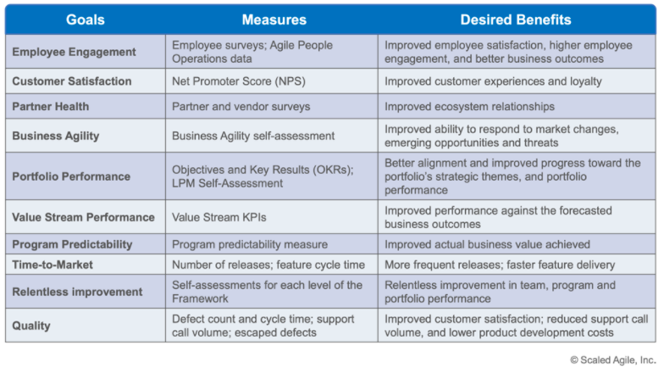
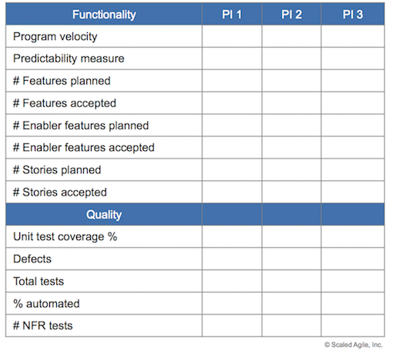
Metrics in large-scale agile frameworks
Scaled Agile Framework – Lean Portfolio and Program Performance Metrics:
Scrum-at-scale
Productivity (e.g., change in amount of working product delivered per Sprint),
Value Delivery (e.g., business value per unit of team effort),
Quality (e.g., defect rate or service downtime),
Sustainability (e.g., team happiness)

Slide 19
Research Method: Action Design Research by Sein and Rossi
Stage I – Problem Formulation
Stage III – Reflection and Learning
Case Organization(s)
German IT-provider with different large-scale agile maturity levels
Specific Organizational Problem
Introduction of metrics together with strategic-goals and improvement of existing large-scale agile metric practices
General Class of Problem
Insight-led introduction and management of metrics in relation to strategic-goals in cross-team agile environments
Scope
Accompanying the goal-oriented introduction and management of metrics in the large-scale agile context in two different areas
Access
Draw a clear picture of how goals and metrics are used
Improve
Establish metrics via a goal-driven approach
Stage II – Building, Intervention and Evaluation
Design Activities
Action design research over 5 months
Iterations
Measurement Systems, Aggregation Process, Presentation
Evaluation Activities
Survey, Expert Interviews, Document Analysis
Stage IV – Formalization and Learning
Generalization
Reference process with general guidelines and principles for establishing and managing strategic goals and metrics in LSAD

