Slide 1

Enabling realtime collaborative data-intensive web applications
A case study using serverside JavaScript
Betreuer: Sascha Roth
Kooperationspartner: Pentasys AG

Slide 2
Outline
  Node.js – Introduction & Survey
  Prototypical implementation of a real-time collaboration tool
  Conclusion & Outlook

Slide 3
Node.js - Introduction
  Developed by Ryan Dahl in 2009
  JavaScript Interpreter
  JavaScript outside of the browser
  Extends Googles V8 with low-level bindings
    Filesystem, Sockets,...
  Every binding is asynchronous, event loop
  Single threaded
  Current version: 0.10

Slide 4
Node.js - Survey
  Hypotheses
    JavaScript developers are unsatisfied with the current tool support
    Developers do not like the syntax of JavaScript
    JavaScript code is hard to maintain
    Node.js is suitable for enterprise applications
  Participants
    100 complete answers
    Countries:
      Germany: 37%
      USA: 22%
      UK: 3%
    Mostly Web-Developers

Slide 5
Node.js - Survey
  Key results about JavaScript
    53.7% are satisfied with their editors
      Most popular: IntelliJ, WebStorm, Emacs
      Missing features: code completion, code navigation, debugging
    65% like the syntax of JavaScript
      CoffeeScript and TypeScript are not planed to be used in future
    44% do not think, JS is hard to maintain
    65% said JS code is easy to read
    42% use testing frameworks
    The usage of testing frameworks influences maintainability

Slide 6
Node.js - Survey
  Key results about Node.js
    88% have heard about Node.js
    Node.js projects tend to be smaller
      41.5% of projects: 1 poeple
      22.6% of projects: 3 poeple
    Typical kinds of projects
      61.9% of projects : Web Application

Slide 7
Node.js - Survey
  Key results about Node.js
    Reasons for using Node.js
      Simplicity
      Performance
      „Good fit for Web Applications“
      No „phase shift“
      Realtime capabilities
      Event-driven
    64.8% confirmed the enterprise readiness
      Scalability
      Stability
      Short time to market
      Same language at client & server

Slide 8
Prototypical implementation of a Real-Time
collaboration tool

Slide 9
Demo

Slide 10
The Real-Time Architecture
  Proposed by Alex MacCaw (JavaScript Web Applications)
    Real-Time architecture = event-driven
    Driven by user interactions
  Client-side MVC
  Which model updates need to be distributed ?
  Who needs to be notified ?
  PubSub pattern

Slide 11
Prototypical Implementation –
Fundamental Architecture

Slide 12
Prototypical Implementation –
Technology Stack
  Client UI with Twitter Bootstrap
  Client MVC with EmberJS:
    Model:
CollaborativeEditor.Documents = Ember.A([]);
CollaborativeEditor.Document = Ember.Object.extend({
name : null,
lastModified : null,
numberOfPeopleEditing : null,
tags : Ember.A([])
});

Slide 13
Prototypical Implementation –
Technology Stack
  Client MVC with EmberJS:
    Controller:
CollaborativeEditor.DocumentsController = Ember.ArrayController.extend({
createNewDoc : function() {
...
},
...

Slide 14
Prototypical Implementation –
Technology Stack
  Client MVC with EmberJS:
    View:
<script type="text/x-handlebars" data-template-name="documents">
<div class="hero-unit">
<h2>Documents</h2>
</div>
<a href="#" class="btn" {{action "createNewDoc"}}>
<i class="icon-plus"></i>
</a>
<table class="table table-striped">
...
{{#each controller}}
<tr>
<td>{{name}}</td>
<td>{{lastModified}}</td>

Slide 15
Prototypical Implementation –
Technology Stack
  Serverside with Node.js
  Socket.io library for realtime communiction
    Abstracts underlying technology (Long-polling, Web-sockets,...)
    Server:
    Client:
socket.on('storeAndDistributeDocument', function(doc, callback) {
documentManager.storeDocument(doc);
socket.broadcast.emit('newDoc', doc);
callback();
});
socket.emit('storeAndDistributeDocument', doc, function() {
ui.addDocument(doc);
});

Slide 16
Prototypical Implementation –
Technology Stack
  Share.js library for concurrent editing
    Concurrent Editing of plain text
    Operational Transformation based
  Database
    Redis

Slide 17
Conclusion & Outlook

Slide 18
Conclusion & Outlook
  Node.js is enterprise ready
  Node.js is a good fit for real-time web applications
    Event-driven itself
    Non-blocking IO
    Offers lot of real-time functionalities
  Pattern for Tricia real-time functionalities
  Further Research:
    Collaborative editing of rich text
    Collaborative editing of general models

Slide 19
Thank you for your attention

Slide 20
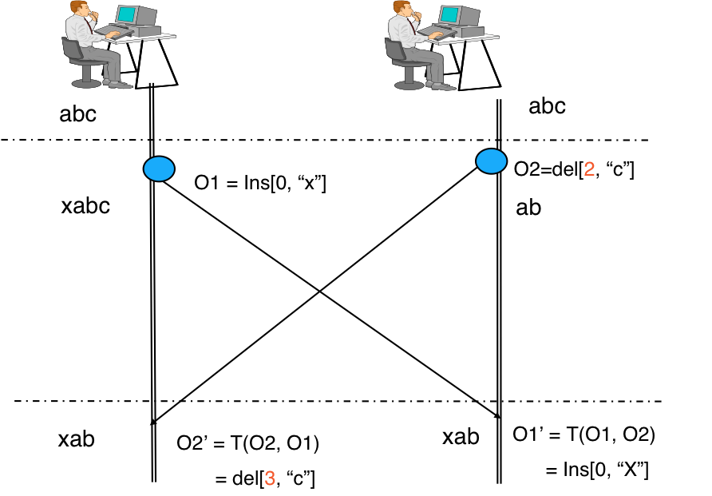
OT

