Slide 1
Investigating the Adoption and Management of Metrics in Large-Scale Agile Software Development at a German IT-Provider
Leon Marius Menzel, 13.09.2021, Final Presentation Master‘s Thesis

Slide 2
Outline
Motivation
Research questions
Research approach
Results
Key findings, limitations and future work

Slide 3




Motivation – The role of metrics in large-scale agile software development
Agile methods have become the dominant software development mode
Adoption of agile practices on a larger scale with guidance from frameworks
Metrics power data-driven decision making as part of large-scale agile frameworks
95 % of companies use agile software development methods
Multiple, globally distributed teams
Transparency and control over larger structures of teams and processes
Small, co-located, single teams with fewer than 50 people
Frameworks organize team collaboration and, thus avoid decline in volume, speed, quality & agility
Metrics challenges include e.g. limited availability of data, time, skills, guidance, and a feeling of pressure
Sources: Hoda et al. (2018); Kupiainen et al. (2015); Ram et al. (2018); State of Agile Survey. (2020); Sutherland, J. and Scrum Inc. (2021)

Slide 4

Motivation – Research gap in two respects
“There is a need for further studies to gain an understanding on the potential implications of scaling approaches on performance measurement.”
“There is a need of inducing a reference
framework for metrics program.”
“Organizations need to understand how to support the distributed metrics teams, balance resource allocation […], and monitor the evolution of the measurement programs.”
Korpivaara et al. (2021)
Oza and Korkala. (2012)
Meding et al. (2021)
The investigation of metrics in large agile development efforts have a high priority
Dingsøyr, T., & Moe, N. B. (2014)
Missing investigation of metrics adoption in large-scale agile environments
Lack of a reference framework for continuous measurement management
Build and evaluate an approach to introduce metrics and improve management of measurement programs in the long-term

Slide 5
Outline
Motivation
Research questions
Research methodology
Results
Key findings, limitations and future work

Slide 6
Research questions
1
How are metrics in relation to strategic goals currently being used in large-scale agile software development?
2
How can different stakeholders establish and manage metrics and strategic goals to improve the current large-scale agile software development measurement program?

Slide 7
Outline
Motivation
Research questions
Research methodology
Results
Key findings, limitations and future work

Slide 8
Research methodology – Overview
Rigor
Rele- vance
Knowledge Base
Environment
Literature review
Foundations:
Agile & lean software development
Scrum
Large-scale agile software development
Scaled Agile Framework
Scrum-at-Scale
Metrics in reporting
Metrics in agile software development
Metrics in large-scale agile software development
Goal-based measurement
Metrics team maturity model
Measurement challenges
Action Design Research
(Sein et al. 2011)
Case study
(Runeson & Höst 2009)
1. Problem formulation
Exploratory case study to investigate the current use of metrics & goals
Lack of a LSAD reference framework for introducing and managing metrics
Methods:
Semi-structured
Informal interviews
Observations
Document analysis
Business needs
2. Building, Intervention, and Evaluation
Applicable knowledge
Artifact
Approach for goal-based metrics introduction & improved management
Execution of the approach
Two surveys
4. Formalization of Learning
3. Reflection & Learning
Reflect on organization-specific design & execution of the approach
Derive a generalizable reference for introducing & managing metrics

Slide 9
Research methodology – Case study
Embedded case study setup:
Case study and interview participants:
Context: Large-scale agile software development
No. | Agile role | Agile experience | Case unit
1 | Release Train Engineer | 2 years | Sales ART
2 | Product Manager | 2 years | Sales ART
3 | Developer | 5 years | Sales ART
4 | Scrum Master | 6 years | Sales ART
5 | Scrum Master | 3 years | Sales ART
6 | Scrum Master | 10 years | IT-provider
7 | Product Owner | 4 years | IT-provider
8 | Principal Product Owner | 3 years | IT-provider
9 | Chief Technology Officer | 11 years | IT-provider
10 | Information Security Officer | 4 years | IT-provider
Case: German insurance group
Unit of analysis:
IT-provider
Scrum-at-Scale
3-4 software development teams
Unit of analysis: Sales ART
SAFe
10 software development teams
(Runeson & Höst 2009)
Case study and interview focus topics:
Existing goals
Existing metrics
Responsibilities for metrics and goals
Metrics challenges
Recommendations for metrics adoption

Slide 10
Outline
Motivation
Research questions
Research methodology
Results
Key findings, limitations and future work

Slide 11



Results – The approach from theoretical formulation over execution to evaluation
Presentation of the theoretical approach
Execution of the approach
Final evaluation of the approach
Components of the approach
Recommendations for metrics adoption
Part 1: Goal-based introduction of metrics
Part 2: Improvement of the measurement program management
Part 1: Goal-based introduction of metrics at the IT-provider
Part 2: Improvement of the measurement program management at the Sales ART
Summary of the results of the execution of the approach in both instantiations
Results of survey 1: Evaluation of the approach for the introduction of metrics
Results of survey 2: Evaluation of the approach for improved measurement program management

Slide 12
Outline
Motivation
Research questions
Research methodology
Results
Approach to introduce metrics and improve measurement program management
Execution of the approach
Final evaluation of the approach
Key findings, limitations and future work

Slide 13
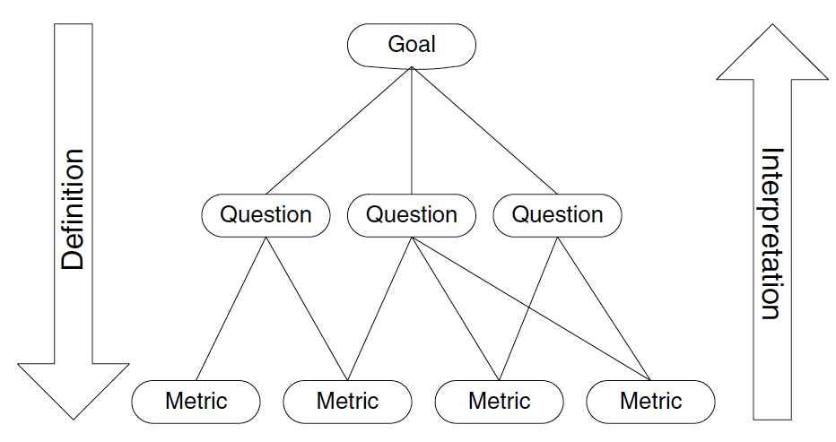
Results – Components of the approach
1
2
Involved stakeholders
Involve any employee responsible for planning, defining, maintaining, operating and managing metrics
Assign metrics team leader
Goal, Question Metrics method
Goal orientation is one of the success factors when introducing metrics
Top-down definition and bottom-up interpretation
Staron & Meding (2018)
Martinez-Fernandez et al. (2018); Ram et al. (2019)
3
4
Set-up
Formalization
Roles in the team
Roles in the org.
Commitment
Of the team
Of the organization
Metrics catalog
Data basis for the mapping of goals and metrics
Consists of 196 metrics and 27 subcategories of goals
Metrics team maturity model
Assesses the maturity of a metrics team based on a questionnaire
Metrics teams get the chance to professionalize their measurement programs
Longevity
Metrics team maturity
Efficiency
Team performance
Impact
On the organization
Outside/outreach
Context
Mission
Talent
Norms
Buy-in
Resources
Courage
Results
Tobisch (2021)
Meding et al. (2021)

Slide 14
Results – Recommendations for metrics adoption
Category | 7 out of 27 recommendations | Source
Preconditions for metrics introduction | Establish the basics of agile working and train employees | Interviews
Features of introduction | View the metric introduction as an agile experiment to try out potential improvements | Interviews
Metrics definition and selection | Focus on a few meaningful metrics | Interviews; Oza & Korkala (2012)
Data collection | Provide accepted and appropriate tools for automated data collection and calculation of metrics | Interviews; Ram et al. (2019); Staron & Meding (2011); Stettina & Schoemaker (2018)
Collaboration and participation | Create awareness of the meaning of metrics and a common understanding of the associated assumptions, limitations, and influencing factors | Interviews
Organizational alignment | Apply the same metrics at the same organizational level | Interviews; Staron & Meding (2011)
Long-term and sustainable use of metrics | Define metric thresholds for triggering actions and develop scenarios that implement them | Interviews; Cheng et al. (2009)

Slide 15

Results – Part 1: Goal-based introduction of metrics
Characteristics
Extension of the Goal, Question Metric method
Systematic, flexible approach to introduce metrics
Integrates agile roles and events
Goal-based introduction of metrics
01
Identify existing metrics
02
Determine goal coverage of existing metrics
The foundation is the as-is analysis
04
Develop questions with hypotheses
03
Collect and prioritize agile software development goals
Prioritizes goals considering goal coverage and creates a GQM-plan
Specifies measurement and analysis plan
05
Search metric candidates and select metrics
06
Prepare the data collection
Iterative review of goals and metrics that continuously improves the measurement program
08
Check the achievement and coverage of goals regularly
07
Collect, analyze and interpret the metrics data

Slide 16

Results – Part 2: Improvement of the measurement program management
Characteristics
Add-on to the introduction of metrics
Can be carried out flexibly and at a time independent of the introduction
Improvement of the measurement program management
Individual interviews, group interview or survey as a means of conducting
01
Assess the metrics team maturity level
02
Evaluate the metrics team maturity level
Calculation of percentage compliance of each area including visualization
Developing a shared understanding of the outcome with subsequent prioritization of areas of focus
04
Perform the metrics team maturity assessment regularly
03
Plan and implement actions to improve the maturity level
Integration with existing recurring agile events

Slide 17
Outline
Motivation
Research questions
Research methodology
Results
Approach to introduce metrics and improve measurement program management
Execution of the approach
Final evaluation of the approach
Key findings, limitations and future work

Slide 18
Results – Execution of the goal-based metrics introduction approach at the IT-provider
Step 1:
Identify existing metrics
Step 2: Determine the goal coverage of existing metrics
Step 3: Collect and prioritize software development goals
Metric | Org. level
Change velocity | Cross-team
Team velocity | Agile teams
Burn-down chart | Agile teams
Burn-up chart | Agile teams
Sprint report | Agile teams
Cumulative flow diagram | Agile teams
Version report | Agile teams
Goal | Coverage
Transparency | 5/7
Predictability | 5/7
Improved planning | 2/7
Productivity | 2/7
Delivery reliability | 2/7
Cost management | 1/7
Quality | 1/7
Speed | 1/7
Agility | 1/7
1
Improve the quality with the delivered features from the customer's point of view in the context of the IT-provider
2
Improve the commitment with regard to the delivery of software from the customer's point of view in the context of the IT-provider
3
Increase the security in software products from the customer's point of view in the context of the IT-provider

Slide 19
Results – Execution of the goal-based metrics introduction approach at the IT-provider
Step 4: Develop questions with hypotheses
Step 5: Search metric candidates and select metrics
Quality
No. | Metric (7 out of 13) | Org. level | Source
1 | Defects per feature after deployment | Cross-team | Catalog
1 | Defects per user story | Agile team | Interview, Scrum@Scale Guide
1 | Defects per epic | Cross-team | Interview, Scrum@Scale Guide
1 | Defects per customer environment | Cross-team | Interview
6 | Feature cycle time | Cross-team | Catalog, Interview
6 | Average user story cycle time | Agile team | Catalog, Interview
7 | Security related story points per sprint | Cross-team | Interview
1
How qualitative are the features?
2
How critical are the defects?
3
How quickly are teams able to respond to critical defects?
4
How automated are the tests?
Commitment
5
How committed is the planning and its communication?
6
How fast is the development?
Security
7
What proportion of capacity spent is devoted to security?

Slide 20

Results – Execution of the goal-based metrics introduction approach at the IT-provider
Step 6:
Prepare the data collection
Step 7: Collect, analyze and interpret the metrics data
Step 8: Check the achieve-ment of goals regularly
Measurement plan:
Analysis plan:
Iterative introduction of metrics over two month
Scrum Master has the main responsibility
Configuration of metrics in Jira
Integration into one central dashboard
Analysis and interpretation as part of the bi-weekly sprint review event
Introduction is followed by a presentation to the management
Regular execution within the two-week Sprint Retrospective
Participants: Scrum Master, Product Owner, all developers of the Scrum teams
Objects: Feature, user story, story point, epic, customer environment, defect, regression test, release progress
Scope: All agile teams
Time/Event: Deployment, after set to done, release, continuously
Source: Jira, X-Ray
Responsible: Scrum Master, Test manager, Information Security Officer
Means: All automatic except defects per feature after deployement

Slide 21


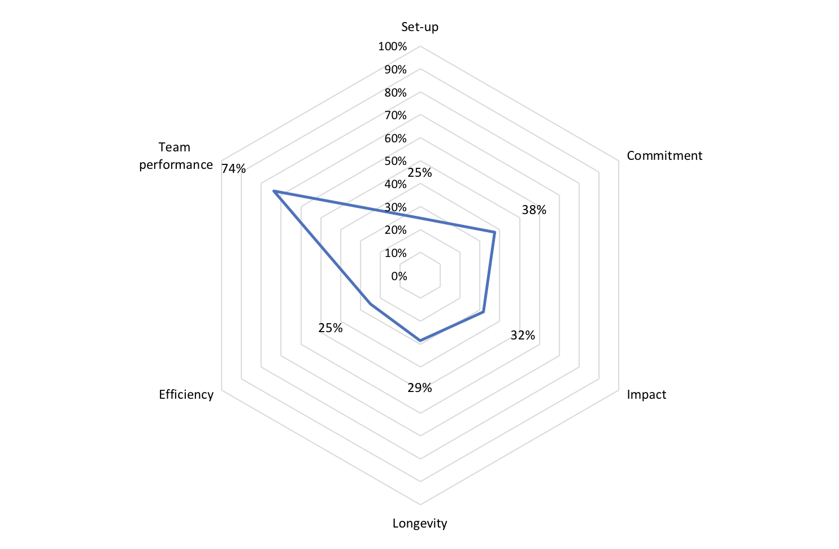
Results – Execution of the measurement program management improvement approach at the Sales ART
Step 1: Assess the metrics team maturity level
Step 2: Evaluate the metrics team maturity level
Step 3: Plan and implement actions to improve maturity level
Step 4: Perform the metrics team maturity assessment regularly
Remote interview
Participants: Release Train Engineer and Scrum Masters representative
Dialog about assessment
Focus on on set-up and commitment area
E.g. assigning roles of metrics team leader and measure-ment process owner
E.g. establish metrics community
Regular assessment every six months
Special re-assessment after the upcoming PI to get fast feedback for implemented actions

Slide 22
Results – Summary of the execution of the approach in both instantiations
Execution at the IT-provider
Execution at the Sales ART
Scrum Master, (Principal) Product Owner and Developers are the key stakeholders of metrics
Exchange on metrics in the Sprint Review, Sprint Retrospective and Executive Meta Scrum events
Previous focus on team-level metrics
Introduction of a total of 13 mostly cross-team metrics
Quality, commitment and security are the most important goals in the introduction
Iterative introduction over two months followed by a management presentation
Need for action in the areas of setup, commitment, and impact for a better management of the metrics program
Release Train Engineer, Scrum Master, Product Owner and Developers are the key stakeholders of metrics
Exchange on metrics mainly in the Scrum of Scrums (program-level), Sprint Planning and Sprint Retrospective (team-level) events
Previous focus on program metrics that are based on person days; lack of homogeneity at team level
Introduction of a total of 19 metrics (12 short-term; 4 medium-term; 3 long-term)
Quality, collaboration, commitment, transparency are the most important goals
Need for action in the areas setup and commitment for a better management of the metrics program

Slide 23
Outline
Motivation
Research questions
Research methodology
Results
Approach to introduce metrics and improve measurement program management
Execution of the approach
Final evaluation of the approach
Key findings, limitations and future work

Slide 24
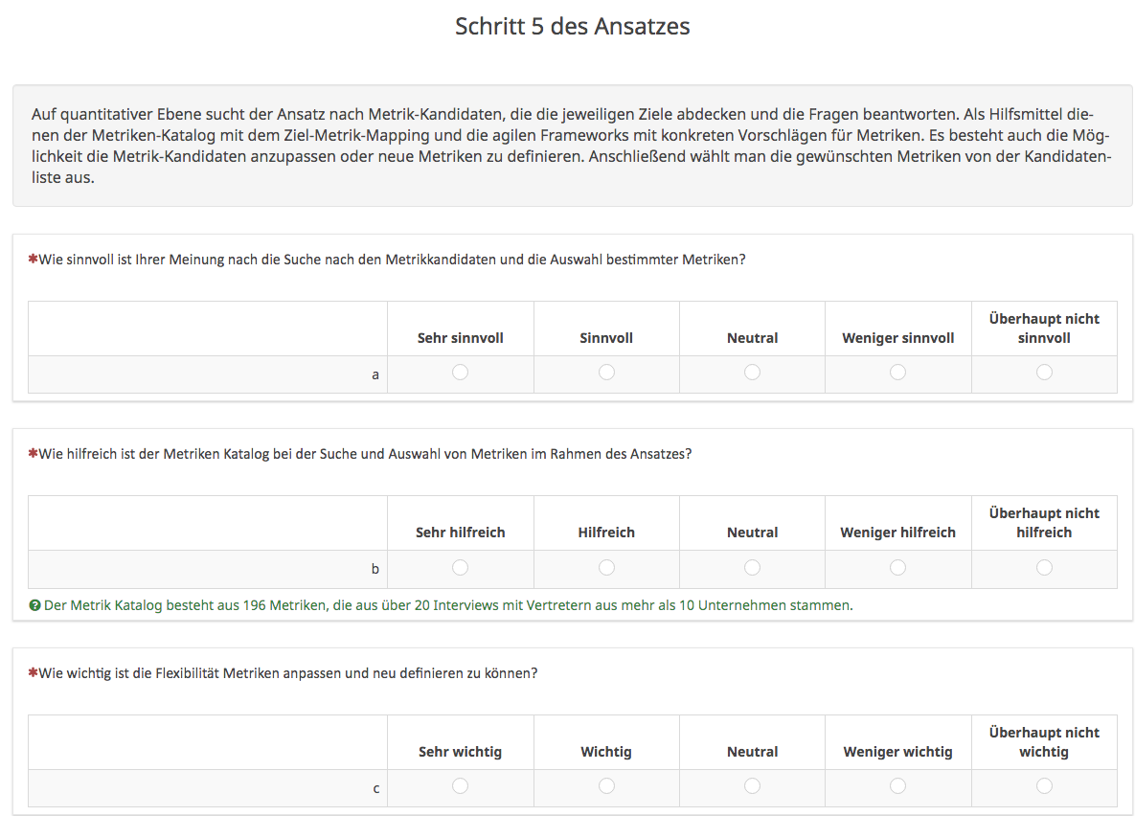
Results – Survey structure
Survey facts:
Two surveys for the final evaluation of the two parts of the approach
30 questions in total
Seven to ten survey participants
100 % response rate
Survey goals:
Quantification of the value of the individual steps of the approach and its components
Collection of potential improvements for the solution artifact

Slide 25
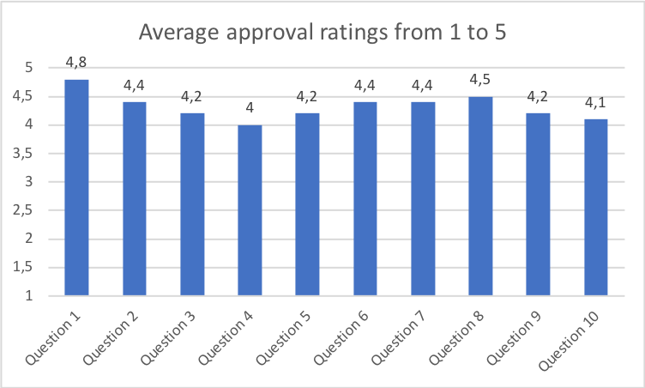
Results – Evaluation of the approach for the introduction of metrics
Q1: How valuable do you think the as-is analysis is as a starting point for the approach?
Q2: How valuable do you think is the goal-based metrics adoption?
Q3: How useful are the questions as a link between goals and metrics?
Q4: How useful do you think it is to search for candidate metrics and select specific metrics?
Q5: How helpful is the metrics catalog in searching and selecting metrics as part of the approach?
Q6: How important is the step of preparing the data collection?
Q7: How important do you consider the analysis plan and the subsequent interpretation along the questions, hypotheses and goals?
Q8: How valuable do you think is the regular review of the goal achievement and coverage?
Q9: How useful is the integration into the flow of the agile framework you are using in your company?
Q10: How do you evaluate the goal-based metrics adoption approach overall?
= Step 1 & 2
= Step 3
= Step 4
= Step 5
= Step 5
= Step 6
= Step 7
= Step 8

Slide 26
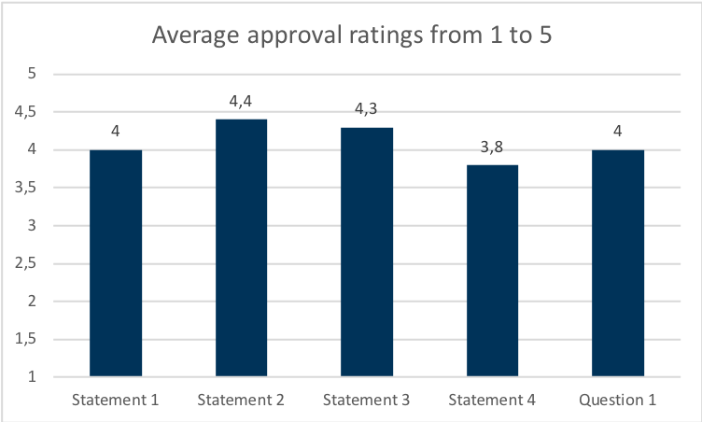
Results – Evaluation of the approach for improving the measurement program
S1: The maturity assessment covers the relevant and essential characteristics of a successful metrics team.
S2: [...] the maturity model gave us an overview of the strengths and weaknesses of the current measurement program.
S3: The maturity assessment has revealed the potentials of the measurement program, so we now know what we should work on.
S4: We plan to conduct the maturity assessment at regular intervals in the future.
Q1: What is your overall opinion of the measurement program management improvement approach?
= Step 1
= Step 2
= Step 3
= Step 4

Slide 27
Outline
Motivation
Research questions
Research methodology
Results
Key findings, limitations and future work

Slide 28






Key findings, limitations & future work
Key findings
limitations & future work
Identification of recommendations for the adoption of metrics
Derivation and identification of 27 recommendations integrated into the approach
Limitations
Limited number of interview partners (10) and survey participants (7-10) => threat to validity
Lack of observation of long-term effects of the approach
Design of an approach for the adoption and management of metrics in scaled agile development
Strong appreciation (90 % and 70% approval)
Future work
Guiding and evaluating the medium- and long-term adoption of metrics and their impact
Additional maturity assessments after three months to evaluate the success of targeted actions
Application of approach in another case organization
Development of an IT-artifact that digitalizes the goal-metric mapping
Effects of executing the approach in both instantiations
Iterative and goal-based introduction of 13 (IT-provider and 19 (ART) metrics
Revealing potential for improvement in the management of measurement programs
First validation of the metrics catalog in practice
80 % say the catalog was (very) helpful

Slide 29
B.Sc.
Leon Menzel
Master‘s Student Information Systems
leon.menzel@tum.de

Slide 30
References
Boerman, M. P., Lubsen, Z., Tamburri, D. A., & Visser, J. (2015, May). Measuring and monitoring agile development status. In 2015 IEEE/ACM 6th International Workshop on Emerging Trends in Software Metrics (pp. 54-62). IEEE.
Cheng, T. H., Jansen, S., & Remmers, M. (2009, May). Controlling and monitoring agile software development in three dutch product software companies. In 2009 ICSE workshop on software development governance (pp. 29-35). IEEE.
Dingsøyr, T., & Moe, N. B. (2014, May). Towards principles of large-scale agile development. In International Conference on Agile Software Development (pp. 1-8). Springer, Cham.
Hoda, R., Salleh, N., & Grundy, J. (2018). The rise and evolution of agile software development. IEEE software, 35(5), 58-63.
Korpivaara, I., Tuunanen, T., & Seppänen, V. (2021). Performance Measurement in Scaled Agile Organizations. In Proceedings of the Annual Hawaii International Conference on System Sciences. University of Hawai'i at Manoa.
Kupiainen, E., Mäntylä, M. V., & Itkonen, J. (2015). Using metrics in Agile and Lean Software Development–A systematic literature review of industrial studies. Information and Software Technology, 62, 143-163.
Martinez-Fernandez, S., A. Jedlitschka, L. Guzmán, and A. M. Vollmer. (2018). “A quality model for actionable analytics in rapid software development”. In:2018 44th Euromicro Conference on Software Engineering and Advanced Applications (SEAA). IEEE. (pp. 370–377).
Meding, W., M. Staron, and O. Söder. (2021). “MeTeaM—A method for characterizing mature software metrics teams”. Journal of Systems and Software.
Oza, N., & Korkala, M. (2012, March). Lessons Learned In Implementing Agile Software Development Metrics. In UKAIS (p. 38).
Ram, P., Rodriguez, P., & Oivo, M. (2018, November). Software process measurement and related challenges in agile software development: A multiple case study. In International Conference on Product-Focused Software Process Improvement (pp. 272-287). Springer, Cham.
Ram, P., Rodriguez, P., Oivo, M., & Martínez-Fernández, S. (2019, May). Success factors for effective process metrics operationalization in agile software development: A multiple case study. In 2019 IEEE/ACM International Conference on Software and System Processes (ICSSP) (pp. 14-23). IEEE.
Runeson, P., and M. Höst. (2009). “Guidelines for conducting and reporting case study research in software engineering”. Empirical software engineering (pp. 131–164).
State of Agile Survey. (2020). URL: https://stateofagile.com/#ufh-i-615706098-14th-annual-state-of-agile-report/7027494
Sein, M. K., Henfridsson, O., Purao, S., Rossi, M., & Lindgren, R. (2011). Action design research. MIS quarterly, 37-56.
Staron, M. and Medig, W. (2011). “Factors determining long-term success of a measurement program: an industrial case study”. In:e-Informatica Software Engineering Journal 5.1.
Staron, M. and Medig, W. (2018). “Software Development Measurement Programs”. Springer. https://doi.org/10.1007/978-3-319-91836-510. (p. 3281333).
Stettina, C. J. and Schoemaker, L. (2018). “Reporting in agile portfolio management: routines, metrics and artefacts to maintain an effective oversight”. International Conference on Agile Software Development. Springer, Cham. (pp. 199–215).
Sutherland, J. and Scrum Inc. (2021). Read the Scrum@Scale Guide Today. url: https://www.scrumatscale.com/scrum-at-scale-guide/
Tobisch, F. (2021). “Design of a Metric Catalog for Large-Scale Agile Software Development”.
Williams, L., & Cockburn, A. (2003). Agile software development: it’s about feedback and change. IEEE computer, 36(6), 39-43.

Slide 31
Goal Question Metric plan of the IT-provider
Goal = step 3 | Question = step 4 | Metric = step 5
Improve the quality of the delivered features from the customer’s point of view in the context of the IT-provider | How qualitative are the features? | Defects per feature after deployment
 |  | Defects per user story
 |  | Defects per epic
 |  | Defects per customer environment
 | How critical are the defects? | Amount of defects per criticality category
 | How quickly are teams able to respond to (critical) defects? | Average defect lead time per criticality category
 |  | Average defect cycle time per criticality category
 | How automated are the tests? | Percentage of automated tests
Improve the commitment with regard to the on-time, on-cost, and performance-agreed delivery of software by the agile software teams from the customer’s point of view in the context of the IT-provider | How committed is the planning and its communication to the customer? | Epic burn-down chart
 |  | Release burn-down chart
 | How fast is the development? | Feature cycle time
 |  | Average user story cycle time
Increasing security in software products from the customer’s point of view in the context of the IT-provider | What proportion of the capacity spent is devoted to security-related content? | Security related story points per sprint

Slide 32
Goal Question Metric plan of the Sales ART I
Goal = step 3 | Question = step 4 | Metric = step 5
Improve the quality with respect to software code as well as conceptual design from the perspective of management and agile development teams within the ART | How many defects occur per sprint? | Number of defects per sprint
 | How extensive is our test coverage? | Unit test coverage
 |  | Number of new test cases
 |  | Total tests
 | How automated are the tests? | Percentage of automated tests
 |  | Number of new automated tests
 | How much software code is reused? | Number of refactors
Improve the collaboration to accelerate work processes and stimulate direct communication between teams and team members within the ART | What are the team's relative strengths and weaknesses in collaboration and communication? | Team Self-Assessment

Slide 33
Goal Question Metric plan of the Sales ART II
Goal = step 3 | Question = step 4 | Metric = step 5
Increase the commitment to build trust and better plan work packages in terms of their content and scope from the perspective of customers and members within the ART | How committed is the sprint planning of the teams in terms of content and scope? | Number of added stories
 |  | Number of stories planned
 | How committed is the team to achieving the sprint planning? | Sprint burn-down chart
 |  | Number of not accepted stories
 |  | Number of accepted stories
 |  | Percentage of accepted stories
 | How committed is the ART in achieving the PI planning? | PI burn-down chart
 | How do disruptions affect commitment? | Number of stories pushed to next iteration
 |  | Number of stories not accepted and deferred to later date
 |  | Number of stories not accepted and deleted from backlog
Improve the transparency of the status of workflows and requirements from the perspective of all members within the ART | How well do the workflows function within a PI? | Cumulative flow diagram

Slide 34
All Recommendations for metrics adoption I
Category | Recommendations | Source
Preconditions for metrics introduction | Establish the basics of agile working and train employees | Interviews
 | Assign responsibility for metrics to a person who centrally coordinates the adoption project | Interviews
Features of introduction | View the metric introduction as an agile experiment to try out potential improvements | Interviews
 | Introduce metrics iteratively | Interviews; Oza & Korkala (2012); Ram et al. (2019)
 | Ensure the goal-based introduction of metrics | Interviews; Kettunen et al. (2019)
 | Use hypotheses and questions in addition to goals to operationalize metrics | Interviews
 | Document the adoption of metrics | Interviews
Metrics definition and selection | Focus on a few meaningful metrics | Interviews; Oza & Korkala (2012)
 | Verify that the benefit exceeds the effort for a metric | Interviews; Staron & Meding (2011)
 | Allow for the coordinated and uniform customization of metrics | Coyle & Barata (2016)
Data collection | Provide accepted and appropriate tools for automated data collection and calculation of metrics | Interviews; Ram et al. (2019); Staron & Meding (2011); Stettina & Schoemaker (2018)
 | Prioritize the use of existing data for metrics definition | Interviews; Ram et al. (2019); Staron & Meding (2011)

Slide 35
All Recommendations for metrics adoption II
Category | Recommendations | Source
Collaboration and participation | Engage in a collaborative transparent dialogue with agile teams about the benefits and purpose of adopting metrics | Interviews; Cheng et al. (2009); Oza & Korkala (2012); Ram et al. (2019); Staron & Meding (2011)
 | Make metrics visible and easily accessible to everyone | Interviews; Cheng et al. (2009); Korpivaara et al. (2021); Oza & Korkala (2012); Samios et al. (2012)
 | Involve the agile teams in defining goals and metrics | Fagerholm et al. (2015); Horlach et al. (2019); Samios et al. (2012)
 | Convince all relevant stakeholders and promote acceptance and commitment | Interviews; Staron & Meding (2011)
 | Ensure that the agile teams trust the measurement program | Ram et al. (2019)
 | Avoid the impression of control and emphasize the intrinsic value of metrics | Interviews
 | Create awareness of the meaning of metrics and a common understanding of the associated assumptions, limitations, and influencing factors | Interviews
Organizational alignment | Integrate the metrics into the flow of the agile development process | Ram et al. (2019); Staron & Meding (2011)
 | Apply the same metrics at the same organizational level | Interviews; Staron & Meding (2011)
 | Define goals and metrics at all organizational levels | Fagerholm et al. (2015); Horlach et al. (2019); Oza & Korkala (2012)
 | Standardize reporting management systems across all organizational levels | Samios et al. (2012)

Slide 36
All Recommendations for metrics adoption III
Category | Recommendations | Source
Long-term and sustainable use of metrics | Use metrics actively in short cross-team meetings | Interviews
 | Monitor metrics regularly | Cheng et al. (2009); Korpivaara et al. (2021); Staron & Meding (2011)
 | Define metric thresholds for triggering actions and develop scenarios that implement them | Interviews; Cheng et al. (2009)
 | Review goals and metrics regularly and readjust their mutual alignment | Interviews; Korpivaara et al. (2021); Ram et al. (2019)

Slide 37
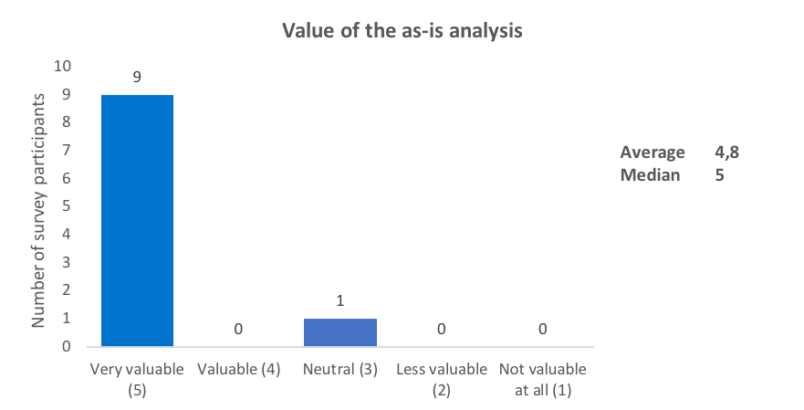
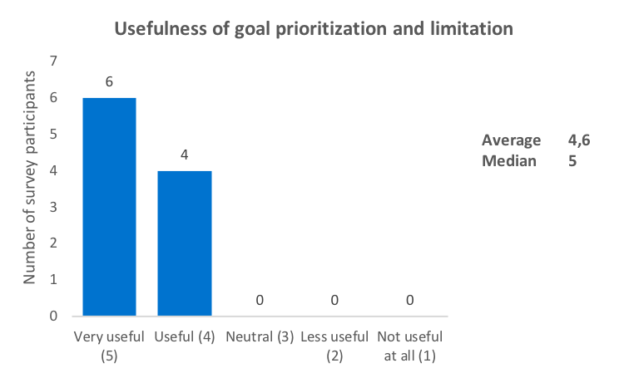
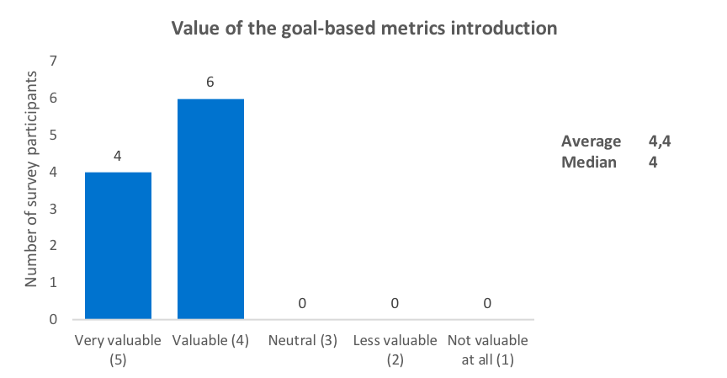
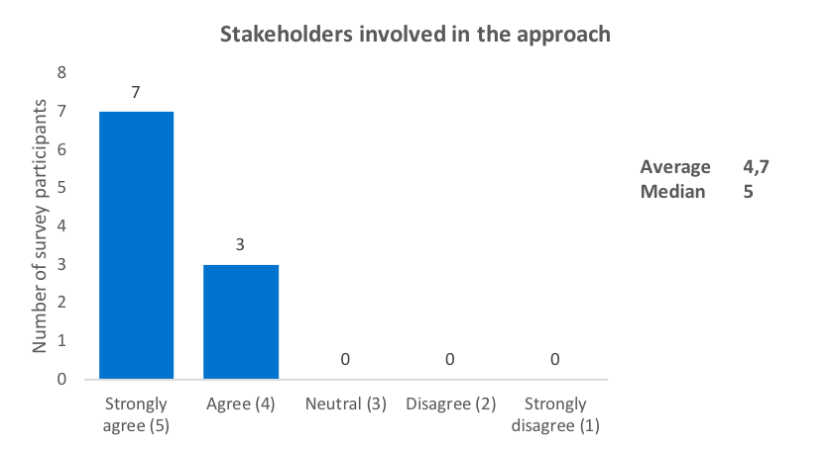
Survey results – Q1 to Q4

Slide 38
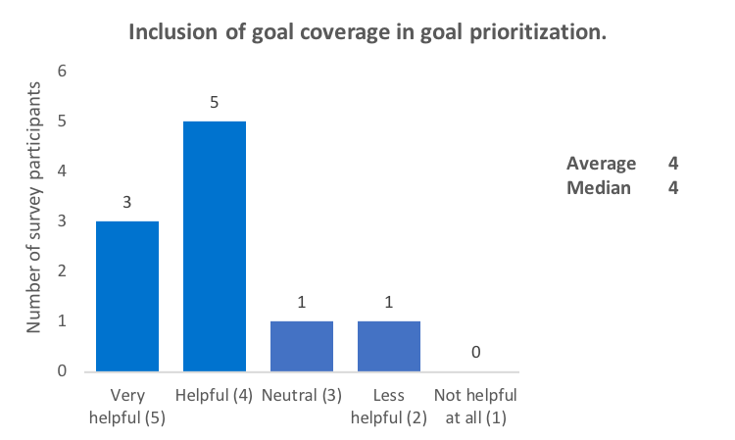
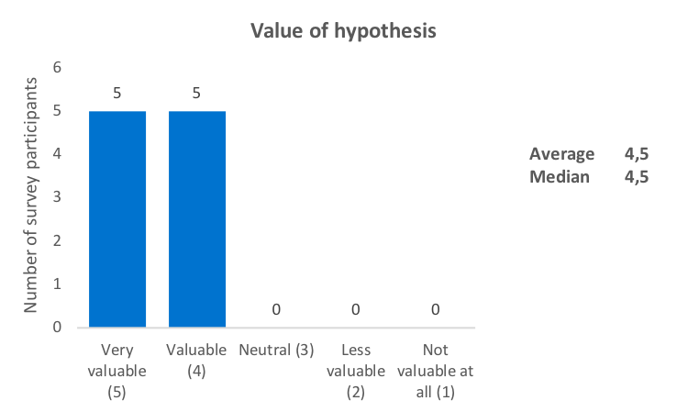
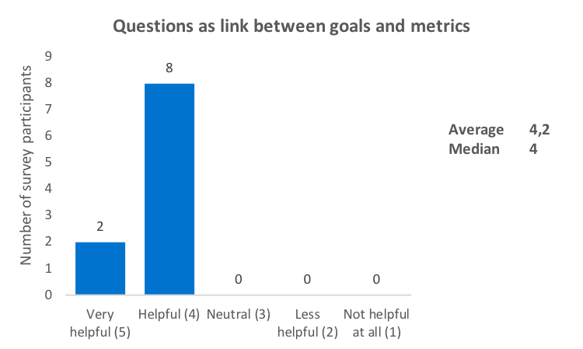
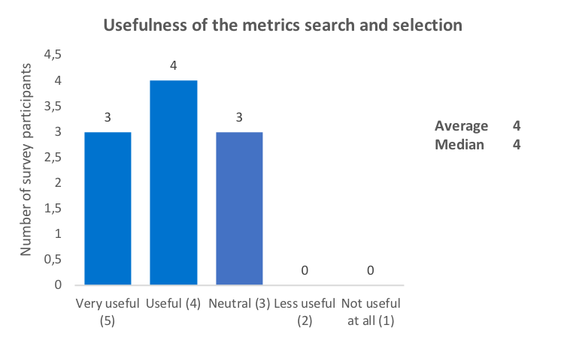
Survey results – Q5 to Q8

Slide 39
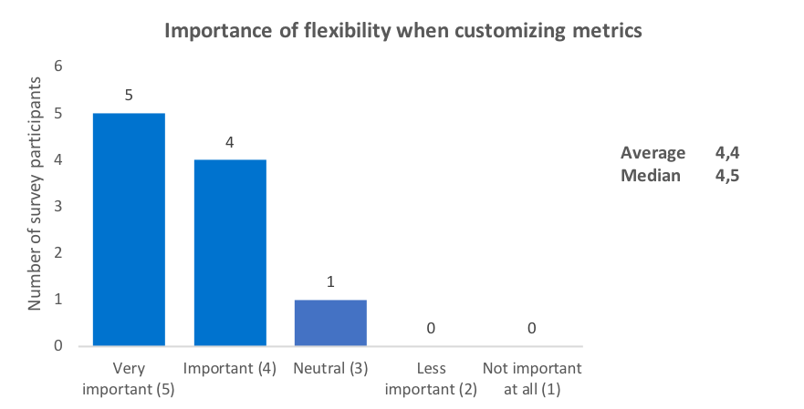
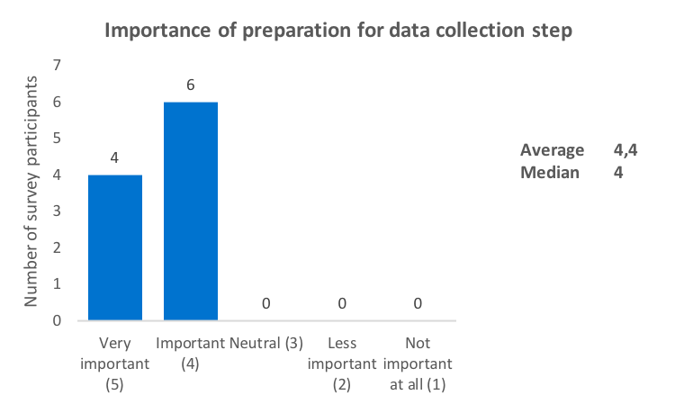
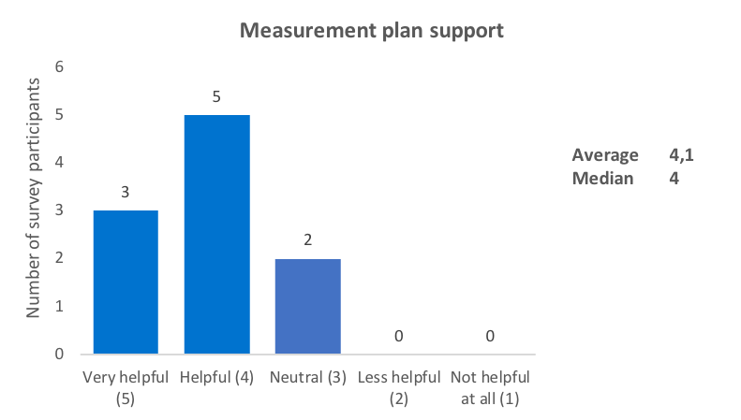
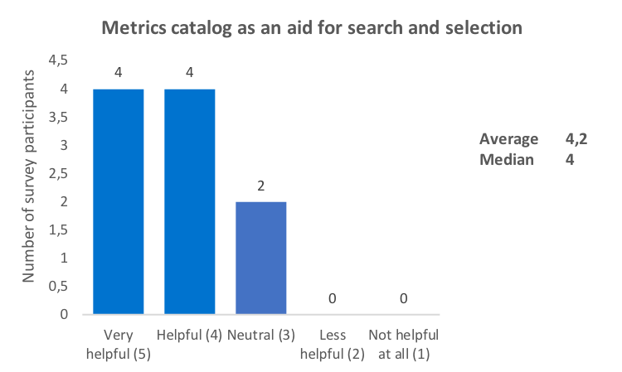
Survey results – Q9 to Q12

Slide 40
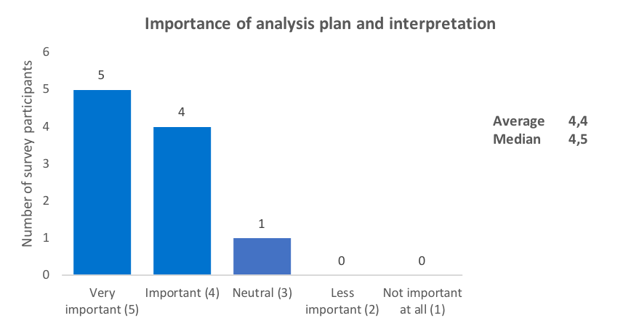
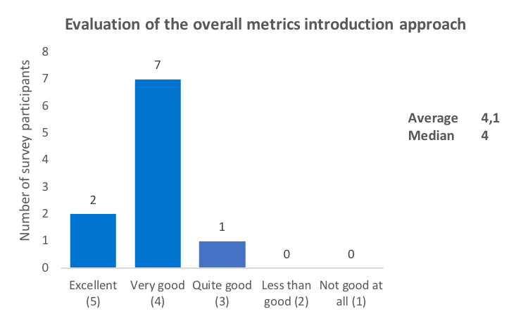
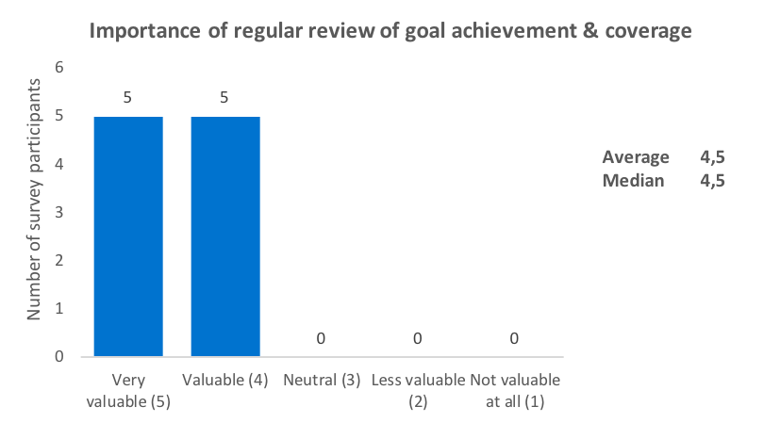
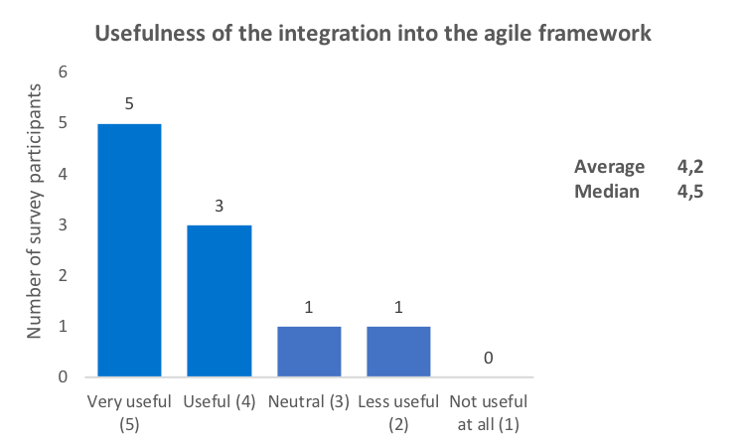
Survey results – Q13 to Q16

Slide 41
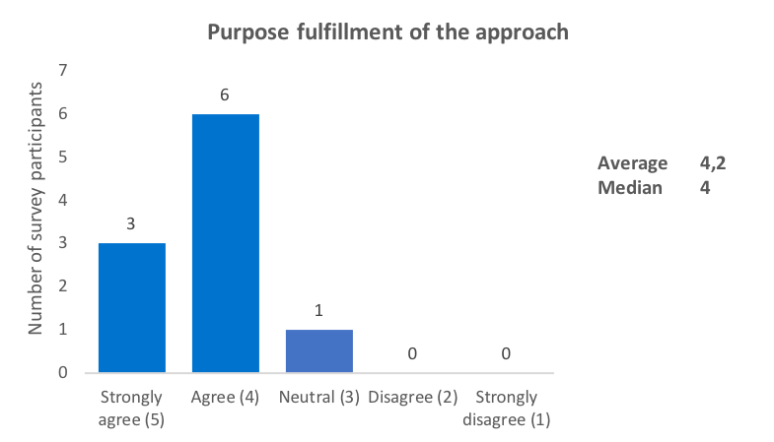
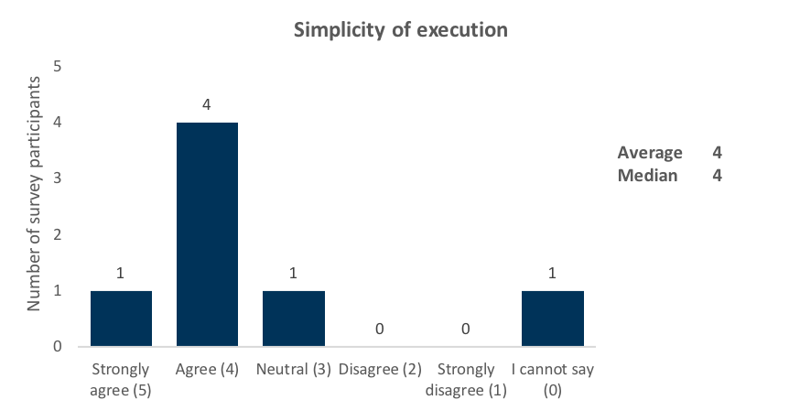
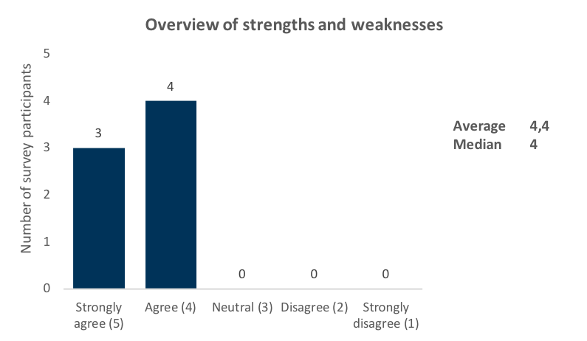
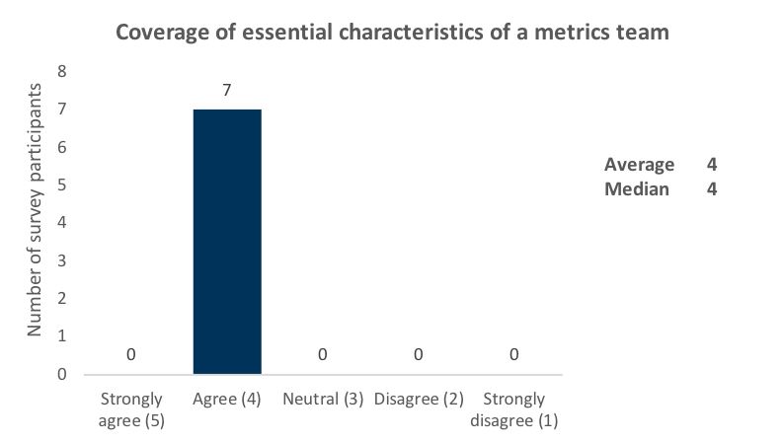
Survey results – Q17 to Q20

Slide 42
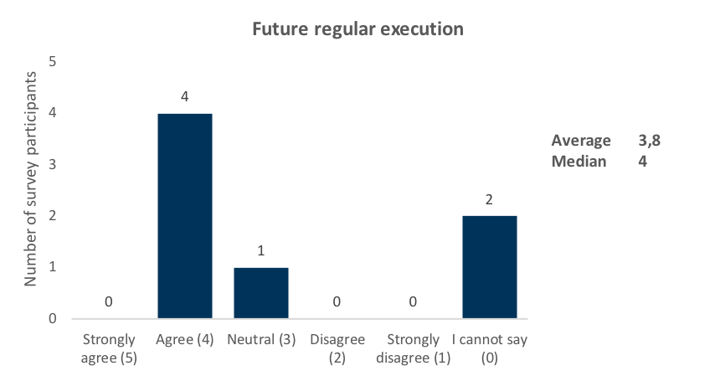
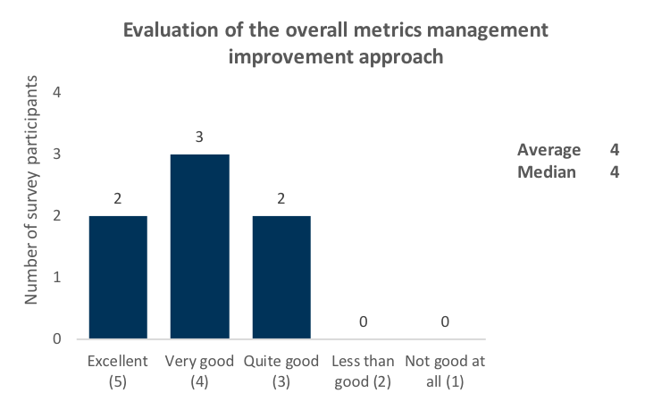
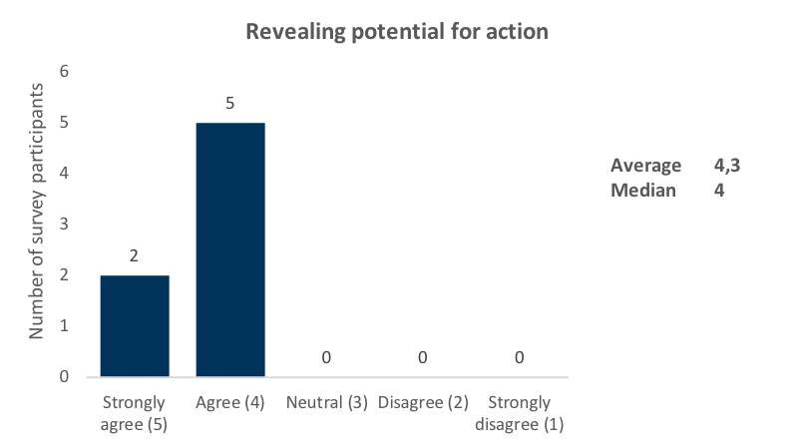
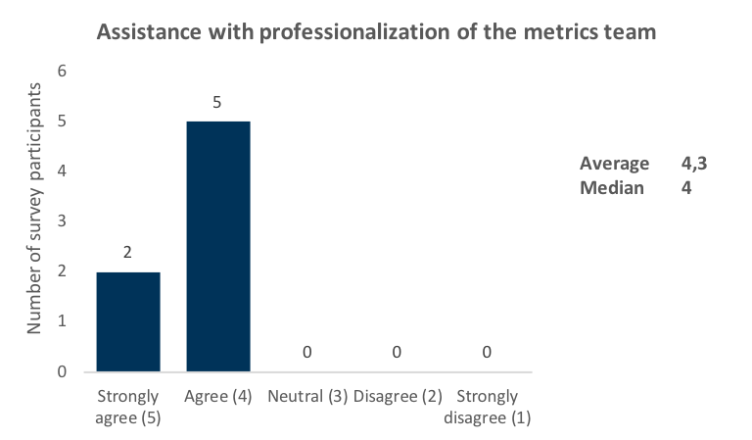
Survey results – Q21 to Q24

