Slide 1
Toward Measuring the Success of Communities of Practice in
Large-Scale Agile Software Development
Lixun Dai, June 17th, 2024, Master Thesis Kick-off Meeting

Slide 2
Outline
Motivation
Research Questions
Research Methodology
Current State
Timeline

Slide 3
Outline
Motivation
Research Questions
Research Methodology
Current State
Timeline

Slide 4



1. Motivation
Rapid Changes Drive
the Need for Agility
Technology, markets, and customers change quickly
Companies must react agilely to stay competitive
Agile Methodology Rise in Software Development
Digital world demands agile development methods
Small teams successfully use agile like Scrum
Scaling Agility Brings
New Challenges
Increased complexity from multiple teams and programs
Coordination and knowledge sharing is difficult
I.F. Schlömer (2022), M. Franco, J. Guimarães, M. Rodrigues (2023)
Ö. Uludağ et al. (2022), R. Hoda, N. Salleh, J. Grundy (2018)
K. Hutter et al. (2023), M. Kalenda, P. Hyna, B. Rossi (2018)

Slide 5




1. Motivation
Communities of Practice Proposed as a Solution
Allow knowledge exchange while preserving agility
Address cross-team coordination and information siloing
Measuring Success
is a Challenge
Suitable measures are not clear yet in practice
CoPs sounds useful but not proven in industries
Research Goal
for this Thesis
Identify characteristics that indicate CoPs are successful
Investigate existing approaches for measuring
Design a novel approach to measure the success
I. Monte, L. Lins, M.L. Marinho (2022) M. Paasivaara, C. Lassenius (2014)
Monte, L. Lins and M. Marinho (2022), Ö. Uludağ et al. (2022)
K. Hutter et al. (2023), M. Kalenda, P. Hyna, B. Rossi (2018)

Slide 6
Outline
Motivation
Research Questions
Research Methodology
Current State
Timeline

Slide 7
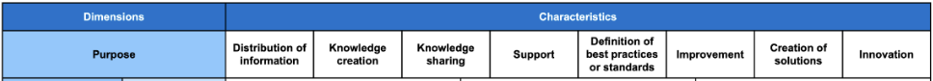
2. Research Questions
RQ1
What are the existing approaches to assessing the success of CoPs* in the context of Large-Scale Agile Software Development, Agile Software Development, and General Organizational Setting?
Structured Literature Review (Scientific & Gray) + Interviews (Coding & Analysis)
RQ2
What traditional group structures within organizations are similar to the CoPs* in the context of Large-Scale Agile Software Development and how has their success been assessed?
Literature Review (Scientific), not necessarily structured
RQ3
How could a novel approach to assessing the success of the CoPs* in the context of Large-Scale Agile Software Development be designed?
Design Science Research
*Based on Taxonomy of CoP (from Franziska Tobisch)

Slide 8
Outline
Motivation
Research Questions
Research Methodology
Current State
Timeline

Slide 9





3. Research Methodology - Design Science Research
combined with Interview Study, Expert Evaluation (Survey), and Multivocal Literature Review
Design Science Research
Hevner et al. (2004), Peffers et al. (2007)
Problem Identification
and Motivation
Objectives of a Solution
Multivocal Literature Review
(Literature and Gray Literature)
V. Garousi, M. Felderer, M. V. Mäntylä (2017)
Expert Interview Study
M. Miles , A.M. Hubermann, J. Saldaña (2018)
M. D. Myers, M. Newman (2007)
C.B. Seaman (1999)
Design and Development
Investigate related knowledge about success of
CoPs / similar approaches in the fields:
Large-Scale Agile Software Development
Agile Software Development
General Organizational Setting
Literature searched from:
Selected Academic Databases
(IEEE Xplore, Science Direct, etc.)
Gray Literature searched from:
Search Engines (Google, etc.)
LLMs (Microsoft Copilot, ChatGPT, etc.)
39 semi-structured expert interviews
(already exist)
Artifact:
Measurement Approach
for CoPs Success
Future Work
Demonstration and Evaluation
Expert Evaluation (Survey)
K. Peffers, M. Rothenberger,
T. Tuunanen, R. Vaezi (2012)
Communication
Modified from: Tobisch, F. (2021) Master Thesis Final Presentation

Slide 10
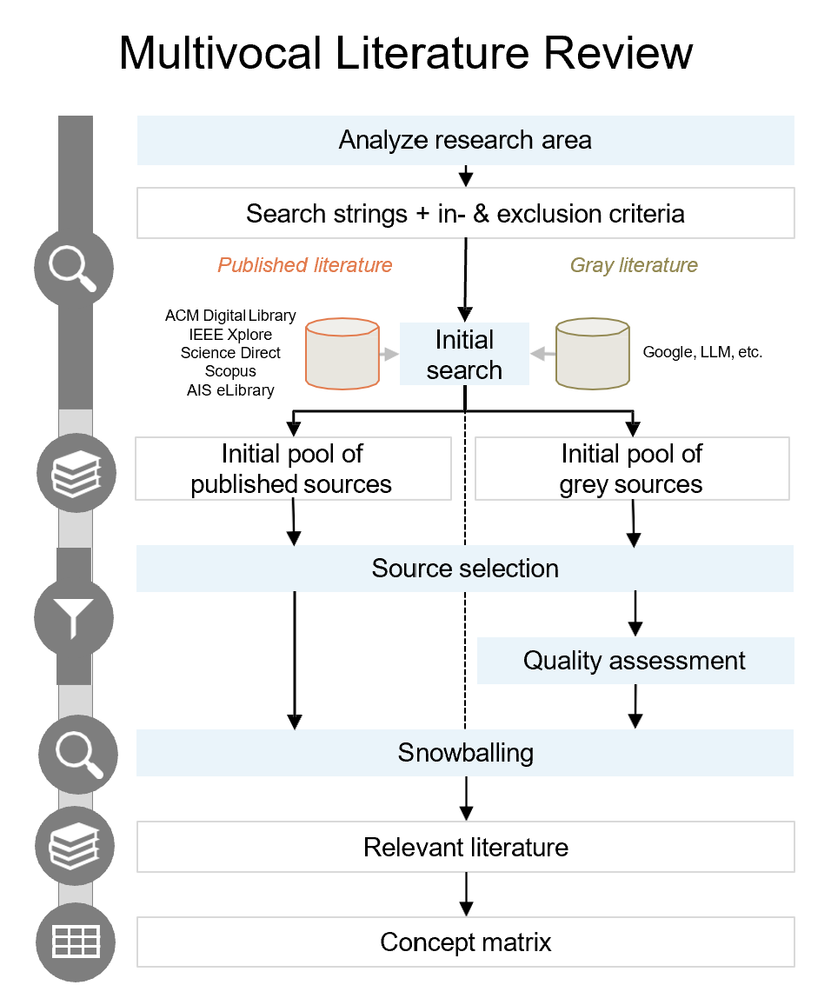
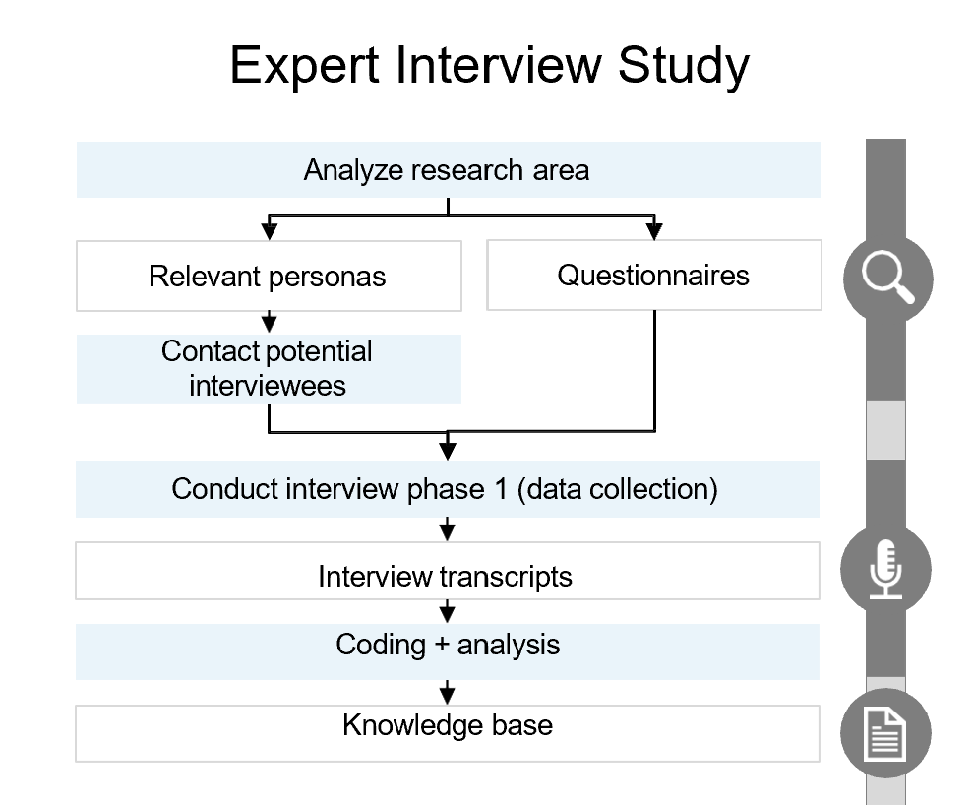
3. Research Methodology - Multivocal Literature Review & Interview Study
Modified from: Schenk, N. (2022) Master Thesis Kick-Off Presentation

Slide 11
Outline
Motivation
Research Questions
Research Methodology
Current State
Timeline

Slide 12
4. Current State - Search Strategy for RQ1

Slide 13
4. Current State - Search String for RQ1

Slide 14
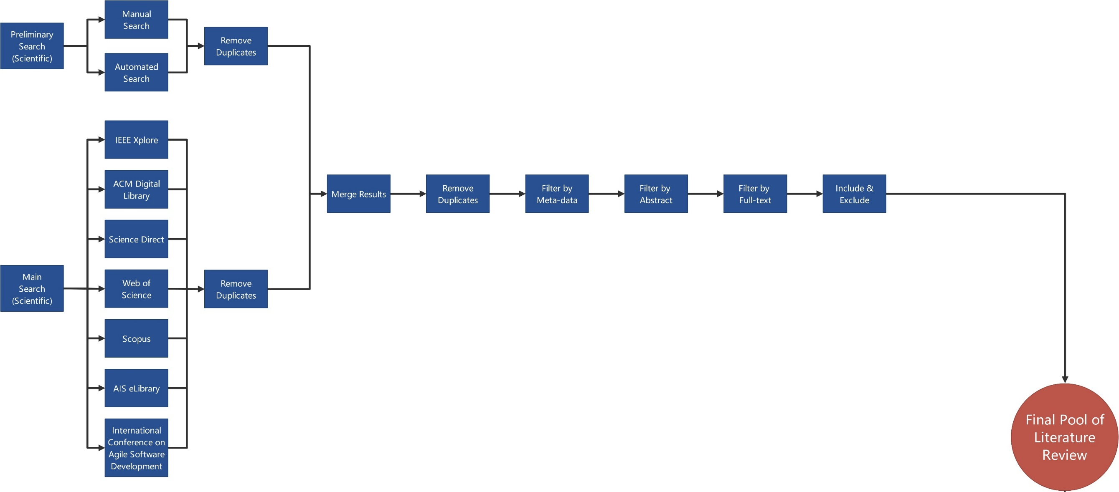
4. Current State - Process Graph of Structured Literature Review (1/2)

Slide 15
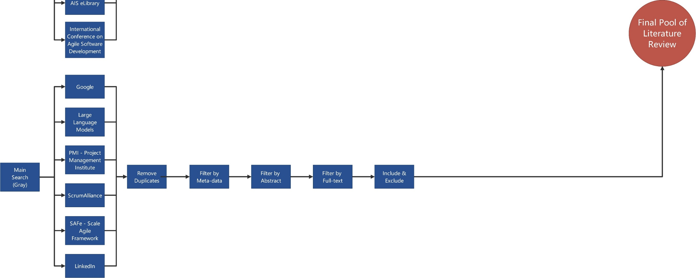
4. Current State - Process Graph of Structured Literature Review (2/2)

Slide 16
Outline
Motivation
Research Questions
Research Methodology
Current State
Timeline

Slide 17
5. Timeline
2024
June
July
Aug.
Sept.
Oct.
Nov.
Dec.
Jan.
Research
Multivocal Literature
Analysis
Literature
Analysis
Gray Literature
Coding & Analysis
Interview Results
Design Artifact
Writing
Current Date
June 17th, 2024
Registration Date
July 15th, 2024
Submission Date
January 15th, 2025
Modified from: Tobisch, F. (2021) Master Thesis Final Presentation

Slide 18
B.Eng.
Lixun Dai
17132
lixun.dai@tum.de

Slide 19
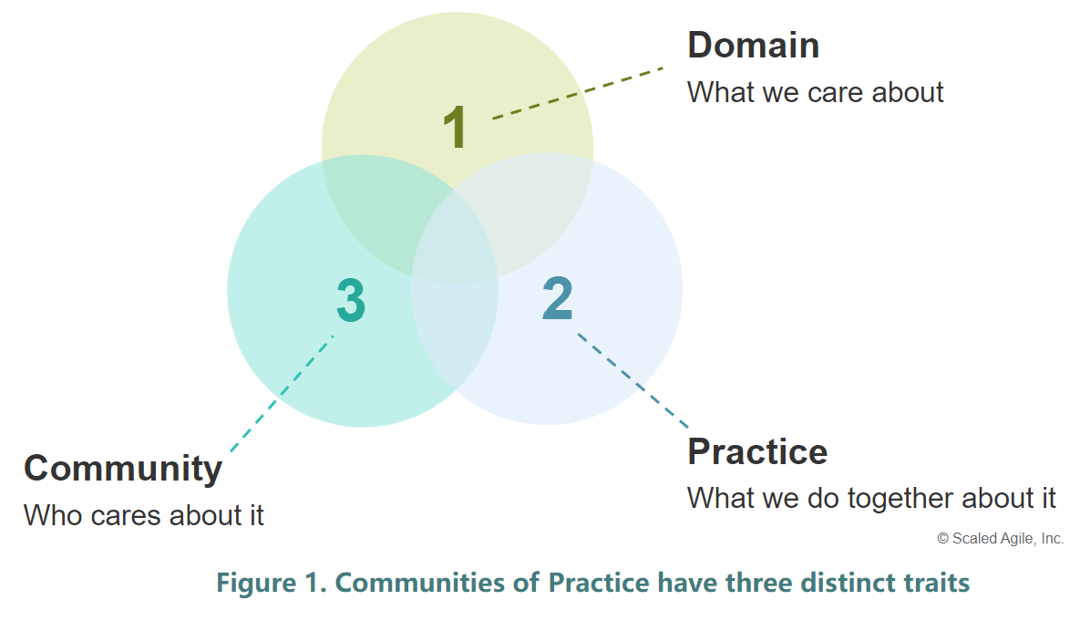
Appendix - Three Distinct Traits for CoPs
https://scaledagileframework.com/communities-of-practice/
Wenger, Etienne. Communities of Practice: Learning, Meaning, and Identity. Cambridge University Press, 1999.

Slide 20
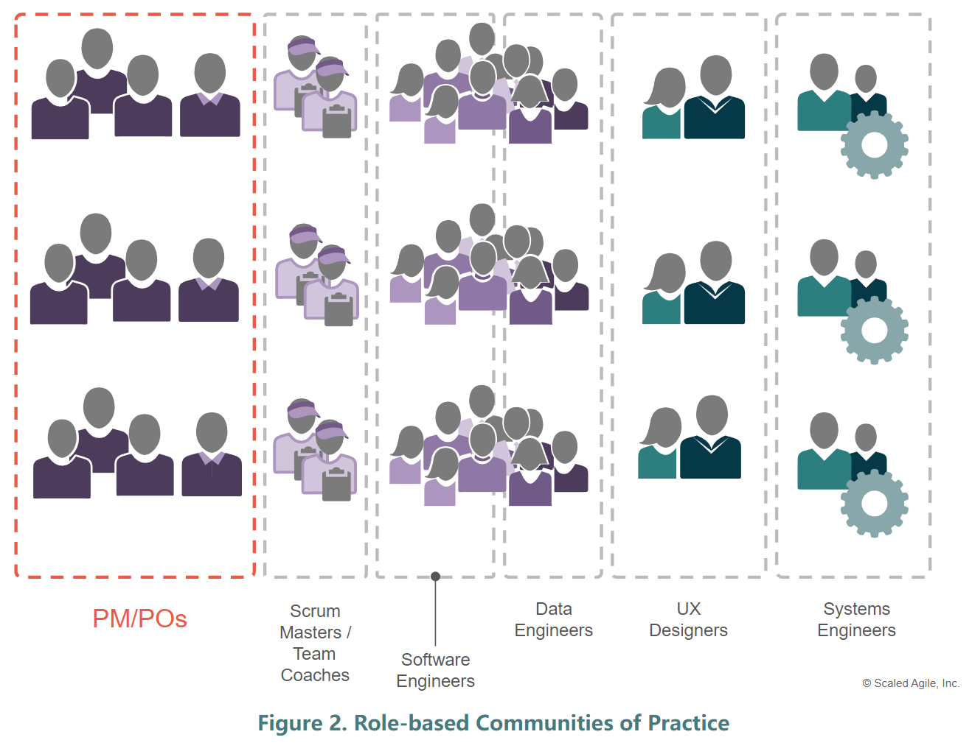
Appendix - Role-based CoPs
https://scaledagileframework.com/communities-of-practice/
Wenger, Etienne. Communities of Practice: Learning, Meaning, and Identity. Cambridge University Press, 1999.

Slide 21
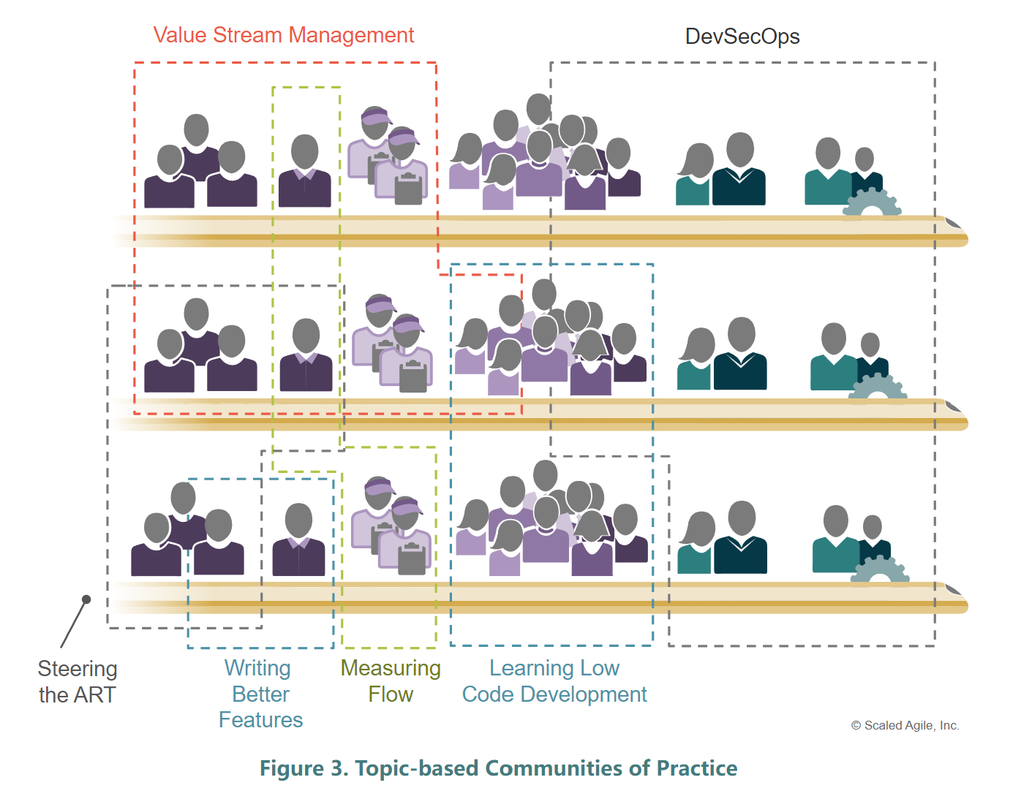
Appendix - Topic-based CoPs
https://scaledagileframework.com/communities-of-practice/
Wenger, Etienne. Communities of Practice: Learning, Meaning, and Identity. Cambridge University Press, 1999.

Slide 22
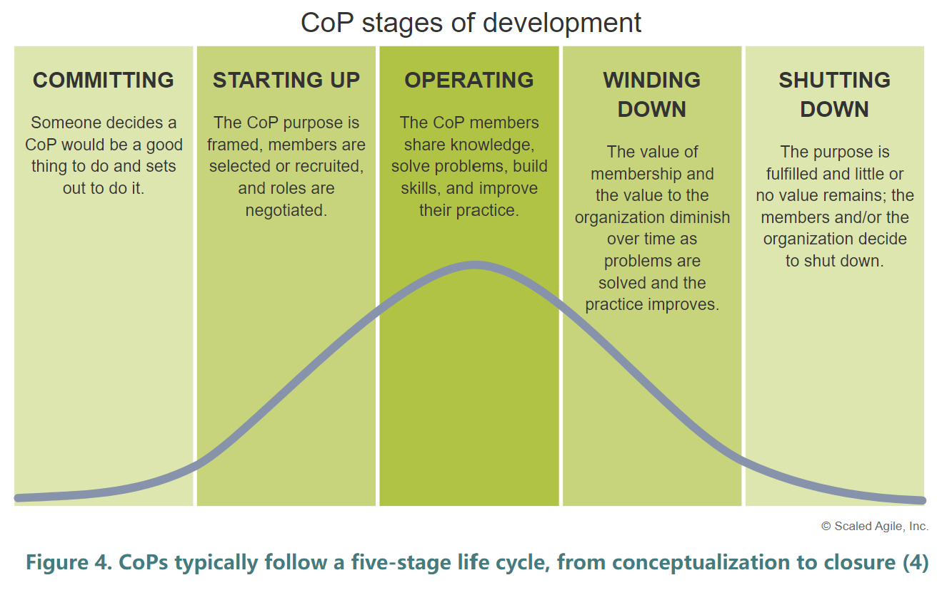
Appendix - Organizing a CoP
https://scaledagileframework.com/communities-of-practice/
Wenger, Etienne. Communities of Practice: Learning, Meaning, and Identity. Cambridge University Press, 1999.

