Slide 1
Bachelor Thesis Final Presentation: An Approach for a Semantic Information Extraction of Decisions of the Federal Court of Justice
Tobias Eyl 21.10.2019

Slide 2
Key Facts
Title: An Approach for a Semantic Information Extraction of Decisions of the Federal Court of Justice
Author: Tobias Eyl
Advisor: M.Sc. Ingo Glaser
Supervisor: Prof. Dr. Florian Matthes
Start: April 15th, 2019
End: September 15th, 2019

Slide 3
Outline
Introduction
Motivation
Problem Statement
Research Questions
How an ontology for representing semantic information of court decisions can look like?
How the key information of a court decision can automatically be extracted using NLP?
How a prototype for a semantic analysis of court decisions can be implemented?
Evaluation
Conclusion

Slide 4
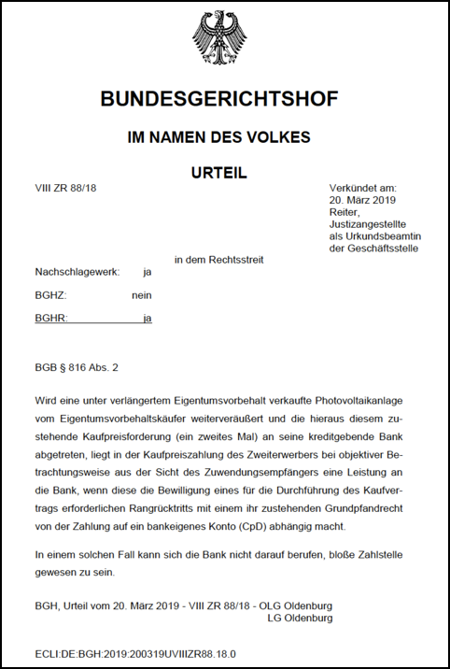
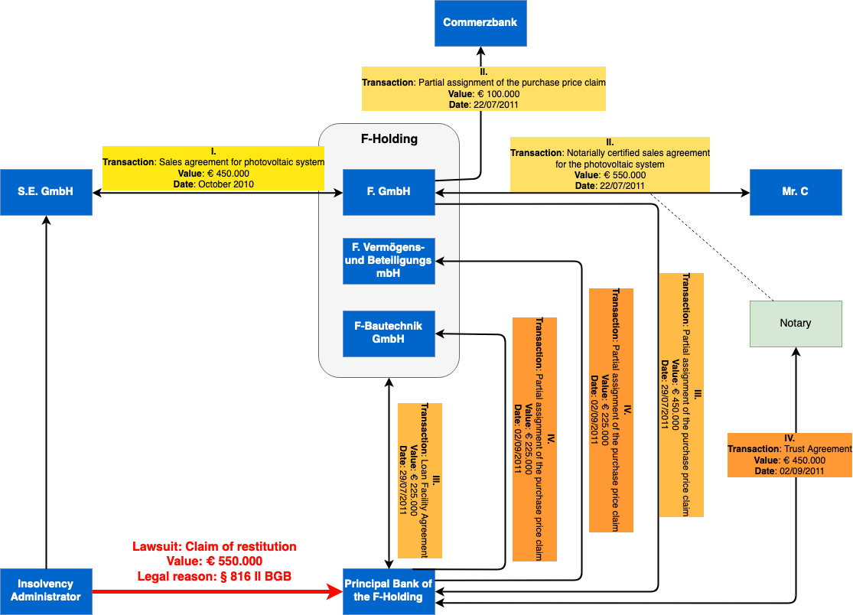
Motivation & Problem Statement

Slide 5
Outline
Introduction
Motivation
Problem Statement
Research Questions
How an ontology for semantic information of court decisions can look like?
How the key information of a court decision can automatically be extracted using NLP?
How a prototype for a semantic analysis of court decisions can be implemented?
Evaluation
Conclusion

Slide 6
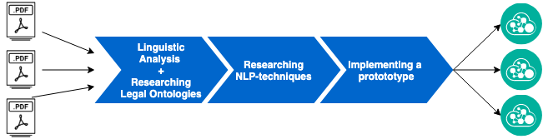
Research Process
RQ 1
RQ 2
RQ 3

Slide 7
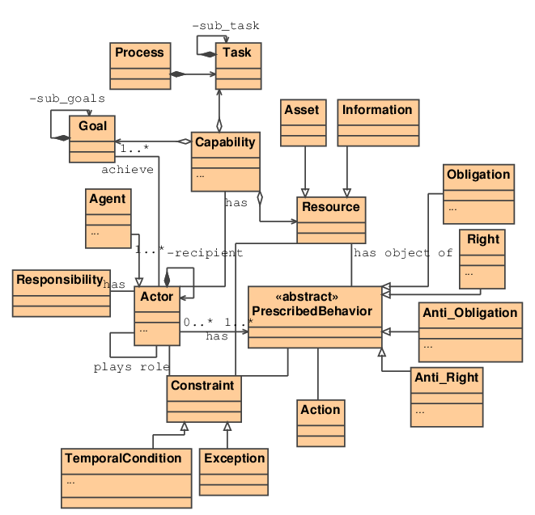
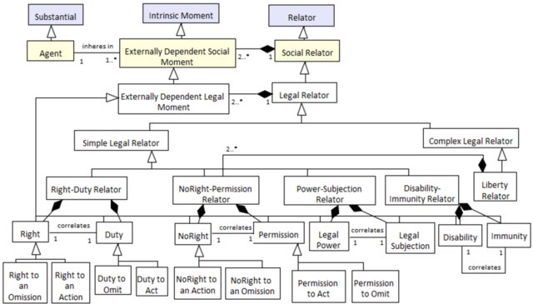
RQ1: How an ontology for representing semantic information of court decisions can look like?
Literature Research
GaiusT [10]
UFO-L [11]

Slide 8
RQ1: How an ontology for representing semantic information of court decisions can look like?
Linguistic Analysis – Example
Der Beklagte beteiligte sich mit Beitrittserklärung vom 30. Dezember 1982 über die A-GmbH als Treuhandkommanditistin mit einer Einlage von 100.000 DM zzgl. 5 % Agio an der K-KG (im Folgenden: KG), deren Zweck die Errichtung und Verwaltung von Wohn- und Geschäftsgebäuden im öffentlich geförderten Wohnungsbau war.
Der Kläger beteiligte sich mit Beitrittserklärung vom 2. Mai 2005 als Treugeber über die Beklagte als Treuhänderin mit einer Einlage von 50.000 € zuzüglich 3 % Agio an der E-P-M-GmbH&CoKG IV, einer zu einer Serie von Filmfonds gehörenden Publikumsgesellschaft.

Slide 9
RQ1: How an ontology for representing semantic information of court decisions can look like?
Linguistic Analysis – General findings [2]
Small amount of sentence patterns (even a strong structured sequence of known and new information)
Long sentences
Personifications
Nominal paraphrasing instead of using simple verbs
Chains of subordinated nouns and genitive attributes
Common phrasing
Among the different types of legal documents, judgments are the ones with the smallest syllabus

Slide 10
RQ2: How the key information of a court decision can automatically be extracted using NLP?
Comparing different parsing techniques [3]
Constituency Parsing (CP)
Dependency Parsing (DP)
CP mainly consists of two parts:
Develop a grammar to define certain groups of words which are treated as single units (constituents) of a sentence
Apply an algorithm to process a sentence’s constituents
The constituents are often defined by using a context-free grammar (CFG)
Constituents can consist of other syntactic components
The parsing algorithm determines the order in which the syntactic components are processed
DP mainly consists of two parts:
Develop a dependency grammar (DG) that defines the relation between a pair of words
Apply an algorithm to parse the generated dependency tree of a sentence.
The DG consists of a set of directed binary (grammatical) relations between the tokens
Every sentence has a designated root node with no incoming arcs
Besides the root node, every element has exactly one incoming arc
There is a unique path from the root to every other node

Slide 11
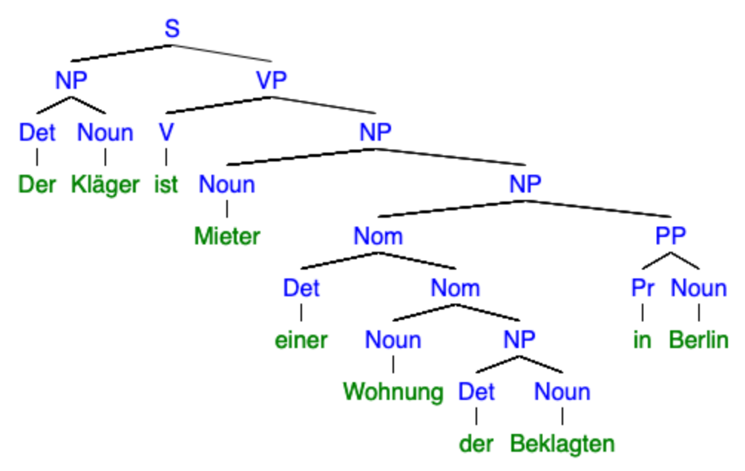
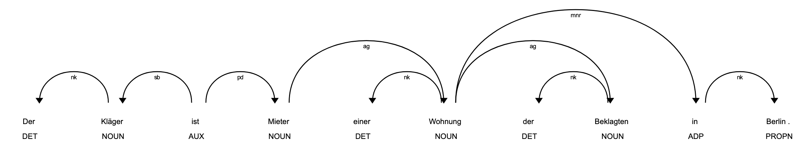
RQ2: How the key information of a court decision can automatically be extracted using NLP?
Constituency- vs. Dependency-based Parse Tree

Slide 12
RQ2: How the key information of a court decision can automatically be extracted using NLP?
Constituency vs. Dependency Parsing - Conclusion
Advantages of dependency parsing:
Incidently defines word-order and by doing so it only consists of information that is necessary for parsing
From the perspective of semantic information: By its head-dependent relations, it delivers an approximation to the semantic (legal) relations between the predicate and its arguments within a sentence
However, for the purpose of extracting the involved parties and their legal relationships between them, there is still missing semantic information when using grammatic dependency grammars!

Slide 13
RQ2: How the key information of a court decision can automatically be extracted using NLP?
Dependency Parsing & Semantic Role Labeling
Semantic Role Labeling (SRL) describes the usage of domain-specific semantic relations as dependency labels instead of using grammatical functions.
  A general disadvantage of SRL:
  → Less general, therefor, more training data needed.
  Exception - Domain specific sentences which met the following criteria [7]:
  A limited syllabus
  Word usage has patterns
  Little semantic ambiguities
  Frequently used domain jargon

Slide 14
RQ2: How the key information of a court decision can automatically be extracted using NLP?
Example of a semantically annotated sentence
What about the words without any legal meaning?

Slide 15
RQ2: How the key information of a court decision can automatically be extracted using NLP?
What about the remaining syntactic auxiliary tokens?
Grammatic dependencies
Semantic dependencies
Sentence is grouped by legal concepts themselves
Making the “legal concepts” the predicates

Slide 16
RQ2: How the key information of a court decision can automatically be extracted using NLP?
Excerpt of the developed legal ontology
Every concept is identified by keywords
Legal Root
Abtretung
Darlehen
Gesellschafts-beteiligung
Insolvenz-verwaltung
Kaufvertrag
Mietvertrag
...

Slide 17
RQ2: How the key information of a court decision can automatically be extracted using NLP?
Legal Concepts and their dependencies
Gesellschaftsbeteiligung
Anteilseigner
Beteiligungsform
Mietvertrag
Mieter
Vermieter
Beteiligungssumme
Agio
Beteiligungsform
Treugeber
Treuhänder
Miethöhe
Mietgegenstand
Ort

Slide 18
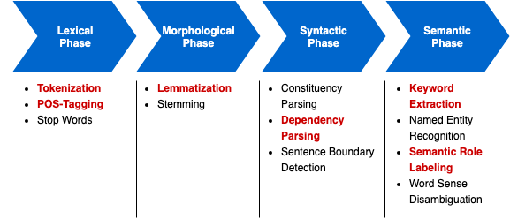
RQ3: How a prototype for a semantic analysis of court decisions can be implemented?
NLP pipeline
Prototype is based on the NLP-library spaCy

Slide 19
Outline
Introduction
Motivation
Problem Statement
Research Questions
How an ontology for semantic information of court decisions can look like?
How the key information of a court decision can automatically be extracted using NLP?
How a prototype for a semantic analysis of court decisions can be implemented?
Evaluation
Conclusion

Slide 20
Evaluation
 | Without POS-component | With POS-component
UAS | 79.46 | 80.10
LAS | 42.94 | 68.37
Despite the limited amount of annotated training data, the approach reaches a relatively high LAS.

Slide 21
Outline
Introduction
Motivation
Problem Statement
Research Questions
How an ontology for semantic information of court decisions can look like?
How the key information of a court decision can automatically be extracted using NLP?
How a prototype for a semantic analysis of court decisions can be implemented?
Evaluation
Conclusion

Slide 22
Conclusion
RQ1: How an ontology for representing semantic information of court decisions
can look like?
→ Developed a first version of an ontology for representing semantic information within
sentences of the section “Tatbestand” from civil law cases of the Federal Court of Justice.
RQ2: How the key information of a court decision can automatically be extracted
using NLP?
→ Developed a concept for a dependency parser using semantic labels as dependency labels
RQ3: How a prototype for a semantic analysis of court decisions can be implemented?
→ Achieved to implement a prototype based on the NLP-library spacy

Slide 23
Limitations & Future Work
Create more annotated training data
Extend ontology to support annotating and extracting information from relative clauses (Coreferencing)
Improve quality of parsing algorithm to extract semantic information and add support of extracting hierarchically wrapped legal concepts (this can be mainly reached by having more training data available and thereby a better dependency parser model)
Improve quality of preprocessing
Necessity of manually defining which party is the plaintiff and which is the defendant since not all judgments explicitly name it

Slide 24
References
Busse, D.: Rechtssprache als problems der Bedeutungsbeschreibung. Semastische Aspekte einer instituonellen Fachsprache. Sprache und Literatur. 29(1):24–47. 1998.
Hansen-Schirra, S.; Neumann, S.: Linguistische Verständlichmachung in der juristischen Realität. Lerch, Kent D.(Hg.): Recht Verstehen. Verständlichkeit, Missverständlichkeit und Unverständlichkeit von Recht. Berlin/New York: de Gruyter. pages 167–184. 2004
Jurafsky, D.; Martin, J. H.: Speech and Language Processing (2nd Edition). Prentice-Hall, Inc. 2009. 0131873210.
Sleimi, Amin & Sannier, Nicolas & Sabetzadeh, Mehrdad & Briand, Lionel & Dann, John. (2018). Automated Extraction of Semantic Legal Metadata using Natural Language Processing. 124-135. 10.1109/RE.2018.00022.
Wyner A., Mochales-Palau R., Moens MF., Milward D. (2010) Approaches to Text Mining Arguments from Legal Cases. In: Francesconi E., Montemagni S., Peters W., Tiscornia D. (eds) Semantic Processing of Legal Texts. Lecture Notes in Computer Science, vol 6036. Springer, Berlin, Heidelberg
Kiperwasser, E.; Goldberg, Y.: Simple and Accurate Dependency Parsing Using Bidirectional LSTM Feature Representations. Transactions of the Association for Computational Linguistics. 4:313–327. 2016
Li, J.; Zhang, L.; Yu, Y.: Learning to Generate Semantic Annotation for Domain Specific Sentences. In Semannot@K-CAP 2001.
Nivre, J.; Fernández-González, D.: Arc-Eager Parsing with the Tree Constraint. Computational Linguistics. 40:259–267. 2014.
Nivre, J.: An Efficient Algorithm for Projective Dependency Parsing. Proceedings of the Eighth International Conference on Parsing Technologies. pages 149–160.
Zeni, N.; Kiyavitskaya, N.; Mich, L.; Cordy, J. R.; Mylopoulos, J.: GaiusT: supporting the extraction of rights and obligations for regulatory compliance. Requirements Engineering. 20(1):1–22. 2015
Griffo, C.; Almeida, J. P. A.; Guizzardi, G.: Conceptual Modeling of Legal Relations. Conceptual Modeling. pages 169–183. Springer International Publishing.
Akbik, A.; Li, Y.: K-SRL: Instance-based Learning for Semantic Role Labeling. Proceedings of COLING 2016, the 26th International
Conference on Computational Linguistics: Technical Papers. pages 599–608. The COLING 2016 Organizing Committee
Höfler, S., Bünzli, A., Northfleet, C., Silva, D.D., Bridi, P., Granada, R., Vieira, R., Rao, P., Sander, T., Nallapati, R., Manning, C.D., Wyner, A.Z., & Peters, W. (2010). Legal Claim Identification : Information Extraction with Hierarchically Labeled Data. https://nlp.stanford.edu/pubs/lrec_splet10-surdeanu.pdf
Cavar D, Herring J., Meyer A. (2018) Case Law Analysis using Deep NLP and Knowledge Graphs. In : Rehm G., Rodríguez-Doncel V., Moreno-Schneider J. Proceedings of the Eleventh International Conference on Language Resources and Evaluation (LREC 2018), ELRA, Paris
Athan T., Boley H., Governatori G., Palmirani M., Paschke A., Wyner A. (2013) LegalRuleML: From Metamodel to Use Cases. In: Morgenstern L., Stefaneas P., Lévy F., Wyner A., Paschke A. (eds) Theory, Practice, and Applications of Rules on the Web. RuleML 2013. Lecture Notes in Computer Science, vol 8035. Springer, Berlin, Heidelberg

Slide 25
Tobias Eyl
17132
matthes@in.tum.de

Slide 26
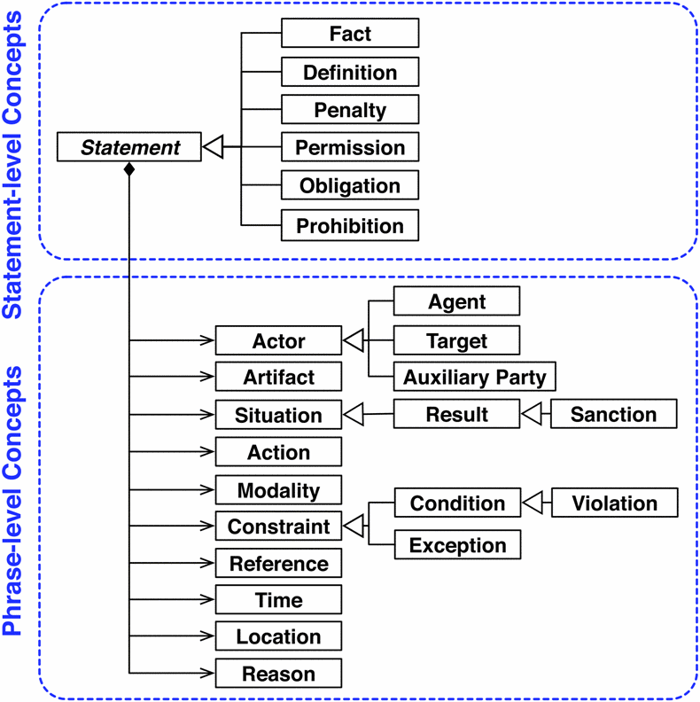
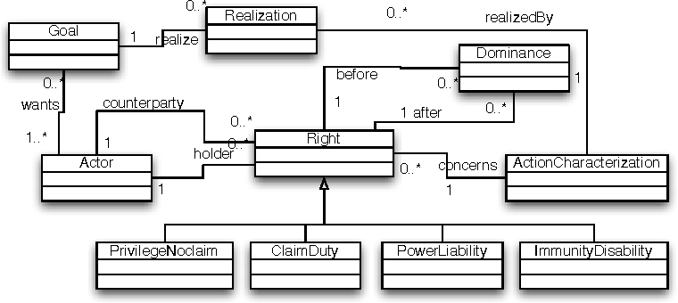
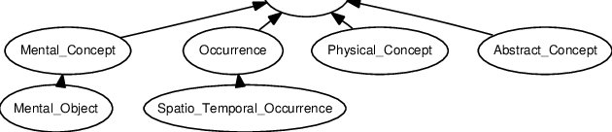
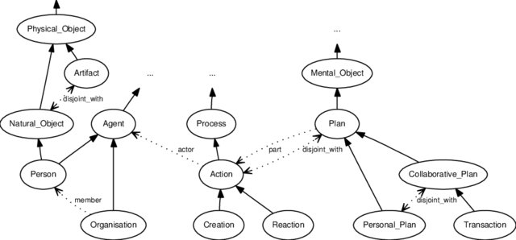
Legal Ontologies

Slide 27
Legal Ontologies

