Slide 1
Designing a data access control concept for the Knowledge4Retail platform
Kilian Dresse, 16.05.2022, Final Presentation

Slide 2
Agenda
Motivation
Research Design
Results
Evaluation
Limitations
Conclusion

Slide 3




Motivation
Access control for the K4R platform
Optimizing product placements
Optimize retailer’s internal product logistics
Handling traffic between various components controlled by a digital twin
Knowledge4Retail needs a data access control concept
Notes:
- digitalize the stationary retail through AI and robotic powered applications
Optimize product placement to improve customer experience and drive turnover
K4R partnering with various organization
At the heart of the platform lies a digital twin
Digital replication of a physical object
- Centralized database for the other components to access
- Made up of multiple use cases to achieve these goals
- To handle traffic between the various component
- the access on the digital twin and other components needs to be controlled create secure environment

Slide 4
Research Design
From interview-based analysis to the access control model
Foundations and Background
Role-based access control
  Assign roles to all entities about what it can access
Data flows and involved organizations
Semi-structured interviews
Requirement analysis for roles and organizations
  Understand the data flow
  Define roles for the different components
Data access control concept
Incorporate results from
Literature review
Requirement analysis
Notes:
- Literarture Review
- Access control model

Slide 5
Research Questions
RQ1
How to model data flows within the Knowledge4Retail platform for associated organizations and roles?
RQ2
What are requirements of partner organizations for a Knowledge4Retail data access control concept?
RQ3
How to design a data access control concept for the Knowledge4Retail platform?
Notes:
How to model data flows within the Knowledge4Retail platform for associated organizations and roles? What are requirements of partner organizations for a Knowledge4Retail data access control concept? And How to design a data access control concept for the Knowledge4Retail platform? All of which are corresponding to one of the research design sections.

Slide 6


Expert Interviews
With experts from the different sectors of the project
Interview Partners
Questioning
Six Interviewees from various partners of the project
Each expert in a different sector
  From dm, DFKI, Uni Bremen, nagarro
Access roles
  Components of the platform
  Staff of supermarket chains
On-Premise vs. Cloud

Slide 7
Data flows of the platform
Overview
Notes:
Data flow can be divided into four sectors
- digital twin
- external
- staff
- use cases

Slide 8
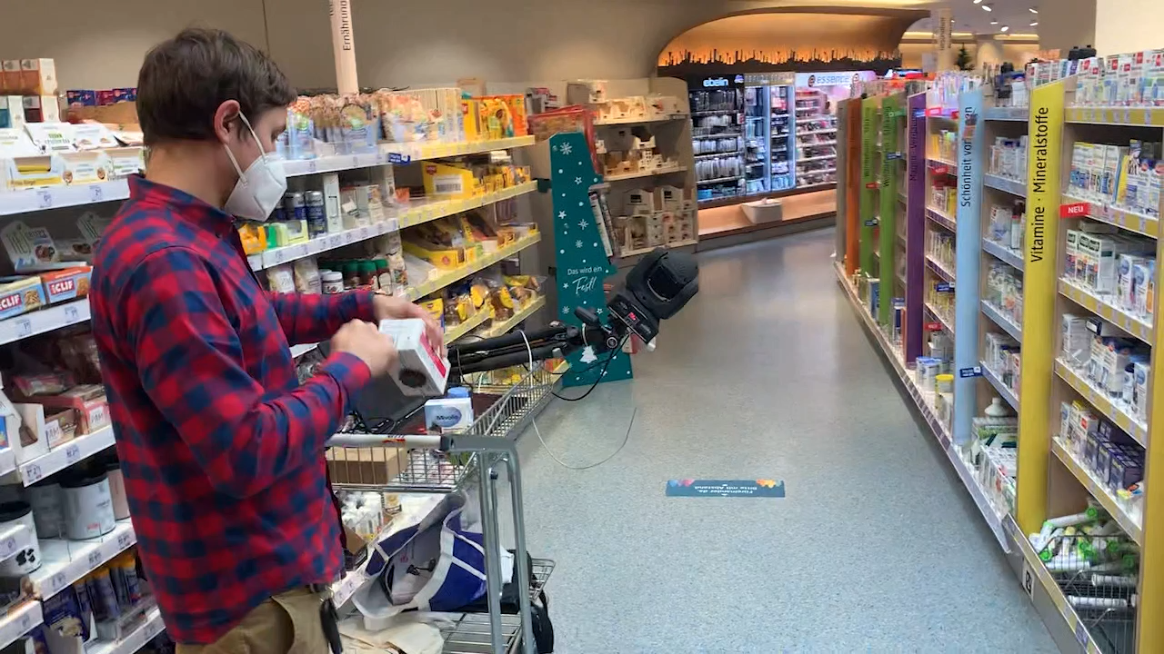
Data flows of the platform
The example of the optimized stocking strategy

Slide 9
Digital Twin and its access objects
Overview
Notes:
Overview of the different access objects of the system
Quick workaround on the left side

Slide 10
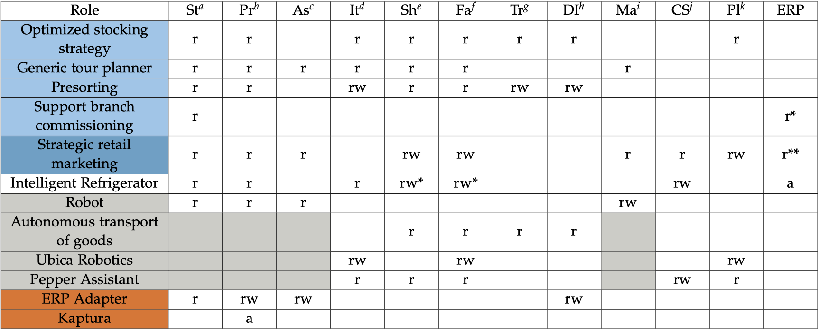
Access control list of the digital components
Overview
Role | Store | Product | Item | Shelf & Layer | Trolley | DeliveredItem | Planogram
Optimized stocking strategy | Read-only | Read-only | Read-only | Read-only | Read-only | Read-only | Read-only
Notes:
Access control list of the digital components
Only read access since it is solely assisting and does not place the items itself

Slide 11
Role Hierarchy – Staff
A role has all rights of roles beneath
Notes:
Corresponding access control lists not shown

Slide 12


Hosting Approach
On-Premise vs. Cloud
Supermarket chains
Small retailers
Company internal hosting
  Full control over system
  Possibility to enhance and change system to its needs
Cloud hosting through K4R
  Less administration and setup

Slide 13


Evaluation
Two experts from implementation side and supermarket side
General agreement with the chosen roles and data flows in the system
Most chosen access rights were regarded as reasonable
Implementation may differ from presented concept
Minor suggestion for the chosen access rights

Slide 14


Limitations
Opinions on the functionality are not coordinated
  Makes room for different interpretations
  Concept serves as one possible solution
Focus on dm as the only retail partner in the interviews

Slide 15
Conclusion & Future Work
Data flows and access roles for the Knowledge4Retail platform
Conclusion
Created elements of a role-based access control concept for the K4R platform
  All components and resources
  Role hierarchies
  Access rights
  Hosting proposal
Future Work
Foundation for an access control concept of the platform
Presentation of initial results for a hosting approach
Providing an approach for conceptualizing an access control concept of an interdisciplinary project

Slide 16
Prof. Dr.
Florian Matthes
17132
matthes@in.tum.de

