Slide 1
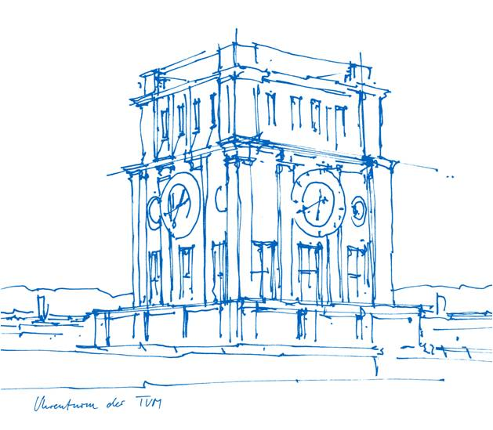
Bachelor Thesis:
Identification of a minimal set of interaction patterns to support a service-oriented manufacturing IT landscape
Student: Sandro Stürzenhofecker
Advisor: Peter Kuhn
Supervisor: Prof. Dr. Florian Matthes
Technical University of Munich
Department of Informatics
Chair of Software Engineering for Business
Information Systems
Munich, 2nd of May 2022
Notes:
1

Slide 2





Bigger Picture: Which layer are we looking at?
Enterprise IT
Level
ERP
PDM/PLM
Manufacturing IT
Level
Message Bus
Receives orders, material volume
and comparable from ERP
Supports employee activities e.g.
with manuals
Monitors production
Processes machine & production data
Advanced Services
Supporting Services
MES
MQTT
REST
OPC-UA
Middleware
Manufacturing OT
Level
(Shopfloor)
Gateway
Captures and standardizes
machine & production data
proprietary
2

Slide 3

Bigger Picture: Why do we need the interaction patters?
Enterprise IT
Enterprise IT
Manufacturing as-is architecture
Manufacturing to-be architecture
Silo factory A
Silo factory B
Silo factory C
Manufacturing IT platform
Message Bus
Manufacturing IT
Manufacturing IT
Manufacturing IT
Operating data acquisition
Existing Service
Existing Service
Existing Service
Existing Service
New Service
…
…
…
…
…
…
Local Manu-facturing IT
Local Manu-facturing IT
Local Manu-facturing IT
Existing Service
Existing Service
Machine data acquisition
Middleware
Middleware
Middleware
Manufacturing OT
Manufacturing OT
Manufacturing OT
Manufacturing OT
Manufacturing OT
Manufacturing OT
3
Notes:
Currently 3 silos representing a factory each
Synergies are not utilized in the manufacturing IT
Hard to rollout new services or updates to existing ones
Not all machines are connected, not all production data is captured
Goal is one standardized manufacturing IT located in munich
Communication with the plants is standardized/translated through a middleware
Message Bus handles interactions between services & towards other layers

Slide 4

Thesis goal
Enterprise IT
Starting point:
3-4 generic (core) use cases describing the demanded communication for services of the manufacturing IT platform and its ecosystem, as well as in between services of the manufacturing IT platform.
Manufacturing to-be architecture
Manufacturing IT platform
Message Bus
Existing Service
Existing Service
New Service
Goal:
Identify the required interaction functionalities by analyzing the use cases and derive a minimal set of interaction patterns for the communication architecture of the future manufacturing IT platform of the case study provider, that satisfy the identified demand.
Local Manu-facturing IT
Local Manu-facturing IT
Local Manu-facturing IT
Middleware
Middleware
Middleware
Manufacturing OT
Manufacturing OT
Manufacturing OT
4

Slide 5
Use Cases
Enterprise IT
Manufacturing to-be architecture
Manufacturing IT platform
Use Case 1
Use Case 2
Use Case 3
(Use Case 4 ?)
Message Bus
Existing Service
Existing Service
New Service
Local Manu-facturing IT
Local Manu-facturing IT
Local Manu-facturing IT
Middleware
Middleware
Middleware
Manufacturing OT
Manufacturing OT
Manufacturing OT
5

Slide 6
Approach/Research Questions
What are the types of interactions to fulfill the use cases of a manufacturing IT platform of a high-tech electronics manufacturer?
Research Design: Literature review, use case study & explorative expert interviews with solution
architects of the case study provider
Expected Result: Set of relevant interaction capabilities
What is a suitable set of interaction patterns for a manufacturing IT platform?
Research Design: Iterative approach, literature review
Expected Result: Overview of interaction patterns
What is a minimal set of interaction patterns to satisfy the demand of the given use cases?
Research Design: Use case analysis, combining the findings of RQ1 & RQ2
Expected Result: Set of interaction patterns, that satisfy the communication requirements
6

Slide 7
Thesis scope
 | In Scope | Out of Scope | Never in Scope
Interaction Protocols (MQTT, AMQP, SOAP/WSDL, …) | X
Interactions (publish-subscribe, push-pull, sync-async, …) | X
Persistence behavior (expire/retry, storing/logging, alerting) | X
Fallout, exception & error patterns | X
Security (authorization, authentication, encryption, …) |  | X
Hosting (cloud/on premise) |  | X
Cost minimization & monitoring |  | X
Monitoring, maintenance, administration |  | X
API naming convention & versioning & monitoring |  | X
Certificate management |  | X
Streaming |  |  | X
Service-Mesh |  |  | X
Hardware infrastructure |  |  | X
7

Slide 8
Thesis artifact example
Name | Subscription Pattern
Actors | Publisher: The actor, who rises new information Subscriber: The actor, who receives a notification about the new information
Description | The Publisher publishes new information e.g. by uploading data As soon as the data arrives, each subscriber receives a notification, that there is new information available
Sketch
Possible Nested Patterns | Fire and forget Confirmation and retry …
Subscriber
Publisher
Subscription service
1.
2.
Subscriber
8

Slide 9
Thesis: Schedule
March
April
May
June
July
Aug.
Identification & documentation of core use cases
Background literature research: Platformization & Interactions
RQ 1: Identify demanded interactions
RQ 2: Interaction patterns overview
RQ 3: Minimized applicable set
Application
Submission Deadline
9

