Slide 1
Towards Self-Service Analysis and Integration of Publicly Available Data Sources for Corporate Security
Malte Brockmann, 8th of February 2019, Munich, Kickoff Presentation - Master Thesis
Notes:
Kickoff Presentation
Title
Thesis with BMW
Had internship have a year ago
Patrick

Slide 2





Agenda
Initial Situation
Motivation
Research Question
Approach
Timeline

Slide 3


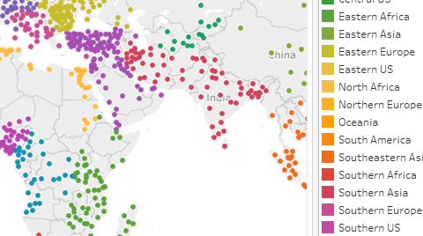

Initial Situation
Sources
Data Lake
Views
External Sources
Incidents
Internal Sources
Incidents
Group Directory
Notes:
Security situation Analysis System
Data Lake
Technologie use for big Data → just put stuff in
External
Anvil -> email -> processed
Internal -> incidents, travel, group directory (locations)
Lake -> matching distants
View
Dashboards
Reports for Differnt hiracical level
→ Manual work

Slide 4

Motivation
Current Situation for Changes
Goal
Corporate security department
Goals:
Easy access to data sources
Flexibility with existing data sources
Self-service
Corporate security department
Direct access to data sources
Work with data independently
To implement goals:
contact
IT department
Impediments:
High complexity
High costs
Low process speed
To implement goals:
contact
IT department
Notes:
CSD
IT:
High integration manpower cost to add new sources
Infrastructure cost (data lake not build for use case)
Could take time im requirement / User story is not prioritiesed
Self-service:
Cut out the middle man
Probleme klar definieren

Slide 5


Motivation
GLOBALEVENTID | SQLDATE | MonthYear | Year | FractionDate | Actor1Code | Actor1Name | Actor1CountryCode | Actor1KnownGroupCode | Actor1EthnicCode | Actor1Religion1Code | Actor1Religion2Code | Actor1Type1Code | Actor1Type2Code | Actor1Type3Code | Actor2Code | Actor2Name | Actor2CountryCode | Actor2KnownGroupCode | Actor2EthnicCode | Actor2Religion1Code | Actor2Religion2Code | Actor2Type1Code | Actor2Type2Code | Actor2Type3Code | IsRootEvent | EventCode | EventBaseCode | EventRootCode | QuadClass | GoldsteinScale | NumMentions | NumSources | NumArticles | AvgTone | …
526870433 | 20160403 | 201604 | 2016 | 20.162.548 | LEG | CONGRESS | null | null | null | null | null | LEG | null | null | null | null | null | null | null | null | null | null | null | null | 1 | 190 | 190 | 19 | 4 | -10.0 | 65 | 4 | 45 | -3.87019321369491 | …
459554803 | 20150821 | 201508 | 2015 | 20.156.329 | COP | DEPUTY | null | null | null | null | null | COP | null | null | null | null | null | null | null | null | null | null | null | null | 1 | 15 | 15 | 1 | 1 | 0.0 | 365 | 37 | 345 | -7.60546699954661 | …
294461014 | 20140422 | 201404 | 2014 | 20.143.068 | USA | TWIN FALLS | USA | null | null | null | null | null | null | null | JUD | PUBLIC DEFENDER | null | null | null | null | null | JUD | null | null | 1 | 84 | 84 | 8 | 2 | 7.0 | 5 | 1 | 5 | 0.0 | …
Placement | Dataset | Edition | GLOBAL ID | Series code | Series | Series unindented | Attribute | ALB
Placement | Dataset | Edition | GLOBAL ID | Code GCR | Series | Series unindented | Attribute | Albania
1 | Global Competitiveness Index | 2017-2018 | EOSQ051 | 1,01 | 1.01 Property rights, 1-7 (best) | Property rights, 1-7 (best) | Value | 3,70733666
1 | Global Competitiveness Index | 2017-2018 | EOSQ051 | 1,01 | 1.01 Property rights, 1-7 (best) | Property rights, 1-7 (best) | Period | Weighted average 2016-2017
1 | Global Competitiveness Index | 2017-2018 | EOSQ051 | 1,01 | 1.01 Property rights, 1-7 (best) | Property rights, 1-7 (best) | Rank | 107
1 | Global Competitiveness Index | 2017-2018 | EOSQ051 | 1,01 | 1.01 Property rights, 1-7 (best) | Property rights, 1-7 (best) | Source | World Economic Forum; Executive Opinion Survey; www.weforum.org/gcr
1 | Global Competitiveness Index | 2017-2018 | EOSQ051 | 1,01 | 1.01 Property rights, 1-7 (best) | Property rights, 1-7 (best) | Source date | 27/09/2017
1 | Global Competitiveness Index | 2017-2018 | EOSQ051 | 1,01 | 1.01 Property rights, 1-7 (best) | Property rights, 1-7 (best) | Note | Refer to the "Technical Notes and Sources" of The Global Competitiveness Report 2017-2018 for details about the computation methodology
2 | Global Competitiveness Index | 2017-2018 | EOSQ052 | 1,02 | 1.02 Intellectual property protection, 1-7 (best) | Intellectual property protection, 1-7 (best) | Value | 3,38570881
2 | Global Competitiveness Index | 2017-2018 | EOSQ052 | 1,02 | 1.02 Intellectual property protection, 1-7 (best) | Intellectual property protection, 1-7 (best) | Period | Weighted average 2016-2017
2 | Global Competitiveness Index | 2017-2018 | EOSQ052 | 1,02 | 1.02 Intellectual property protection, 1-7 (best) | Intellectual property protection, 1-7 (best) | Rank | 113
2 | Global Competitiveness Index | 2017-2018 | EOSQ052 | 1,02 | 1.02 Intellectual property protection, 1-7 (best) | Intellectual property protection, 1-7 (best) | Source | World Economic Forum; Executive Opinion Survey; www.weforum.org/gcr
2 | Global Competitiveness Index | 2017-2018 | EOSQ052 | 1,02 | 1.02 Intellectual property protection, 1-7 (best) | Intellectual property protection, 1-7 (best) | Source date | 27/09/2017
2 | Global Competitiveness Index | 2017-2018 | EOSQ052 | 1,02 | 1.02 Intellectual property protection, 1-7 (best) | Intellectual property protection, 1-7 (best) | Note | Refer to the "Technical Notes and Sources" of The Global Competitiveness Report 2017-2018 for details about the computation methodology
Notes:
To self-service:
Need to understd the data
Not clear by just simply the column/Attribute name
EG. Event code 190
If you put i on a map
-> not: yes everone know wath to do then
CAMEO: 190 Use conventional military force

Slide 6
Research Question
Which short lived information can be gather by a media monitoring tool?
How can a data model for security data be developed?
Which open online sources can be used to gather information regarding company security?
MIDAS
Ubermetrics
Metadata enrichment of data relevant for corporate security
Relevant information for corporate security
Notes:
But to do this we need data:
BMW has acces to this data but only manual way
Gathering of open online sources
Gathering of live information
Make them usable

Slide 7



Approach
Which open online sources can be used to gather information regarding company security?
TO DO
Integration of relevant external Sources into Midas
→ Little integration expenses
UCDP
UNODC
Global Competitiveness Index
GDELT
Others
Copy Update
Midas
Idea
Because streaming through data lake is not efficient
→ Proposal of a new Architecture
Future
?
Config File für Tableau
API Interface
BMW
Notes:
Midas:
Paltform to collectifly use differnt data sources
Independen of type: relational api or excel file
Work with Data: virtual dataset
Current state: on tum server
Conection via cofig file
TO DO
Quellen ausgewählt:
Data Analysts genutzt über die Jahre
External Experts
Look at the sources-> see if usable
Connect
Proposal of new Architecture:
→ Also connect Internal sources

Slide 8

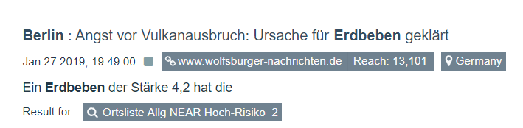
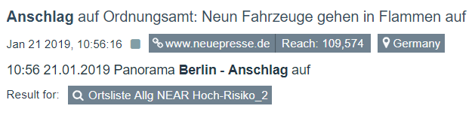
Approach
Which short lived information can be gather by a media monitoring tool?
Input
Output
Notes:
Input:
Boolsche logic:
Munich next to attack
Output;
Snipped with link

Slide 9
Approach
Which short lived information can be gather by a media monitoring tool?
Issues
Content about past events
False positives through unfortunate hits
Iterative Approach
Literary research on effective search
Finding pattern in false positive
Notes:
Currently has room to improve:
to mutch non usefull events
Past
False positive
Hard time with emotions, irony other quircks
Problem of seein if it works if luckily ther aer no real desasters
Approch:
Iteratice
See the good bad
How to improve
Additonalty see how others have done it
Iterativ approach is good

Slide 10


Approach
How can a data model for security data be developed?
!
Needs coordinates to display precise position
Event DB
Event
title | „Accident“
location | „Arcisstraße 21, München“
g489Code | 15
Event
title | „Accident“
location | „Arcisstraße 21, München“
latitude | 48.1487974
longitude | 11.5674676
g489Code | 15
g489Code: This code describes X which is the impact level on Y…
Metadata Enrichment
Data Enrichment
By e.g.
With e.g.
Domain
Expert
Notes:
As mentioned:
Data not intuative –> need to look elsewhere for decription
Can‘t be the soltion
Event from db
Read Event
2 ways
On one hand
Manual enrichtment
Code is X…
other hand
Not usable for tableau
There are way to improve this
Google Maps API
Add info
Be happy with the result

Slide 11
Timeline
Dec | Jan |  | Feb |  | Mar |  | Apr |  | May |  | Jun
Literary Research
MIDAS (RQ1)
Search Query adjustments (iterative) (RQ2)
Data Enrichment (RQ3)
Write
Review
Notes:
1 and half month in
Lierary research
2 Interviews
Data source selection
Current situation on ubermetrics
Issues
Data model:
Imporatn information
MIDAS: open source
Iterative process: ~ weekly meetings → decent sucess
Data enrichment
Write the beauty of master thesis
Done mit June

Slide 12
References
GDELT, “The gdelt project,” Website, 2019, online available at https://www.gdeltproject.org/; Retrieved
January 29, 2019.
World Economic Forum, “Global competitiveness index 2017-2018,” Website, 2019, online available at
http://reports.weforum.org/global-competitiveness-index-2017-2018/downloads/; Retrieved January
29, 2019.
U.S. National Science Foundation, “Cameo event data codebook,” Website, 2013, online available at
http://eventdata.parusanalytics.com/data.dir/cameo.html; Retrieved January 30, 2019.
P. A. Schrodt, “Cameo: Conflict and mediation event observations event and actor codebook,”
Pennsylvania State University, 2012.
P. Hitzler, M. Krötzsch, S. Rudolph, and Y. Sure, Semantic Web: Grundlagen. Springer-Verlag, 2007.

Slide 13
B.Sc.
Malte Brockmann
malte.brockmann@tum.de
Notes:
Question?
Feedback?
Brilliant Ideas to approch the issues?

Slide 14
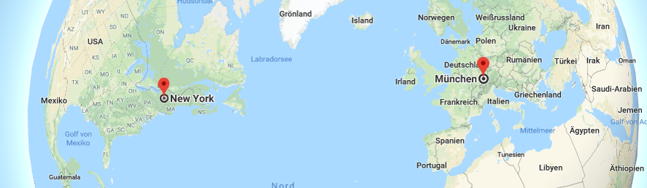
Approach
How can a data model for security data be developed?
When not to call a New Yorker from Munich?
Triple
→ Readable for a computer
Meta Data Enrichment for Security Data
Event
https://www.google.com/maps
has
has
Titel
Distant to asset
happens at
has
belongs to
Subject | Predicate | Object
Munich | Is in | Germany
New York City | Is in | East of the US
Time difference GER East US | Is | 6 hours
Location
Category
Actors
Actor
Actor
Notes:
GDELT hat 61 unterschiedliche Spalten
Metadaten
Impliced knowledge Problem (human know this)
Semantic data types
Goal:
Which information are important regarding corporate security?
Which information is present in data sources?
Describing a semantic data model
Approach:
Data analysts
Comparing/analyse selected sources
Ressource Description Framework (RDF)
E.g. Conflict and Mediation Event Observations (CAMEO)

