Slide 1
Toward Measuring the Success of Communities of Practice in
Large-Scale Agile Software Development
Lixun Dai, Jan 27th, 2025, Master Thesis Final Meeting

Slide 2
Outline
Motivation
Research Questions
Research Methodology
Results
Key Findings
Future Work
30min
5min – Opening & Motivation & RQ & Methodology
20min – Results
Measured Aspects (one sentence for each aspects, and relationship to CoPs + Example)
Measurement Approach (4 methods, mainly focus on the first 3)
Good Practice (7 practices)
Success Metrics Pyramid
New Designed Catalog (Structure + Navigation + Example)
5min – Future Work & Question
Backup Slides
for Methodology & Measured Aspects (more examples in metrics)
Answers for each RQ

Slide 3
Outline
Motivation
Research Questions
Research Methodology
Results
Key Findings
Future Work

Slide 4



1. Motivation
Rapid Changes Drive
the Need for Agility
Technology, markets, and customers change quickly
Companies must react agilely to stay competitive
Agile Methodology Rise in Software Development
Digital world demands agile development methods
Small teams successfully use agile like Scrum
Scaling Agility Brings
New Challenges
Increased complexity from multiple teams and programs
Coordination and knowledge sharing is difficult
I.F. Schlömer (2022), M. Franco, J. Guimarães, M. Rodrigues (2023)
Ö. Uludağ et al. (2022), R. Hoda, N. Salleh, J. Grundy (2018)
K. Hutter et al. (2023), M. Kalenda, P. Hyna, B. Rossi (2018)

Slide 5




1. Motivation
Communities of Practice Proposed as a Solution
Allow knowledge exchange while preserving agility
Address cross-team coordination and information siloing
Measuring Success
is a Challenge
Suitable measures are not clear yet in practice
CoPs sounds useful but not proven in industries
Research Goal
for this Thesis
Identify characteristics that indicate CoPs are successful
Investigate existing approaches for measuring
Design a novel approach to measure the success
I. Monte, L. Lins, M.L. Marinho (2022) M. Paasivaara, C. Lassenius (2014)
Monte, L. Lins and M. Marinho (2022), Ö. Uludağ et al. (2022)
K. Hutter et al. (2023), M. Kalenda, P. Hyna, B. Rossi (2018)

Slide 6
Outline
Motivation
Research Questions
Research Methodology
Results
Key Findings
Future Work

Slide 7
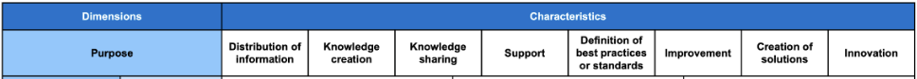
2. Research Questions
RQ1
What are the existing approaches to assessing the success of CoPs* in the context of Large-Scale Agile Software Development, Agile Software Development, and General Organizational Settings?
Structured Literature Review (Scientific & Gray) + Interviews (Coding & Analysis)
RQ2
What traditional group structures within organizations are similar to the CoPs* in the context of Large-Scale Agile Software Development and how has their success been assessed?
Literature Review (Scientific), not necessarily structured
RQ3
How could a novel approach to assessing the success of the CoPs* in the context of Large-Scale Agile Software Development be designed?
Design Science Research
*Based on Taxonomy of CoP (from Franziska Tobisch)

Slide 8
Outline
Motivation
Research Questions
Research Methodology
Results
Key Findings
Future Work

Slide 9





3. Research Methodology - Design Science Research
combined with Interview Study, and Multivocal Literature Review
Design Science Research
Hevner et al. (2004), Peffers et al. (2007)
Chapter 2 Foundations
Chapter 3 Related Work
Chapter 4 & 5
Problem Identification
and Motivation
Chapter 1
Objectives of a Solution
Multivocal Literature Review
(Literature and Grey Literature)
V. Garousi, M. Felderer, M. V. Mäntylä (2017)
Expert Interview Study
M. Miles , A.M. Hubermann, J. Saldaña (2018)
M. D. Myers, M. Newman (2007)
C.B. Seaman (1999)
Design and Development
Chapter 4 & 5
Chapter 6
Investigate related knowledge about the success of CoPs / similar approaches in the fields:
Large-Scale Agile Software Development
Agile Software Development
General Organizational Settings
39 semi-structured expert interviews
(already exist)
Artifact:
Measurement Approach
for CoPs Success
Chapter 4 & 5
Future Work
Investigate related knowledge about the success measurement of traditional organizational structures
Demonstration and Evaluation
Expert Evaluation (Survey)
K. Peffers, M. Rothenberger,
T. Tuunanen, R. Vaezi (2012)
Communication
Chapter 7 Discussion
Chapter 8 Conclusion
Modified from: Tobisch, F. (2021) Master Thesis Final Presentation

Slide 10
Outline
Motivation
Research Questions
Research Methodology
Results
Key Findings
Future Work

Slide 11
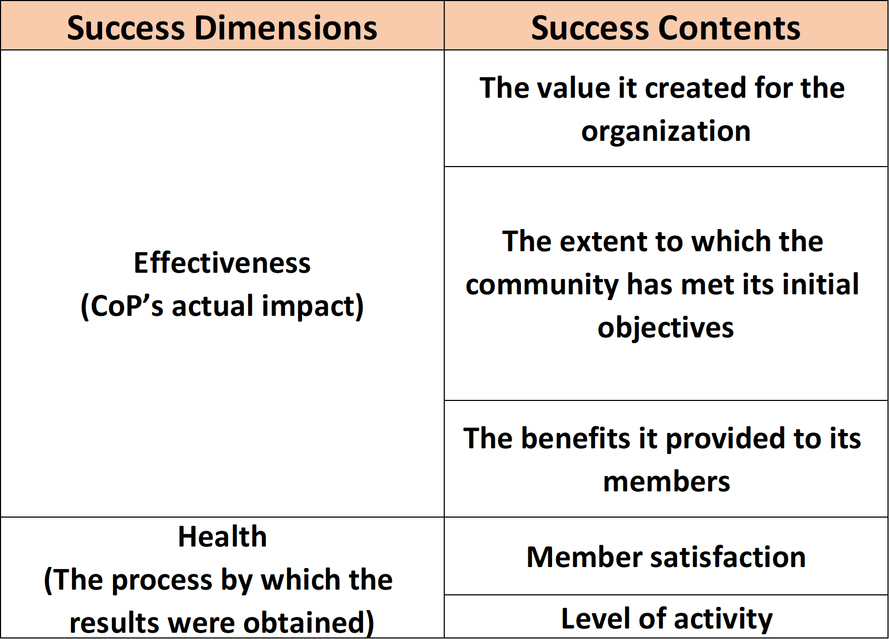
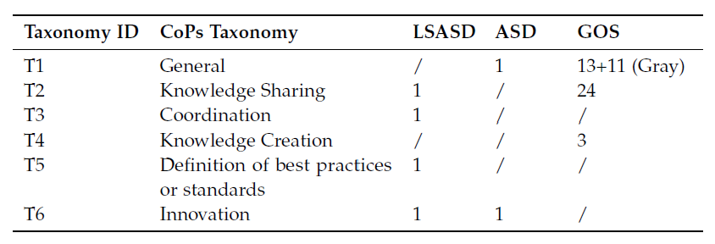
4. Results - Success Definition
A. Bourhis and L. Dube. (2010)

Slide 12
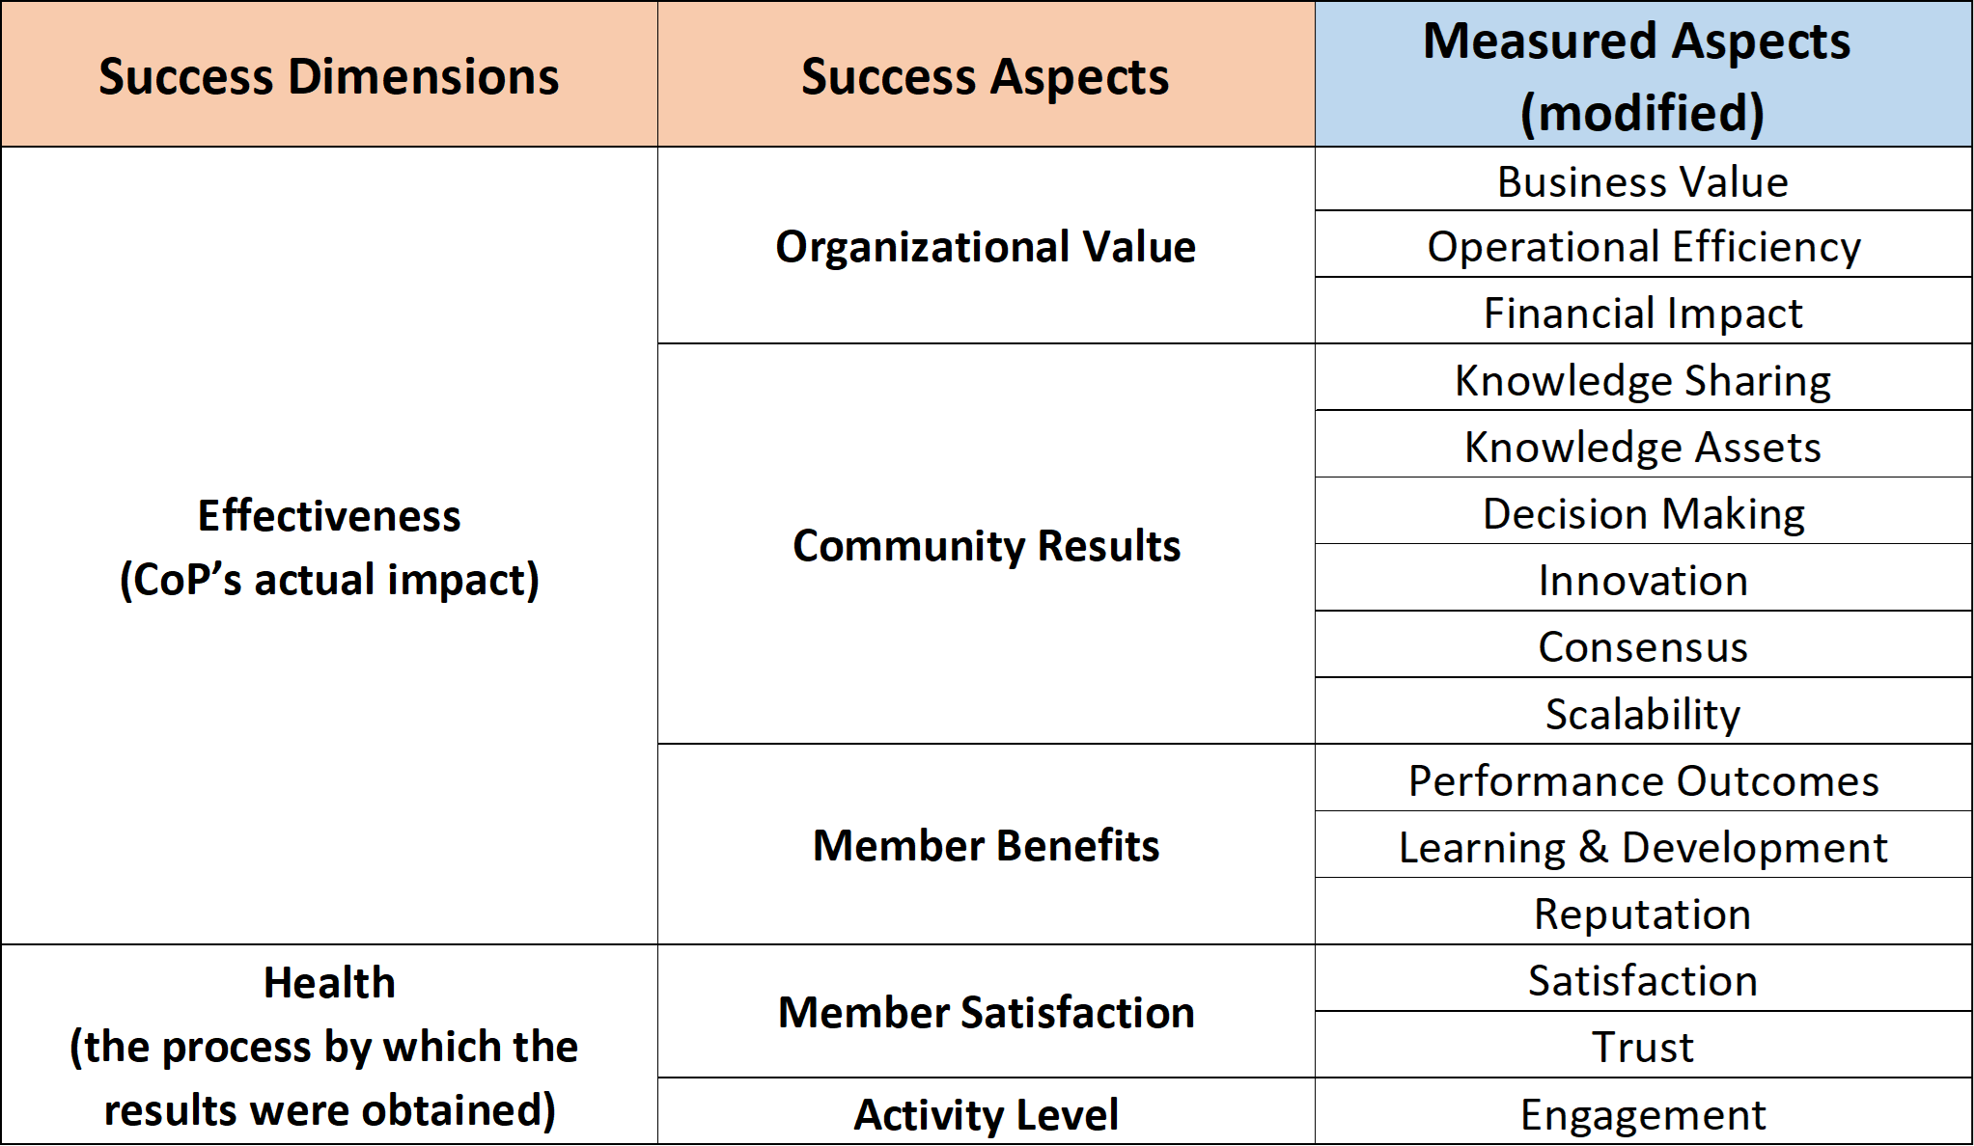
4. Results - Measured Aspects

Slide 13
4. Results - Measured Aspects - Organizational Value
1) Business Value
In the measured aspect of Business Value, the business impacts created for the company are highlighted, such as customer satisfaction, market share, etc. CoPs enhance an organization’s ability to respond effectively to customer needs through knowledge sharing, collaborative problem-solving, and leveraging collective expertise.
2) Operational Efficiency
The measured aspect of Operational Efficiency focuses on internal optimization impacts, e.g., reducing the cycle time of new product development and reducing the time of interactions with community members. CoPs optimize organizational workflows by reducing redundancies and facilitating better use of available resources.
3) Financial Impact
For the measured aspect of Financial Impact, financial metrics, including but not limited to return on investment, percentage of revenue increase, and cost savings, are mentioned. These metrics provide a clear linkage between CoPs’ activities and CoPs’ ability to create sustained value, showcasing CoPs’ role as a strategic asset in driving financial
growth and operational resilience for the organization.
Metrics Example
Response time for customers
Level of customer satisfaction
Number of customer problems resolved
Metrics Example
Percentage of cost reduction
Percentage of time reduction
Value of the benefit
Metrics Example
Profit
Revenue
Return on investment

Slide 14
4. Results - Measured Aspects - Community Results
4) Knowledge Sharing
The measured aspect of Knowledge Sharing focuses on the knowledge-sharing process, e.g., inviting external experts to share insights. Its measurement indicates how well CoPs facilitate the transfer of expertise and foster learning within and across organizational boundaries.
5) Knowledge Assets
The measured aspect of Knowledge Assets focuses on the knowledge asset creation, e.g., best practice documentation in a database. This aspect evaluates the CoPs’ contribution to organizational intellectual capital.
6) Decision Making
The measured aspect of Decision Making focuses on the decision-making authority, e.g., taking the responsibility for making critical decisions. Decision Making measures the CoPs’ role in enabling informed, collaborative, and effective decisions, often addressing complex or cross-disciplinary challenges. This aligns with a CoPs’ contribution of enhancing organizational decision-making through collective intelligence.
Metrics Example
Frequency of documents are requested
Number of collaborative projects
Evidence of reusing best practices
Metrics Example
Level of established knowledge and expert system
Number of solutions submitted
Evidence of developing and defining best practices
Metrics Example
Level of improved quality of decisions
Evidence of making key decisions and resolving issues
Evidence of resolving problems between the different home organizations

Slide 15
4. Results - Measured Aspects - Community Results
7) Innovation
The measured aspect of Innovation focuses on creating new approaches, methods, and products, e.g., new practices on how to convince customers to place orders. Innovation captures the CoPs’ success in generating new ideas, approaches, or solutions.
8) Consensus
The measured aspect of Consensus focuses on creating consensus inside the community and organization, e.g., developing a common set of norms, standards, and language. Consensus reflects the CoPs’ ability to align members toward shared goals, build mutual understanding, and resolve conflicts.
9) Scalability
The measured aspect of Scalability focuses on scaling the knowledge asset, such as good practices, to the organizational level or outside the community, e.g., standardization across the organization units. Scalability assesses the CoPs’ capacity to create impact outside the community, which sets a solid foundation for increasing membership or broadening the scope of activities.
Metrics Example
Evidence of innovative ideas created from community knowledge
Evidence of capitalizing new opportunities
Evidence of new assessment processes
Metrics Example
Evidence of common language, method, understanding, identity, and model
Level of building enough background context
Level of clear primary purpose
Metrics Example
Evidence of making key decisions and resolving issues
Evidence of resolving problems between the different home organizations

Slide 16
4. Results - Measured Aspects - Member Benefits
10) Performance Outcomes
The measured aspect of Performance Outcomes focuses on increasing individual performance, e.g., working more efficiently and solving problems in the work. By sharing knowledge and best practices, CoPs enable members to improve their work performance and address challenges more effectively.
11) Learning and Development
The measured aspect of Learning and Development focuses on personal learning and development, e.g., increasing expertise in pricing digital products and development of mentor-mentee relationships. Learning and Development reflects the CoPs’ role in fostering continuous professional growth.
12) Reputation
The measured aspect of Reputation focuses on individual reputation, e.g., improving other coworkers’ recognition of me. Reputation focuses on the recognition members gain within and beyond the organization due to their contributions to the CoPs.
Metrics Example
Level of confidence and motivation
Level of enhancing working efficiency
Level of coordinating activities more effectively
Metrics Example
Level of increasing individual capability
Evidence of fostering the development of mentor-mentee relationships
Evidence of reflection on practice and situation
Metrics Example
Level of appreciation from peers for what I have accomplished
Level of recognition from co-workers for my knowledge sharing
Number of honorable prizes received for my knowledge sharing

Slide 17
4. Results - Measured Aspects - Member Satisfaction
13) Satisfaction
The measured aspect of Satisfaction focuses on member satisfaction, e.g., the sense of belonging, like being part of the community. Satisfaction reflects the degree to which members feel their needs and expectations are met within the CoPs. This includes their experiences with knowledge sharing, collaborative efforts, and the value derived from their participation.
14) Trust
The measured aspect of Trust focuses on trust itself, e.g., creating a safe environment where people feel comfortable sharing challenges. Trust represents the confidence members have in the CoPs and its participants.
Metrics Example
Level of satisfaction of communication tool and knowledge management system
Level of satisfaction of co-ordination
Level of sense of belonging
Metrics Example
Number of referrals or recommendations
Level of sense of safety to company and colleagues
Evidence of bringing up difficult problems and failures from practice

Slide 18
4. Results - Measured Aspects - Activity Level
15) Engagement
The measured aspect of Engagement focuses on engagement itself, e.g., the number of messages posted and average participation rate (messages/person). Engagement reflects the degree to which members actively participate in community activities, share knowledge, and collaborate with others.
Metrics Example
Frequency of activities happen in the community
Number of outside expert
Level of satisfaction of co-ordination
Percentage of users updating weekly

Slide 19
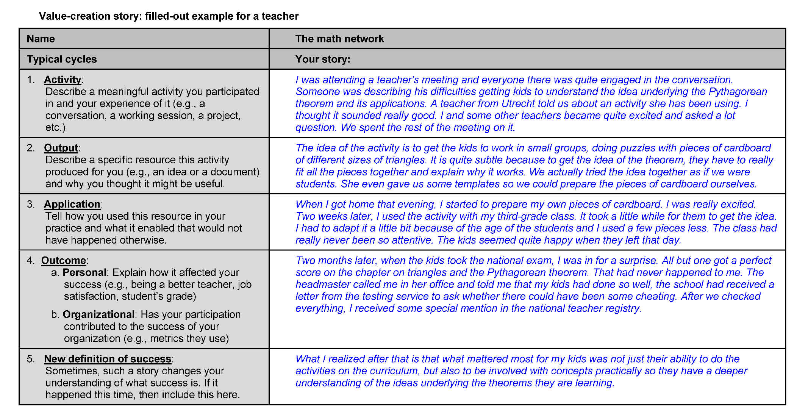
4. Results - Measurement Approach
Measurement Approach 1: Log Data Tracking
Measurement Approach 2: Surveys and Questionnaires
Measurement Approach 3: Interviews
Measurement Approach 4: Social Network Analysis
Wenger et al. (2011)

Slide 20
4. Results - Good Practice
Good Practice 1: Creating the Awareness and Involvement of Measurement
Good Practice 2: Standardizing the Data Collection Process
Good Practice 3: Revealing Hidden Value through Interviews
Good Practice 4: Combining Data for Holistic Insights
Good Practice 5: Balancing Tangible and Intangible Measurement
Good Practice 6: Refining Data Collection through Modular Approaches
Good Practice 7: Establishing a Baseline Measurement at an Early Stage

Slide 21
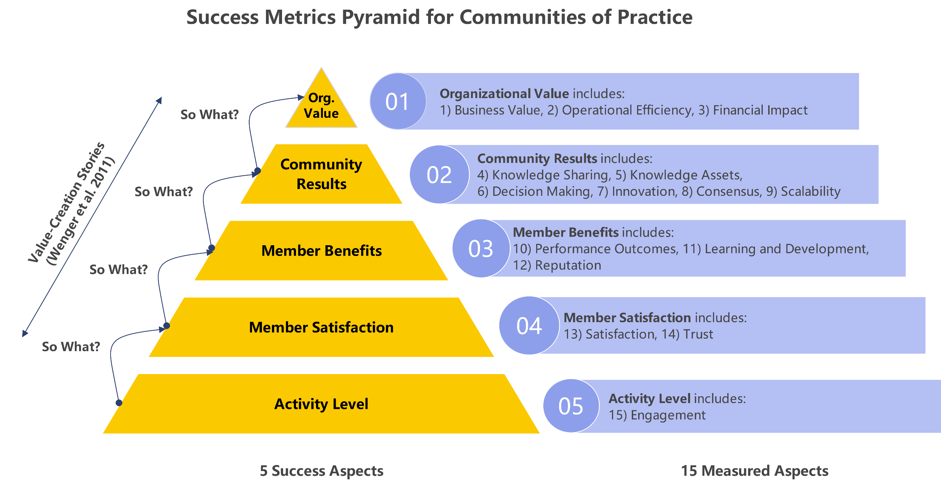
4. Results - Success Metrics Pyramid

Slide 22
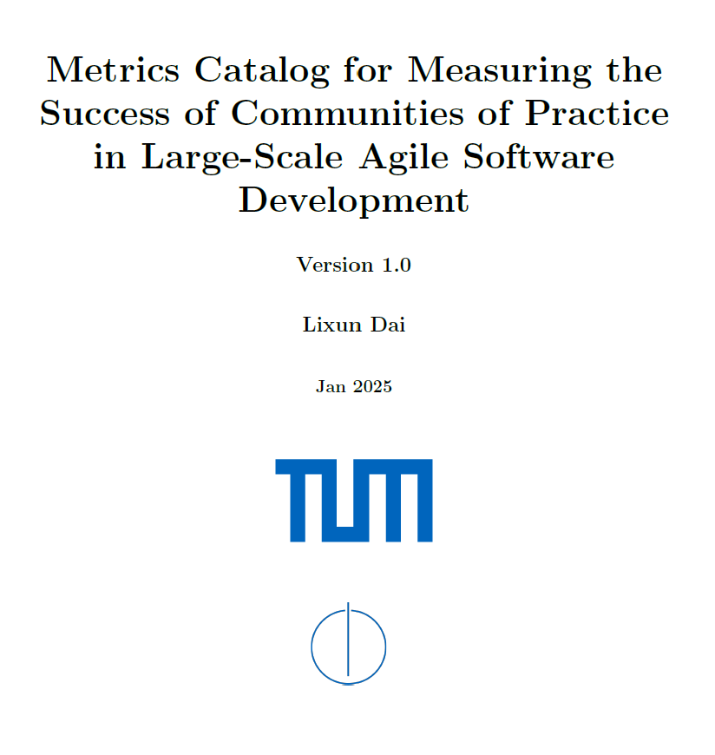
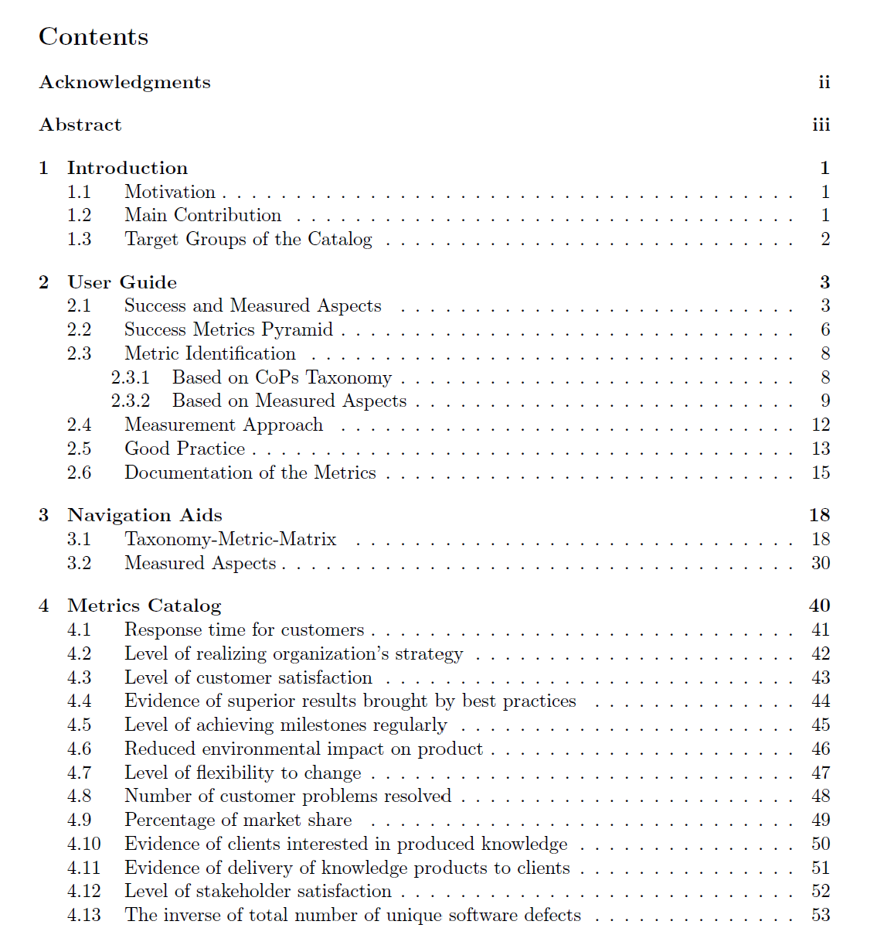
4. Results - New Designed Metrics Catalog
-> 237 Metrics

Slide 23
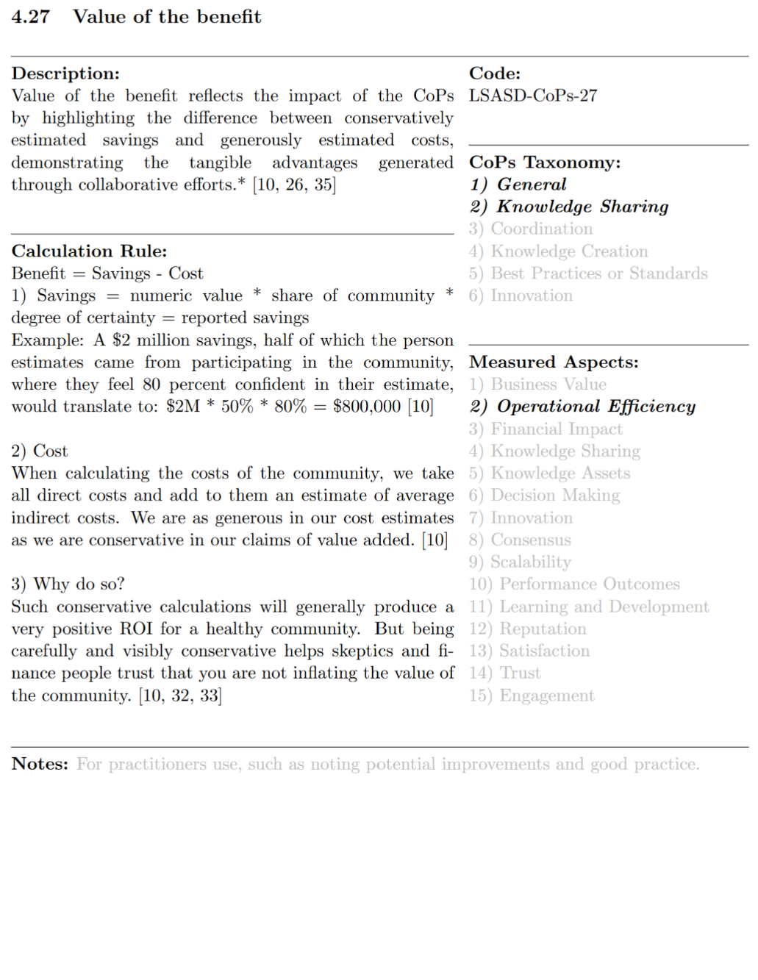
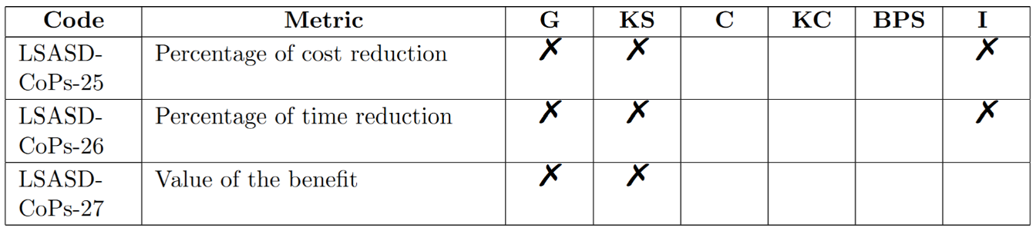
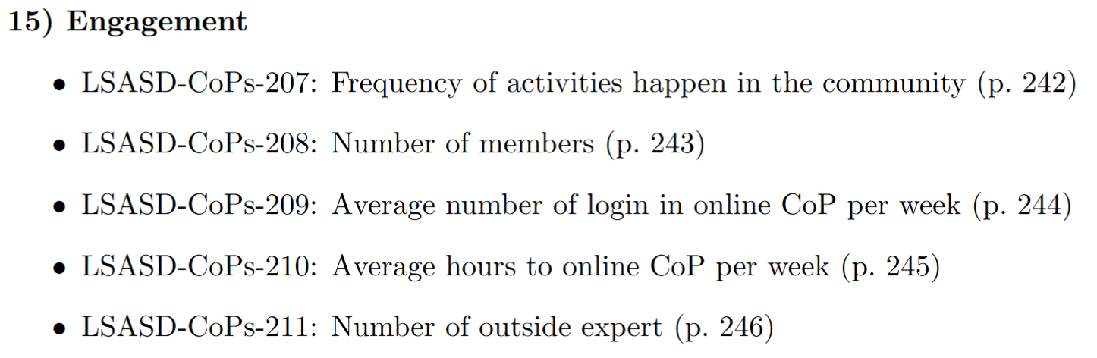
4. Results - New Designed Metrics Catalog
Navigation based on CoPs Taxonomy
(Taxonomy-Metric-Matrix)
Navigation based on Measured Aspects
Modified from: Tobisch, F. (2021) Master Thesis Final Presentation

Slide 24
Outline
Motivation
Research Questions
Research Methodology
Results
Key Findings
Future Work

Slide 25
5. Key Findings
Key Finding 1: Current scientific research lacks a consistent definition of success for Communities of Practice
Key Finding 2: Currently the most comprehensive and systematic understanding and frameworks for assessing the value of Communities of Practice come from Wenger
Key Finding 3: The three most common measurement approaches for measuring the success of Communities of Practice are: 1) log data tracking, 2) surveys and questionnaires, and 3) interviews
Key Finding 4: Success metrics for Communities of Practice are predominantly derived from GOS, with limited insights from LSASD and ASD, and the CoPs taxonomy type Knowledge Sharing is the most commonly addressed
Key Finding 5: Success metrics for traditional organizational structures are limited, with existing literature focusing primarily on cross-functional teams and project teams
Modified from: Tobisch, F. (2021) Master Thesis Final Presentation

Slide 26
Outline
Motivation
Research Questions
Research Methodology
Results
Key Findings
Future Work

Slide 27
6. Future Work
Metric Catalog Evaluation and Improvement
  The evaluation of the metric catalog's first version is crucial. Feedback from real-world practice will show its usefulness and value for practitioners.
  Based on this feedback, the catalog can be iterated to enhance user experience. This could involve highlighting popular metrics in specific CoPs taxonomy or measured aspects and adding different metric usage cases.
Incorporating Automated Tools for Measurement
  Consider how to integrate automated tools like data analytics platforms or performance management software for measuring CoPs success.
  Current measurement methods rely heavily on questionnaires and interviews with manual post-data-collection processing. Automation can provide real-time views of CoPs activities, such as automatically collecting value-creation stories from community members.
  Large language models can also suggest metric combinations from the catalog to gain more insights into the value-creation chain, including causal relationships and potential for value generation in CoPs and organizations.
Refining Metrics for Large-Scale Software Development Environments
  Most existing metrics are based on general organizational settings.
  Metrics specifically tailored to large-scale software development environments need to be further refined to identify the most effective ones for measuring CoPs success in such environments.
Modified from: Tobisch, F. (2021) Master Thesis Final Presentation

Slide 28
B.Eng.
Lixun Dai
17132
lixun.dai@tum.de

Slide 29
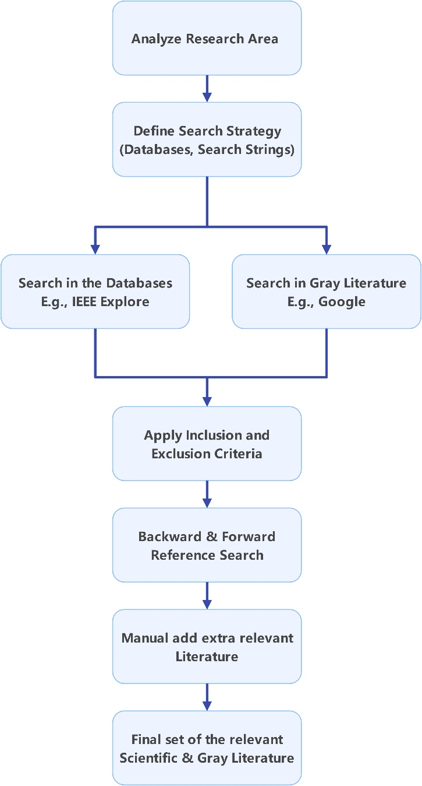
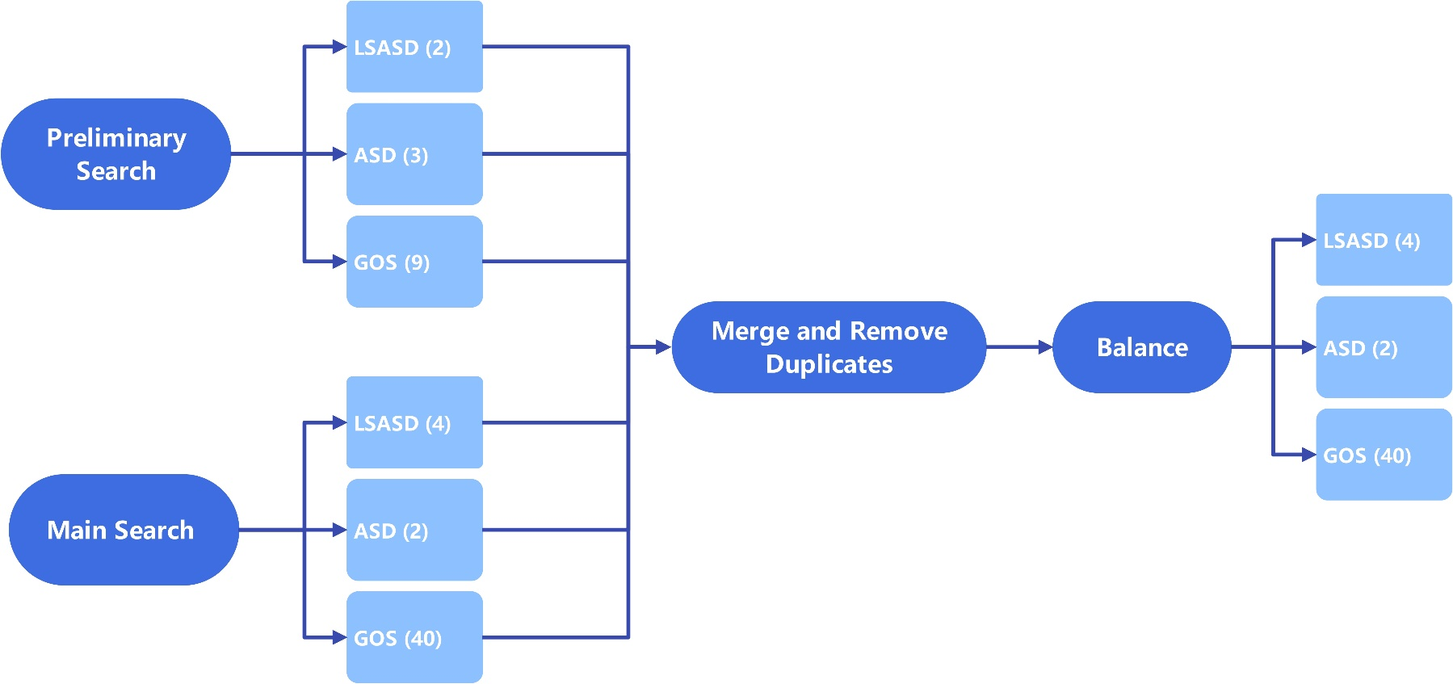
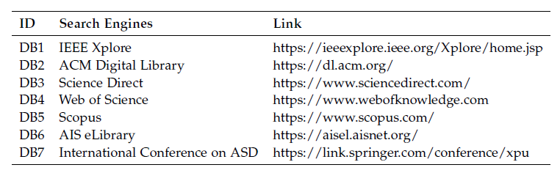
Appendix - Research Methodology

Slide 30
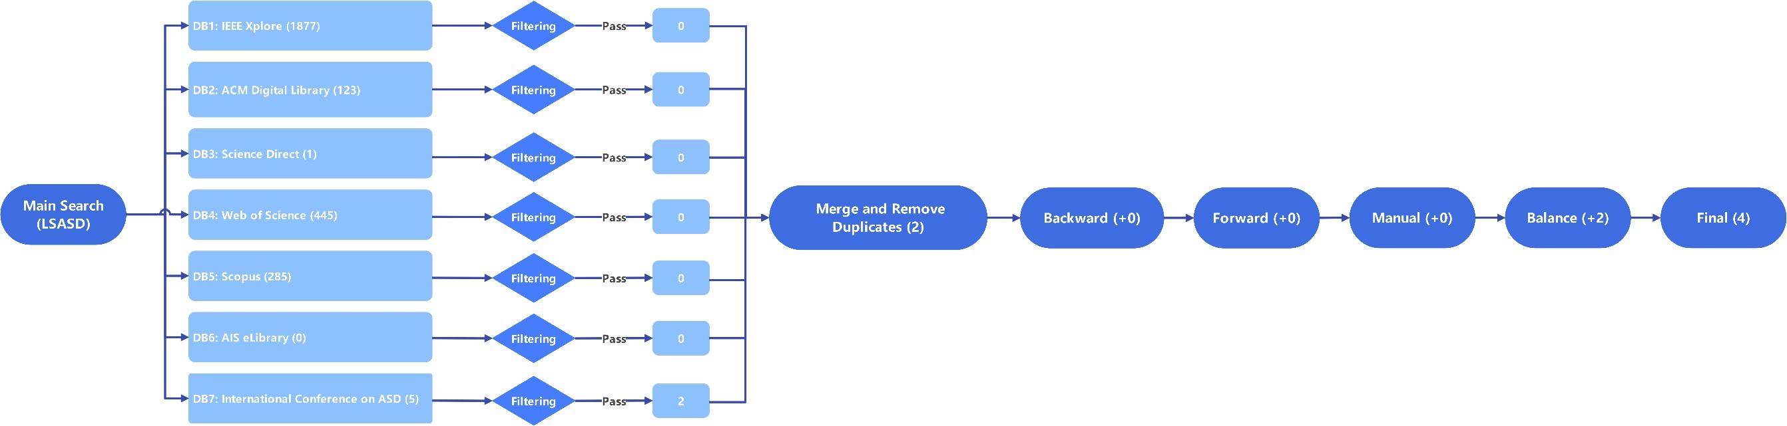
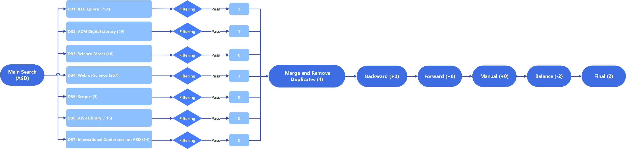
Appendix - Research Methodology

Slide 31
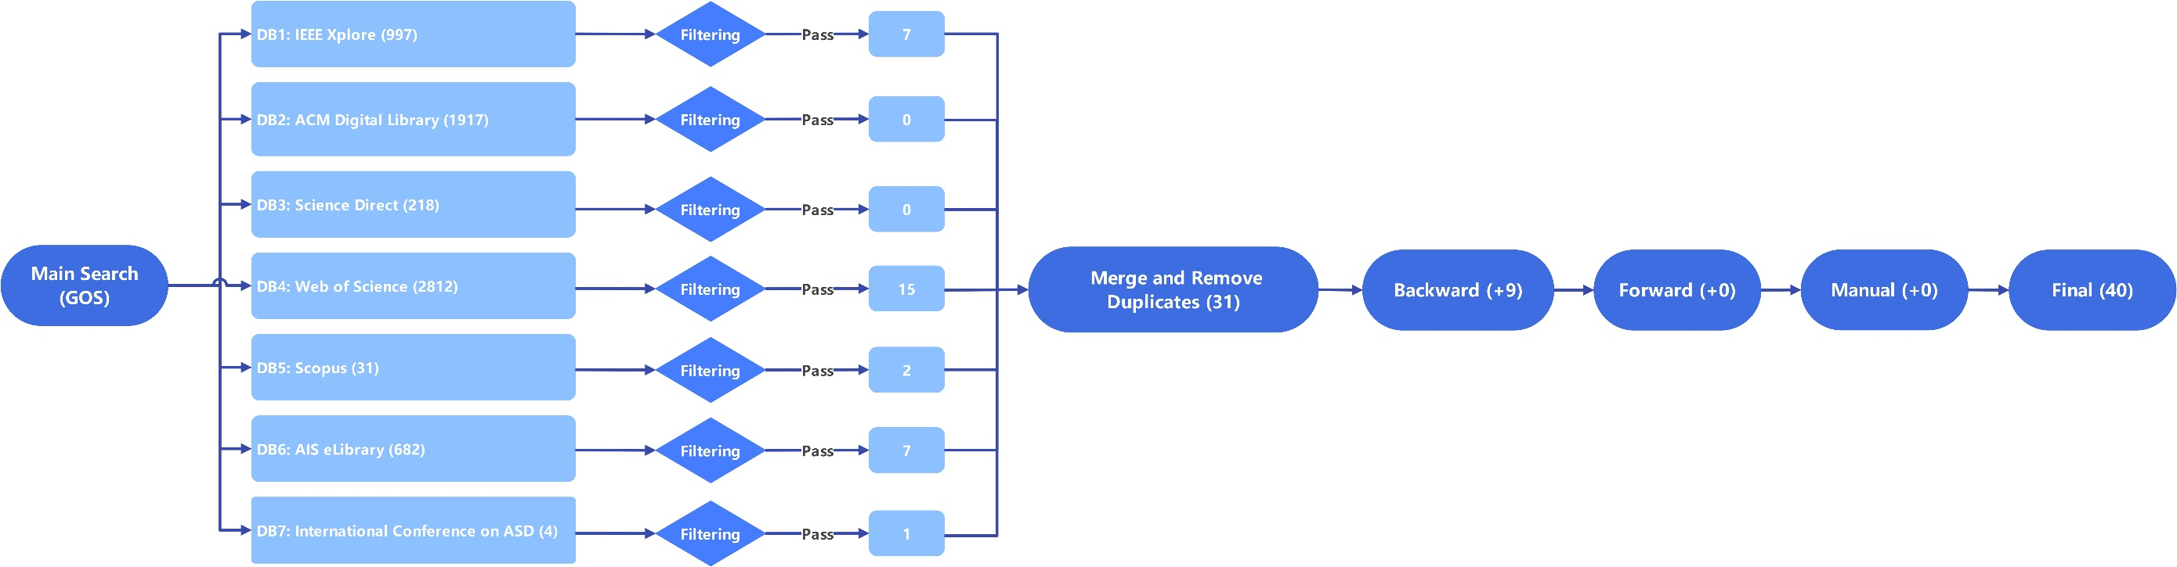
Appendix - Research Methodology

Slide 32
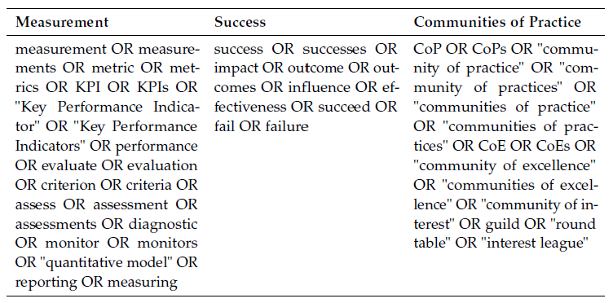
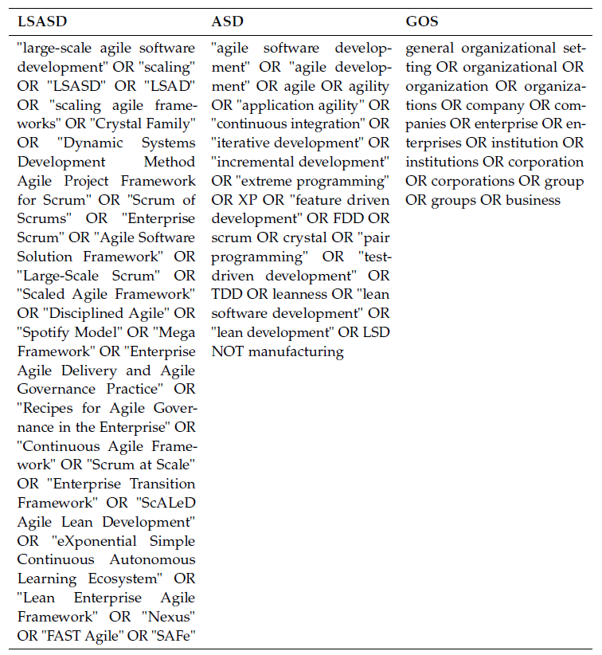
Appendix - Research Methodology

Slide 33
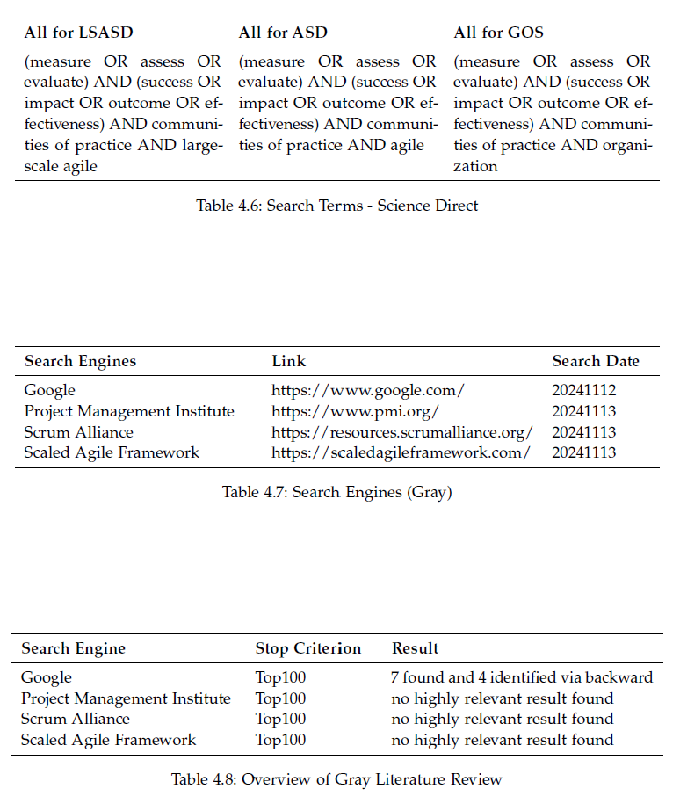
Appendix - Research Methodology

Slide 34
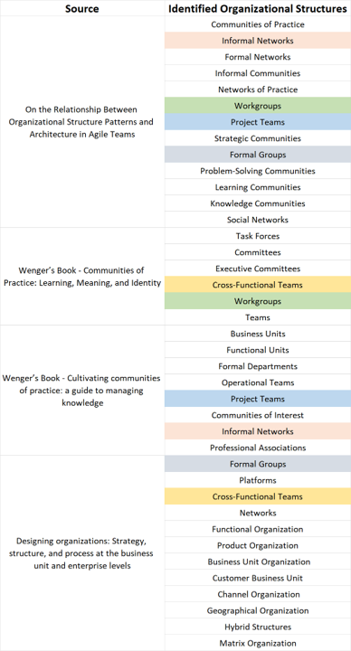
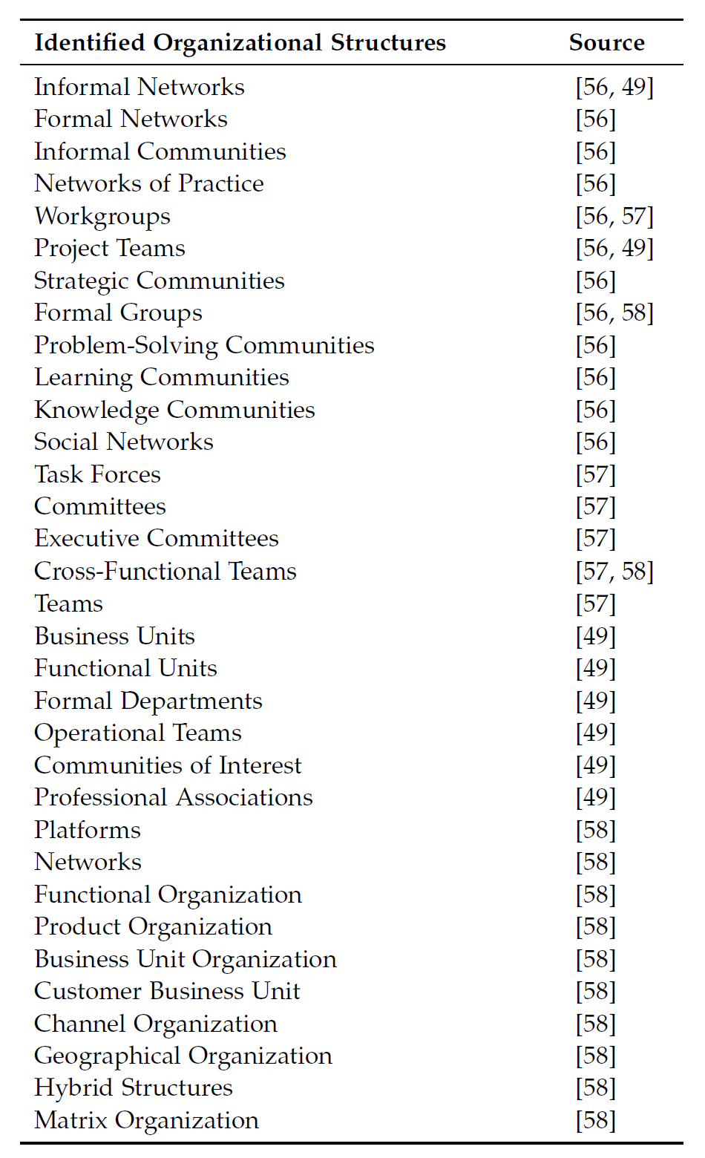
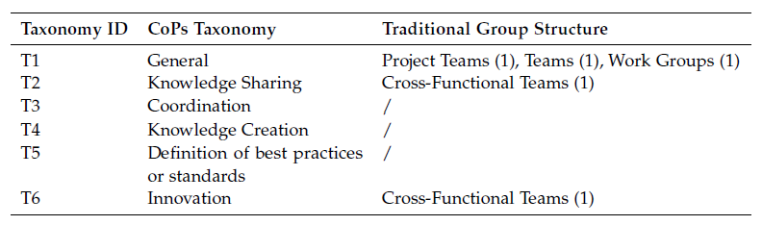
Appendix - Research Methodology

Slide 35
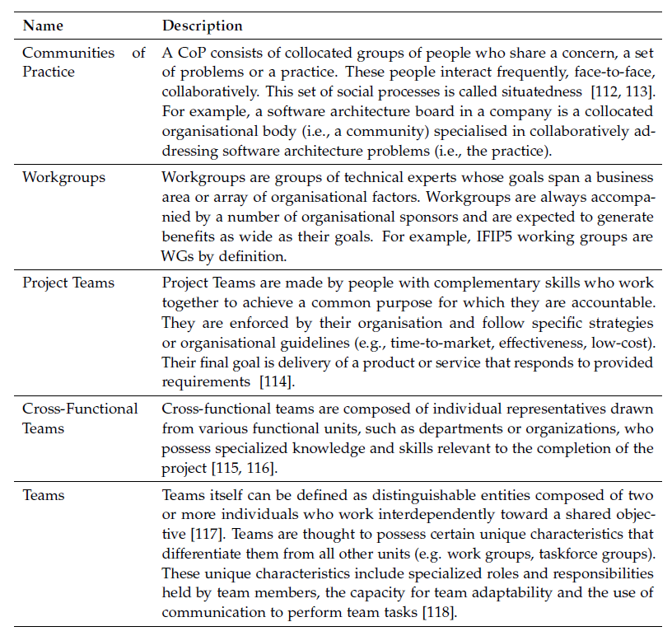
Appendix - Traditional Group Structures (RQ2)

Slide 36
Appendix - CoP Taxonomy
*Based on Taxonomy of CoP (from Franziska Tobisch)

Slide 37
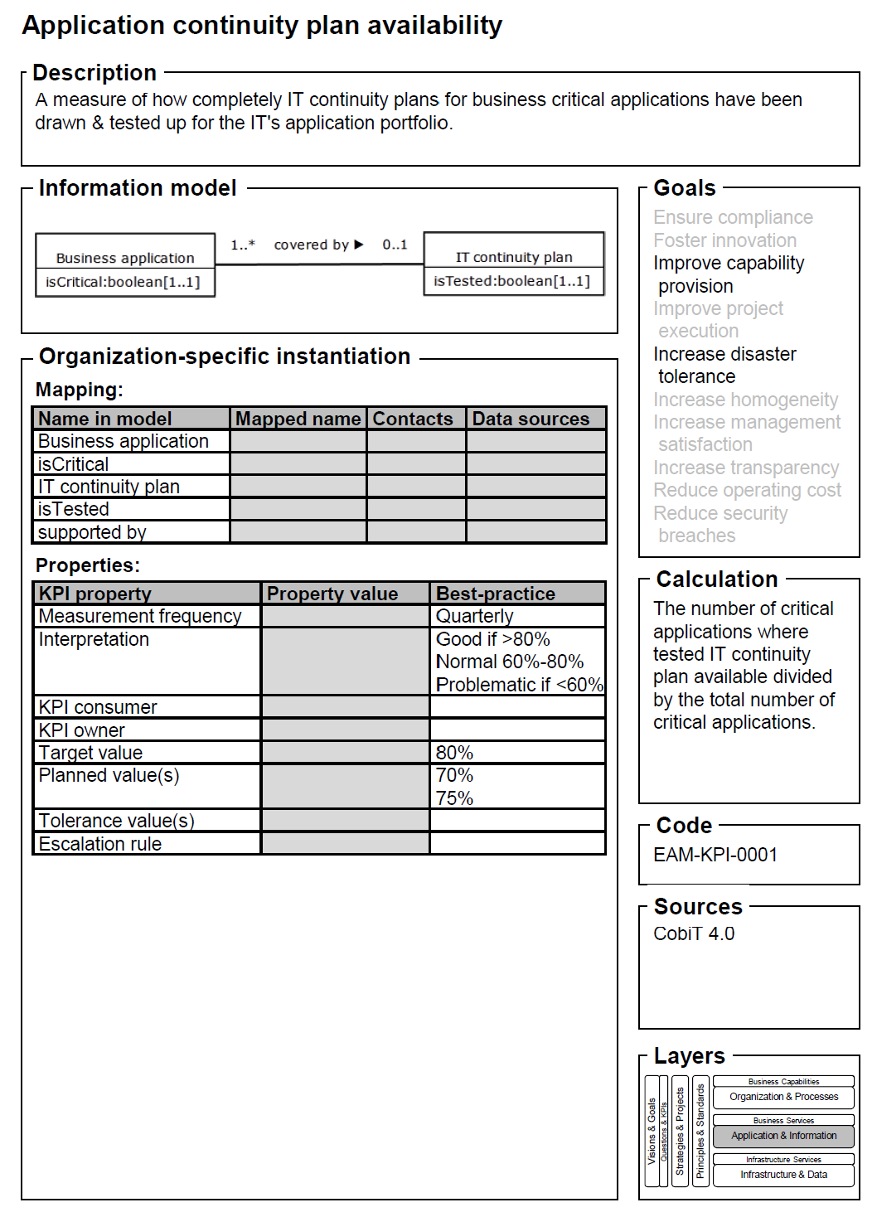
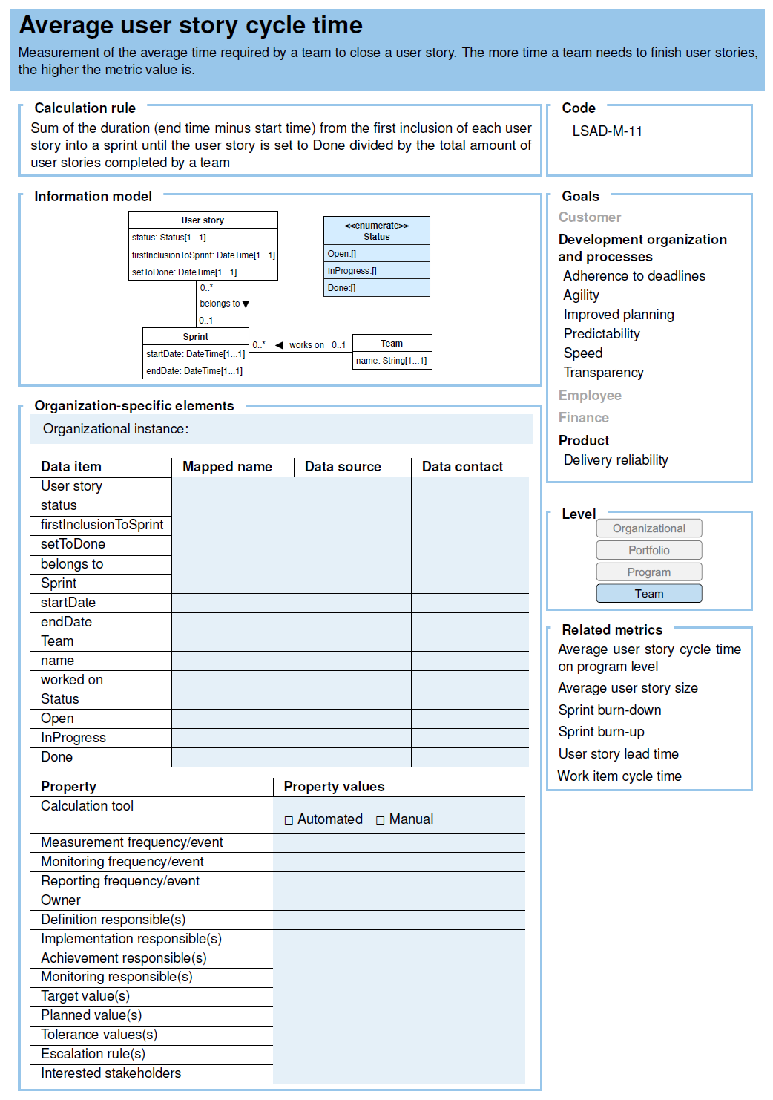
Appendix - RQ3 Reference Catalog
F. Matthes et al. (2011)
P. Philipp and F. Tobisch. (2021)

Slide 38
Appendix - Answer for each RQ
Research Question 1: What are the existing approaches to assessing the success of CoPs* in
the context of LSASD, ASD, and GOS?
Three questions are to be answered in RQ1:
1) What are the current metrics and their corresponding measured aspects? 2) How is the measurement conducted? 3) What needs to be considered when conducting measurement (good practice)?
According to the research in this thesis, the definition of success for CoPs was first defined based on the existing literature, focusing on the two primary success dimensions: effectiveness and health. Building on these dimensions, five key aspects of CoPs success were identified: organizational value, community results, member benefits, member satisfaction, and activity level. Through a systematic classification of success metrics found in the literature, a final set of 15 measured aspects and their corresponding metrics was determined, providing a comprehensive framework for assessing CoP success. The three most common measurement approaches for measuring the success of CoPs are: 1) log data tracking, 2) surveys and questionnaires, and 3) interviews. Seven good practices were summarized from the literature, namely creating the awareness and involvement of measurement, standardizing the data collection process, revealing hidden value through interviews, combining data for holistic insights, balancing tangible and intangible measurement, refining data collection through modular approaches, establishing a baseline measurement at an early stage.

Slide 39
Appendix - Answer for each RQ
Research Question 2: What traditional group structures within organizations are similar to
the CoPs* in the context of LSASD and how has their success been assessed?
In RQ2, the traditional organizational structures identified in the literature include cross-functional team, project team, team, and work group. Among these structures, the quality of success metrics research is notably higher for cross-functional teams and project teams. This can be attributed to the established focus on cross-functional teams as a distinct research domain and the extensive body of work in project management, which naturally includes studies on success metrics for project teams. The collected success metrics were mapped to the 15 measurement aspects identified in RQ1, ensuring alignment across CoPs and traditional organizational structures. The most commonly employed measurement method involves surveys and questionnaires incorporating a Likert scale to capture data effectively. Besides, self-reporting by members is also an approach mentioned for measurement. Furthermore,
two key good practices highlighted in the literature are creating the awareness and involvement of measurement and establishing a baseline measurement at an early stage, both of which emphasize the importance of proactive and structured approaches to measurement in traditional organizational contexts.

Slide 40
Appendix - Answer for each RQ
Research Question 3: How could a novel approach to assessing the success of the CoPs* in
the context of LSASD be designed?
Based on the synthesis from RQ1 and RQ2, a novel approach is designed, and 2 questions are to be answered: 1) How should measurement in an agile environment be conducted? 2) How should an approach for measuring the success of CoPs in LSASD look like?
A new metrics catalog with 237 metrics and corresponding navigation tools was developed in this thesis. To effectively conduct measurement in an agile environment, several key success factors have been identified through literature review, such as ensuring understanding of metric purpose, keep metric adoption simple, and empowerment of teams in metric adoption, etc. To measure the success of CoPs in an LSASD environment, a structured process has been designed. Practitioners begin by mapping their CoPs’ goals to the CoPs taxonomy types included in the catalog. They can then determine the final metrics by selecting relevant measured aspects or utilizing navigation tools such as the Taxonomy-Metric-Matrix and the metric lists categorized by measured aspects for quick identification. A highly recommended approach involves integrating value-creation stories to uncover key insights. By understanding the causal relationships in value creation, practitioners can leverage the Success Metrics Pyramid to select appropriate success aspects and their corresponding measured aspects to identify potential metrics. This process enables a deeper understanding of how the CoP creates value and how the chosen metrics reflect the community’s potential for future value creation. For example, through employee interviews, practitioners may identify that shared best practices help employees resolve work-related challenges, saving time for both the company and the employees. If practitioners focus on metrics like the download frequency and quality ratings of shared best practice documents, they can gain insights into the extent to which these practices are appreciated by community members, thus reflecting the success of the CoP in knowledge sharing. This combination of metrics and stories offers a comprehensive view of the CoP’s impact and its potential to foster ongoing value creation. The specific catalog details can be found in the accompanying metric catalog for further reference.

Slide 41
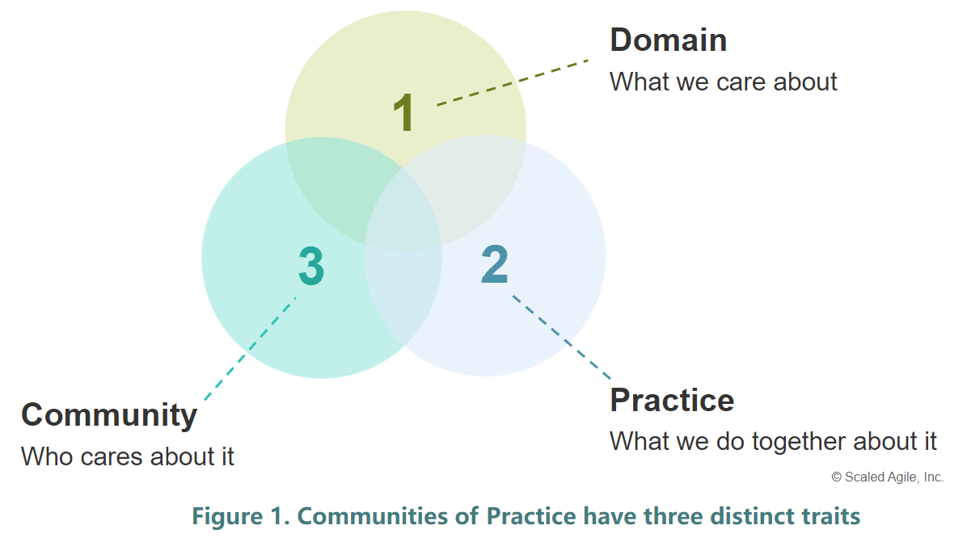
Appendix - Three Distinct Traits for CoPs
https://scaledagileframework.com/communities-of-practice/
Wenger, Etienne. Communities of Practice: Learning, Meaning, and Identity. Cambridge University Press, 1999.

Slide 42
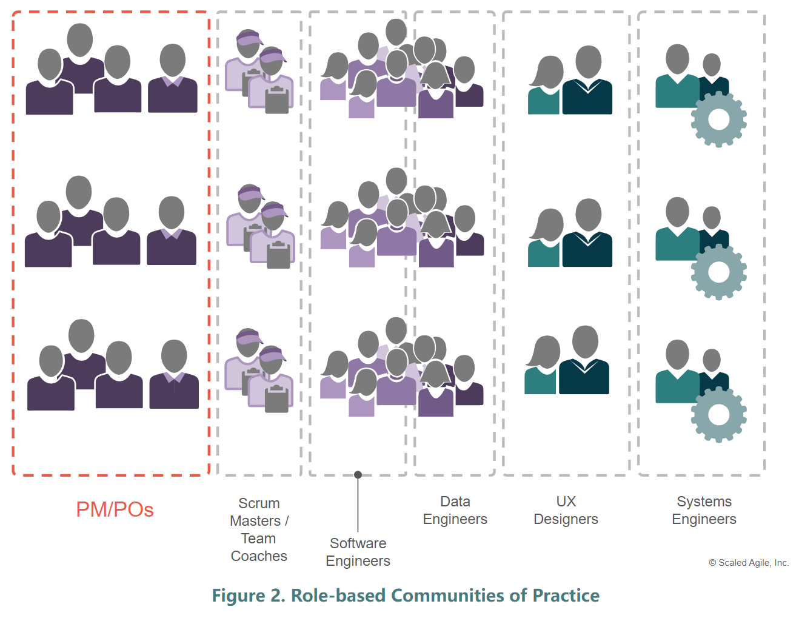
Appendix - Role-based CoPs
https://scaledagileframework.com/communities-of-practice/
Wenger, Etienne. Communities of Practice: Learning, Meaning, and Identity. Cambridge University Press, 1999.

Slide 43
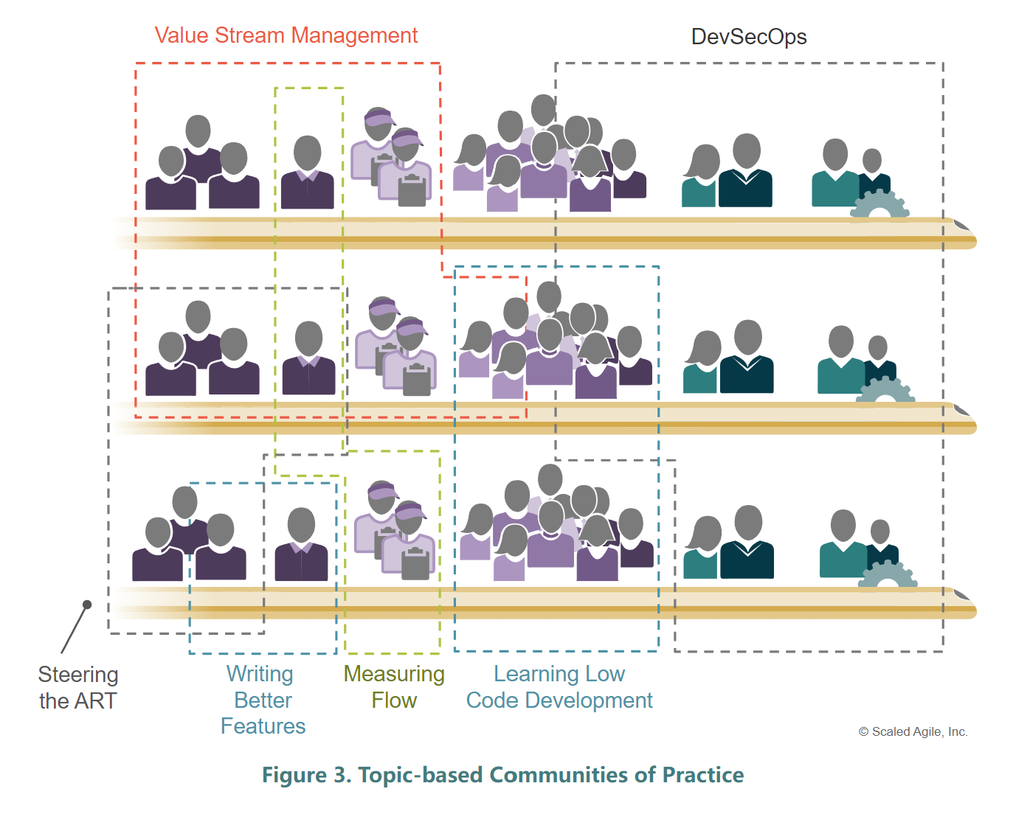
Appendix - Topic-based CoPs
https://scaledagileframework.com/communities-of-practice/
Wenger, Etienne. Communities of Practice: Learning, Meaning, and Identity. Cambridge University Press, 1999.

Slide 44
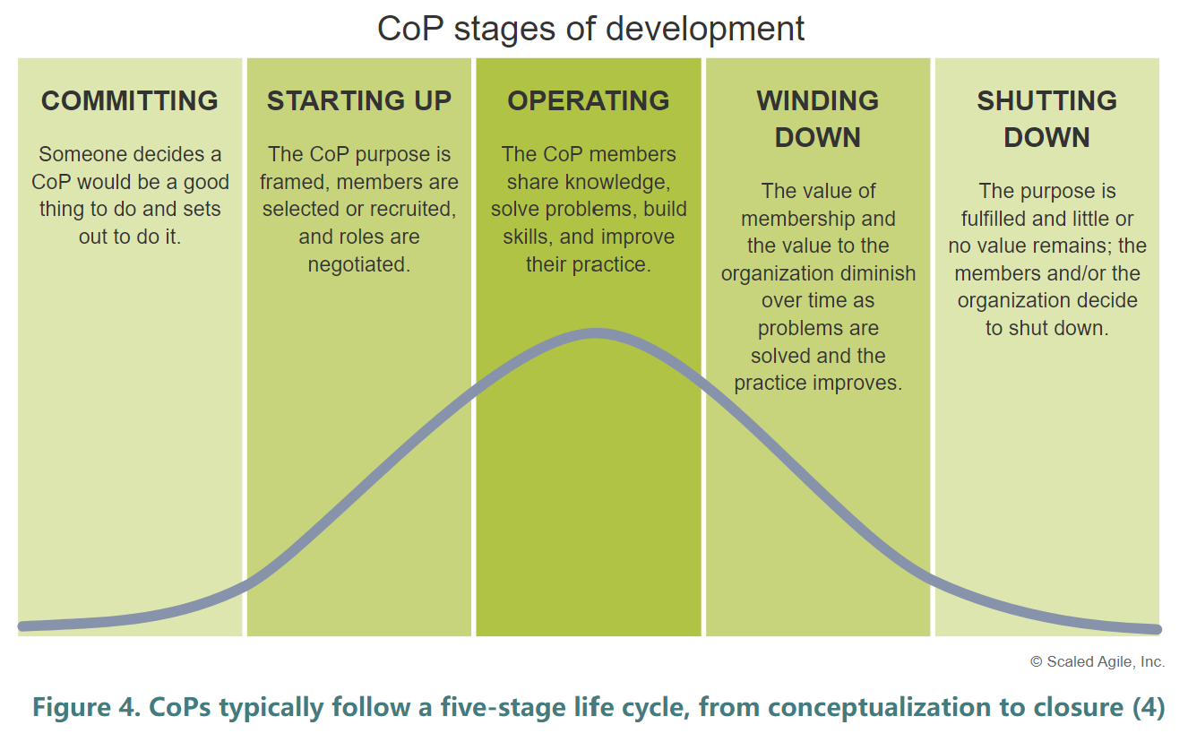
Appendix - Organizing a CoP
https://scaledagileframework.com/communities-of-practice/
Wenger, Etienne. Communities of Practice: Learning, Meaning, and Identity. Cambridge University Press, 1999.

Slide 45
Bibliography
Please refer to the thesis at SEBIS website.
https://wwwmatthes.in.tum.de/pages/y0h0omlmoxf0/Toward-Measuring-the-Success-of-Communities-of-Practice-in-Large-Scale-Agile-Software-Development

