Slide 1
Trend Analysis of NLP Use Cases in the Legal Domain within the DACH Region
06/11/2024, Master’s Thesis Proposal
Henrik Sergoyan

Slide 2
Outline
Introduction
Problem Statement and Motivation
Research Questions
Methodology
Expected Outcomes
Timeline

Slide 3
Introduction
Name: Henrik Sergoyan
Program: Master’s in Mathematics in Data Science
Education:
  American University of Armenia: BSc in Computer Science
  Yerevan State University: MSc in Applied Statistics in Data Science
Professional Experience:
  8+ years of experience in Data Science and Machine Learning
  Industries: Banking, Government, United Nations, Retail, Legal Tech, Animal Healthcare
Personal Motivation
Passion for Legal Tech rooted from professional experience
Inspired by your team’s long-standing commitment to Legal AI
Excited to build on your research and contribute with my own expertise
Notes:
1. Passion for Legal NLP, rooted in my professional experience at Legal Tech
Led the development of a legal document analysis platform utilizing:
GPT-4 API for data annotation.
Fine-tuning LLama 3.0 for entity extraction (parties, dates, monetary values).
RAG for document retrieval and summarization.
LangChain and vector embeddings for clause identification and regulatory compliance
2. Inspired by your team’s long-standing commitment to Legal NLP.
3. Excited to build on your research and contribute with my own expertise

Slide 4
Problem Statement and Motivation
The Legal AI Use Case Radar Report serves as a dynamic resource, updated annually with insights from surveys, interviews, and literature reviews.
While the radar highlights current Legal AI use cases, it lacks a mechanism to track the evolution and shifting relevance of these use cases over time.
There is a need to capture trends in how Legal AI technologies are utilized and adapted within the legal sector.
Additionally, understanding the challenges that legal teams face when integrating these technologies is essential for refining the radar.
By addressing these gaps, the radar can evolve into a more valuable, practical tool for the legal industry, offering insights that reflect both current use and future potential.
241106 Henrik
Notes:
The Legal AI Use Case Radar Report is designed to be a dynamic, evolving resource, updated annually through surveys, interviews, and literature reviews to reflect changes in Legal AI use cases. While the radar effectively highlights current use cases, there is a need to capture how these use cases evolve over time and to identify trends in their shifting. Additionally, understanding the challenges legal teams face when integrating these technologies remains crucial for further refining the radar.
As Legal AI technologies continue to evolve, documenting their real-world application and adoption trends is crucial to understanding their impact. My research will build upon the foundation set by the Legal AI Use Case Radar Report and updated literature review, with a focus on tracking the trends in NLP adoption and the shifting relevance of different use cases over time. Furthermore, there is a need to continually add Experience Reports, providing real-world insights from legal professionals. These reports will contribute to the ongoing refinement of the radar and will be published on the website as part of the growing resource. By identifying challenges and opportunities that legal teams encounter when integrating these tools, I aim to provide actionable recommendations to ensure the radar remains a relevant and valuable resource for the legal sector in Germany, Austria, and Switzerland.

Slide 5
Research Questions
What are the key trends of NLP technologies in Legal AI, as reflected in both the literature and their utilization by companies within the DACH region?
How can a structured methodology be developed and applied to track the evolution of Legal AI use cases over time?
What challenges do legal teams face when integrating NLP solutions into their workflows?
What are the Ethical, Legal, and Social Aspects (ELSA) concerns associated with the adoption of NLP in the legal domain?

Slide 6
Methodolgy
Systematic Literature Review
Conduct a comprehensive survey of recent Legal NLP literature, focusing on the latest trends then structure these findings by use case.
Semi-Structured Interviews
Review insights from previous interviews, followed by conducting additional semi-structured interviews with legal professionals and technology providers using a standardized set of questions.
Trend Mapping
Develop and apply a structured methodology to analyze the evolution of NLP use cases over time, using data from the literature review and semi-structured interviews. This approach will identify patterns in adoption, with timelines and trend graphs illustrating shifts in the relevance and priorities of use cases.
Challenges and ELSA Concerns
Extract and categorize common challenges from interview data and relevant literature, focusing on technical and operational aspects of NLP implementation in the legal sector. Specific Ethical, Legal, and Social Aspects (ELSA) concerns will be highlighted through thematic analysis.
Synthesis and Experience Reports
Summarize each interview into an Experience Report, capturing real-world applications, challenges, and insights from the interviewee’s perspective.

Slide 7
Expected Outcomes
Enhanced Knowledge Base of Legal AI Use Cases
Updated collection of Legal AI use cases in the DACH region, combining literature insights and new Experience Reports.
Trend Mapping Methodology
A structured approach to analyze trends in Legal AI adoption, based on data from the literature review and interviews.
Challenges and ELSA Concerns
An analysis of the key challenges faced by legal teams, with a focus on technical and operational aspects, including ELSA concerns.

Slide 8
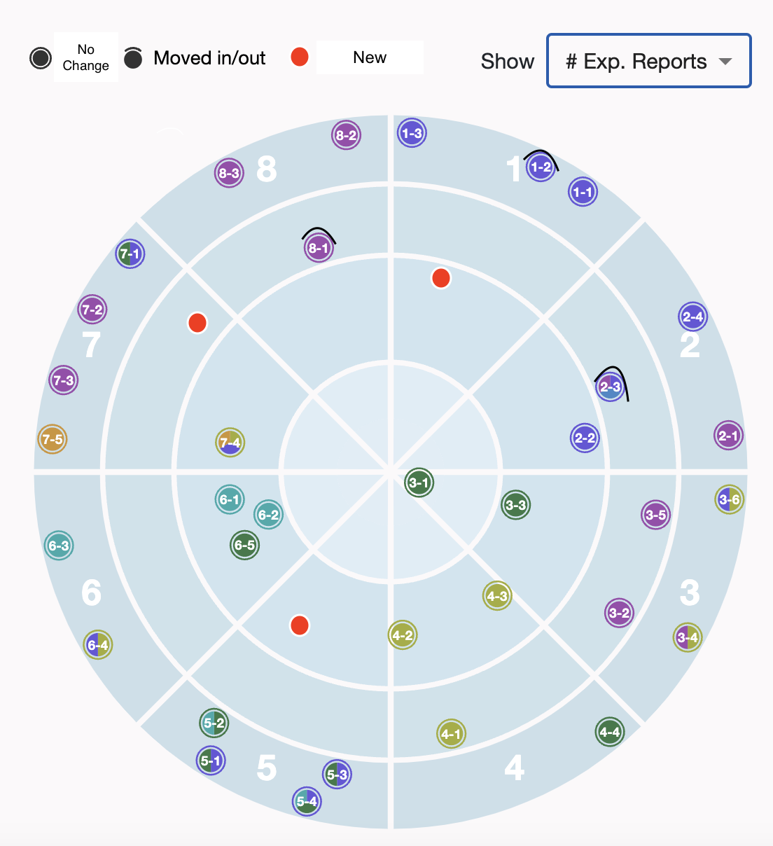
Future Vision of the Updated Radar

Slide 9
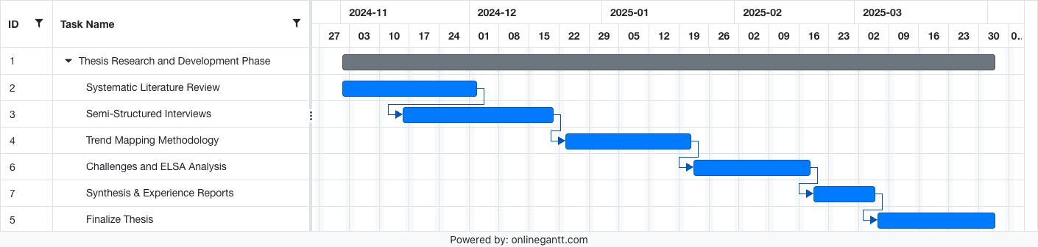
Timelines

Slide 10
Thank You

Slide 11
Prof. Dr.
Florian Matthes
17132
matthes@in.tum.de

